Slide 1
Unsupervised Learning – Part 1
• ARTIFICIAL INTELLIGENCE & MACHINE LEARNING – HANDS-ON WORKSHOP
• Session 5: Unsupervised Learning – Part 1
• Vishnu H S
25 April 2025

Slide 2

What is Unsupervised Learning?
Definition:
A type of machine learning where the model learns patterns from unlabeled data.
Goal:
Discover hidden structures and groupings without knowing the answers in advance.
Real-life Examples:
Customer segmentation in marketing
Organizing news articles
Recommending similar movies
Types:
Clustering
Association Rule Mining

Slide 3
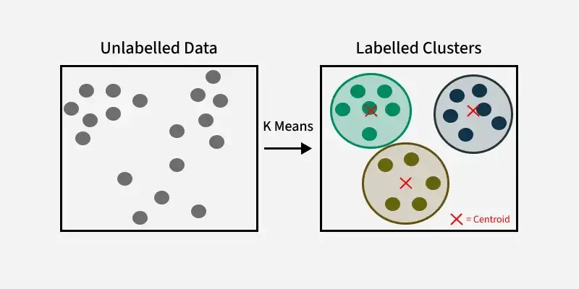
K-Means Clustering
What is K-Means?
K-Means groups data points into ‘k’ clusters based
on similarity.
How it Works:
Choose number of clusters k
Randomly place k cluster centers (centroids)
Assign each point to the nearest cluster
Recalculate centroids
Repeat until stable

Slide 4
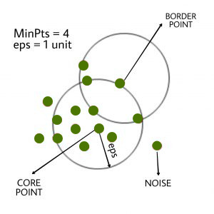
DBSCAN (Density Based Spatial Clustering of Applications with Noise)
Finds clusters based on data density.
Can detect clusters of any shape (not just circles like K-Means).
Automatically detects noise/outliers.
How it Works:
Choose two parameters: eps (radius) and min_samples (minimum points to form a cluster).
Core points have enough neighbors → form clusters.
Border points are connected to clusters.
Noise points don't belong anywhere.
Great For:
Geographic data, irregular shapes, removing outliers

Slide 5
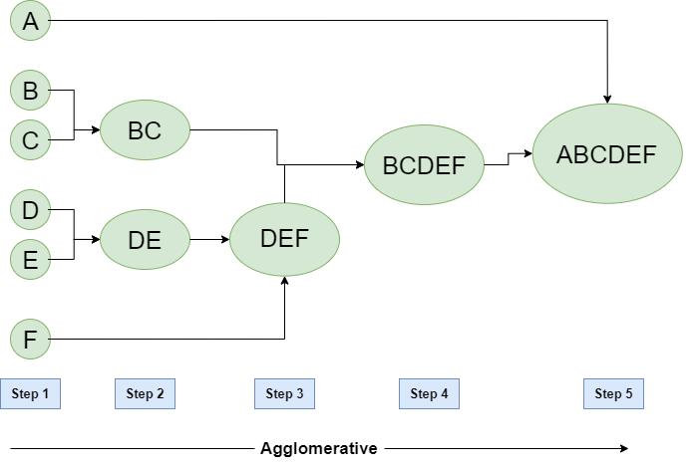
Hierarchical Clustering (Agglomerative)
Builds a tree of clusters from the bottom up.
Each point starts as its own cluster → Merge closest pairs until one big tree
Key Output:
Dendrogram – a tree diagram showing merge steps
Steps:
Calculate distance matrix
Merge nearest clusters
Repeat until one cluster remains
Great For:
Small datasets, exploring cluster relationships

Slide 6
Hands-on: K-Means Customer Segmentation
Dataset: Customer data
Algorithm: K-Means

Slide 7
Session 5 Summary & Q&A
Summary Points:
Unsupervised learning = finding patterns in unlabelled data
K-Means groups data based on similarity
Choosing k is crucial – Elbow method helps
DBSCAN & Hierarchical are useful alternatives

Slide 8
Unsupervised Learning – Part 2
• ARTIFICIAL INTELLIGENCE & MACHINE LEARNING – HANDS-ON WORKSHOP
• Session 6: Unsupervised Learning – Part 2
• Vishnu H S
25 April 2025

Slide 9
What is Association Rule Mining?
Goal:
Discover relationships between items in large datasets
Commonly used in market basket analysis
Real-life Examples:
Customers who buy bread also buy butter
If a user watches action movies, suggest superhero films

Slide 10
Key Metrics
Support:
How frequently an itemset appears in the dataset
Example: Bread appears in 40% of all transactions → Support = 0.4
Confidence:
Probability of seeing item B when item A is bought
Formula: Support(A and B) / Support(A)
Lift:
How much more likely B is purchased when A is purchased
Formula: Confidence / Support(B)
Lift > 1 = positive correlation

Slide 11
Apriori Algorithm
What is Apriori?
It’s like finding shopping patterns — "If people buy A and B, they often buy C too."
Helps uncover frequent item combinations in big datasets.
Real-Life Analogy:
At a supermarket, if many customers buy bread + butter, the store might place jam nearby as a bundle.
How Apriori Works (Step-by-Step):
List all items that are frequently bought (based on support).
Combine items into pairs/triples, etc.
Keep only those combos that meet the support threshold.
Use confidence and lift to check if the rules are strong.
Fun Example:
If 70% of customers who bought "chips" also bought "soda", that’s a rule!

Slide 12
Hands-on: Market Basket Analysis
Dataset: Groceries
Algorithm: apriori

Slide 13
Session 6 Summary & Q&A
Summary Points:
Association rules help uncover product relationships
Apriori uses support/confidence to prune rules
Lift adds context to strength of rule

