Slide 1
AI Chatbot – RAG style
• ARTIFICIAL INTELLIGENCE & MACHINE LEARNING – HANDS-ON WORKSHOP
• Session: AI Chatbot
• Vishnu H S
25 April 2025

Slide 2

What are we building?
Imagine this 👇
A chatbot that answers FAQs using your own documents
Like ChatGPT, but with your notes, policies, or books
This is called: RAG (Retrieval-Augmented Generation)
Combine search with generation!
Goal Today:
Build a mini chatbot that answers from a custom document

Slide 3
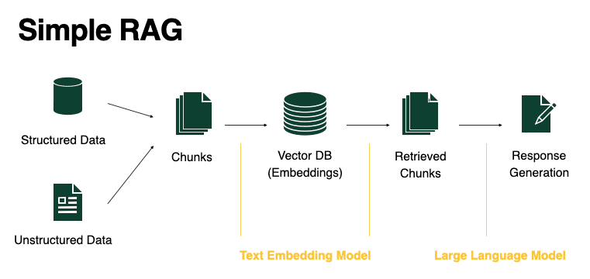

Slide 4
Key Concepts Made Simple
1. Embeddings:
Convert text into numbers (vectors) that represent meaning
Similar meanings → similar vectors
2. Vector Database (FAISS):
Store all your document chunks as vectors
Later, find the most similar chunk to a question
3. OpenAI (GPT):
Use retrieved content + question → generate smart answer

