Slide 1
Introduction to AI & ML
• ARTIFICIAL INTELLIGENCE & MACHINE LEARNING – HANDS-ON WORKSHOP
• Session 1: Introduction to AI & ML
• Vishnu H S
24 April 2025

Slide 2

What is Artificial Intelligence?
Artificial Intelligence (AI) is the simulation of human intelligence in machines that are programmed to think and learn.
Examples:
Siri or Google Assistant (Natural Language Processing)
Google Maps (Pathfinding, Recommender Systems)
Amazon Recommendations (Machine Learning)

Slide 3


AI vs ML vs DL
AI: Broad concept where machines can carry out tasks in a smart way.
ML: A subset of AI where machines learn from data.
DL: A further subset of ML using deep neural networks.

Slide 4
Types of Machine Learning
Supervised Learning: A type of machine learning where the algorithm learns from labeled training data to make predictions or decisions.
Unsupervised Learning: Learning approach that identifies patterns in unlabeled data without explicit guidance.
Reinforcement Learning: Learning paradigm where an agent learns to make decisions by interacting with an environment and receiving rewards or penalties.

Slide 5
Real-World Applications of ML
Healthcare: Disease detection, Diagnosis, Drug discovery
Finance: Fraud detection, Algorithmic trading
E-commerce: Recommendation systems, Chatbots
Social Media: Content curation, Face tagging

Slide 6

Tools Setup
Setup Guide:
1. Google Colab
Visit: https://colab.research.google.com
Sign in with Google
Create a new notebook
2. VS Code
Install VS Code, python and pip
Install python extension
Validate with python --version

Slide 7
Classification Algorithms: K-Nearest Neighbors (KNN)
What is KNN?
KNN stands for K-Nearest Neighbors.
It’s like asking your neighbors for advice: the majority opinion decides.
To predict something new, it looks at the closest 'k' examples and checks what most of them say.
Simple Example:
Imagine you're trying to identify a flower.
You check 5 nearby flowers — if 3 are 'Setosa', your flower is likely 'Setosa’.
How it works:
Measure the distance between the new point and all others.
Choose the closest ‘k’ neighbors.
Take a vote – the most common class is the prediction.
Key Points:
Easy to understand and implement.
Works best when data is well-distributed and small.

Slide 8
Hands-On: KNN Classification
Hands-on: K-Nearest Neighbors (KNN)
Dataset: Iris Dataset (150 flower records, 4 features, 3 classes)
Algorithm: K-Nearest Neighbors (KNN)

Slide 9
Session 1 Summary & Q&A
Summary Points:
AI is the broader field; ML and DL are its subdomains
ML types: Supervised, Unsupervised, Reinforcement
KNN, Decision Tree, and Random Forest are common supervised learning algorithms

Slide 10
Supervised Learning – Classification and Regression
• ARTIFICIAL INTELLIGENCE & MACHINE LEARNING – HANDS-ON WORKSHOP
• Session 2: Supervised Learning – Classification and Regression
• Vishnu H S
24 April 2025

Slide 11
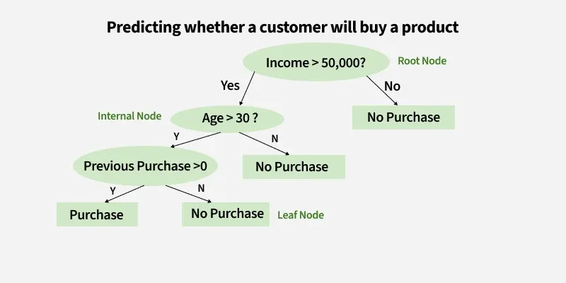
Classification Algorithms: Decision Tree
What is a Decision Tree?
A decision tree makes decisions by asking simple yes/no questions.
It splits data based on answers and continues splitting until it reaches a final decision.
Simple Example:
Question: "Is petal length < 2.5 cm?" → Yes → 'Setosa', No → Ask another question
How it works:
Start at the root (a question).
Split into branches based on answers.
Keep splitting until the data can't be split further (leaf node).
Key Points:
Easy to visualize and explain.
Can be prone to overfitting if too deep.

Slide 12
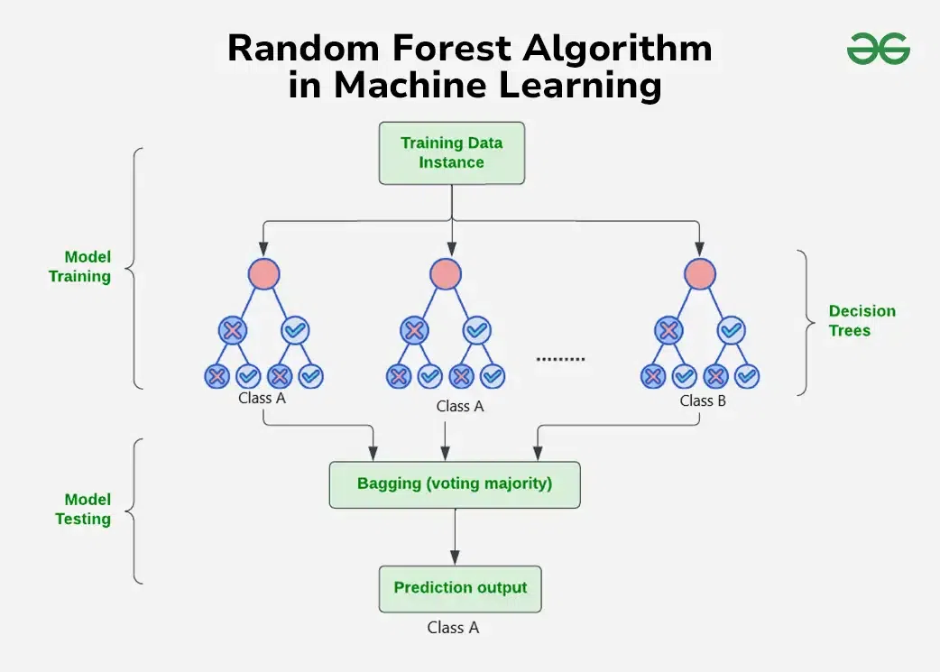
Classification Algorithms: Random Forest
What is a Random Forest?
A Random Forest is like a group of decision trees working together.
Each tree gives a prediction, and the forest picks the most common one.
Simple Example:
10 trees predict if an email is spam. If 7 say “spam,” the forest classifies it as spam.
How it works:
Build many decision trees on random parts of data.
Each tree gives a prediction.
Combine them all and take the majority vote.
Key Points:
More accurate than one tree alone.
Handles noise and overfitting better.

Slide 13
Introduction to Regression
What is Regression?
Regression is a supervised learning technique used to predict continuous values.
Unlike classification (which predicts categories), regression predicts numerical outputs.
Simple Examples:
Predicting house prices based on size and location.
Estimating salary based on experience and education level.

Slide 14
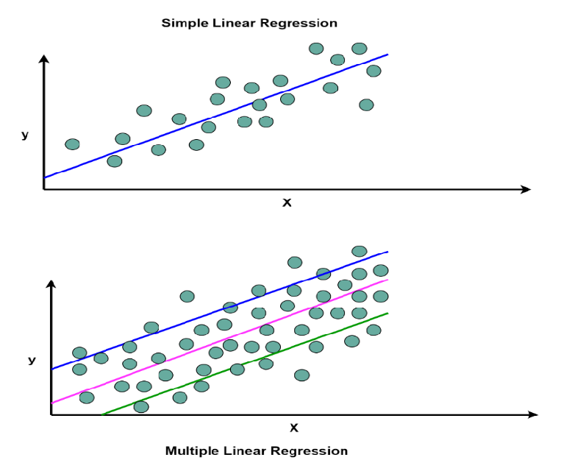
Types of Regression
1. Linear Regression:
Draws a straight line through data points to best fit the trend.
Predicts output using the formula: y = mx + c, where:
y = predicted value
m = slope (weight)
x = input feature
c = intercept (bias)
2. Multiple Linear Regression:
Same as linear regression but with more than one input feature.
Formula: y = b0 + b1x1 + b2x2 + ... + bnxn
where each x is a different input, and b is its corresponding weight.
Key Concepts:
Regression finds relationships between variables.
Good for forecasting and trend analysis.

Slide 15
Hands-On: KNN Classification
Hands-on: House Price Prediction
Goal: Predict house prices using Linear Regression
Dataset fields: Number of rooms, area, location, index etc..

Slide 16
Session 2 Summary & Q&A
Summary Points:
Decision Tree and Random Forest are powerful classifiers
Regression predicts continuous values

