Slide 1
Supervised Learning
• ARTIFICIAL INTELLIGENCE & MACHINE LEARNING – HANDS-ON WORKSHOP
• Session 3: Supervised Learning
• Vishnu H S
24 April 2025

Slide 2

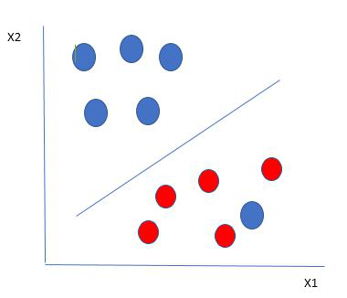
Classification Algorithms: Support Vector Machine (SVM)
What is SVM?
SVM is a supervised learning algorithm used for classification tasks.
It finds the best line or boundary (called a hyperplane) that separates different classes of data.
Simple Example:
Imagine separating apples and oranges on a table using a ruler — the ruler is the boundary.
SVM chooses the ruler position so that it’s as far from the apples and oranges as possible.
How it Works:
Plot the data points.
Find a hyperplane that best separates the classes.
Maximize the margin between the hyperplane and the nearest points of each class (support vectors).
Key Points:
Works well for both linear and non-linear data.
Effective in high-dimensional spaces.
Sensitive to choice of kernel and regularization.

Slide 3
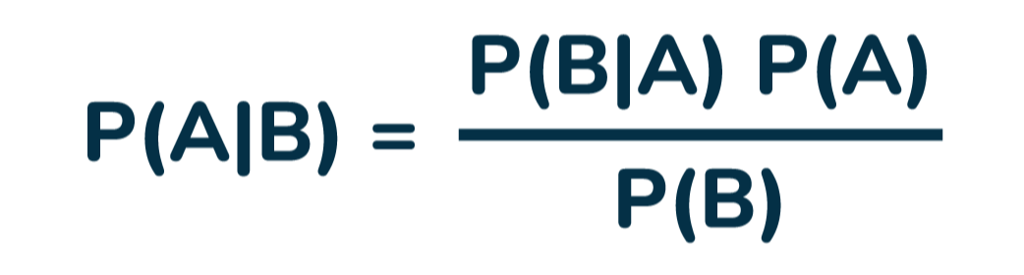
Classification Algorithms: Naive Bayes
What is Naive Bayes?
Naive Bayes is a probabilistic algorithm based on Bayes’ Theorem.
It assumes all input features are independent of each other — hence the name "naive."
Simple Example:
If a message contains the word "free," what is the probability that it's spam?
Naive Bayes looks at the frequency of the word "free" in spam and ham messages to decide.
How it Works:
Calculate the prior probability of each class (e.g., spam or ham).
Calculate the likelihood of each feature given the class.
Use Bayes’ Theorem to compute the posterior probability for each class.
Choose the class with the highest probability.
Key Points:
Very fast and requires less training data.
Performs well for text classification problems.
Not good if features are highly correlated.

Slide 4
Evaluation Metrics
Why We Need Metrics:
To measure how well our classification model performs.
Different metrics capture different types of errors.
1. Accuracy
Overall correctness of the model.
Formula: (True Positives + True Negatives) / Total Predictions
2. Precision
How many predicted positives are actually positive.
Formula: TP / (TP + FP)
Important when false positives are costly (e.g., marking a valid email as spam).
3. Recall
How many actual positives were correctly identified.
Formula: TP / (TP + FN)
Important when missing a positive is costly (e.g., missing a spam email).
4. F1 Score
Harmonic mean of Precision and Recall.
Useful when you need a balance between Precision and Recall.

Slide 5
Hands-On: KNN Classification
Hands-on: Spam Classifier with Naive Bayes
Goal: Classify SMS messages as spam or ham (not spam)
Algorithm: Naive Bayes

Slide 6
Session 3 Summary & Q&A
Summary Points:
SVM finds the optimal separating boundary using support vectors.
Naive Bayes is fast, simple, and perfect for text classification.
Evaluation metrics are crucial to analyze model performance.

Slide 7
Feature Engineering & Optimization
• ARTIFICIAL INTELLIGENCE & MACHINE LEARNING – HANDS-ON WORKSHOP
• Session 4: Feature Engineering & Optimization
• Vishnu H S
24 April 2025

Slide 8
Smarter Spam Classifier
We'll build a smarter spam classifier by:
Cleaning the data
Converting text to numbers
Testing different models
Tuning model settings to get best accuracy

Slide 9
Session 4 Wrap-Up
Challenge:
Build Your Own Classifier 🚀 From everything you've learned in Sessions 1–4, try to:
Pick any dataset (Iris, Titanic, or your own!)
Preprocess and clean the data
Choose a model (KNN, Decision Tree, Naive Bayes, etc.)
Train, tune, and evaluate it
Show results with accuracy, precision, recall, and F1 Score

