Slide 1




ASTROSAGE ANALYSIS
VISHWANATH NIKHIL
19-07-2025

Slide 2

ABOUT ASTROSAGE
Wisdom Meets Astrology: The name AstroSage blends ‘Astrology’ and ‘Sage’, symbolizing guidance rooted in ancient Vedic knowledge enhanced by modern technology.
India’s Leading Astrology Platform: Offers personalized services such as horoscope readings, kundli matching, and life predictions to help users make informed decisions.
Trusted & Accessible Services: Features a network of verified astrologers with user-rated profiles, flexible pricing, and supports both voice and chat consultations for global reach and convenience.
2
2

Slide 3
PROBLEM STATMENT
To optimize call center operations for AstroSage with a 1 crore investment.
The goal is to determine how to allocate this investment to maximize operational efficiency, customer satisfaction, and profitability.
This project will involve analyzing historical call data, performance metrics, and market trends to make informed decisions.

Slide 4
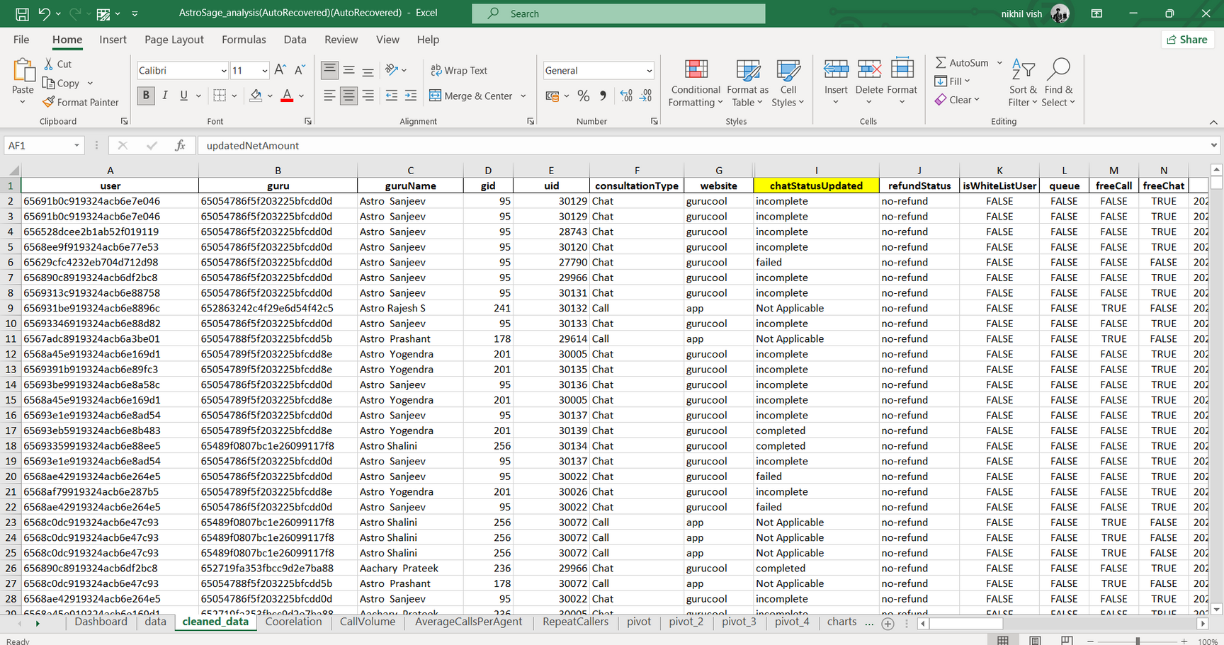
Data Overview
2

Slide 5
Data Cleaning & Analytical Approach
Data Cleaning Process
Data Analysis Techniques
Data Inspection: Review data for completeness and accuracy.
Handling Missing Values: Imputation (Not available (N/A), and ‘0’)
Removing Duplicates: Identify and eliminate duplicate entries.
Standardization: Ensure consistent formatting (e.g., date formats, categorical variables).
Descriptive Analysis: Tracked call/chat counts, durations, and user engagement patterns.
Workload Distribution: Identified imbalance in call/chat load among astrologers.
Sentiment Analysis: Analyze customer feedback to gauge satisfaction levels.

Slide 6
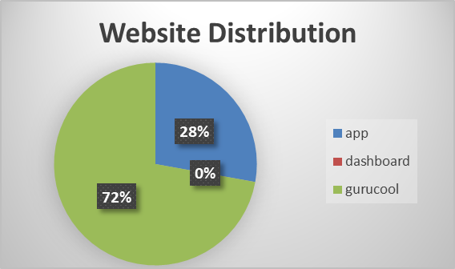
Traffic on Website
According to the given data gurucool
has more traffic compare to app
App
Gurucool
Dashboard
User
Trafiic
(Platform)

Slide 7
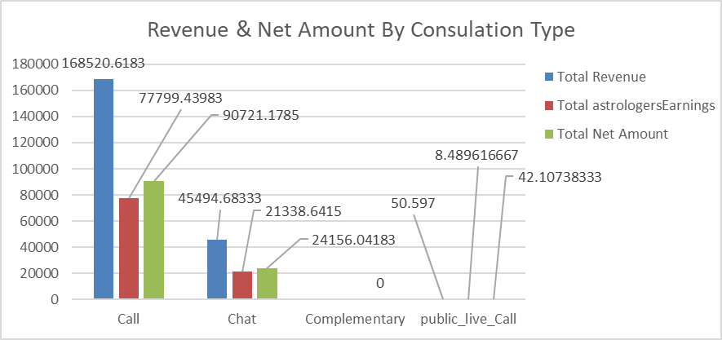
Revenue & NetAmount by Consulation type
The majority of revenue and net earnings are generated through Call consultations, significantly outperforming all other types, while Complementary and Public Live Call sessions contribute negligible revenue.
To maximize profitability, it's recommended to focus resources on enhancing Call consultations (e.g., quality, availability, promotions) and re-evaluate or optimize low-performing types like Complementary or Public Live Calls.

Slide 8
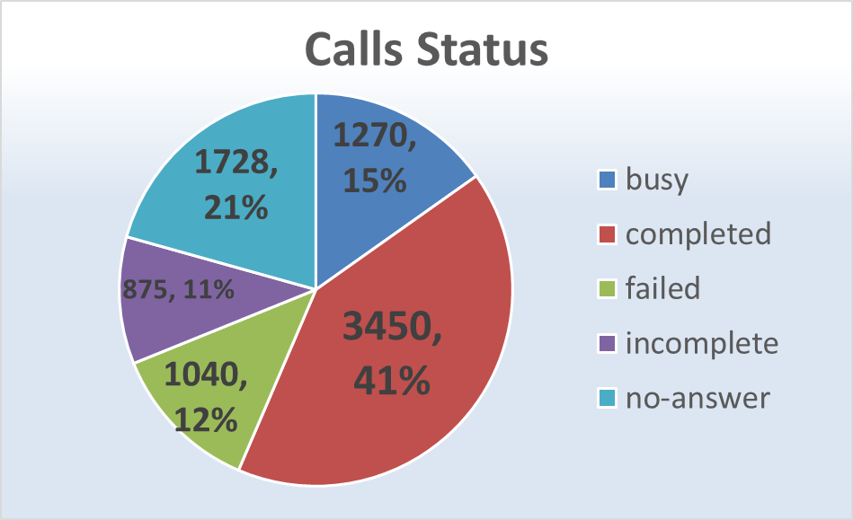
Call Status
Only 41% of calls are completed, while the rest are missed, busy, or failed — indicating low call engagement.
Implement automated IVR calls for initial engagement and hire more agents to improve overall call completion percentage.

Slide 9
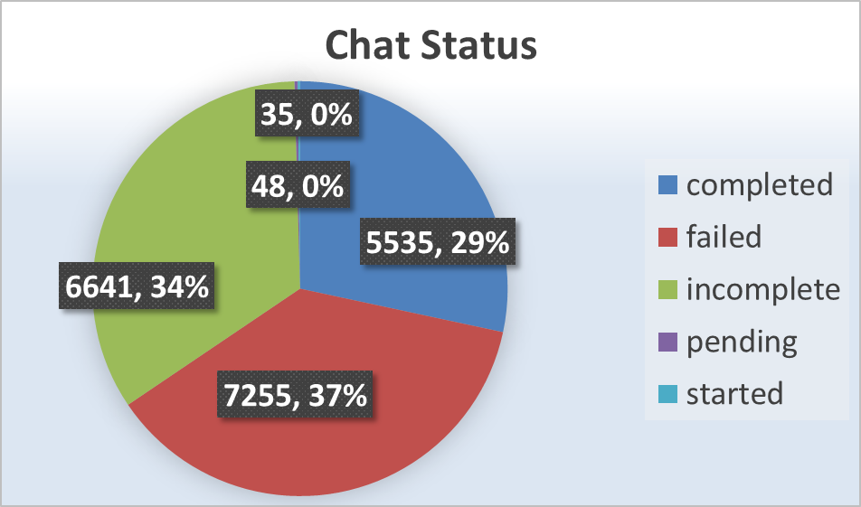
Chat Status
According to the given data,
only 29% of chats are completed, which indicates a low chat resolution rate.
To improve the completion rate,
integrate AI-powered chatbots for initial engagement and
enhance bot response quality to drive better conversation outcomes.

Slide 10
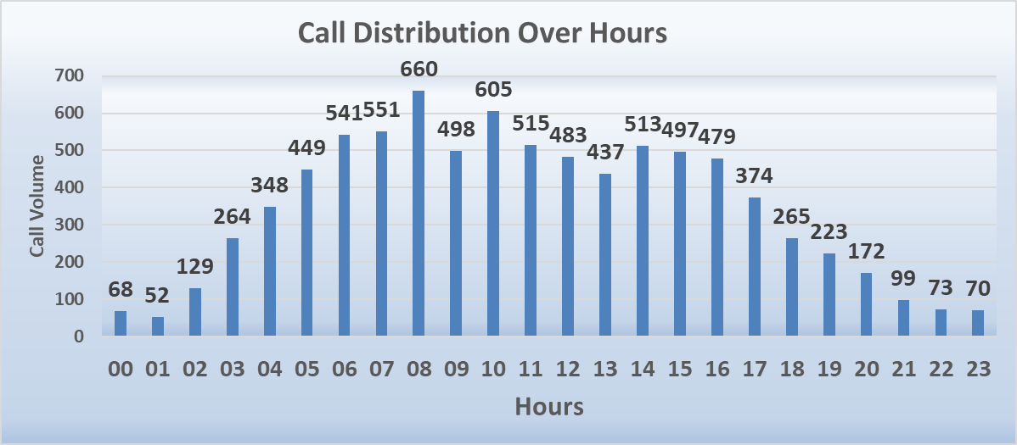
Call Distribution Over Hours
Call peak hours are clearly identified
with the highest volume around 08:00 to 10:00 hours.
To maximize user engagement and
drive higher revenue, it is essential to
optimize support during these peak hours.

Slide 11
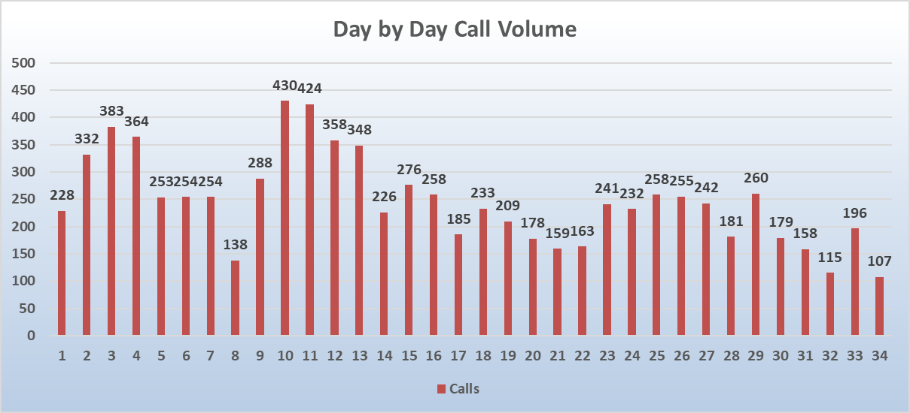
Day by Day Call Volumes
Call volumes peaked significantly around days 10 and 11, indicating heightened user activity during this period.
To ensure efficient support and maximize customer satisfaction, allocate more resources and staffing around these high-volume days.

Slide 12
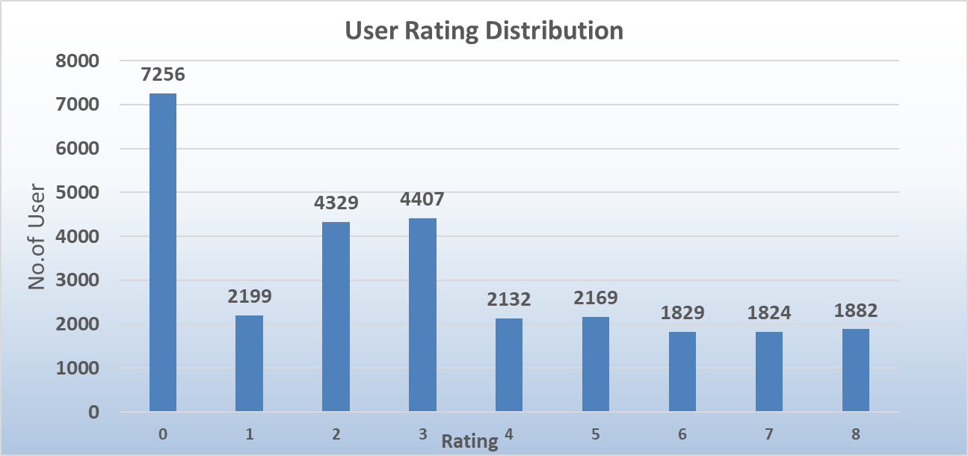
Rating Distribution
According to data Overall rating is very poor it show customer satisfaction is Low.
Need to improve customer satisfaction by providing Free chat through AI Chat Bot .

Slide 13
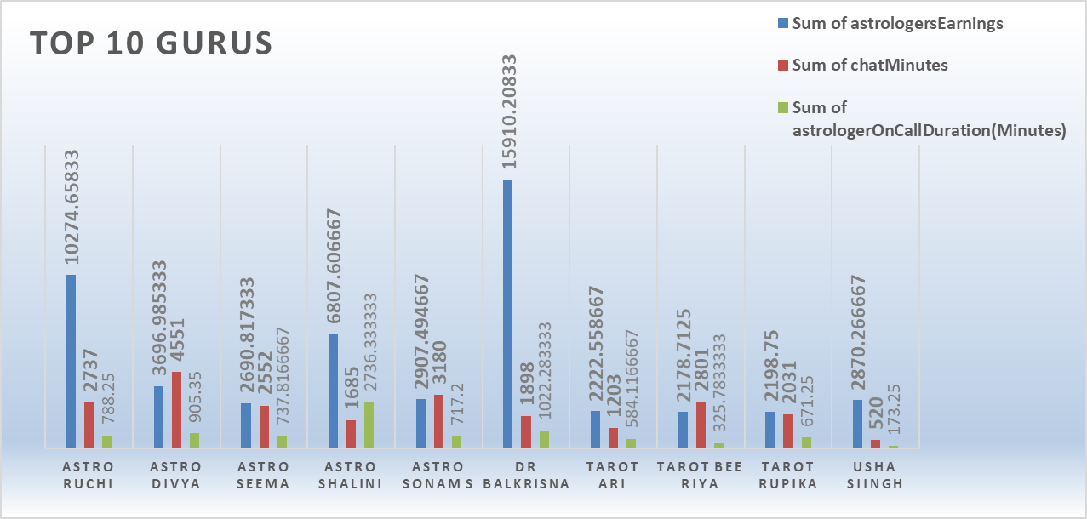
Top 10 Gurus
Dr. Balkrisna generated the highest earnings despite lower chat and call durations, indicating high consultation efficiency or premium pricing.
To boost overall revenue, similar high-performing gurus should be prioritized and their strategies replicated across the team.

Slide 14
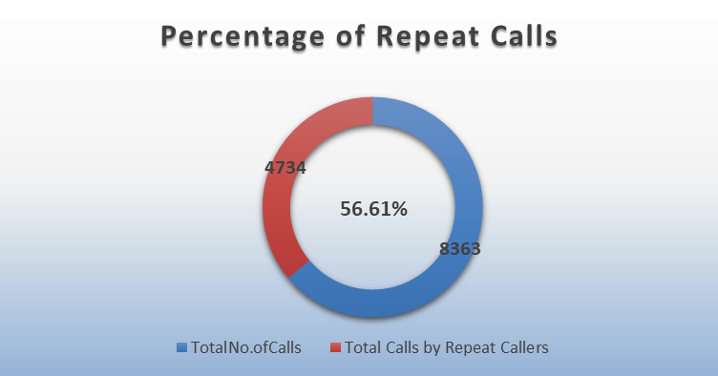
Repeat Calls Percentage
With 56.61% of total calls being repeat calls, it’s evident that a strong portion of users are returning, indicating good satisfaction or trust in the service.
To capitalize on this, it's recommended to nurture these loyal users through personalized offers or loyalty programs, while also strategizing to convert more first-time callers into repeat customers to boost overall engagement.

Slide 15
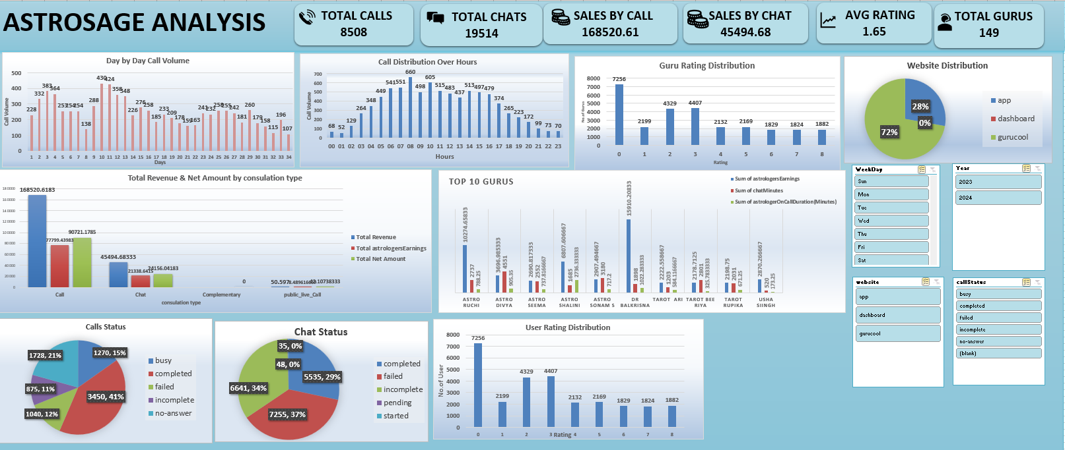

Slide 16
Key Insights Summary
AstroSage has strong consultation call volumes and repeat callers, showing market demand and loyalty.
However, low customer satisfaction, poor success rates (41% calls, 29% chats), and uneven agent performance highlight service and efficiency issues.
Revenue is concentrated in select consultation types, suggesting both strengths and untapped areas.
Possible Key Factors
Inadequate First-Time Resolution: High repeat calls and low chat/call success rates indicate unresolved queries.
Uneven Agent Utilization: Heavy reliance on a few agents leads to inefficiency and burnout risk.
Missing Operational Data: Absence of columns like Call Duration, Agent Expertise Mapping, and Language Preference hinders optimization.
Peak Hour Inefficiency: Low agent activity during high-traffic times reduces response effectiveness.
Agent Skill Gaps: No specialization alignment with consultation types affects call handling quality.
Platform Strength in Paid Consultations: Paid consultation types show better revenue traction this is a strategic advantage.
Lack of Regional/Language Support Insights: Potential mismatch between caller needs and available agent capabilities.
Repeat Call Patterns: While indicating loyalty, they also reveal service experience gaps that need addressing.

Slide 17
Conclusion
AstroSage faces challenges in customer satisfaction, call success rates, and agent utilization.
Immediate action is needed to optimize agent performance, balance workloads, and improve service quality during peak hours.
Suggestions for Improvement Based on Findings
Agent Training:Targeted training for agents to improve resolution quality and customer handling during high-traffic periods.
Efficient Agent Utilization:
Distribute call loads more evenly to avoid burnout and ensure consistent performance across all agents.
Success Rate Optimization:
Analyze failed call/chat cases to identify common issues and develop SOPs for better resolution.
Peak Hour Strategy:
Deploy top-performing agents during peak hours to maximize satisfaction and reduce wait times.

Slide 18
THANK YOU

