Slide 1

ARTISHOP · CONCEPT OVERVIEW
Artishop
A local artisan marketplace with a story behind every piece
Discover handmade pieces while knowing the person, process, and place behind each product.
By-
V Pranav
Rohan V Raju
Vishrrut V

Slide 2



THE PROBLEM
Local craft is hard to discover, trust, and support
Hard to find
Hard to understand
Local artisans and traditional handicraft products lack one clear digital marketplace.
Shoppers often see the object without the person, process, or place behind it.
THE CHALLENGE
Promoting local artisans and traditional handicraft products.
Hard to trust
Without provenance and verification, it is harder to buy thoughtfully and support makers directly.

Slide 3
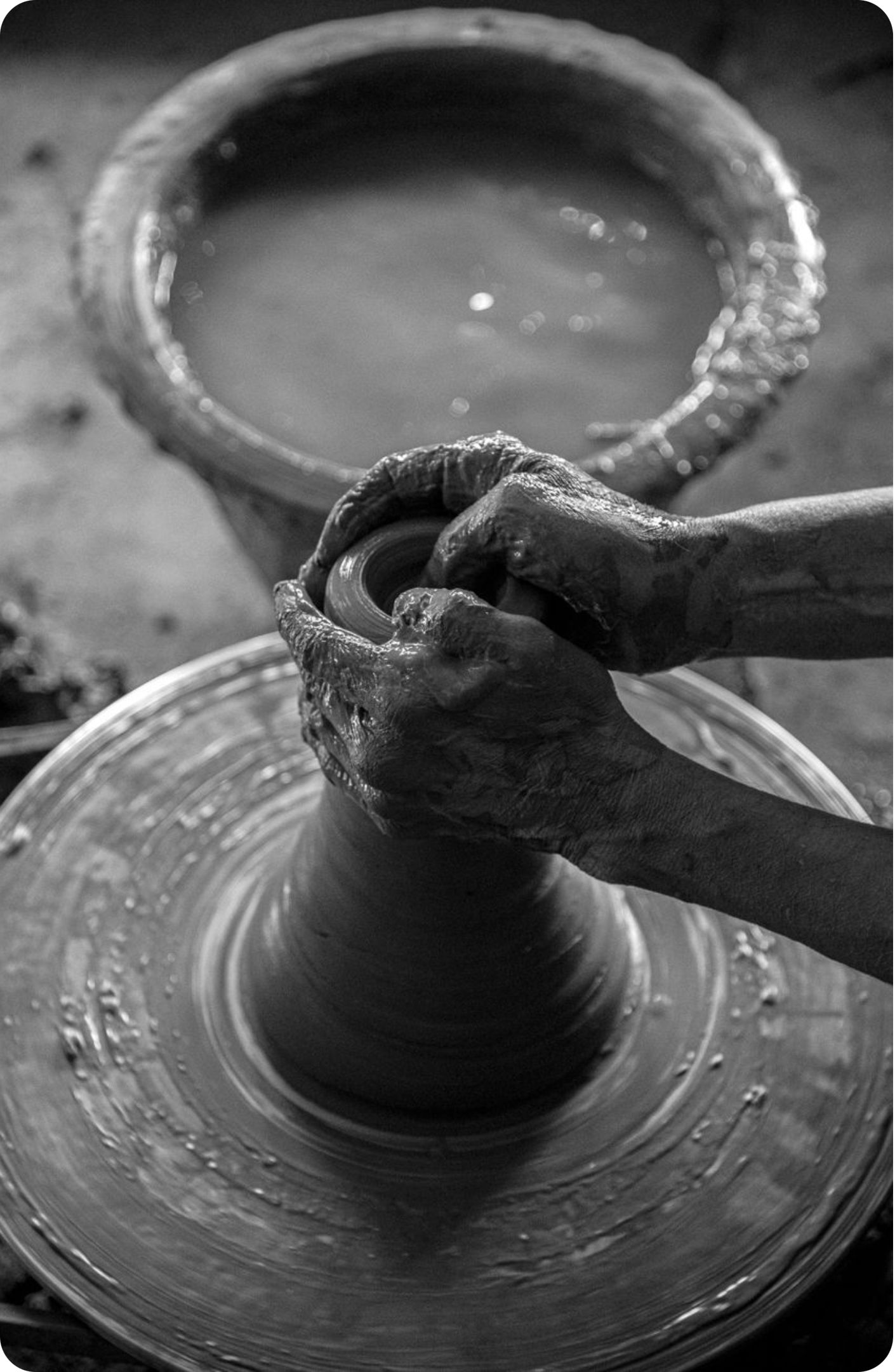
THE SOLUTION
Artishop turns product discovery into maker discovery
Shop handmade pieces from Bangalore's artisans while learning who made them and how.
MAKER-FIRST
ONE EXPERIENCE
The story is part of the product
Browse, learn, support
Products, maker profiles, craft stories, and support options live in one experience.
Keep the marketplace maker-first, not product-only.

Slide 4
THE PLATFORM
Browsing, stories, and support belong in one flow
Each step moves the shopper closer to a maker, a practice, and a meaningful choice.
01
02
03
04
Browse
Open
Support
Follow
Shop by craft category: handloom and textiles, pottery and ceramics, woodcraft, and jewellery.
See the artisan story, process, place, and related gallery.
Add a piece to the basket or support an artisan directly through a donation flow.
Receive new craft stories through the newsletter.

Slide 5
THE SHOPPER JOURNEY
A simple journey from object to connection
Discover
Understand
Search and category navigation make local craft easier to find.
Each listing connects the product to a person and practice.
Choose
Continue
Product details, maker information, and craft context support a more informed purchase.
Donation, maker stories, and weekly updates extend the relationship beyond checkout.

Slide 6
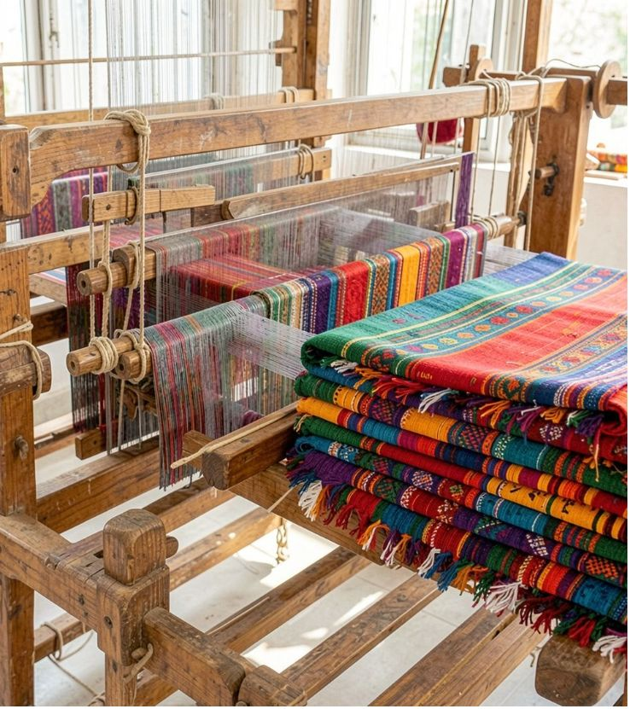
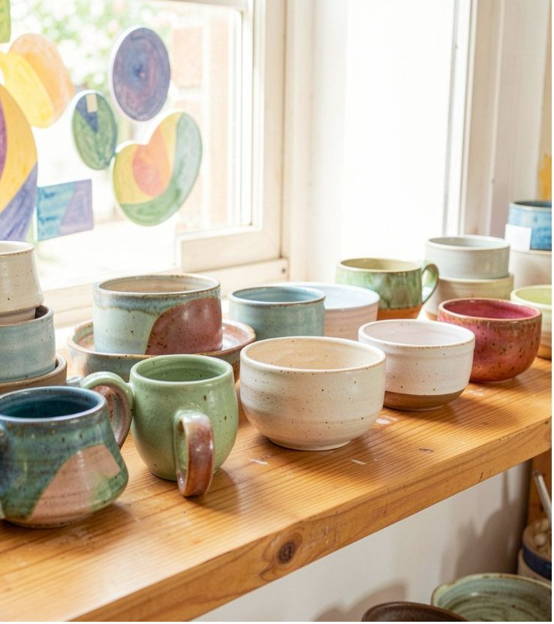
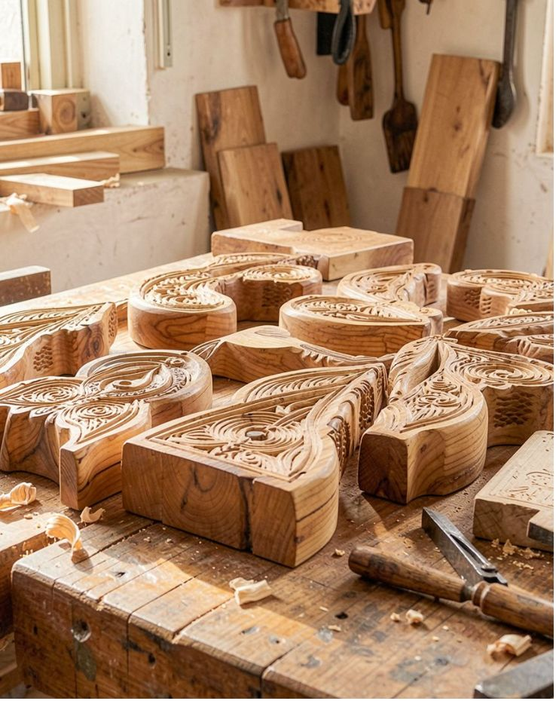
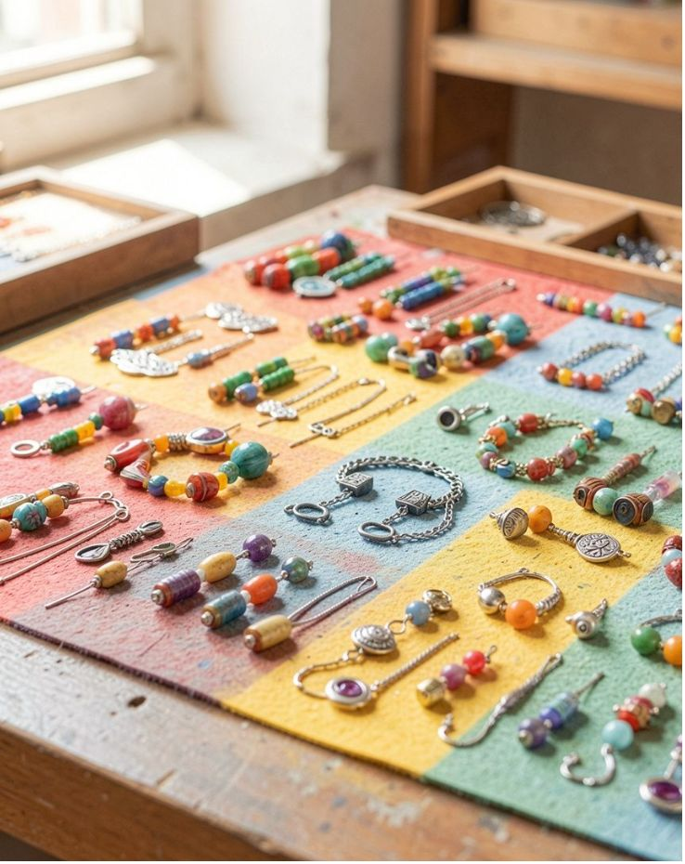
THE CATALOG
Traditional craft becomes easier to explore
Handloom and textiles
Pottery and ceramics
Woodcraft
Jewellery
Sample handmade textile listings.
Objects shown with material context.
Woodwork connected to technique.
A clear entry point for another craft tradition.
Maker profiles capture name, craft, place, years of practice, biography, and technique story. Rooted in Bangalore and Karnataka, the story model can scale to other regions.

Slide 7
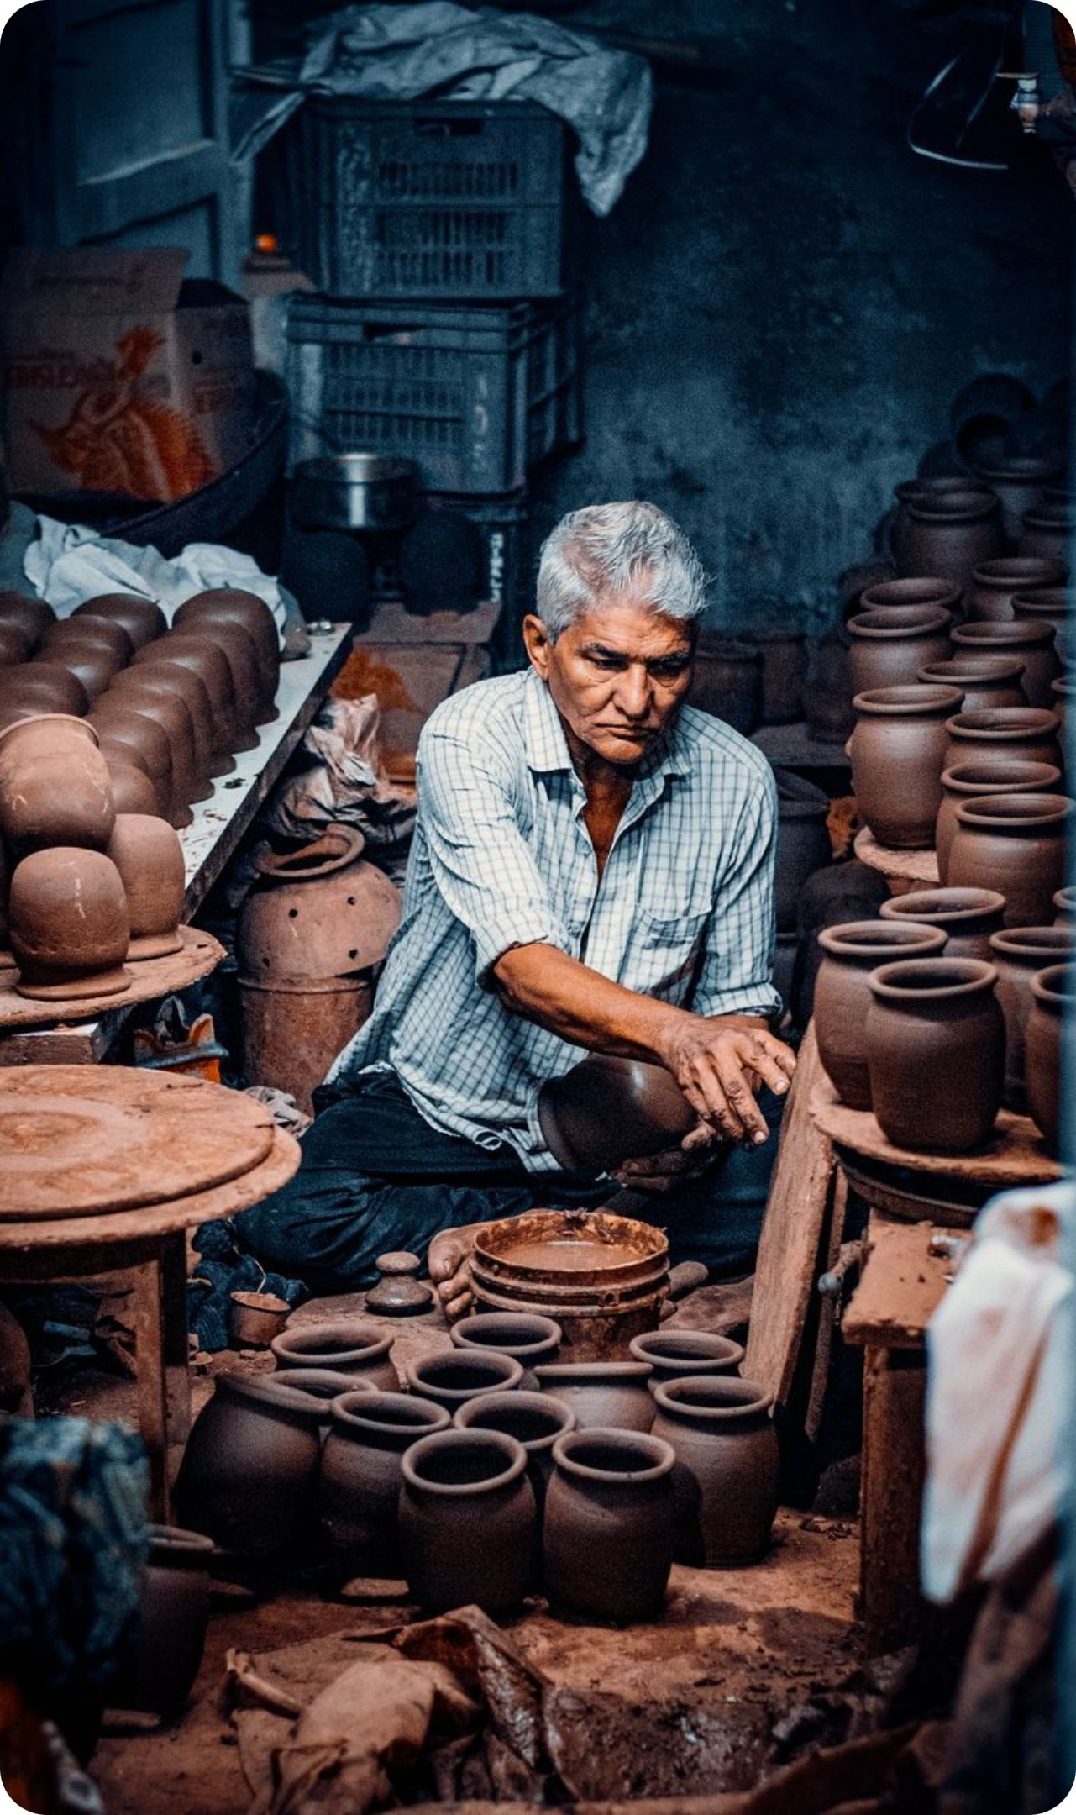
HOW WE VERIFY -
Trust is designed into the marketplace
Meet: visit the workshop or review maker documents.
Document: record technique, materials, and practice.
Be transparent: show what information has been checked and the current verification status.
Keep the story: carry care and provenance information with each piece.
The source concept labels sample listings illustrative and not independently verified; the live product must make verification status visible.

Slide 8
BUILD NOTES
Technology stack and future payment update
HTML structures the website content.
CSS handles styling and responsive layout.
JavaScript powers search, basket, maker stories, donations, and newsletter sign-up.
The current concept is a demo and does not process payments. A secure payment gateway will be integrated in future development; the final provider and supported payment methods are to be confirmed. Most Likely we will use Razorpay

