Slide 1
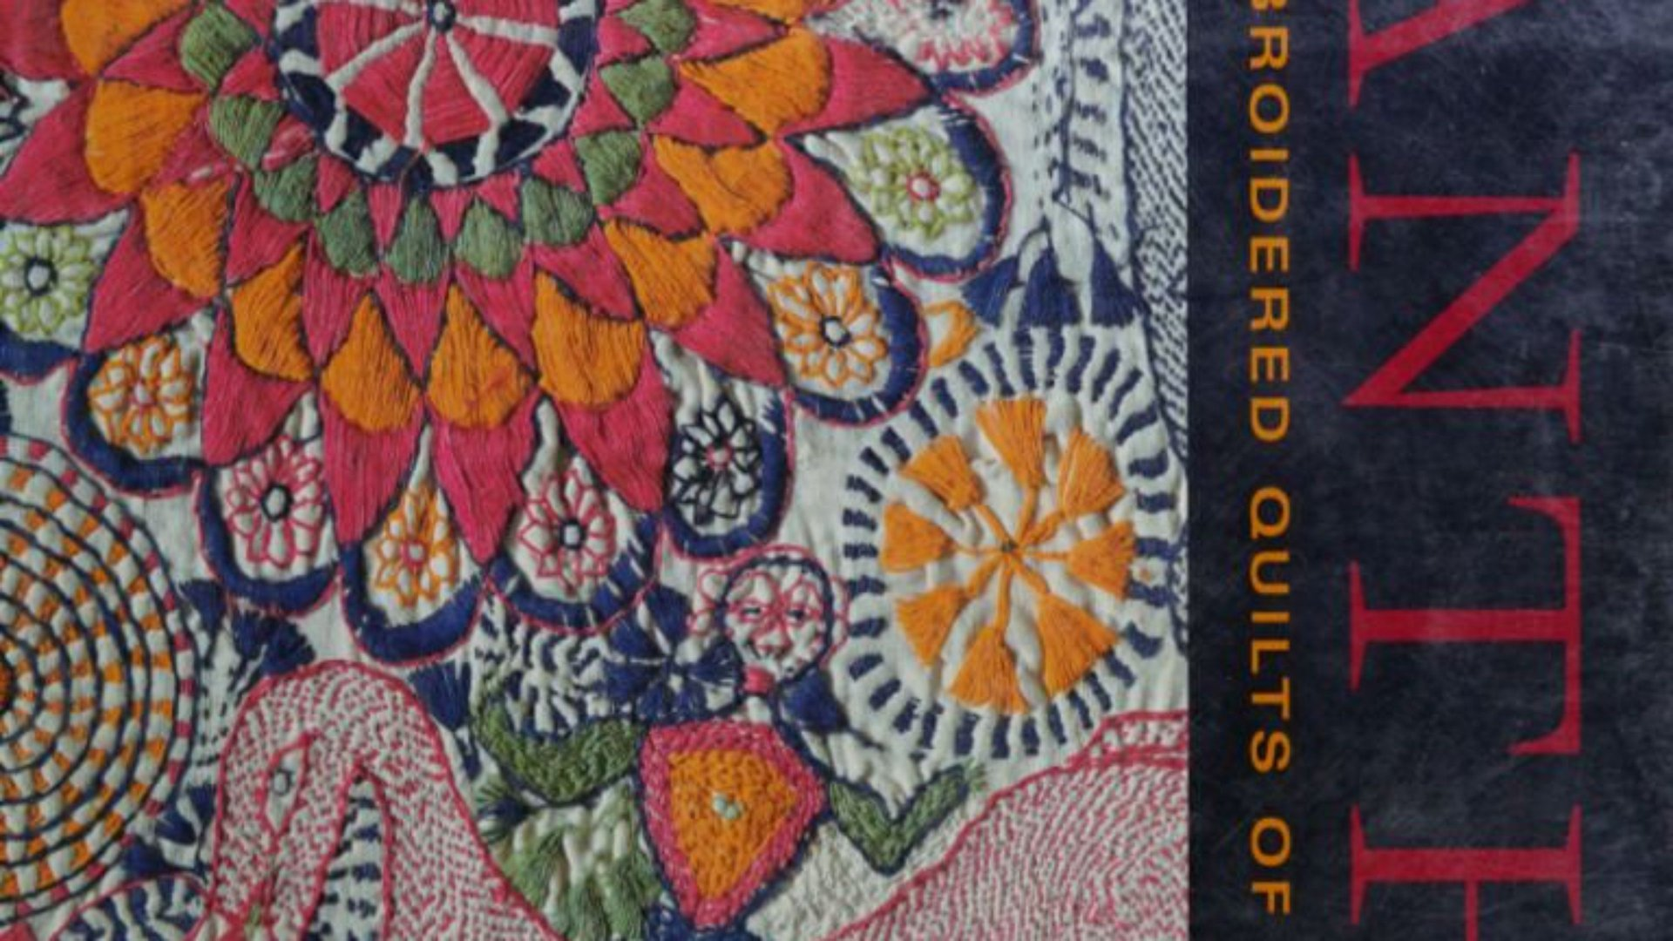

Artishop
2nd Project Review
A local artisan marketplace with a story behind every piece
Team members:
V Pranav
Rohan V Raju
Vishrrut V
Notes:
Introduce the team and the purpose of this review: show the working prototype, code quality, challenges, testing, and alignment with the timeline. Each member will speak to their own contribution.

Slide 2
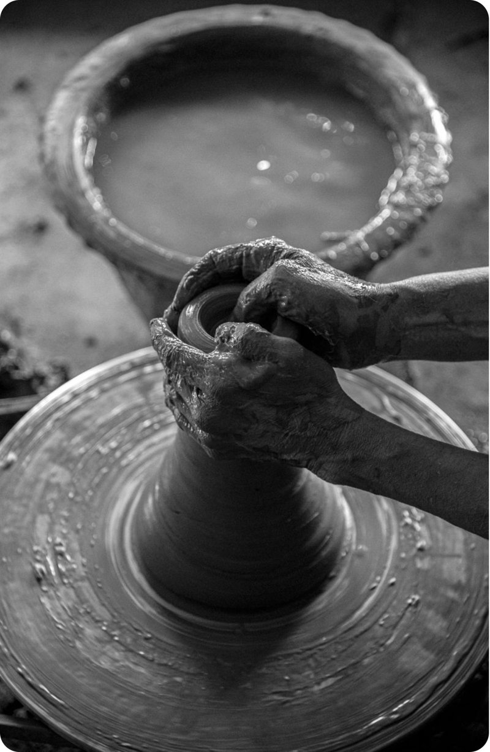
Current Progress
User-Friendly Homepage: Attractive homepage with a navigation bar, promotional banner and product categories.
Product Browsing: Displays the Artisans handmade products
Artisan Profiles: Displays artisan names, locations, crafts and years of experience.
Artisan Stories: Provides detailed information about artisans, their backgrounds, traditional techniques and craft history.
Notes:
One-slide recap: local craft is hard to find, understand and trust. Artishop turns product discovery into maker discovery. These four numbers show the scope of the prototype so far.

Slide 3
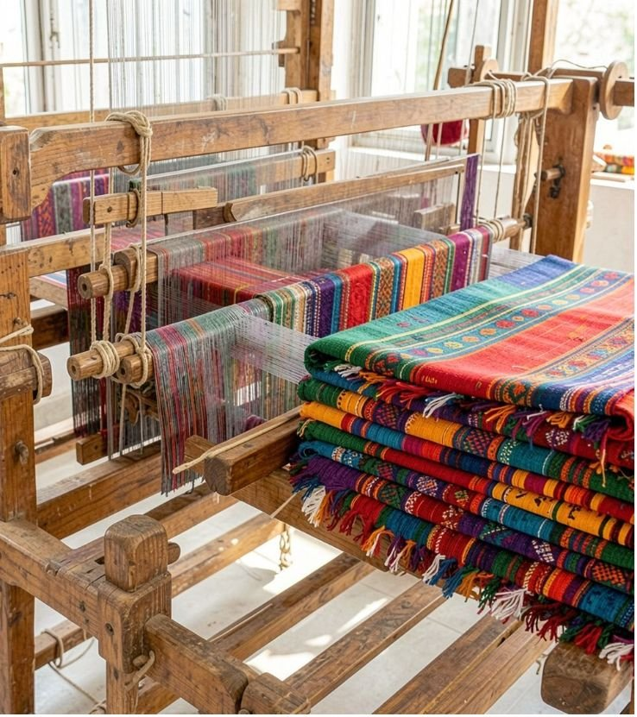
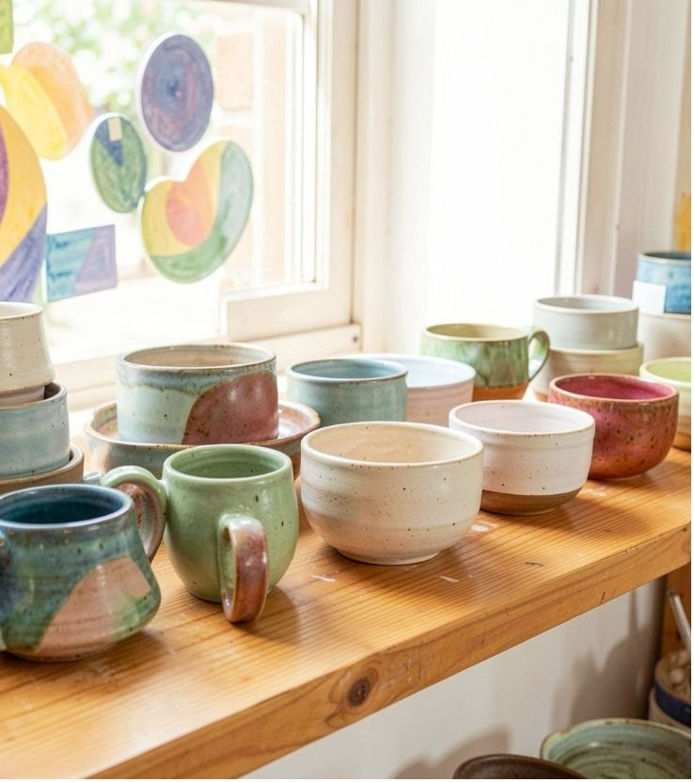
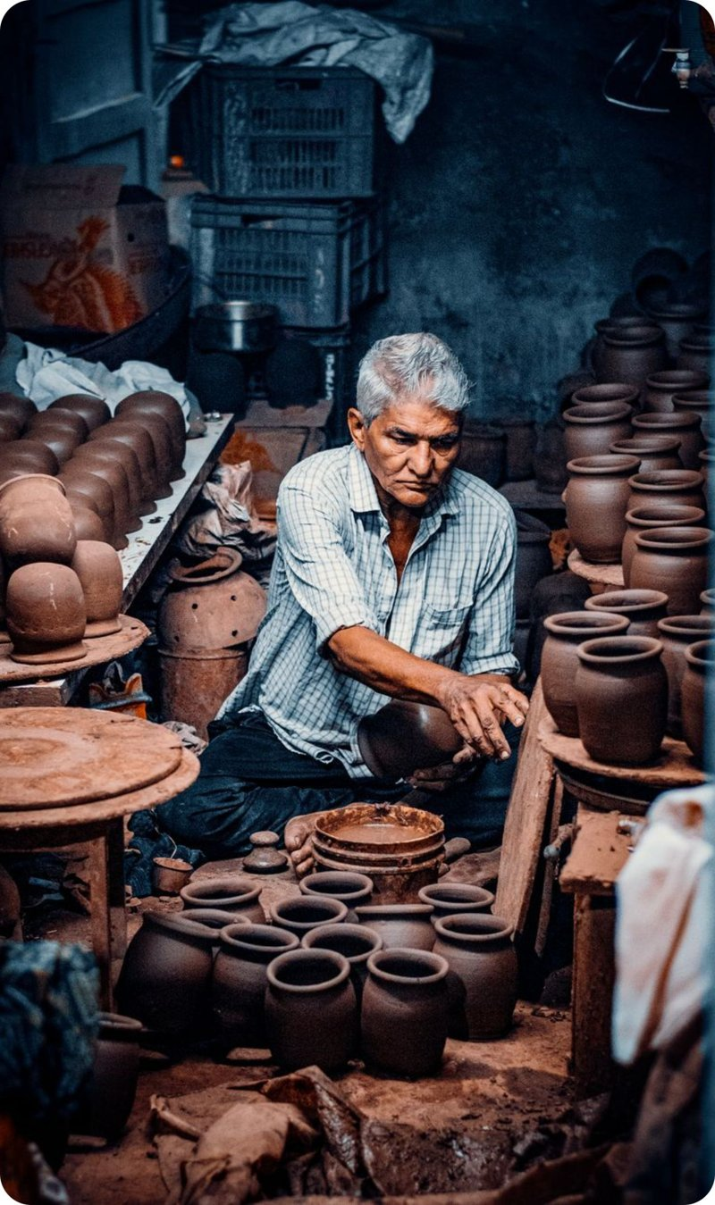
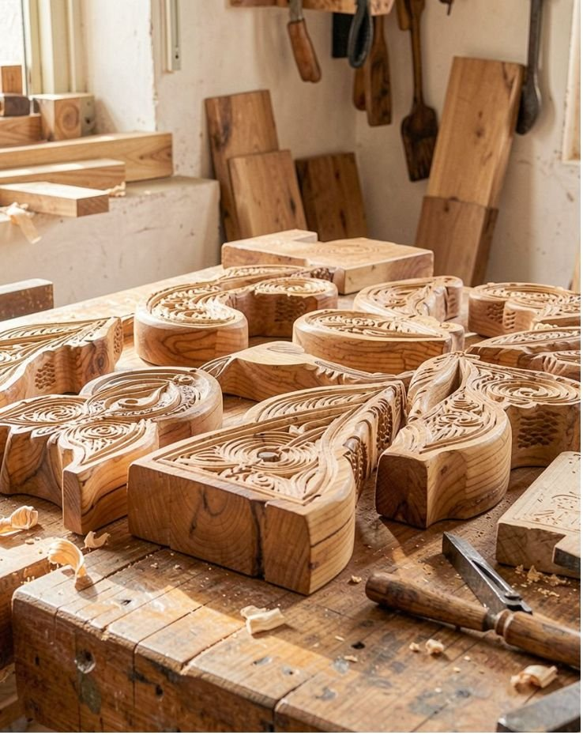
A walk through the prototype
1 · Browse
3 · Support
2 · Open
4 · Follow
Pick a craft category or search for a piece.
Read the artisan story, process and place.
Add a product to the basket or donate to a maker.
Sign up for new craft stories by newsletter.Or support the craft
Notes:
Run the live prototype here, following the four steps. Replace the stock imagery on this slide with screenshots of your own pages if you prefer. Mention clearly that checkout does not process payments yet.

Slide 4
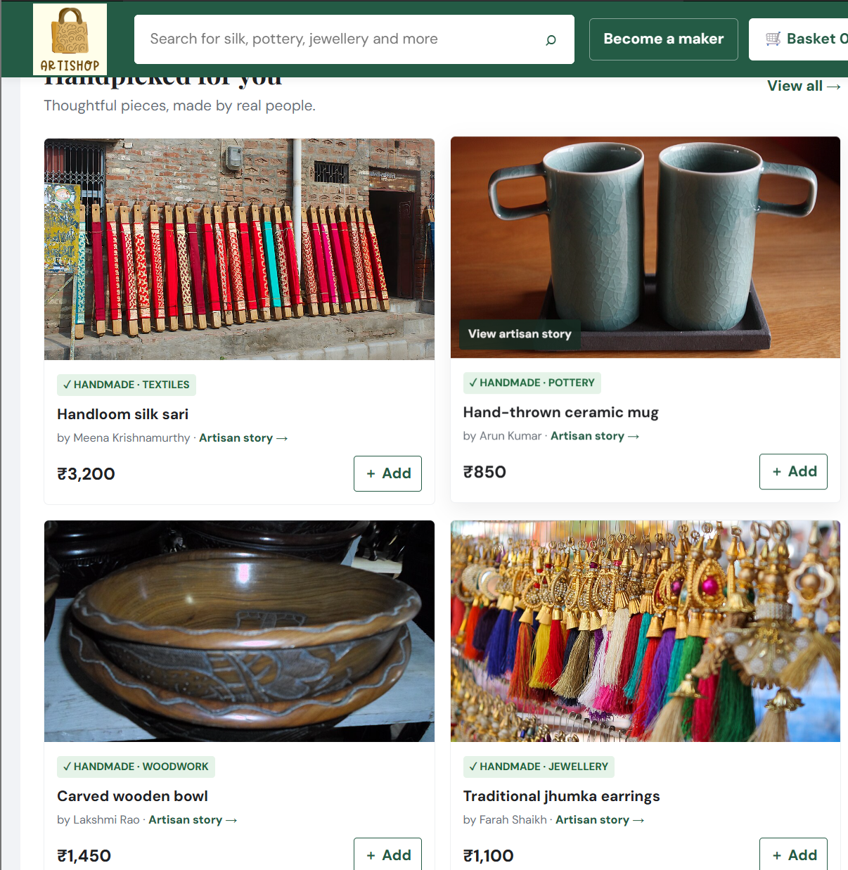
What the prototype can do today
1
Search for products
Keyword and craft filters
2
Explore Maker stories
Name, craft, place, technique
3
Add items toBasket
Add pieces, review selection
4
Donate towards the art form
Support a maker directly
5
Newsletter
Get informed about upcoming items in the market
Next: secure payments
Notes:
This is a drawn layout of the prototype. Swap it for real screenshots if you prefer, keeping the numbered callouts. Walk through each numbered feature, then point to payments as the main piece still to come.

Slide 5
Testing and Preliminary Results:
The following functionalities can be tested in the current prototype:
Product search and category filtering.
Adding and removing products from the basket.
Updating basket item counts and subtotal.
Opening and closing artisan story sections
Selecting artisans and entering donation amounts.
Validating donation form inputs.
Checking website responsiveness on different screen sizes.

Slide 6
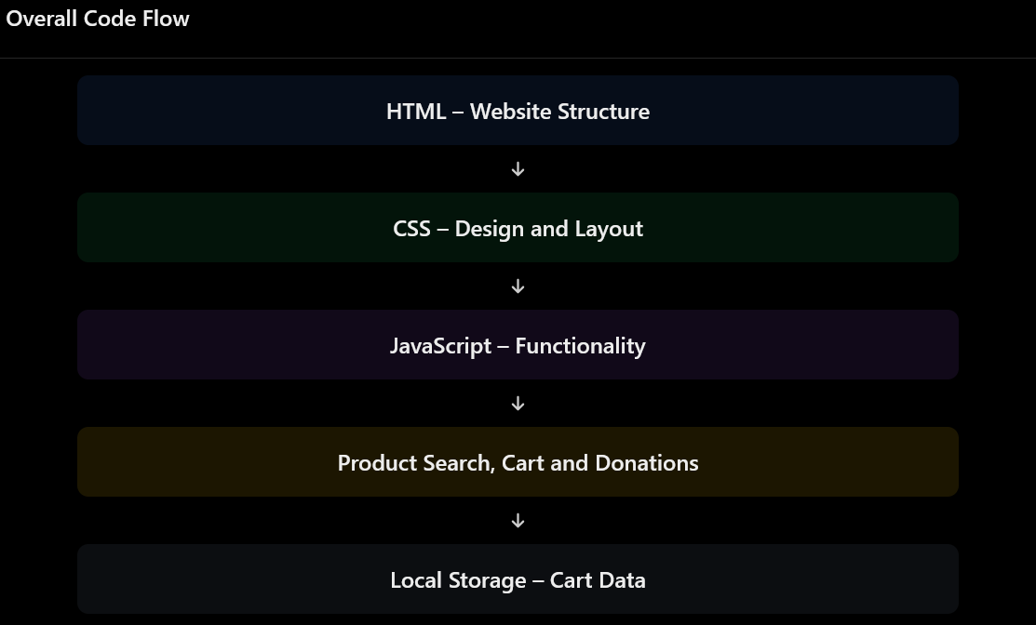
Code Overview
Notes:
The stack: HTML for structure, CSS for style and responsiveness, JavaScript for behaviour, with one module per feature. The data model is what makes it maker-first: each product record points to a maker profile and carries a verification status.

Slide 7

Problems faced
1
Every listing needs a maker story, not just a photo and a price.
One record of the product story per piece, linked to a maker profile.
2
Payments cannot be tested safely in a demo.
Basket and donations are simulated; Razorpay is planned in future update.
3
Sample listings are not independently verified.
Independent verification by a team of experts required
Notes:
Be ready to talk about real problems your team hit (bugs, layout issues, merge conflicts, data decisions) and how each was solved. The three here come from the project concept; edit them to match your experience.

Slide 8
What is yet to be integrated
No backend database is connected.
Online payment functionality is not implemented.
Checkout is currently a demonstration.
Donations are not actually processed.
Artisan details are illustrative and not independently verified.
Notes:
Describe how you tested: manual checks per feature, responsive checks, browser checks and quick usability trials. Before presenting, fill the grid: change a circle's fill to indigo for pass or terracotta for an issue found, and say what you fixed.

Slide 9

Progress Map
Concept & design
Problem, solution, catalog and trust model defined.
UI and UX refinement
Functional and responsive checks; fix what we find.
Final demo & docs
Polish, deploy and finish the GitHub documentation.
3
4
5
Core prototype
Browse, maker stories, basket, donations, newsletter.
We are here
Payments & verification
Razorpay checkout and visible verification status.
Adjustments: payments stay in future scope (the demo processes none), and verification status must be visible in the live product.
Notes:
Compare progress to the proposed timeline. Add real target dates for each phase and correct any status that differs from reality. Explain adjustments honestly: what moved and why.

Slide 10
Who did what
V Pranav
Donation form and interactive elements
Functionality testing and debugging
Rohan V Raju
JavaScript implementation
Search and filtering functionality
Shopping cart and data storage
Vishrrut V
Website structure and layout
UI/UX design and styling
Notes:
Each member fills in their area, key contributions and the part they will explain or demo. Everyone must be ready to answer questions about their own work and the project as a whole.

Slide 11
What's next
1
Integrate secure payments
Add Razorpay checkout (provider still to be confirmed).
2
Show verification status
Make checked and unchecked details visible on each listing.
3
Replace sample listings
Onboard real maker profiles and verified product data.
4
Finish testing and docs
Complete the test log, polish the UI, update the GitHub repo.
Notes:
Close by summarising what is built, what remains, and the plan to the final review. Invite questions and feedback.

Slide 12
THANK YOU

