Slide 1

Smart Recipe Assistant
AI-Driven Voice Controlled Mobile Application
Visha Hameed
Department
Reg No: 232201044
Computer Engineering, KICSIT
Supervisor
Sir Uzair Janjua

Slide 2

INTRODUCTION
Revolutionising the Kitchen Experience
Imagine an Android application that seamlessly blends the power of Artificial Intelligence with intuitive Voice Recognition to simplify the cooking process. This is the core concept behind our Smart Recipe Assistant.
Leveraging the advanced capabilities of Google Gemini AI, this application is designed to transform traditional cooking methods, offering a truly hands-free experience for every home chef.
AI & Voice Recognition
Google Gemini AI
Hands-Free Cooking
Integrated for effortless cooking.
Powering intelligent recipe generation.
Our ultimate goal for user convenience.

Slide 3


PROBLEM STATEMENT
Addressing Kitchen Challenges
The Messy Hand Dilemma
Touching mobile screens during cooking is unhygienic and risks damaging devices. Our solution removes this common kitchen frustration.
Lack of Dynamic Interaction
Traditional recipe apps offer only static text, lacking the engaging, step-by-step vocal guidance that modern users desire.

Slide 4

TECHNICAL OVERVIEW
System Architecture
Frontend
AI Backend
Developed on Android using Java/XML for a native user experience.
Utilises the Google Gemini Pro API for intelligent recipe generation.
Local Storage
Connectivity
File system for offline access to saved recipes.
Ensures seamless data flow between the user interface and the AI model.

Slide 5




CORE FUNCTIONALITY
Key Features: The "Smart" Advantage
Dynamic AI Generation
Gemini AI instantly generates recipes based on user requests, from simple ingredients to complex dishes.
Voice-Guided Interaction
The application audibly reads out recipe steps, making it truly hands-free.
Listen-and-Speak Loop
Responds to commands like "Next" or "Back", providing an interactive cooking guide.

Slide 6


USER INTERACTION
Use Case Analysis
Primary Actor
Key Functions
Our primary user is any cook or chef seeking an enhanced, efficient, and hands-free cooking experience.
Recipe Search (via Voice/Text input)
Voice Mode Toggle (activate/deactivate hands-free guidance)
Navigation (step-by-step guidance through recipes)
Offline Saving (automatic extraction of recipes into .txt files)

Slide 7

IMPLEMENTATION DETAILS
Technical Implementation: Voice Mode
1
2
Speech-to-Text (STT)
Text-to-Speech (TTS)
Utilises Android's built-in SpeechRecognizer to accurately interpret user voice commands.
Enables the application to read recipe instructions aloud, ensuring a truly hands-free experience.
3
Continuous Logic Loop
A continuous listening and speaking loop eliminates the need for repeated button presses during cooking.

Slide 8
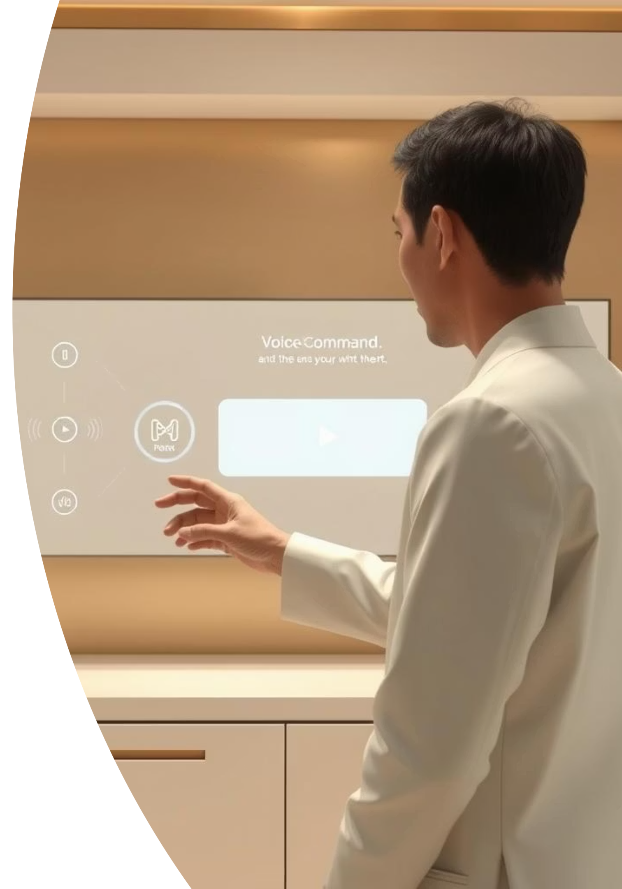
CODE DEEP DIVE
Core Code Logic: Voice Toggle
// Logic to manage hands-free mode if (!isVoiceMode) { isVoiceMode = true; speakCurrentStep(); // App speaks } else { isVoiceMode = false; tts.stop(); // App stops speaking }
This critical code snippet governs the activation and deactivation of the voice command system. It ensures that the application responds appropriately to user input, providing a seamless transition between voice-guided and manual modes, maintaining user control throughout the cooking process.

Slide 9

RELIABILITY
Offline Access & Data Persistence
Automatic Saving
Enhanced Accessibility
AI responses are parsed to extract dish names and automatically saved as .txt files.
Ensures recipes remain accessible even if internet connectivity is lost in the kitchen.
User Convenience
Users can review and listen to previously saved recipes without interruption.

Slide 10

SUMMARY & FUTURE
Conclusion & Future Directions
The Smart Recipe Assistant bridges the gap between digital technology and practical kitchen utility, offering an innovative solution for modern cooking.
Summary
Future Work
A seamless integration of AI and voice control for an effortless cooking experience.
Planned enhancements include support for additional languages (e.g., Urdu) and advanced meal planning features.
Explore the project and contribute:

