Slide 1

Analyzing Amazon
Sales data
Multinational Technology company

Slide 2

About Company
Amazon is one of the leading E-commerce platform where users can buy millions of products from a lot of categories.
AMAZON

Slide 3







The Problems
To find yearly total sales and trend sales
To find which mode of channel generated maximum sales and bestseller Item type
To find which order priority gave highest sales
To calculate total sales, total profit, average profit margin and average unit price
To find sales trend in month-wise & yearly month-wise
To find the number of units sold of a particular item type
To find total sales and total profit by region
AMAZON

Slide 4





The Process
Data Collection
Data Cleaning
Data Analysis
Insights
Summary
The process of gathering and analyzing accurate data from various sources
Data cleaning is the process of fixing or removing incorrect, corrupted, incorrectly formatted or duplicate within a dataset.
The process of cleaning, analyzing, interpreting, and visualizing data using various techniques and business intelligence tools.
Data insights refers to the deep understanding an individual or organization gains from analyzing information on a particular issue.
A data analyst is an individual who gathers, analyzes and interprets data to solve various business problems.
AMAZON

Slide 5

Data Collection
The Data has been collected in the form of a CSV file named “Amazon Sales Data.csv”.
The CSV file has the data of sales of products during the timespan of 2010 and 2017.
AMAZON

Slide 6
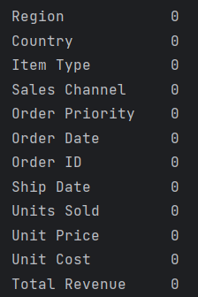
Data Cleaning
There were no Null values or blank fields.
Some values in ‘Order Date’ and ‘Ship Date’ columns are in String datatype. So we converted them to datetime datatype using excel.
Most of the values in ‘Total Revenue’, ‘Total Cost’ and ‘Total Profit’ columns are written with two decimal places, so we make sure that each value in these columns have two decimal places by using Excel.
AMAZON

Slide 7
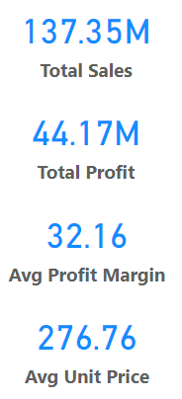
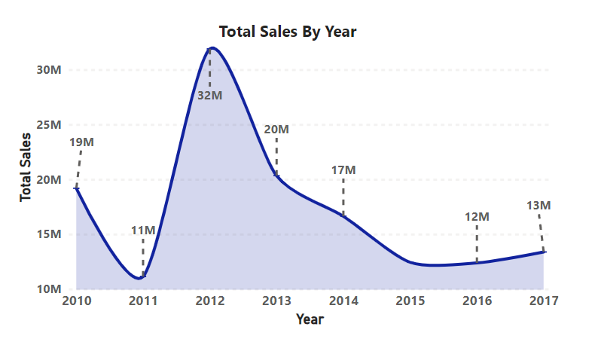
Data Analysis
AMAZON

Slide 8
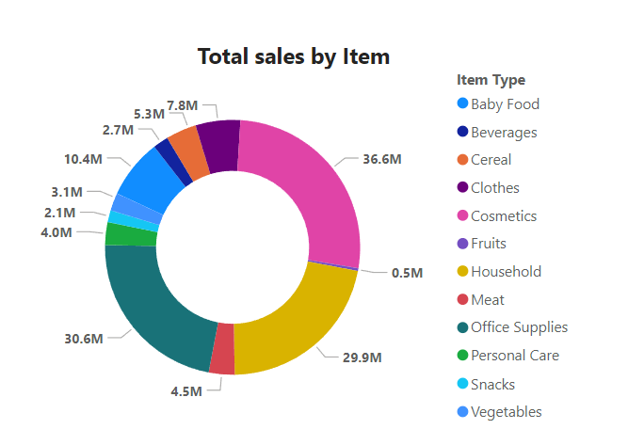
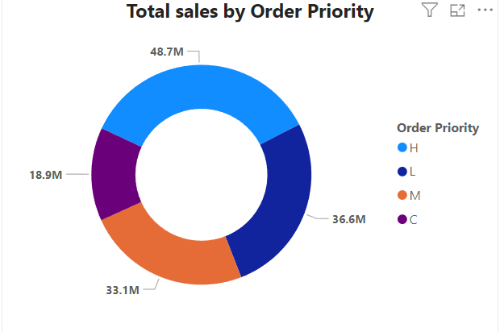
Data Analysis
AMAZON

Slide 9
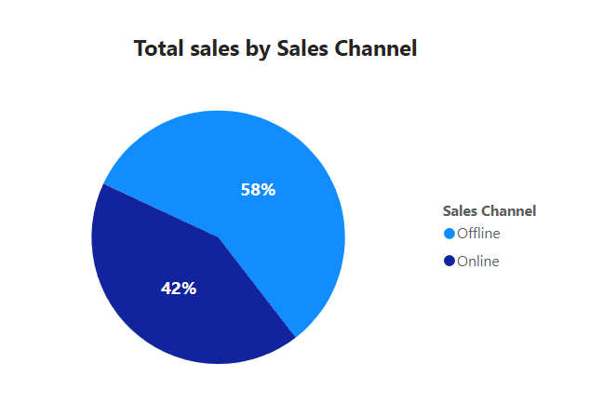
Data Analysis
AMAZON

Slide 10
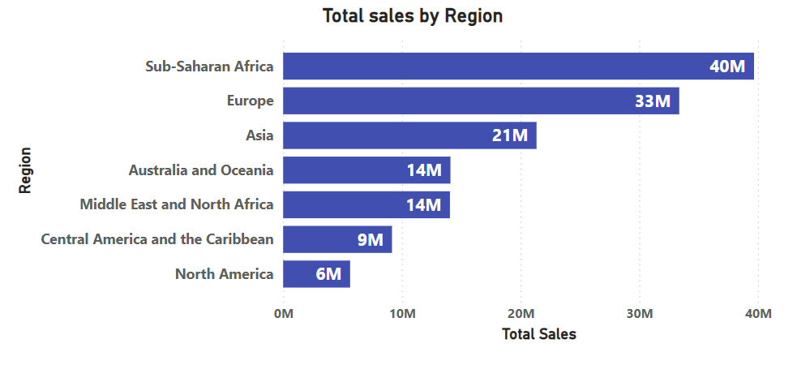
Data Analysis
AMAZON

Slide 11
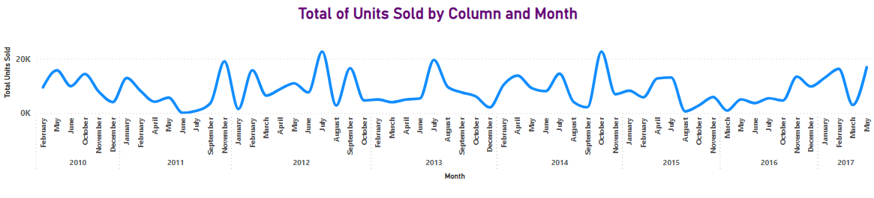
Data Analysis
AMAZON

Slide 12
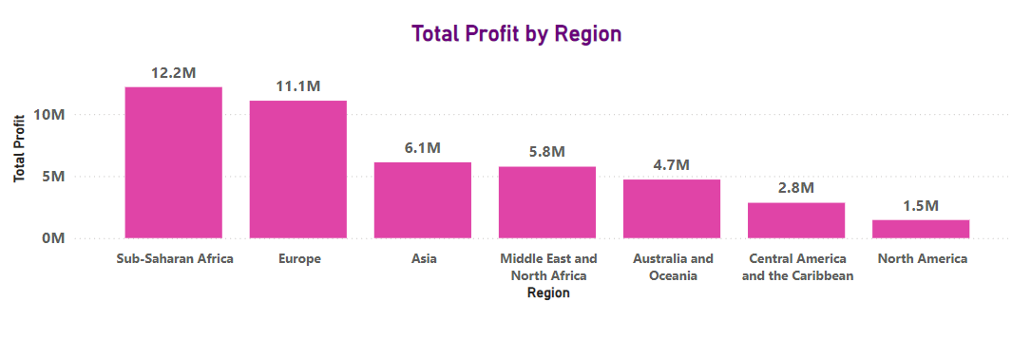
Data Analysis
AMAZON

Slide 13
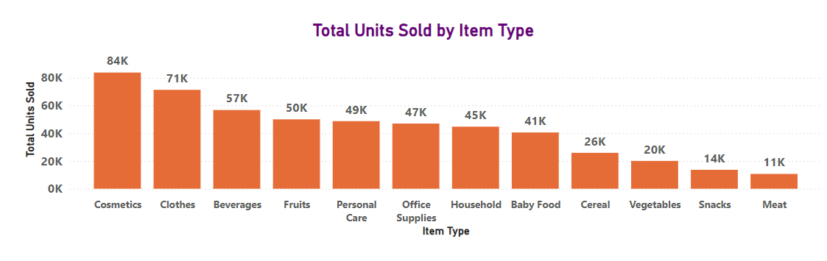
Data Analysis
AMAZON

Slide 14
Insights
The total sales is $137.35 million out of which total profit is $44.17 million.
The average profit margin and unit price is $32.16 and $276.76 respectively.
The “H” order priority gave the highest sales, which means people need their products fast.
“Cosmetics” products gave the highest sales.
Majority of people still prefer “Offline Channel” for buying products.
The year 2012 has seen the highest sales
The Sub-Saharan Africa region has seen the highest sales
AMAZON

Slide 15

Summary
1. Fruits :
- Least profit ($120.50 thousand).
- Understand customer needs, adjust prices, and analyze local preferences.
2. Meat :
- Least sold (11 thousand units) in Australia, Oceania, and Sub-Saharan Africa through online channels.
- Consider selling different types and adjusting prices.
3. Household Items and Cosmetic Products :
- Most sold through offline and online channels, respectively.
- Enhance physical stores with displays and promotions for Household Items.
- Improve website and run targeted ads for Cosmetic products.
AMAZON

Slide 16
Summary
4. Europe :
- Highest profit from Cosmetic products ($14.56 million).
- Promote Cosmetic products through marketing campaigns.
- Second most purchased item is Baby Food, indicating many newlywed couples.
- Suggest promoting baby-related products.
5. North America :
- Prefer offline shopping, but high profits are from online sales.
- Recommend promoting products online.
- Least profit from Personal Care and Household Items through offline channels.
- Promote other products online with discounts.
- Survey local preferences.
6. Sub-Saharan Africa :
- Highest profit from Fruit sales (approx. 31,000 units sold).
- Emphasize health benefits of fruits in marketing campaigns.
- Align marketing with local preferences.
AMAZON

Slide 17



Thank You
Vishal Moruya
+91 8860176199
vishalmorya52@gmail.com
AMAZON

