Slide 1
Human Detection and Tracking Phase 0 – Design and methodology
Vishaal Sivakumar, Sahruday patti

Slide 2
ABOUT US
We are two graduate students from UMCP doing master’s in robotics who want to empower organizations by using our creativity and skills in robotics and deliver products that make a difference.

Slide 3
PROBLEM
Organization
Acme Robotics
TASK
Human Detection and Tracking in real time

Slide 4
SOLUTION
Detection
Tracking
Deep learning models have emerged to be capable of detecting objects.
YOLO
Hungarian algorithm – simple and efficient
Transformation
Real Time
Camera Intrinsics and extrinsics provide us the 3D location of humans in the frame
Simple Design and efficient methods

Slide 5
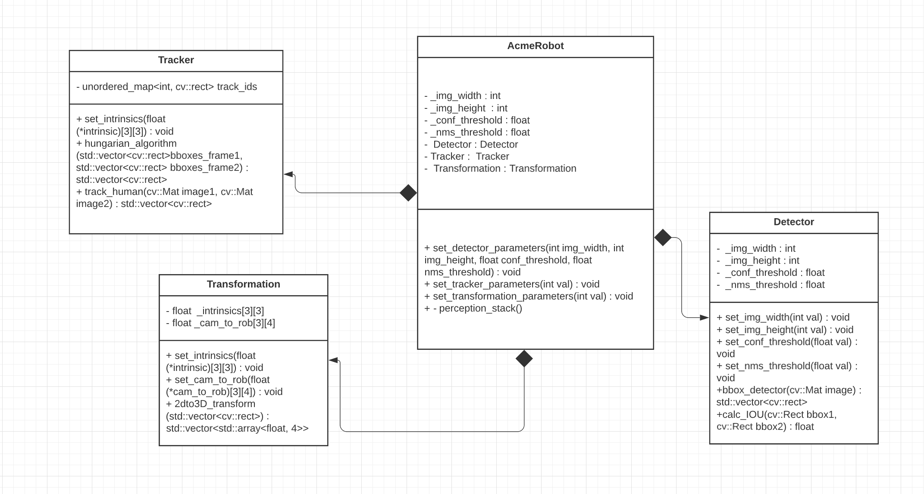
Design

Slide 6
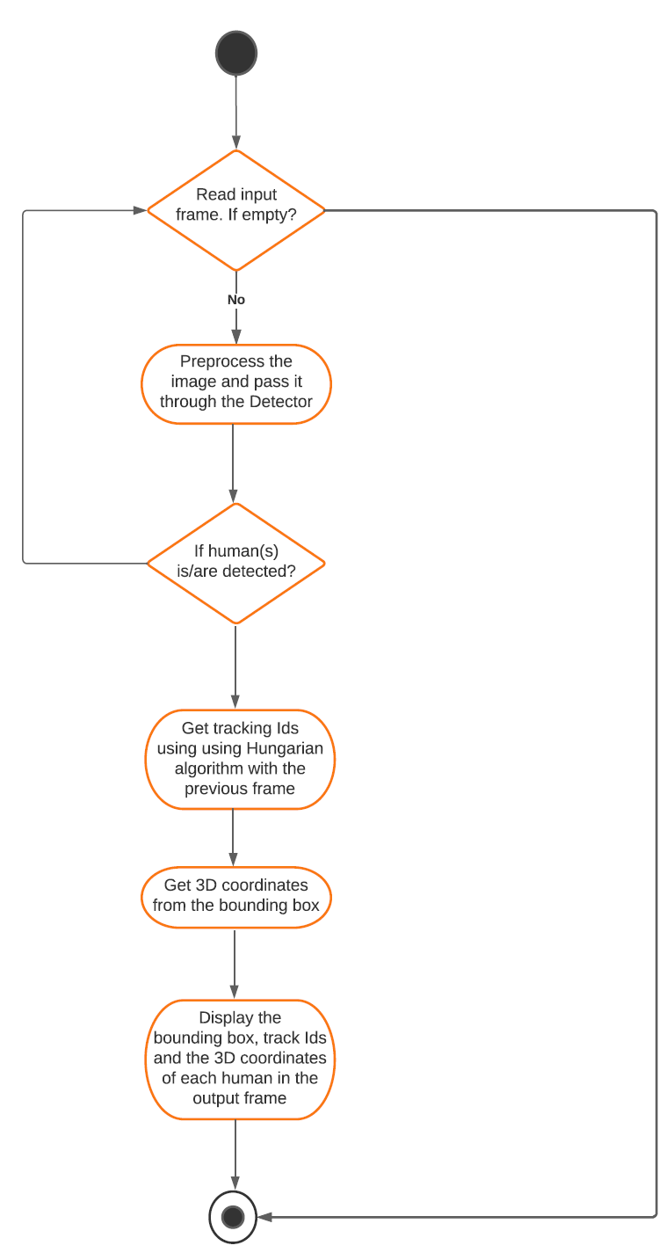
METHODOLOGY

Slide 7
ACTION PLAN
Sprint planning
Tracking Module
Initial Protoype
Iteration for improvements complete
2022
10/12
10/13
10/13
10/14
10/15
10/18
10/19
10/20
10/21
10/24
10/25
10/26
2022
10/12
10/13
10/13
10/14
10/15
10/18
10/19
10/20
10/21
10/24
10/25
10/26
Proposal
Detection Module
Transformation
Phase 1 implementation
Phase2 and completion

Slide 8
THANK YOU
Sahruday Patti
sahruday@umd.edu
Vishaal Sivakumar​
vishaal@umd.edu

