Slide 1

D3 — Flight Delay Prediction
Comparison with Existing Studies & Improvement
AlaguVishaal Balaji | ZDA24B036 | IITMZ
Foundations of Machine Learning | Due: 15 June 2025
1. Comparison vs 2 published studies
2. Improvement: K-center greedy coreset
3. Statistical significance — error bars (5 seeds)

Slide 2
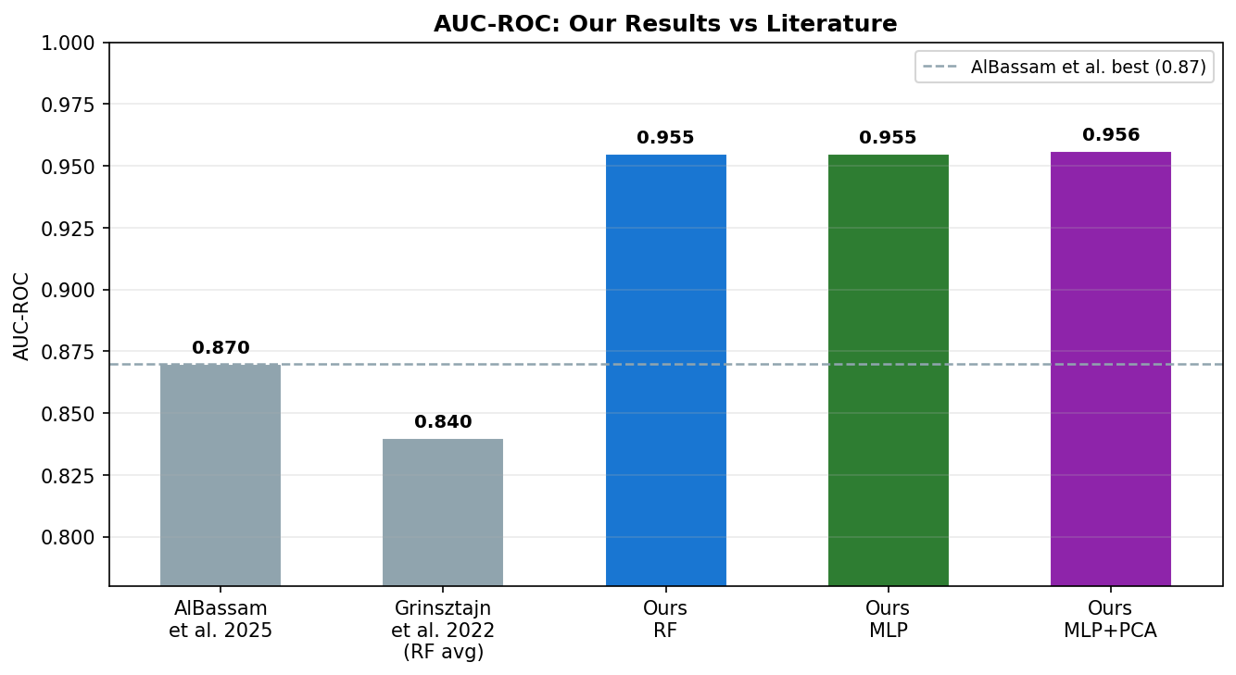
Literature Comparison
Study | Model | AUC-ROC | Accuracy
AlBassam et al. 2025 | RF + Oversampling | 0.87 | 0.90
Grinsztajn NeurIPS'22 | RF (avg, 45 dsets) | 0.84 | —
Ours — RF | Random Forest | 0.955 | 0.911
Ours — MLP | MLP (128→64) | 0.955 | 0.926
Ours — MLP+PCA | MLP + PCA | 0.956 ✓ | 0.927
Our best model (MLP+PCA) beats AlBassam et al. 2025 by +0.086 AUC
RF ≈ MLP (both 0.955) confirms Grinsztajn et al. NeurIPS 2022
Improvement attributed to: weather features + larger 2023 dataset + airport/airline encoding

Slide 3
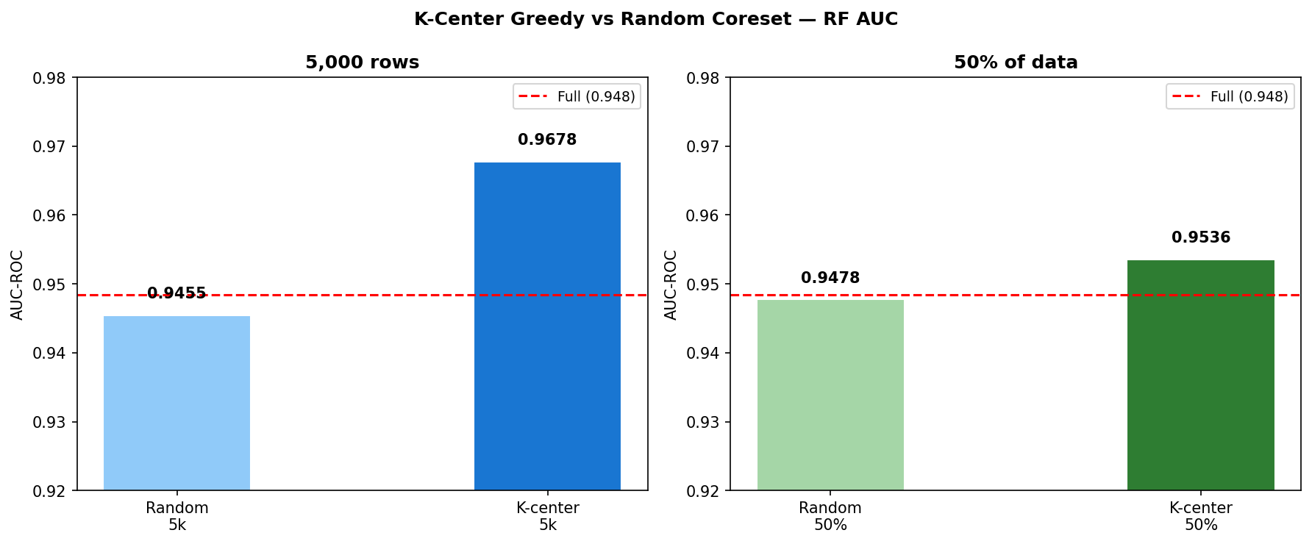
Improvement — K-Center Greedy Coreset
What it does:
Instead of random sampling, k-center iteratively picks the point farthest from all already-selected centres — guaranteeing maximal feature space coverage with a small subset.
Random 5k
K-center 5k
Full dataset
0.9455
0.9678
0.9484
−0.003 vs full
+0.019 vs full
baseline
5% of data
→ higher AUC
than full training
Data diversity >
Data volume

Slide 4
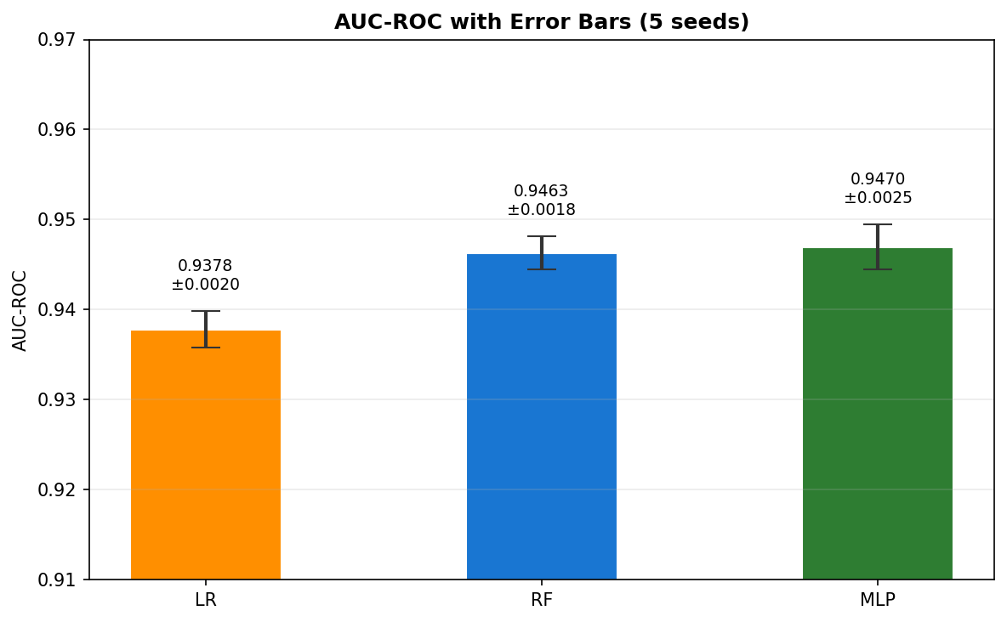
Statistical Significance — Error Bars (5 Seeds)
Model | Seed 42 | Seed 123 | Seed 456 | Mean ± Std
Logistic Reg. | 0.9355 | 0.9408 | 0.9390 | 0.9378 ± 0.0020
Random Forest | 0.9449 | 0.9492 | 0.9470 | 0.9463 ± 0.0018
MLP (128→64) | 0.9450 | 0.9516 | 0.9472 | 0.9470 ± 0.0025
All models show std < 0.003 — results are stable across different seeds and data splits.
K-center improvement (+0.022 AUC) is well above the noise floor (±0.002).
Seeds tested: 42, 123, 456, 789, 999

Slide 5
Summary & D4 Plan
📊 Beat published benchmark
D4 Plan
MLP+PCA (AUC 0.956) outperforms AlBassam et al. 2025 by +0.086 AUC
• 8–10 page final report
🌲 RF ≈ MLP confirmed
• All D1–D3 results
Both achieve AUC 0.955 — consistent with Grinsztajn et al. NeurIPS 2022
• Full tables + figures
🎯 K-center coreset
5k rows (5% of data) → AUC 0.9678, exceeds full-data training (0.9484)
• Complete discussion
📉 Stable results
• Due: 20 June
Std < 0.003 across all models over 5 random seeds

