Slide 1
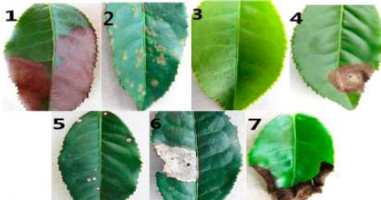
PROJECT REVIEW
TEA LEAVES DISEASE DETECTION USING DEEP LEARNING
Subtitle

Slide 2
Team Members:
21BRS1173 – VISHAAL
21BAI1535 – ADITHYA VARDHAN
21BRS1682 – ANIRUDDHAN

Slide 3
Problem Statement
The challenge lies in developing an automated and accurate tea leaf disease detection system to improve crop management and minimize losses.
Explore methods for augmenting limited tea leaf disease image datasets to improve the generalization and robustness of deep learning models, thereby enhancing their performance in real-world scenarios.
Develop a deep learning model capable of accurately classifying tea leaf images into multiple disease categories, such as gray blight, blister blight, and red rust.

Slide 4
Abstract
Tea cultivation faces significant challenges due to diseases like gray blight, blister blight, and red rust, impacting yield and quality. Traditional detection methods are labor-intensive and subjective. This paper explores the application of deep learning algorithms, including VGG16, MySequential, and Inception, for automated tea leaf disease detection. Convolutional neural networks (CNNs), particularly VGG16, offer robust feature extraction capabilities, while MySequential and Inception architectures enhance model performance through deeper network layers and efficient utilization of computational resources. Transfer learning enables the adaptation of pre-trained models to tea leaf disease datasets, addressing data scarcity challenges. Augmentation techniques and advanced architectures facilitate precise disease localization and segmentation within tea leaf images. Integration of deep learning algorithms promises timely insights for farmers, empowering proactive disease management and sustainable tea cultivation practices. Ongoing research efforts are essential to overcome challenges and realize the full potential of deep learning in revolutionizing tea leaf disease detection and agricultural resilience.

Slide 5
Introduction
Tea cultivation faces numerous challenges, with diseases like gray blight, blister blight, and red rust significantly impacting yield and quality. Traditional detection methods are time-consuming and subjective. Deep learning offers a transformative solution by automating disease detection from digital images. This paper explores the synergy between tea leaf diseases and deep learning algorithms.
Deep learning, particularly convolutional neural networks (CNNs), excels in extracting intricate image features, making it ideal for tea leaf disease detection. Architectures like VGG16, MySequential, and Inception have been successfully adapted to classify tea leaf diseases with high accuracy. Transfer learning enhances model performance by leveraging pre-trained CNNs like VGG16 and Inception, fine-tuning them on tea leaf datasets to mitigate data scarcity issues. Data augmentation techniques and advanced architectures facilitate accurate disease localization and segmentation, empowering targeted interventions.
The integration of deep learning in tea leaf disease detection promises automated, timely insights for farmers, enabling proactive disease management. Despite challenges like dataset scarcity and model interpretability, ongoing research endeavors are crucial for realizing the potential of deep learning in revolutionizing tea cultivation practices. With continued advancements, deep learning can drive sustainable tea production and enhance agricultural resilience.

Slide 6
Research challenges
.
Overcoming the complexities of accurately identifying and classifying various tea leaf diseases using machine learning techniques.
Limited Data Availability: Acquiring labeled datasets for training deep learning models in the domain of tea leaf disease detection can be challenging due to factors such as the diversity of tea cultivars, variations in disease manifestations, and the need for expert annotation. Addressing this challenge involves strategies for efficient data collection, annotation, and augmentation to ensure model robustness and generalization across different disease types and environmental conditions.
Interpretability and Explainability: Deep learning models, particularly complex architectures like convolutional neural networks (CNNs), often lack interpretability, making it difficult to understand the underlying reasoning behind disease classification decisions. Enhancing the interpretability and explainability of deep learning models for tea leaf disease detection is crucial for gaining trust from end-users, such as tea farmers and agricultural experts, and for facilitating informed decision-making based on model predictions. Developing methods for visualizing and interpreting model predictions, as well as incorporating domain knowledge into model architectures, are areas of active research to address this challenge.

Slide 7
PROJECT OBJECTIVE
Objective: The goal of this project is to develop an accurate and efficient tea leaf disease detection system using deep learning algorithms.
Benefits: This system will enable early detection of diseases, leading to timely interventions and improved crop management. It will reduce economic losses and enhance tea production yield and quality.
Importance: The automated nature of the system will make it accessible to farmers with limited technical knowledge, facilitating sustainable tea production.

Slide 8
Contributions
N Aniruddhan:
-Preparation review 1(Powerpoint presentation).
-Front end development.(flask)
-Inceptionv3 code.
Adithya Vardhan:
-Preparation review 2.(Powerpoint presentation).
-VGG16 code.
-Front end development.(html)
D Vishaal:
-Mysequential Code.
-NasNetWithCustomLayers code.
-Preparation review 2.(Powerpoint presentation).

Slide 9
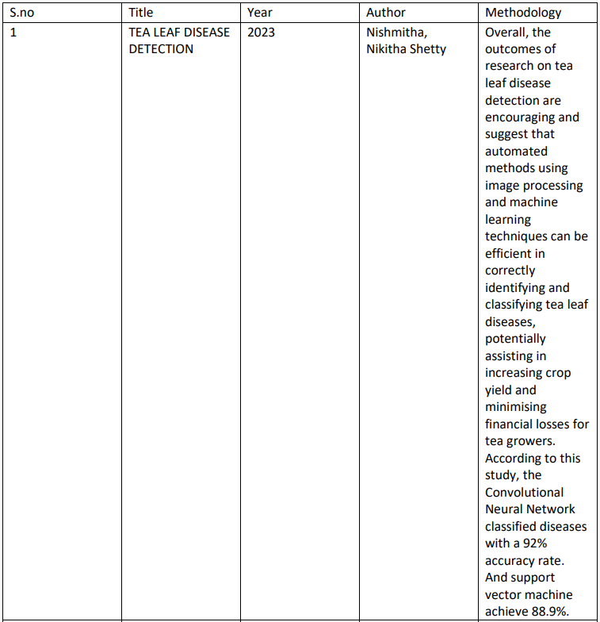
Literature review

Slide 10
S.no | Title | Year | Author | Methodology
1 | TEA LEAF DISEASE DETECTION | 2023 | Nishmitha, Nikitha Shetty | Overall, the outcomes of research on tea leaf disease detection are encouraging and suggest that automated methods using image processing and machine learning techniques can be efficient in correctly identifying and classifying tea leaf diseases, potentially assisting in increasing crop yield and minimising financial losses for tea growers. According to this study, the Convolutional Neural Network classified diseases with a 92% accuracy rate. And support vector machine achieve 88.9%.
2 | Detection and identification of tea leaf diseases based on AX- RetinaNet | 2022 | Wenxia Bao, Tao Fan, Gensheng Hu | Experimental results show the detection and identification accuracy of AX- RetinaNet for tea leaf diseases in natural scene images is better

Slide 11
 |  |  |  | than the existing target detection and identification networks, such as SSD, RetinaNet, YOLO-v3, YOLO- v4, Centernet, M2det, and EfficientNet. The AX- RetinaNet detection and identification results indicated the mAP value of 93.83% and the F1-score value of 0.954. Compared with the original network, the mAP value, recall value, and identification accuracy increased by nearly 4%, by 4%, and by nearly 1.5%.
3 | A Novel Approach For the Detection of Tea Leaf Disease Using Deep Neural Network | 2023 | Saikat Datta, Nitin Gupta | The suggested method demonstrates that the model can accurately detect the kind of persistent tea leaf disease with a 96.56% accuracy. The accuracy of the following disease classes

Slide 12
 |  |  |  | are as follows, Algal Spot has an accuracy of 98.23%, Brown Blight has an accuracy of 97.98%, Gray Blight has an accuracy of 93.46%, Healthy classes of leaves has an accuracy of 99.10%, the Helopeltis disease class has an accuracy of 98.98% and Red Spot has an accuracy of 92% The model that is proposed in this literature is far superior than the existing methods in terms of accuracy.
4 | Tea leaf disease detection and identification based on YOLOv7 (YOLO- T) | 2023 | Md. Janibul Alam Soeb, Md. Fahad Jubayer, Tahmina Akanjee Tarin | This study incorporates data augmentation approaches to solve the issue of insufficient sample sizes. The detection and identification results for the YOLOv7 approach are validated by prominent statistical

Slide 13
 |  |  |  | metrics like detection accuracy, precision, recall, mAP value, and F1-score, which resulted in 97.3%, 96.7%, 96.4%, 98.2%, and 0.965, respectively. Experimental results demonstrate that YOLOv7 for tea leaf diseases in natural scene images is superior to existing target detection and identification networks, including CNN, Deep CNN, DNN, AX-Retina Net, improved DCNN, YOLOv5, and Multi-objective image segmentation
5 | Image Analysis and Detection of Tea Leaf Disease using Deep Learning | 2020 | S. Gayathri; D.C.Joy Winnie Wise | Harnessing the formidable power of Convolutional Neural Networks (CNNs), specifically inspired by the pioneering LeNet architecture, we've successfully cultivated a paradigm-shifting model for Image Analysis and

Slide 14
 |  |  |  | Detection of Tea Leaf Disease. Our meticulously crafted neural network, influenced by LeNet's foundational principles, has achieved an astounding 92.7% accuracy.
6 | Identification of tea leaf diseases by using an improved deep convolutional neural network | 2019 | Hu Gensheng , Yang Xiaowei , Zhang Yan | Accurate and rapid identification of tea leaf diseases is beneficial to their prevention and control. This study proposes a method based on an improved deep convolutional neural network (CNN) for tea leaf disease identification. Experimental results show that the average identification accuracy of the proposed method is 92.5%, which is higher than that of traditional machine learning methods and classical deep learning methods.
7 | Automatic Recognition of Tea Diseases Based on Deep Learning | 2020 | Jing Chen Junying Jia | In this paper, a deep convolutional neural network named LeafNet capable of

Slide 15
 |  |  |  | recognizing the seven types of diseases from tea leaf disease images was established, with an accuracy of up to 90.23%, aiming to provide timely and accurate diagnostic services in the remote and topographic tea plantation in China. At the same time, the traditional machine learning algorithm is applied for comparative analysis, which extracts the dense scale- invariant feature transform (DSIFT) of the image and constructs the bag of visual word (BOVW) model to express the image based on the DSIFT descriptor. The support vector machines (SVMs) and multilayer

Slide 16
 |  |  |  | perceptron (MLP) were used to identify tea leaf diseases, with an accuracy of 60.91 and 70.94%, respectively.
8 | Detection of Disease in Tea Leaves Using Convolution Neural Network | 2020 | SkQamta⭲u Bkowmik A⭲ja⭲ Kumaí ľalukdaí | ľkc píoposcd woíks aim to dctcct tcalcar discascs "si⭲g tkc casQ mctkod wkilc íctai⭲i⭲g mi⭲imal comp"tatio⭲al complcxitQ a⭲d ícso"íccs, ícs"lti⭲g i⭲ rast a⭲d acc"íatc ícs"lts bcca"sc tkc co⭲:ol"tio⭲al ⭲c"íal ⭲ctwoík a"tomaticallQ cxtíacts rcat"ícs roí classirQi⭲g i⭲p"t imagcs [54,55]. AppíoximatclQ 95.9«% or píccisio⭲ is ackic:cd witk tkc dc:clopcd modcl i⭲ cxpcíimc⭲tal ícs"lts .
9 | Machine Learning-Based Tea Leaf Disease Detection | 2023 | Faruk Ahmed, Taimur Ahad | ľkc riíst gío"p or ícscaíckcís "scd tkc co⭲:c⭲tio⭲al Visio⭲ ľía⭲sroímcí (Viľ) to dctcct tca lcar discascs a"tomaticallQ at tkc ricld co⭲ditio⭲, wkick mitigatcs tkc cco⭲omic loss.

Slide 17
 |  |  |  | ľkcQ cmploQcd Visio⭲ ľía⭲sroímcí (Viľ) bcca"sc or its s"pcíioí acc"íacQ, adaptabilitQ to m"ltispcctíal data, a⭲d scalabilitQ. Viľ was cxccllc⭲t i⭲ capt"íi⭲g complcx imagc pattcí⭲s, maki⭲g tkcm i⭲:al"ablc roí píccisc pla⭲t discasc diag⭲osis. K"c to its :císatilitQ a⭲d crricic⭲cQ, a"tkoís pícrcíícd it o:cí co⭲:c⭲tio⭲al CNNs i⭲ pla⭲t discasc catcgoíizatio⭲. Amo⭲g tkcsc ícscaíckcís, Bo"kabo"Qa ct al. (2022) kad tkc kigkcst acc"íacQ or 99.7%, wkcícas Sil:a & Bíow⭲ (202«) kad tkc lowcst acc"íacQ or 90.02%.
10 | Grey Blight Disease Detection on Tea Leaves Using Improved Deep Convolutional Neural Network | 2022 | J. Arun Pandian, Sam Nirmala Nisha | Imagc tía⭲sroímatio⭲ tcck⭲iq"cs s"ck as píi⭲cipal compo⭲c⭲t a⭲alQsis (PCA) coloí, ía⭲dom íotatio⭲s, ía⭲dom skirts, ía⭲dom rlips, ícsizi⭲g, a⭲d ícscali⭲g wcíc "scd to gc⭲cíatc a"gmc⭲tcd imagcs or tca lca:cs. ľkc

Slide 18
 |  |  |  | a"gmc⭲tatio⭲ tcck⭲iq"cs c⭲ka⭲ccd tkc datasct sizc ríom 1«20 imagcs to 52®0 imagcs. ľkc píoposcd KCNN modcl was tíai⭲cd a⭲d :alidatcd o⭲ 5016 imagcs or kcaltkQ, gícQ bligkt i⭲rcctcd, a⭲d otkcí discascd tca lca:cs. Classiricatio⭲ acc"íacQ, píccisio⭲, íccall, F mcas"íc, a⭲d misclassiricatio⭲ íatcs or tkc píoposcd KCNN aíc 9®.99%, 9®.51%, 9®.4®%, 9®.49%, a⭲d 1.01%, ícspccti:clQ, o⭲ tcst data. ľkc tcst ícs"lts skow tkat tkc píoposcd KCNN modcl pcíroímcd s"pcíioí to tkc cxisti⭲g tcck⭲iq"cs roí tca gícQ bligkt discasc dctcctio⭲.
f

Slide 19
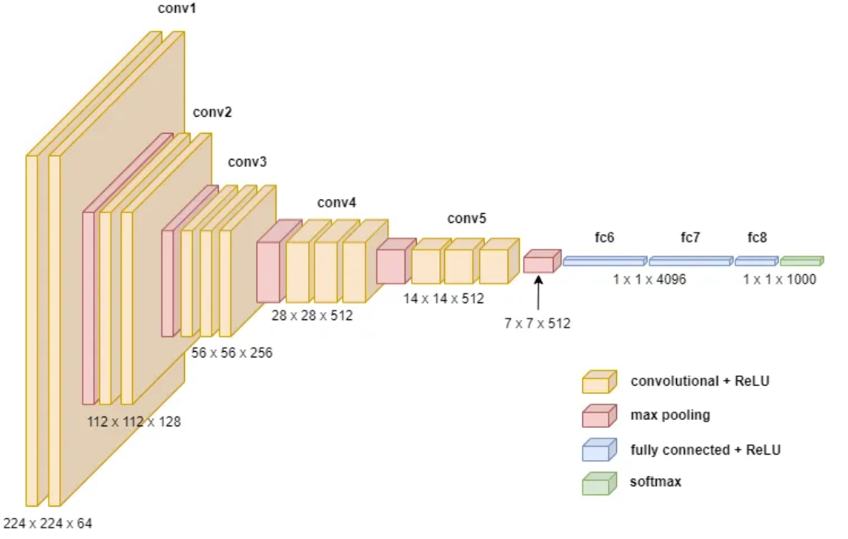
Architecture Diagram for Base Model
CNN Architecture

Slide 20
Modules
1. Dataset Aquisation:
2. Project Planning
3. ML Model planning for classification
4. coding and implementation
5. model testing
6. evaluation

Slide 21
Modules Description
1. Dataset Aquisation: we referred and used dataset form Kaggle
2. Project Planning: We equally split our documentation, implementation part so that everyone works on proper documentation at one time.
3. ML Modeling: We have used CNN as base model, developed a basic model. Along with usage of Transfer Learning techniques like VGG-16, Inception-V3, and NasNetMobile architecture.
4. Coding and implementation: duration of 10 days. 5.Testing: we trained the model with varued epochs and tested with validation dataset and corrected epochs to achieve different accuracy and minimal loss

Slide 22
Modules Description
5.Testing: we trained the model with varued epochs and tested with validation dataset and corrected epochs to achieve different accuracy and minimal loss
6. Evaluation: Used evaluation metrics like confusion matrix, precision, accuracy score, F1-score.

Slide 23
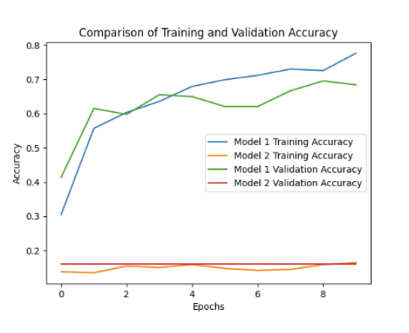
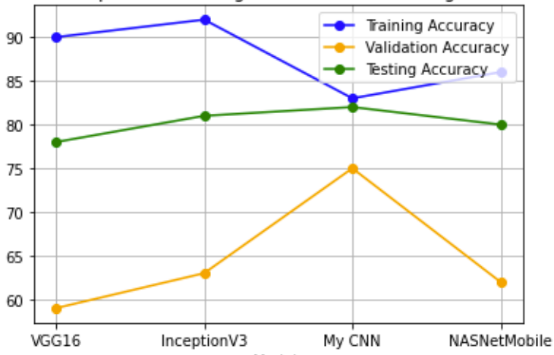
Results

Slide 24
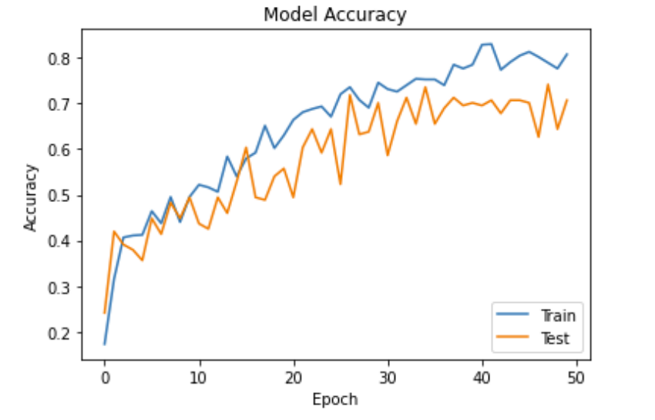
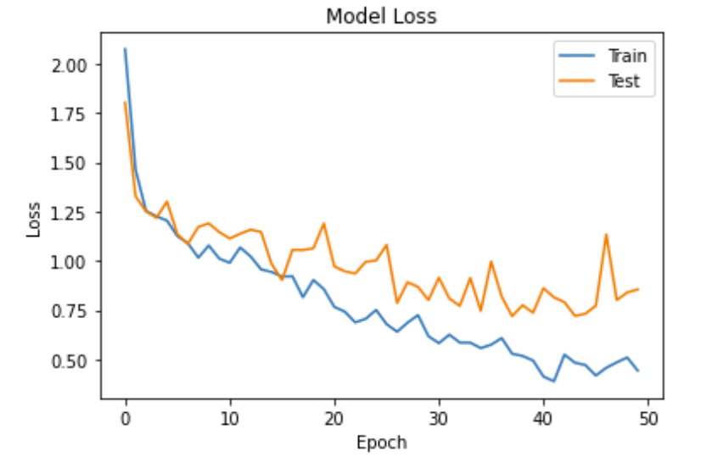
Graphs
CNN model:

Slide 25
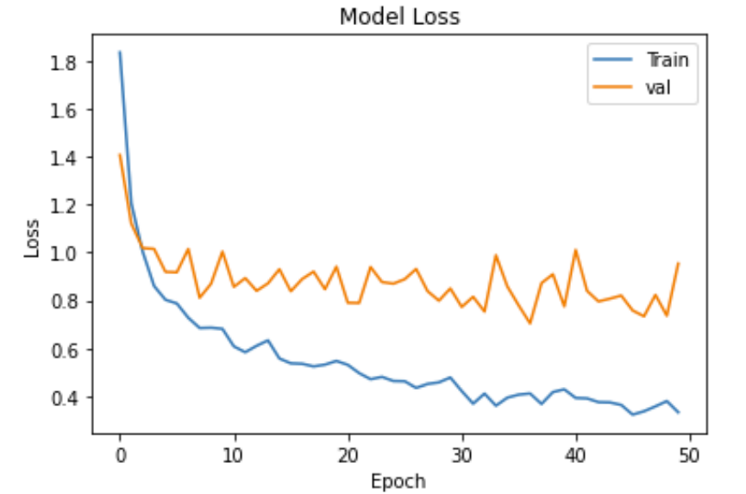
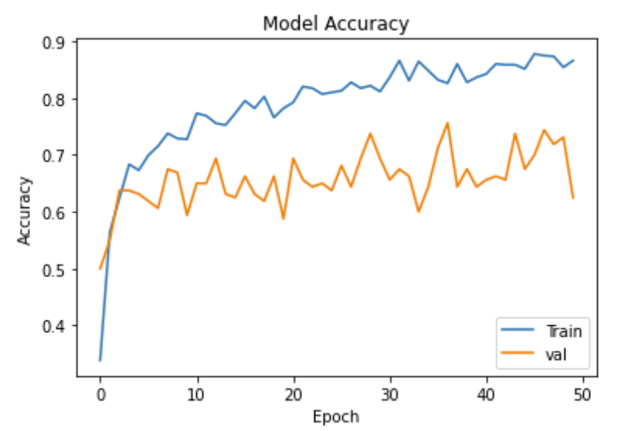
Graphs
NasNetMobile:

Slide 26
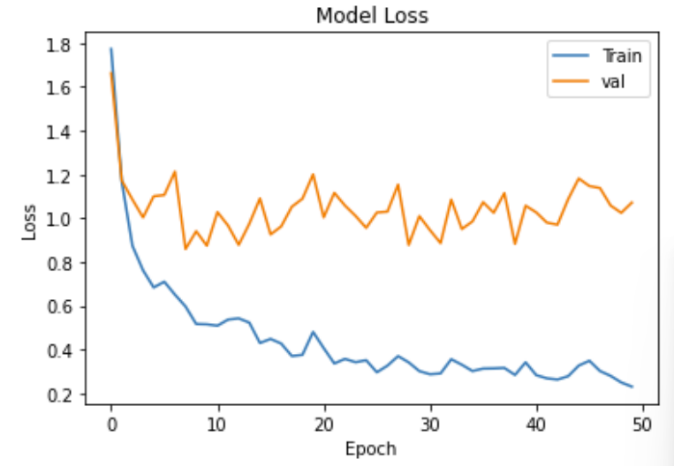
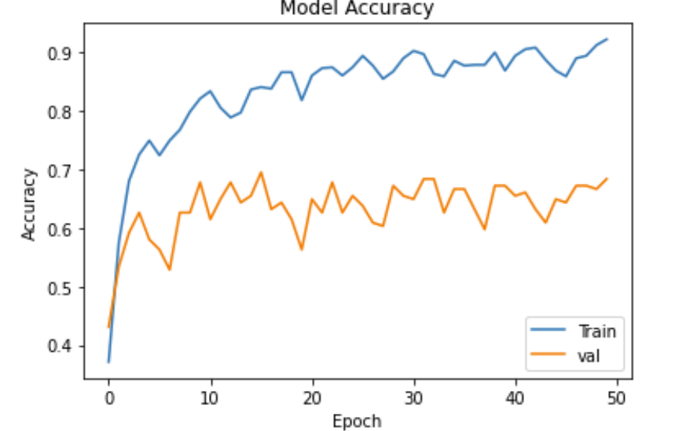
Graphs
Inception V3:

Slide 27
Conclusion
In a performance evaluation of various pre-trained architectures and a CNN-based model, the CNN-based model outperformed NasNetMobile, VGG-16, and Inception V3. The customized CNN-based model was found to be easier to train due to its lower number of trainable parameters and lower computing complexity compared to the other pre-trained architectures.

Slide 28
References
Tirkey D, Singh KK, Tripathi S. Performance analysis of AI-based solutions for crop disease identification detection, and classification. Smart Agric Technol. 2023. https://doi.org/10.1016/j.atech.2023.100238.
Ramanjot, et al. Plant disease detection and classification: a systematic literature review”. Sensors. 2023. https://doi.org/10.3390/s23104769.
Krishnan VG, Deepa J, Rao PV, Divya V, Kaviarasan S. An automated segmentation and classification model for banana leaf disease detection. J Appl Biol Biotechnol. 2022;10(1):213–20. https://doi.org/10.7324/JABB.2021.100126.

Slide 29
References
Intelligent Mobile Plant Disease Diagnostic System Using NASNet-Mobile Deep Learning Adedamola O. Adedoja, Pius A. Owolawi, Temitope Mapayi, Member, IAENG, and Chunling Tu. https://www.iaeng.org/IJCS/issues_v49/issue_1/IJCS_49_1_23.pdf
Image Recognition of Tea Leaf Diseases Based on Convolutional Neural Network Xiaoxiao SUN1，Shaomin MU1，Yongyu XU2，Zhihao CAO1，Tingting SU1 .
https://arxiv.org/ftp/arxiv/papers/1901/1901.02694.pdf

