Slide 1
TEAM TECHNO
Swetha Jayakumar
Vishaalee.O
Sherwin Vishaal.R
Selva Muthu Kumaran.S
Mentor: Deepa.R
St.Joseph’s College of Engineering,
Chennai

Slide 2

Energy Conservation

Slide 3
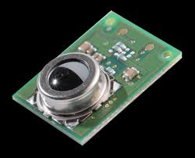
D6T
Thermal
Sensor

Slide 4
Objectives
To conserve energy
Home automation
To provide security(fire alarm,theft,etc)

Slide 5
Advantage
High accuracy
Network free
Compatible with IOT
Easy installation

Slide 6
Implementation

Slide 7
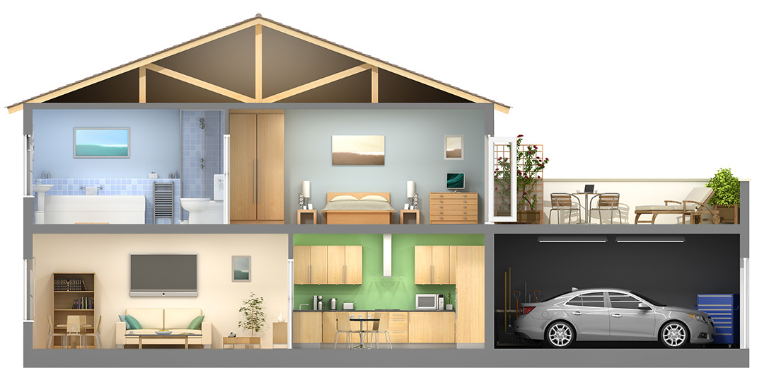
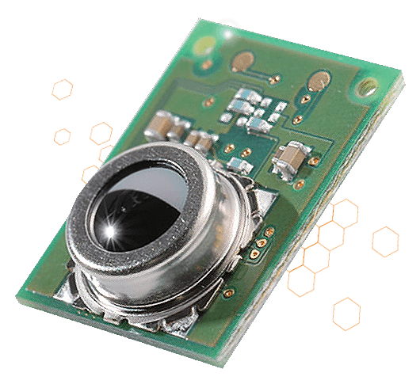
First we install D6T thermal sensor in your house.

Slide 8
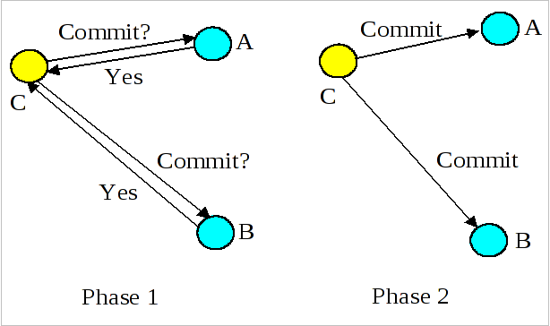
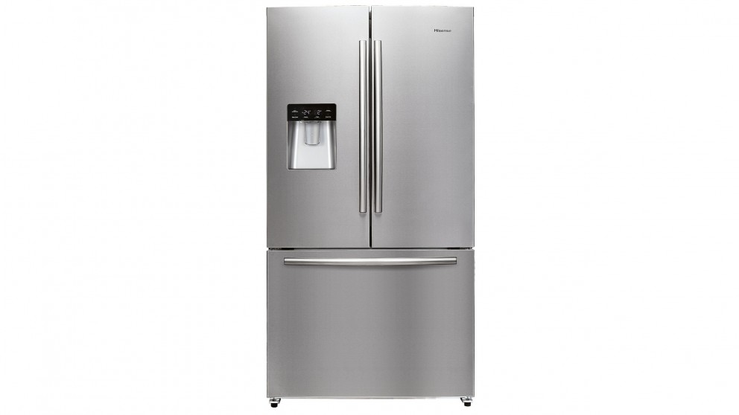
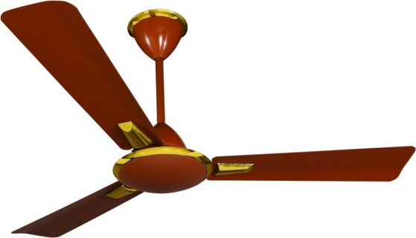
Appliances to be operated automatically will be connected to one phase with the sensor.
Appliances to be operated manually will be connected to another phase.

Slide 9


As long as there is a person in the room electrical appliances will stay on.

Slide 10


The sensor will continuously measure the heat radiated from the body and compare it with the room temperature.

Slide 11
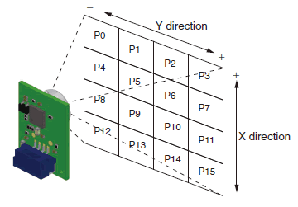
The sensor takes measurements as 16 inputs and produces a reference temperature which is compared with the current temperature measurements.
As long as there is a temperature difference the bulb will stay on.

Slide 12
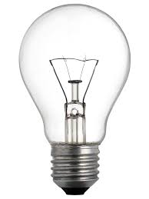
When the person leaves the room the temperature measured will decrease to room temperature.
Then the electrical appliances automatically turn off.

Slide 13
Temperature credentials
Normal body temperature is an oral temperature of 98.6°F (37°C).
This is an average of normal body temperatures.
Also, your normal temperature changes by as much as 1°F (0.6°C) during the day, depending on how active you are and the time of day.
In most adults, a fever is an oral temperature above 100.4°F (38°C) or a rectal or ear temperature above 101°F (38.3°C).
A child has a fever when his or her rectal temperature is 100.4°F (38°C) or higher.
For scientific work, room temperature is taken to be about 20 to 25 degrees Celsius with an average of 23 °C (about 73.4 degrees Fahrenheit (°F), 528 to 537 degrees Rankine (°R), or 293 to 298 Kelvins (K)).
Reference:
http://www.webmd.com/first-aid/body-temperature#1
https://simple.wikipedia.org/wiki/Room_temperature

Slide 14
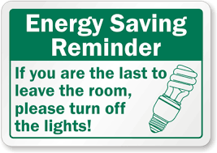
Hence people can leave the room without worrying about switching off appliances.
This ensures conservation of energy.

Slide 15
Future implementation
IOT
THERMAL IMAGING
Fire alarm

Slide 16

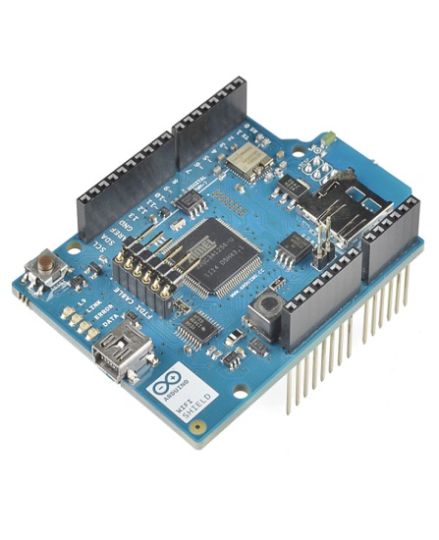
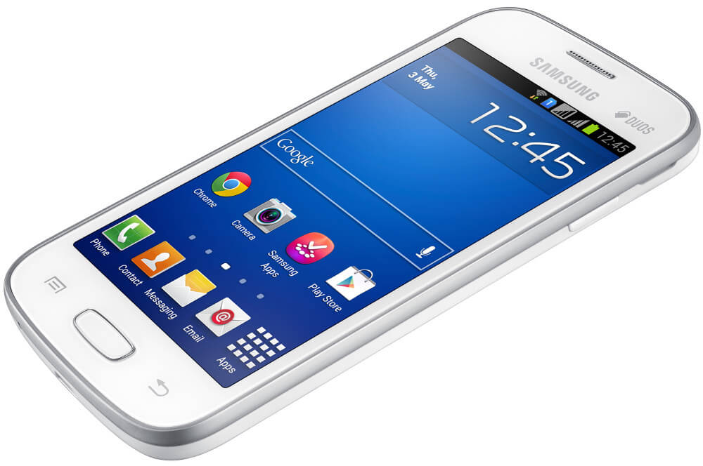

IOT
Can be connected with arduino wifi to operate with android mobiles using wifi

Slide 17
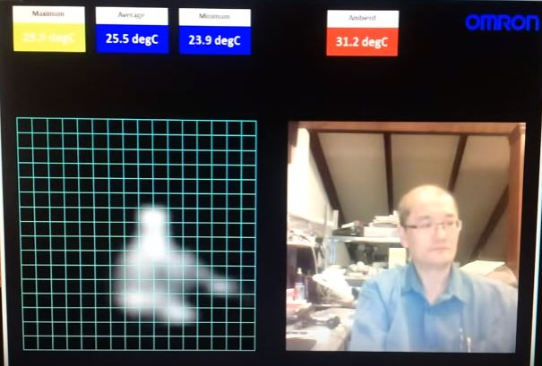
Thermal Imaging
Detect human presence and intimate the persons in the house ,thus ensuring safety.

Slide 18
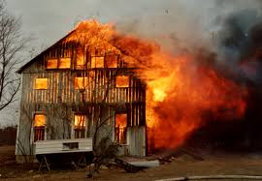
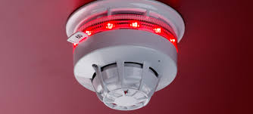
Fire alarm
Threshold temperature
200-600º c

Slide 19
CONCLUSION
Annual Energy Consumption
Year | Domestic | Commercial
2001-02 | 75629 | 22545
2002-03 | 79694 | 24139
2003-04 | 83355 | 25437
2004-05 | 89736 | 28201
2005-06 | 95660 | 31381
2006-07 | 100090 | 35965
2007-08 | 111002 | 40220
2008-09 | 120918 | 46685
2009-10 | 131720 | 54189
2010-11 | 146080 | 60600
2011-12 | 169326 | 67289
2012-13 | 171104 | 65381
2013-14 | 183700 | 72794
2014-15(P) | 198246 | 76968

Slide 20
CONCLUSION
Implementation of this project in wide range will decrease energy consumption to a greater extent ,thus resulting in low power consumption.

