Slide 1

Web scraping PROJECT to gain company insights and real world experience in analysis sentiments
Platform – Jupyter Notebooks

Slide 2
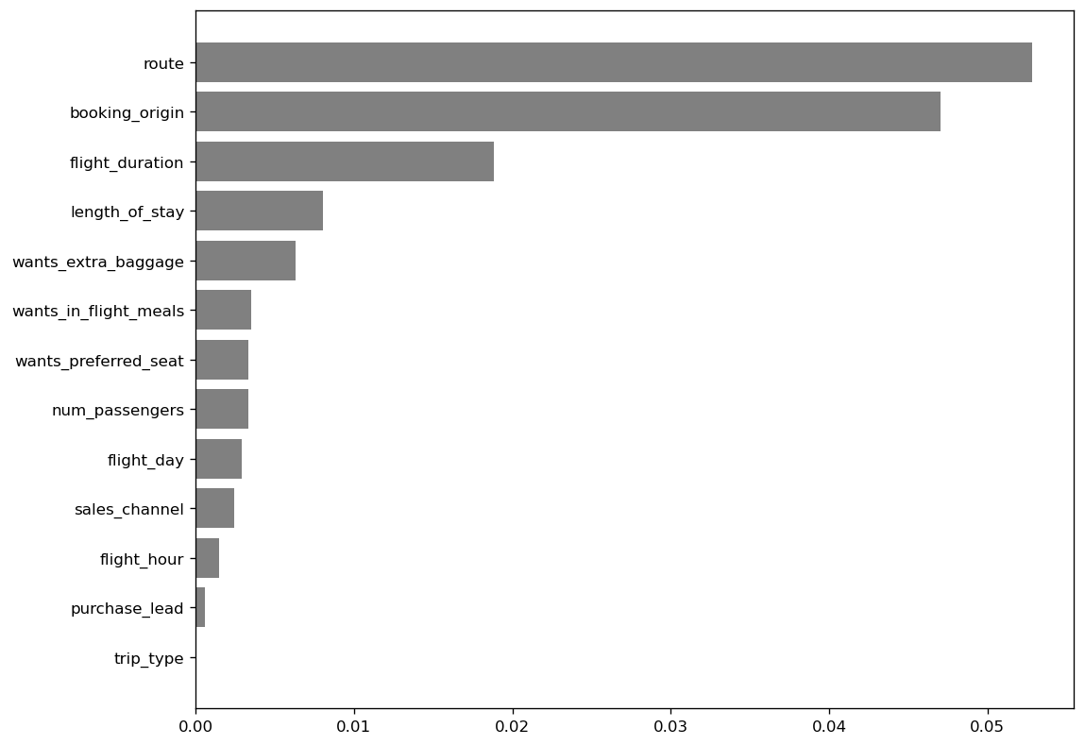
After training with Random forest classifier model the accuracy is 84.76 and the AUC score is 0.54
The top five features are -
route
booking_origin
flight_duration
length_of_stay
wants_extra_baggage
My suggestion is to increase the AUC score

