Slide 1
EMPLOYEE ATTRITION
Data Dragons
Rohit Reddy Ambati
Vishaal Sai Devisetty
Jahnavi Sanjana Patnala
Jahnavi Addula
Koushik Meesala
Context:
Employee attrition refers to the rate at which employees leave an organization over a specified period. High attrition rates can be costly for Businesses, leading to decreased productivity, increased recruitment costs, and loss of institutional knowledge.

Slide 2
Agenda
PROBLEM STATEMENT
Conclusion
Exploratory Data Analysis
Text
Mining
MODEL SELECTION
01
05
02
04
03

Slide 3

PROBLEM STATEMENT | Exploratory Data Analysis | MODEL SELECTION | Text Mining | Conclusion
The HR department of IBM is facing challenges related to employee attrition. The organization is experiencing higher-than-desired turnover rates, which are impacting overall performance and employee morale. To address this issue, the HR team has hired us, an external team of Data Analysts, to analyze the factors influencing employee attrition and also to find a way to determine the employees at risk of leaving the company.

Slide 4
DATA DESCRIPTION
PROBLEM STATEMENT | Exploratory Data Analysis | MODEL SELECTION | Text Mining | Conclusion
Total records - 1470
Total features - 36)
Numerical features - 27
Categorical Features - 9
Target Variable - Attrition

Slide 5
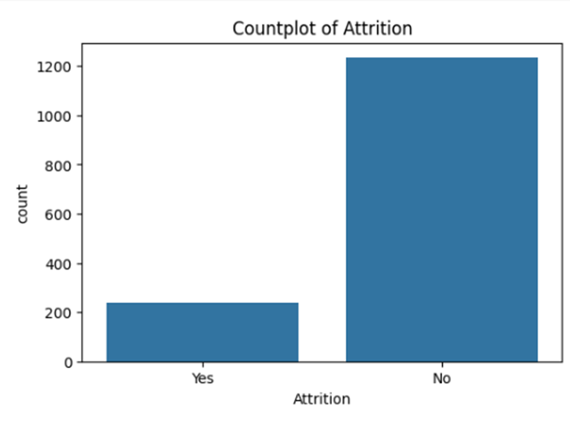
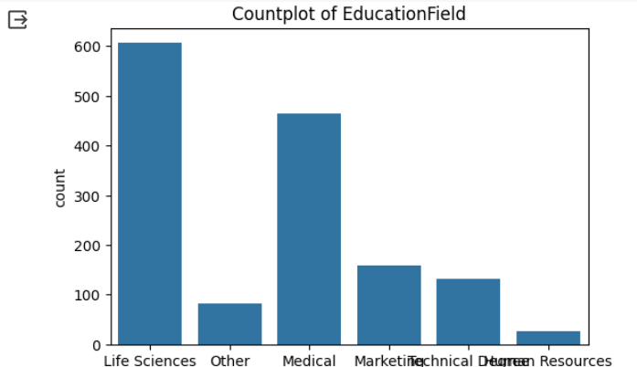
PROBLEM STATEMENT | Exploratory Data Analysis | MODEL SELECTION | Text Mining | Conclusion
Key Takeaway: The dataset is highly imbalance and is biased toward attrition = ‘NO’

Slide 6
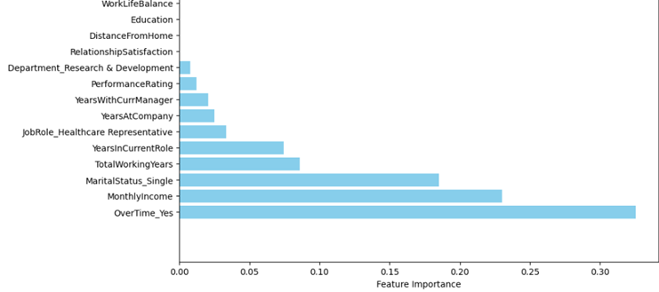
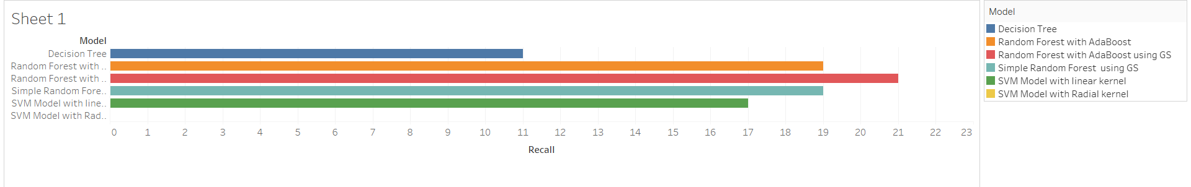
PROBLEM STATEMENT | Exploratory Data Analysis | MODEL SELECTION | Text Mining | Conclusion
Out of the 55 features the decision tree has only considered 10 features as evident from the feature importance plot.
After dummy coding the number of features is 55
The accuracy for all the models shown below is greater than 80%
Recall statistics for Attrition = “Yes” for various models that were tried

Slide 7
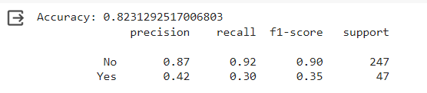
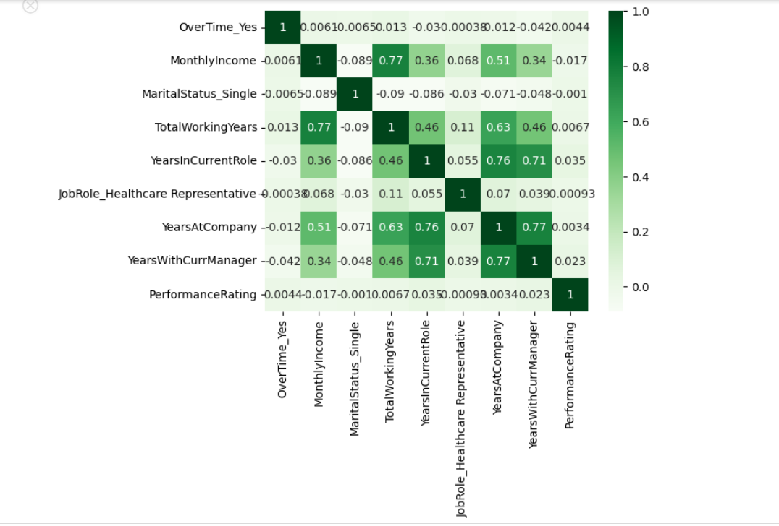
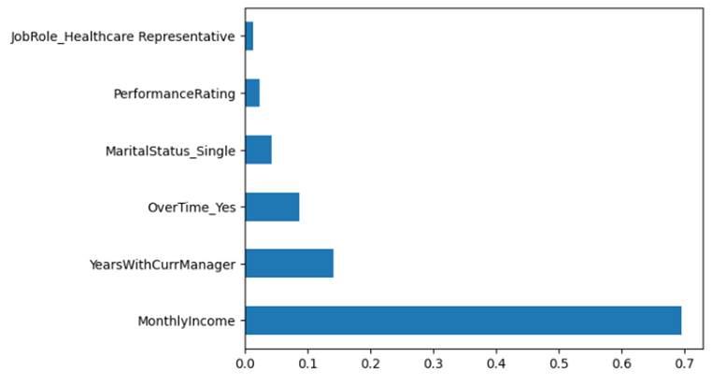
PROBLEM STATEMENT | Exploratory Data Analysis | MODEL SELECTION | Text Mining | Conclusion
The correlation matrix shows that high correlation exists in features TotalWorkingYears, YearsInCurrentRole and YearsAtCompany.
The removal correlated variables improves the recall of Attrition = “Yes”to 30%

Slide 8
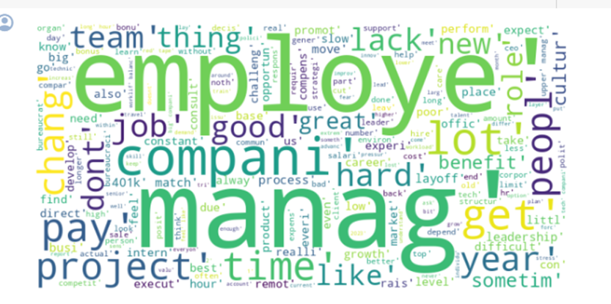

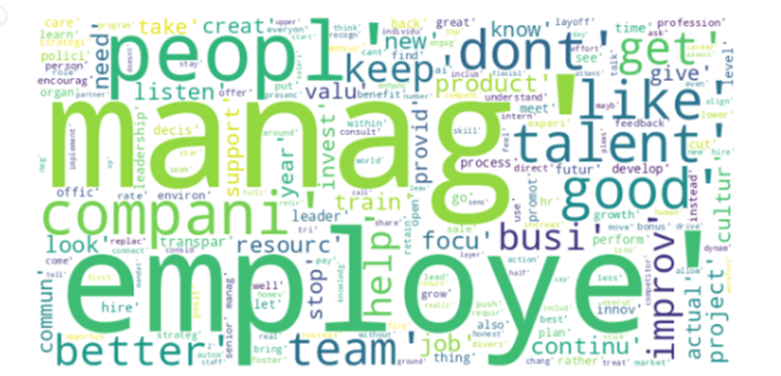
PROBLEM STATEMENT | Exploratory Data Analysis | MODEL SELECTION | Text Mining | Conclusion

Slide 9
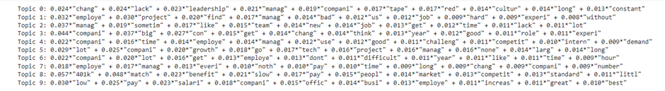
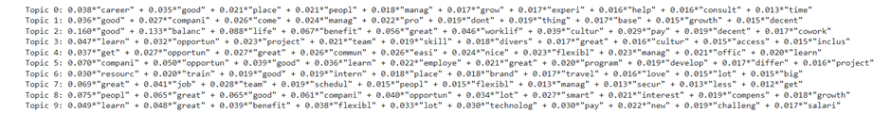
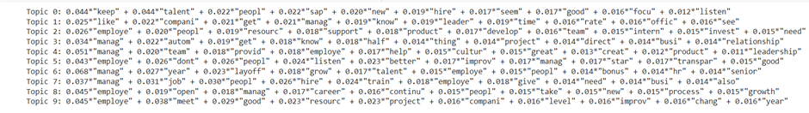
PROBLEM STATEMENT | Exploratory Data Analysis | MODEL SELECTION | Text Mining | Conclusion
Key Takeaway: IBM excels in employee benefits and work-life balance but needs to improve in management transparency and professional development.

Slide 10
PROBLEM STATEMENT | Exploratory Data Analysis | MODEL SELECTION | Text Mining | Conclusion
In conclusion, the analytical journey from understanding the problem to extracting actionable insights via model selection and text mining was successful.
To further mitigate attrition risks, IBM should consider improving managerial effectiveness, providing clear career progression opportunities, and maintaining a balance of expectations with employees.
By prioritizing these areas, the organization may enhance employee satisfaction and retention, consequently support performance and morale across the company.

Slide 11


