Slide 1
Java Pet Store 1.3.1_02
Existing Architecture — Low-Level Design
Reverse-engineered from source as the baseline for a modernization migration
J2EE 1.3 BluePrints · 4 enterprise apps · 19 components · ~36k LOC · EJB 2.x CMP · JMS

Slide 2
Executive Summary
What the system is
• A distributed J2EE 1.3 e-commerce system (Sun BluePrints, 2003).
• Online pet store: catalog browse, cart, checkout, async order fulfilment, supplier integration, admin.
• It is NOT one application —
– 4 separately-deployed .ear apps that talk asynchronously over JMS.
– They share a library of 19 reusable EJB components.
– Each app owns its own DB view; shared data travels as XML over JMS.
• Persistence is split two ways:
– EJB 2.x CMP (container-generated) for most entities.
– One hand-written DAO (catalog) with a clean relational schema.
Metric | Value
Deployable apps (.ear) | 4 — petstore, opc, supplier, admin
Reusable components | 19
Java source files | ~309
Lines of Java | ~36,000
JSP pages | 98
EJB descriptors | 20
Persistence | EJB 2.x CMP + 1 DAO
Database | Cloudscape (→ Derby)
Messaging | JMS point-to-point
Runtime | Sun J2EE 1.3 RI, JDK 1.4

Slide 3
Application (Deployment) View
4 apps coupled only through JMS queues
Browser ─HTTP─▶ petstore.ear (storefront) WAF MainServlet → EJBControllerLocalEJB (session façade) → catalog / cart / customer / signon components checkout builds PurchaseOrder (XML) │ jms/PurchaseOrderQueue ▼ opc.ear (Order Processing Center) PurchaseOrderMDB → ProcessManager (workflow state) large order → jms/OrderApprovalQueue ◀── admin approves InvoiceMDB, Mail MDBs → jms/*MailQueue → mailer → email │ jms/supplier (forward PO as XML) ▼ supplier.ear (warehouse) — SupplierOrderMDB, Inventory │ invoice (XML) ──▶ back to opc petstoreadmin.ear — Swing client (Java Web Start) → opc
KEY FACT
The only edges between the 4 apps are JMS queues:
PurchaseOrderQueue
OrderApprovalQueue
supplier
*MailQueue
This is database-per-service / distributed data — 2003's version of microservice data isolation.

Slide 4
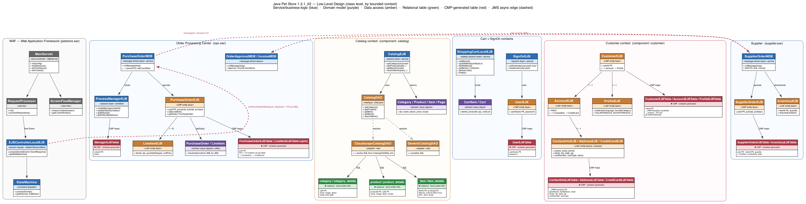
Class-Level Design (by Bounded Context)
Service (blue) · Domain (purple) · Data access (amber) · Relational table (green) · CMP table (red) · JMS (dashed)

Slide 5
Service & Business-Logic Layer
Session beans, MDBs, and the WAF controllers
Class | Stereotype | Key methods / responsibility
MainServlet | Front controller (Servlet) | init(); doGet/doPost → doProcess()
EJBControllerLocalEJB | Session façade (stateful SB) | processEvent(Event): EventResponse + StateMachine
CatalogEJB | Session bean | getCategory, getProducts, getItem, searchItems
ShoppingCartLocalEJB | Stateful session bean | addItem, updateItemQuantity, deleteItem, getSubTotal
SignOnEJB | Session bean | authenticate(user,pwd): boolean; createUser
ProcessManagerEJB | Session bean (workflow) | createManager, updateStatus, getStatus, getOrdersByStatus
PurchaseOrderMDB | Message-driven bean | onMessage → persist PO, start workflow
OrderApprovalMDB / InvoiceMDB | Message-driven beans | approval / invoice transitions
SupplierOrderMDB | Message-driven bean | onMessage → fulfil PO, ship, invoice

Slide 6
Domain Model & Data-Access Layer
Domain value objects (persistence-agnostic)
• Catalog: Category, Product, Item, Page
• Cart: Cart, CartItem
• Order: PurchaseOrder, LineItem — marshalled to/from XML for JMS transport
Data-access — two mechanisms
Mechanism | Where | Components
Hand-written DAO | CatalogDAO (port) + Cloudscape/Generic adapters; SQL in CatalogDAOSQL.xml | catalog
EJB 2.x CMP | Abstract entity beans; container generates SQL from <cmp-field> in ejb-jar.xml | customer, account, profile, signon, creditcard, contactinfo, address, lineitem, purchaseorder, supplierpo, processmanager, uidgen

Slide 7
Data Model — Two Schema Styles
The single biggest migration surface
Catalog — hand-designed relational (clean)
Everything else — CMP container-generated
• Normalized; locale-split (base + _details per locale).
• Real foreign keys, proper types (DECIMAL(10,2)).
• category → product → item hierarchy
– category / category_details
– product / product_details
– item / item_details (price, attr1..5)
• Migrates easily — already port/adapter shaped.
• Auto-generated from <cmp-field> (sun-j2ee-ri.xml).
• Tell-tale: __PMPrimaryKey, __reverse_* FKs, all VARCHAR(255).
– Customer: User/Customer/Account/Profile/ContactInfo/Address/CreditCard
– Order: PurchaseOrder/LineItem(+join)/Manager
– Supplier: SupplierOrder/Inventory
• ContactInfo/Address/CreditCard/LineItem DUPLICATED across all 3 apps.
• Needs reverse-engineering + redesign + data-migration script.

Slide 8
Legacy Patterns → Modern Equivalents
What each 2003 construct becomes
Pet Store (2003) | Modern equivalent (Spring Boot / Java 21)
WAF MainServlet front controller | Spring MVC DispatcherServlet
EJBControllerLocalEJB + StateMachine + EJBAction | @Controller / @Service methods
EJB 2.x Local Home/Interface/Bean trios | plain @Service / @Component beans
CMP entity beans | JPA entities + Spring Data repositories
Catalog DAO + CatalogDAOSQL.xml | Spring Data repository / JdbcTemplate adapter
ServiceLocator (JNDI caching) | Spring dependency injection (eliminated)
JMS + MDBs between 4 EARs | Spring events, or Kafka/RabbitMQ, or in-process (monolith)
xmldocuments (XML over JMS) | JSON DTOs / records
JSP + custom taglibs + WAF templates | Thymeleaf / React
Cloudscape | H2 / PostgreSQL / MongoDB

Slide 9
Migration Implications & Approach
How to break up the work, de-risked
• Strategy: Strangler Fig — stand up the new system beside the old behind a façade; migrate one bounded context at a time; never big-bang.
• Sequence by bounded context (leaf/low-risk first):
– 1. Catalog — clean schema, no inbound deps → proves the stack
– 2. Customer / SignOn — self-contained, security-sensitive
– 3. Cart — session state, depends on catalog
– 4. Order / PurchaseOrder — the rich aggregate
– 5. OPC + Supplier fulfilment (JMS backbone) — migrate last
• Principles that carry it:
– Ports & adapters at every infra boundary — DB/messaging swaps become additive
– Framework-free domain model (POJOs/records)
– Contract tests pin the external surface; parallel-run to compare old vs new
– Automate the mechanical (javax→jakarta, boilerplate); humans review the semantic
– Data migration is its own workstream: map schema, backfill, reconcile, reversible scripts

Slide 10
Gaps in the Legacy Design → Java 21 / Maven Alternatives
What blocks a straight port to Spring Boot 3 on Java 21, and the alternative chosen for each
Legacy construct (gap) | Why it blocks Java 21 / a clean build | Alternative applied in the migration
J2EE 1.3 EAR + Sun RI app server, JDK 1.4 | No Jakarta EE 10 / Java 21 runtime; not buildable with modern toolchain | Spring Boot 3.3.5 fat-jars on Java 21 — one runnable jar per service, no app server
Ant build (build.xml) + hand-managed jars | No dependency resolution, no reproducible builds, no test phase | Maven per module (parent+client aggregators); ~/.m2 resolution; build-all.sh orders libs→apps
EJB 2.x CMP entity beans (container-generated tables) | javax.ejb gone; CMP unsupported; synthetic __PMPrimaryKey schema | Spring Data JPA + Hibernate; POJO/record domain; explicit Flyway/schema.sql
javax.* APIs (servlet, jms, persistence, mail) | Renamed to jakarta.* in Jakarta EE 9+ — won't compile on Java 21 stack | Mechanical javax→jakarta namespace migration (automatable; human-reviewed)
Sun-RI JMS + XML-over-JMS (TPA), SOAP web services | RI JMS not portable; JAX-RPC SOAP removed from JDK | ActiveMQ Artemis broker (KEEP JMS) + JSON event envelope; SOAP → REST client SDKs
One shared DB, tables duplicated across EARs (no owner) | Cross-context coupling; can't split or scale a service independently | DB-per-service; each service owns its schema; stretch: MongoDB for catalog
WAF MVC (MainServlet/*.do) + 98 JSPs, no tests | Dead framework; behaviour undocumented → high migration risk | Spring MVC + Thymeleaf; characterization tests pin behaviour BEFORE the rewrite
Runtime target: latest stable Spring Boot on Java 21 · build: Maven · principle: automate the mechanical (namespace/boilerplate), redesign the semantic (persistence, messaging, service boundaries) behind tests.

Slide 11
Functional Walkthrough
Every use-case from the entry point — with the edge cases where it fails.
This is the behavioural contract the characterization tests must pin before migrating.

Slide 12
Entry Point & Request Flow
Everything enters through ONE servlet — MainServlet (*.do)
Browser GET/POST *.do │ ▼ MainServlet.doProcess() ← single front controller │ 1. look up URL in mappings.xml │ 2. if useFlowHandler → run FlowHandler │ 3. RequestProcessor turns *.do into a WAF Event ▼ EJBControllerLocalEJB.processEvent() (stateful session bean) │ StateMachine maps Event → EJBAction (command) ▼ XxxEJBAction.perform(event) ← business logic, calls component EJBs │ returns EventResponse ▼ ScreenFlowManager ← next JSP screen │ on exception → exception-mapping → error screen ▼ JSP screen rendered back to browser
Exception routes (the edge-case map)
Exception | → Screen
ShoppingCartEmptyOrder | cart_empty_order_error
DuplicateAccount | duplicate_account
GeneralFailure | error
URL→screen and Event→EJBAction wiring lives entirely in mappings.xml (data, not code).
No per-page servlets — one controller, declarative flow.

Slide 13
Use-Cases 1–3: Browse · Sign-On · Register
Entry → behaviour → failure edge cases
Use-case (entry) | Happy path | Edge cases where it FAILS / surprises
Browse catalog GET /category.do?id=CATS | CatalogEJB→DAO returns locale rows, paginated (Page) | Unknown id → EMPTY list, NOT 404 · start=9999 → empty · start<0 → SQL error · DB down → error.screen
Sign on POST /signon.do | authenticate(user,pwd)=true → session signed-on | Wrong pwd & unknown user → SAME false (no distinction) · no lockout/counter · userName case-sensitive (Jane≠jane)
Register account POST /createcustomer.do (FlowHandler) | Creates Customer→Account→Profile→ContactInfo→Address graph | Duplicate username → DuplicateAccountException → duplicate_account.screen · partial create rolls back (CMP tx) · weak field validation

Slide 14
Use-Case 4: Shopping Cart
Richest edge cases — source-confirmed behaviour that must be preserved
Operation | Actual code behaviour | Gotcha / failure edge case
ADD_ITEM | cart.put(itemID, 1) | Re-adding an item RESETS qty to 1 — does NOT increment. 'Fixing' this breaks the contract.
UPDATE_ITEMS qty>0 | remove then put(qty) | Sets absolute quantity ✓
UPDATE_ITEMS qty≤0 | remove, does NOT re-add | SILENTLY deletes the line item. Not an error.
UPDATE unknown itemId | put a line for it | Item not in catalog → getSubTotal later throws (dangling ref)
getSubTotal() | loops items; calls CatalogHelper.getItem PER line | Item removed from catalog but still in cart → CatalogException → subtotal fails
Session timeout | stateful bean destroyed | Cart silently empties. Migration to @SessionScope must reproduce; singleton would leak carts across users

Slide 15
Use-Cases 5–6: Checkout & Fulfilment
The async JMS workflow — at-least-once delivery
Step (entry) | Behaviour | Edge case where it fails
Checkout POST /order.do | PO built from cart+customer → XML → jms/PurchaseOrderQueue → order_complete.screen | Empty cart → ShoppingCartEmptyOrderException → error screen · not signed on → blocked by filter
OPC consumes PO | PurchaseOrderMDB → ProcessManager status PENDING; large order → OrderApprovalQueue | JMS broker down → enqueue fails, NO order created · duplicate redelivery → MDB must be IDEMPOTENT (no double order)
Supplier fulfilment | SupplierOrderMDB decrements InventoryEJB, ships, returns Invoice (XML) | Concurrent orders for last unit → inventory race · Invoice for unknown orderId → no manager row → silent drop
Notifications | Mail MDBs send confirmation email | Mail server down → redelivery → must not double-send

Slide 16
Use-Cases 7–8 & Cross-Cutting Failures
Locale · Sign-off · Admin
Use-case | Behaviour | Edge case
changelocale.do?locale=ja_JP | FlowHandler sets session locale; re-renders | Unsupported locale (no _details rows) → blank/fallback text
signoff.do | Invalidate session → signoff.screen | Cart LOST on signoff (stateful bean destroyed) — intended
Admin (petstoreadmin.ear) | Swing/JWS client → approve orders via OPC | Java Web Start WON'T launch on modern JVMs · re-approve shipped order must be idempotent
Cross-cutting failure modes (every use-case)
• DB (Cloudscape) unreachable → *DAOSysException / EJBException → GeneralFailureException → error.screen
• JMS broker down → async steps stall; user-facing enqueue → error.screen
• Session loss/timeout → stateful cart & sign-on vanish → bounced to signon
• Malformed XML message (xmldocuments) → MDB onMessage throws → JMS redelivery loop (poison message) unless a DLQ exists
• Locale with no _details rows → blank/fallback text, never an error

Slide 17
The Dangerous Edge Cases
The behaviours an agent (or human) will 'accidentally fix' — and break the contract
• These MUST be pinned by characterization tests before migrating (CLAUDE.md §4, forbidden shortcuts #1 & #10):
– addItem RESETS quantity to 1 — does not increment
– updateItemQuantity(qty ≤ 0) silently DELETES the line
– getSubTotal SILENTLY SKIPS items removed from the catalog (does NOT throw)
– Unknown catalog id returns EMPTY, not 404
– Checkout must be IDEMPOTENT under JMS redelivery (no double order)
– Sign-on does NOT distinguish bad-password from unknown-user
Rule: pin behaviour AS-IS (including quirks). Migrate → run tests → green before commit. Never weaken a test to make it pass; never 'improve' behaviour during migration — parity first.

Slide 18
Complete API Inventory (all 4 apps)
Verified by full source scan — synchronous HTTP + SOAP endpoints
App | Type | Endpoint / API | Purpose & edge case
petstore | HTTP *.do | cart · order · signon · createcustomer · customer · changelocale · signoff | Storefront (see use-case slides). Front controller MainServlet.
petstore | Servlet | /Populate | Bootstraps catalog + accounts from XML; ~15 params (action, credit_card_*, forcefully). Re-run w/o forcefully → skips if data exists.
petstore | Filter | SignOnFilter (protected) | Guards customer.do/.screen, enter_order_information.screen, signon_welcome.screen → redirect to signon, replay original URL.
opc | SOAP (JAX-RPC) | OPCService.submitInvoice(Source) | Receives supplier invoice as XML. Bad XML → InvalidInvoiceException. This is a web-service variant of the app.
supplier | SOAP (JAX-RPC) | SupplierService.submitOrder(Source); queryOrderStatus(id) | Receive PO / query status. Bad order → InvalidOrderException; unknown id → UnknownOrderIdException.
supplier | Servlet | /RcvrRequestProcessor · /Populate | Inventory display & receive; seed inventory.
admin | Servlet | /AdminRequestProcessor · /ApplRequestProcessor | Back-office order approval UI. Also a Swing/JWS client — WON'T launch on modern JVMs.

Slide 19
Async APIs — 8 MDBs & JMS Destinations
The message-driven surface (verified: 8 MDBs, queues + one Topic)
MDB (consumer) | App | Destination | Responsibility
PurchaseOrderMDB | opc | jms/PurchaseOrderQueue | Consume checkout PO → ProcessManager PENDING; route large orders to approval
OrderApprovalMDB | opc | jms/OrderApprovalQueue | Apply admin approve/deny → next transition
InvoiceMDB | opc | jms/InvoiceTopic (pub/sub) | Supplier invoice → status SHIPPED. NOTE: a Topic (fan-out), not a queue
MailCompletedOrderMDB | opc | jms/CompletedOrderMailQueue | Email order-complete
MailInvoiceMDB | opc | jms/MailQueue | Email invoice
MailOrderApprovalMDB | opc | jms/OrderApprovalMailQueue | Email approval outcome
SupplierOrderMDB | supplier | (ejb-jar dest) | Fulfil PO, decrement InventoryEJB, ship, return invoice
MailerMDB | component | jms/MailQueue | Generic mail sender (shared)
Async edge cases (all MDBs): at-least-once delivery → onMessage must be IDEMPOTENT (re-delivery must not double-process). Malformed XML → onMessage throws → redelivery loop / poison message unless a DLQ exists. InvoiceTopic fan-out means multiple subscribers may each react — order of side-effects matters.

Slide 20
Per-Endpoint Data Flow — DB & JMS
What each endpoint WRITES and what it EMITS (source-verified)
Endpoint | DB written | JMS emitted | Edge / note
GET category/product/item/search.do | — (reads catalog tables) | none | Unknown id → empty, not 404
POST signon.do | — (reads UserEJBTable) | none | authenticate() reads only
POST createcustomer.do | User, Customer, Account, Profile, ContactInfo, Address, CreditCard | none | Dup username → DuplicateAccount; whole graph rolls back (1 tx)
POST customer.do (update) | Account, ContactInfo, Address, CreditCard | none | Protected URL (sign-on required)
cart.do (add/delete/update) | NONE — in-memory session bean | none | No DB touch; lost on timeout/signoff
POST order.do (checkout) | NONE directly (Counter++ for order id) | → jms/AsyncSenderQueue (PO as XML) | Empty cart → exception before send; order NOT persisted here; cart emptied after
changelocale.do / signoff.do | — | none | Session state only
GET /Populate | ALL catalog + sample account tables (bulk) | none | forcefully=true re-seeds; else skips
SupplierService.submitOrder (SOAP) | Inventory (--), SupplierOrder | → jms/opc/InvoiceTopic | Bad order → InvalidOrderException
OPCService.submitInvoice (SOAP) | Manager (status) | → mail queue | Bad XML → InvalidInvoiceException
admin /AdminRequestProcessor | reads Manager | → approval (drives OrderApprovalMDB) | Re-approve shipped order must be idempotent

Slide 21
The Async Write-Chain
Order persistence is entirely async — no HTTP request writes order data
order.do ──JMS──▶ AsyncSenderQueue ──▶ jms/PurchaseOrderQueue (writes: Counter++) │ ▼ PurchaseOrderMDB WRITES: PurchaseOrder, LineItem, ContactInfo, Address, CreditCard, Manager(status=PENDING) │ ┌───────────────────────┴─── large order? yes ▼ jms/OrderApprovalQueue no ▼ → supplier OrderApprovalMDB SupplierOrderMDB UPDATES: Manager(APPROVED) WRITES: Inventory--, SupplierOrder │ │ ▼ OrderApprovalMailQueue ▼ jms/opc/InvoiceTopic (pub/sub!) InvoiceMDB UPDATES: Manager(SHIPPED) │ ▼ CompletedOrderMailQueue ─▶ MailQueue ─▶ email
Migration-critical
Write-side is entirely async — checkout is fire-and-forget. Making it synchronous changes the consistency model (ADR).
ManagerEJBTable is written by 3 MDBs (create/approve/invoice) → consolidate behind one OrderStatusService.
Invoice is a TOPIC (fan-out), not a queue — switching to point-to-point changes delivery semantics.
Every MDB write is exposed to at-least-once redelivery → must be idempotent (characterization tests assert this).

Slide 22
API Split-Up by Actor
Every endpoint segregated by WHO uses it — the target service boundary.
Customer · Supplier staff · Internal/Admin · System↔System · Ops

Slide 23
The Four Applications — Who Runs Each
App (.ear) | Primary user | What it is
petstore | End customers (public) | The storefront web app
opc — Order Processing Center | System (no human) | Async order-workflow backend
supplier | Warehouse/supplier staff + OPC | Fulfilment app + supplier integration
admin | Internal staff | Back-office order approval console
Key: the actor segregation IS the target service boundary.
Only petstore is public. OPC is pure backend. Supplier & admin are staff/system-facing. Inter-app hops (JMS/SOAP) have no human user at all.

Slide 24
1 · Customer-Facing Endpoints (petstore.ear)
Public storefront — browse is anonymous; checkout/profile require login
Browse (anonymous) — *.screen GET URLs via WAF + CatalogEJB
Endpoint | Login? | Role
main.screen | No | Home page
category.screen?category_id · product.screen?product_id · item.screen?item_id | No | Drill down catalog hierarchy
search.screen?keywords | No | Search catalog
Actions — *.do state changes via MainServlet
Endpoint | Login? | Role
cart.do (add/delete/update) | No | Manage cart (in-memory, no DB)
signon.do · createuser.do · createcustomer.do | No | Authenticate / register account
changelocale.do · signoff.do | No | Switch language / log out
customer.do | YES | View/edit own profile
order.do (checkout) | YES | Place order → emits to JMS (no direct DB write)

Slide 25
2–3 · Supplier, Admin & Ops Endpoints
Supplier-facing (supplier.ear)
Endpoint | Actor | Role
/RcvrRequestProcessor | Warehouse staff | View pending supplier orders, trigger shipment
SupplierService.submitOrder / queryOrderStatus (SOAP) | OPC (system) | Receive PO to fulfil / query status — web-services variant only
/Populate (supplier) | Ops | Seed inventory
Admin / back-office (admin.ear)
Endpoint | Actor | Role
/AdminRequestProcessor | Internal staff | Review & approve/deny large orders
/ApplRequestProcessor + Swing/JWS client | Internal staff | Rich admin UI — WON'T launch on modern JVMs
Ops / setup (one-time)
Endpoint | Actor | Role
/Populate (petstore) | Operator | Seed catalog + sample accounts from XML → becomes Flyway/data.sql

Slide 26
4 · System↔System Endpoints (no human user)
The inter-app integration seams — customer never touches these
Channel / endpoint | Producer → Consumer | Transport | Role
AsyncSenderQueue → PurchaseOrderQueue | petstore → OPC | JMS | Deliver checkout PO
OrderApprovalQueue | OPC → OPC | JMS | Route large order to approval
jms/opc/InvoiceTopic | Supplier → OPC | JMS Topic | Return invoice (order shipped) — fan-out
jms/*MailQueue | OPC → Mailer | JMS | Trigger notification emails
OPCService.submitInvoice | Supplier → OPC | SOAP | Return invoice — web-services variant of InvoiceTopic
SupplierService.submitOrder | OPC → Supplier | SOAP | Send PO — web-services variant of supplier queue
The standard build uses JMS for these hops; the web-services build uses SOAP for the same flow. MIGRATE ONE TRANSPORT, NOT BOTH. These three contracts — submitOrder / submitInvoice / queryOrderStatus — become the inter-service API (REST or events).

Slide 27
Target Split — Actor Boundary → New Modules
The actor segregation becomes the Spring Boot module/service map
Actor group | Target module (Spring Boot / Java 21) | Migration note
Customer (public) | Public REST/web module: browse + cart + checkout + account | Migrate first after catalog; most traffic
Supplier | Fulfilment service with inbound 'receive order' endpoint | submitOrder/queryOrderStatus = inter-service contract (REST or events)
Admin | Internal REST admin endpoints | Swing/JWS client is REPLACED, not migrated
System↔System | In-process Spring events (monolith) OR message broker (services) | Collapse JMS+SOAP hops; migrate ONE transport
Ops/setup | Flyway / data.sql seeding | /Populate is NOT a runtime endpoint
Bottom line: 'who uses it' defines the module boundary. Public/staff/system/ops separation maps cleanly onto bounded contexts — and tells you migration order (customer path first, admin last).

Slide 28
How JMS Communicates Between Services
Sender & receiver never know each other — coupled only by a logical destination name
1 · Sender puts an XML message on a named destination (AsyncSenderEJB)
qConnect = qFactory.createQueueConnection(); session = qConnect.createQueueSession(true, 0); // true = transacted → at-least-once qSender = session.createSender(q); TextMessage jmsMsg = session.createTextMessage(); jmsMsg.setText(purchaseOrder.toXML()); // payload = PO as XML qSender.send(jmsMsg); // fire-and-forget, no reply
2 · Destination found via JNDI — never hardcoded (the decoupling)
ASYNC_SENDER_QUEUE = "java:comp/env/jms/AsyncSenderQueue"; // logical alias q = serviceLocator.getQueue(ASYNC_SENDER_QUEUE); // resolved at runtime // server config (setup.xml) maps alias → physical queue → binds the consuming MDB
3 · Receiver (MDB) reacts automatically — container calls onMessage()
public void onMessage(Message recvMsg) { // no polling — event-driven String xml = ((TextMessage) recvMsg).getText(); approval = doWork(xml); // parse PO, persist to DB, set status if (approval != null) doTransition(approval); // fire the NEXT message } // binding declared in ejb-jar.xml: <resource-env-ref-name>jms/PurchaseOrderQueue

Slide 29
JMS Patterns & End-to-End Conversation
Both point-to-point (Queue) and publish/subscribe (Topic) are used
Pattern | Class / call | Used for
Point-to-Point (Queue) | QueueSender .send() | PO, OrderApproval, Mail — ONE consumer
Pub/Sub (Topic) | TopicSender .publish() | InvoiceTopic — EVERY subscriber (fan-out)
petstore OPC supplier ──────── ─── ──────── OrderAction send(PO xml) │ AsyncSenderQueue ▼ [BROKER] ─▶ PurchaseOrderMDB.onMessage persist PO, status=PENDING send(PO) ──▶ supplier queue │ ▼ SupplierOrderMDB.onMessage Inventory--, ship publish(invoice) InvoiceTopic ◀──┘ (pub/sub) InvoiceMDB.onMessage status=SHIPPED ─▶ MailQueue ─▶ MailerMDB ─▶ email
Why JMS (the properties it buys):
Decoupling — apps share only a queue name; redeploy independently
Async — checkout returns instantly; fulfilment happens later
Reliable — transacted session → redelivery if MDB throws (at-least-once)
Buffering — order spikes queue up; OPC drains at its own pace

Slide 30
JMS → Spring / Java 21 Mapping
How the messaging translates in the migration
Pet Store JMS | Spring / Java 21 equivalent
AsyncSenderEJB.send() (queue) | JmsTemplate.convertAndSend() OR ApplicationEventPublisher.publishEvent()
@MDB onMessage() (queue) | @JmsListener OR @EventListener method
TopicSender.publish() (topic) | @JmsListener (topic factory) / Kafka topic / event to many listeners
JNDI destination lookup + ServiceLocator | application.yml connection config (ServiceLocator deleted)
XML TextMessage payload | JSON DTO / record
transacted session (at-least-once) | @Transactional listener + idempotency key
ADR decision: keep it truly async with a broker (Kafka/RabbitMQ + @JmsListener) if preserving the distributed topology — OR collapse to in-process Spring ApplicationEvents for a modular monolith. Either way, preserve the Topic fan-out for invoices and at-least-once idempotency (both in the characterization-test spec).

Slide 31
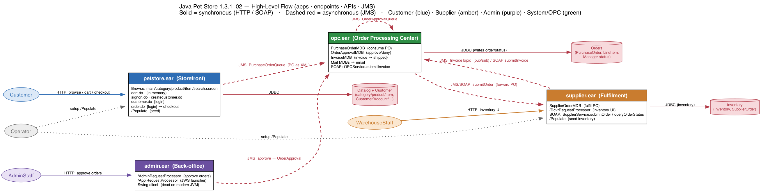
High-Level Flow — Apps, Endpoints & APIs
Actors → apps → datastores · solid = sync (HTTP/SOAP) · dashed red = async (JMS)

Slide 32
Migration Plan
Strangler-fig, bounded-context by bounded-context, contract-tested at every step.
Target: Spring Boot 3.x · Java 21 · hexagonal (ports & adapters) · one transport, not both variants.

Slide 33
Migration Strategy & Principles
• Strategy: Strangler Fig — new system beside old behind a façade; migrate one bounded context at a time; always shippable; easy rollback.
• Characterization tests FIRST — pin legacy behaviour before touching code; migration becomes migrate → test → green-or-rollback.
• Core principles:
– Ports & adapters — DB & messaging behind interfaces → swaps become additive
– Framework-free domain model (POJOs/records) — no JPA/Jackson on domain types
– Preserve the contract — same status codes, message shapes, edge behaviours (see dangerous edge cases)
– Migrate ONE transport, not both variants (JMS standard build, drop the SOAP duplicate)
– Delete, don't port: ServiceLocator, Home/Local trios, WAF engine
– Automate mechanical (javax→jakarta, boilerplate); humans review the semantic
– Data migration is its own workstream: redesign CMP schema, backfill, reconcile, reversible scripts
– State in a ledger (survives context resets) + ADRs for key decisions

Slide 34
Phased Roadmap — by Bounded Context
Order = lowest-risk / most-value first; async backbone last
Phase | Scope | Why here / risk | Done when
0 · Scaffold | Target repo, CI, CLAUDE.md, ledger, char-test harness | De-risk before any rewrite | Empty app deploys; harness runs
1 · Catalog | Browse APIs + catalog schema (clean DAO) | No inbound deps; proves the stack | Browse contract tests green
2 · Customer/SignOn | Register, profile, auth (CMP → JPA) | Self-contained; security-sensitive | Auth + profile tests green
3 · Cart | Cart APIs (stateful → @SessionScope) | Depends on catalog; edge-case heavy | Cart edge tests green
4 · Order | Checkout + PurchaseOrder aggregate | Core domain; the rich write | Checkout emits + persists correctly
5 · OPC + Supplier | MDB workflow, inventory, invoice (JMS backbone) | Highest coupling; async + idempotency | End-to-end order flow green
6 · Admin | Approval endpoints (REST replaces Swing/JWS) | Swing client can't be carried forward | Admin approval flow green
7 · Cutover | Data migration, parallel-run, decommission legacy | Reconcile old↔new before switch | Legacy off; ledger all-green

Slide 35
Target Architecture & Key Decisions (ADRs)
Target: modular monolith (default) — 1 Spring Boot app, module per bounded context, in-process events
Decision (ADR) | Options | Recommended default
Async topology | Keep broker (Kafka/Rabbit) vs in-process Spring events | In-process events (monolith); broker only if OPC needs independent scale
Transport variant | JMS standard build vs SOAP web-services build | Migrate JMS build; drop SOAP duplicate
Persistence | DB-per-context vs single consolidated schema | Single schema (monolith); redesign CMP tables
Checkout consistency | Keep async fire-and-forget vs synchronous write | Keep async (preserve semantics) — flag if UX needs sync
Shared value objects | Duplicate per context vs one shared domain lib | Shared domain module (ContactInfo/Address/CreditCard/LineItem)
Migration order follows the high-level flow: customer path first (catalog→customer→cart→order), then the async OPC/Supplier backbone, admin last. Every phase: characterization tests green → commit → ledger update. Nothing is decommissioned until parallel-run reconciles old vs new.

Slide 36
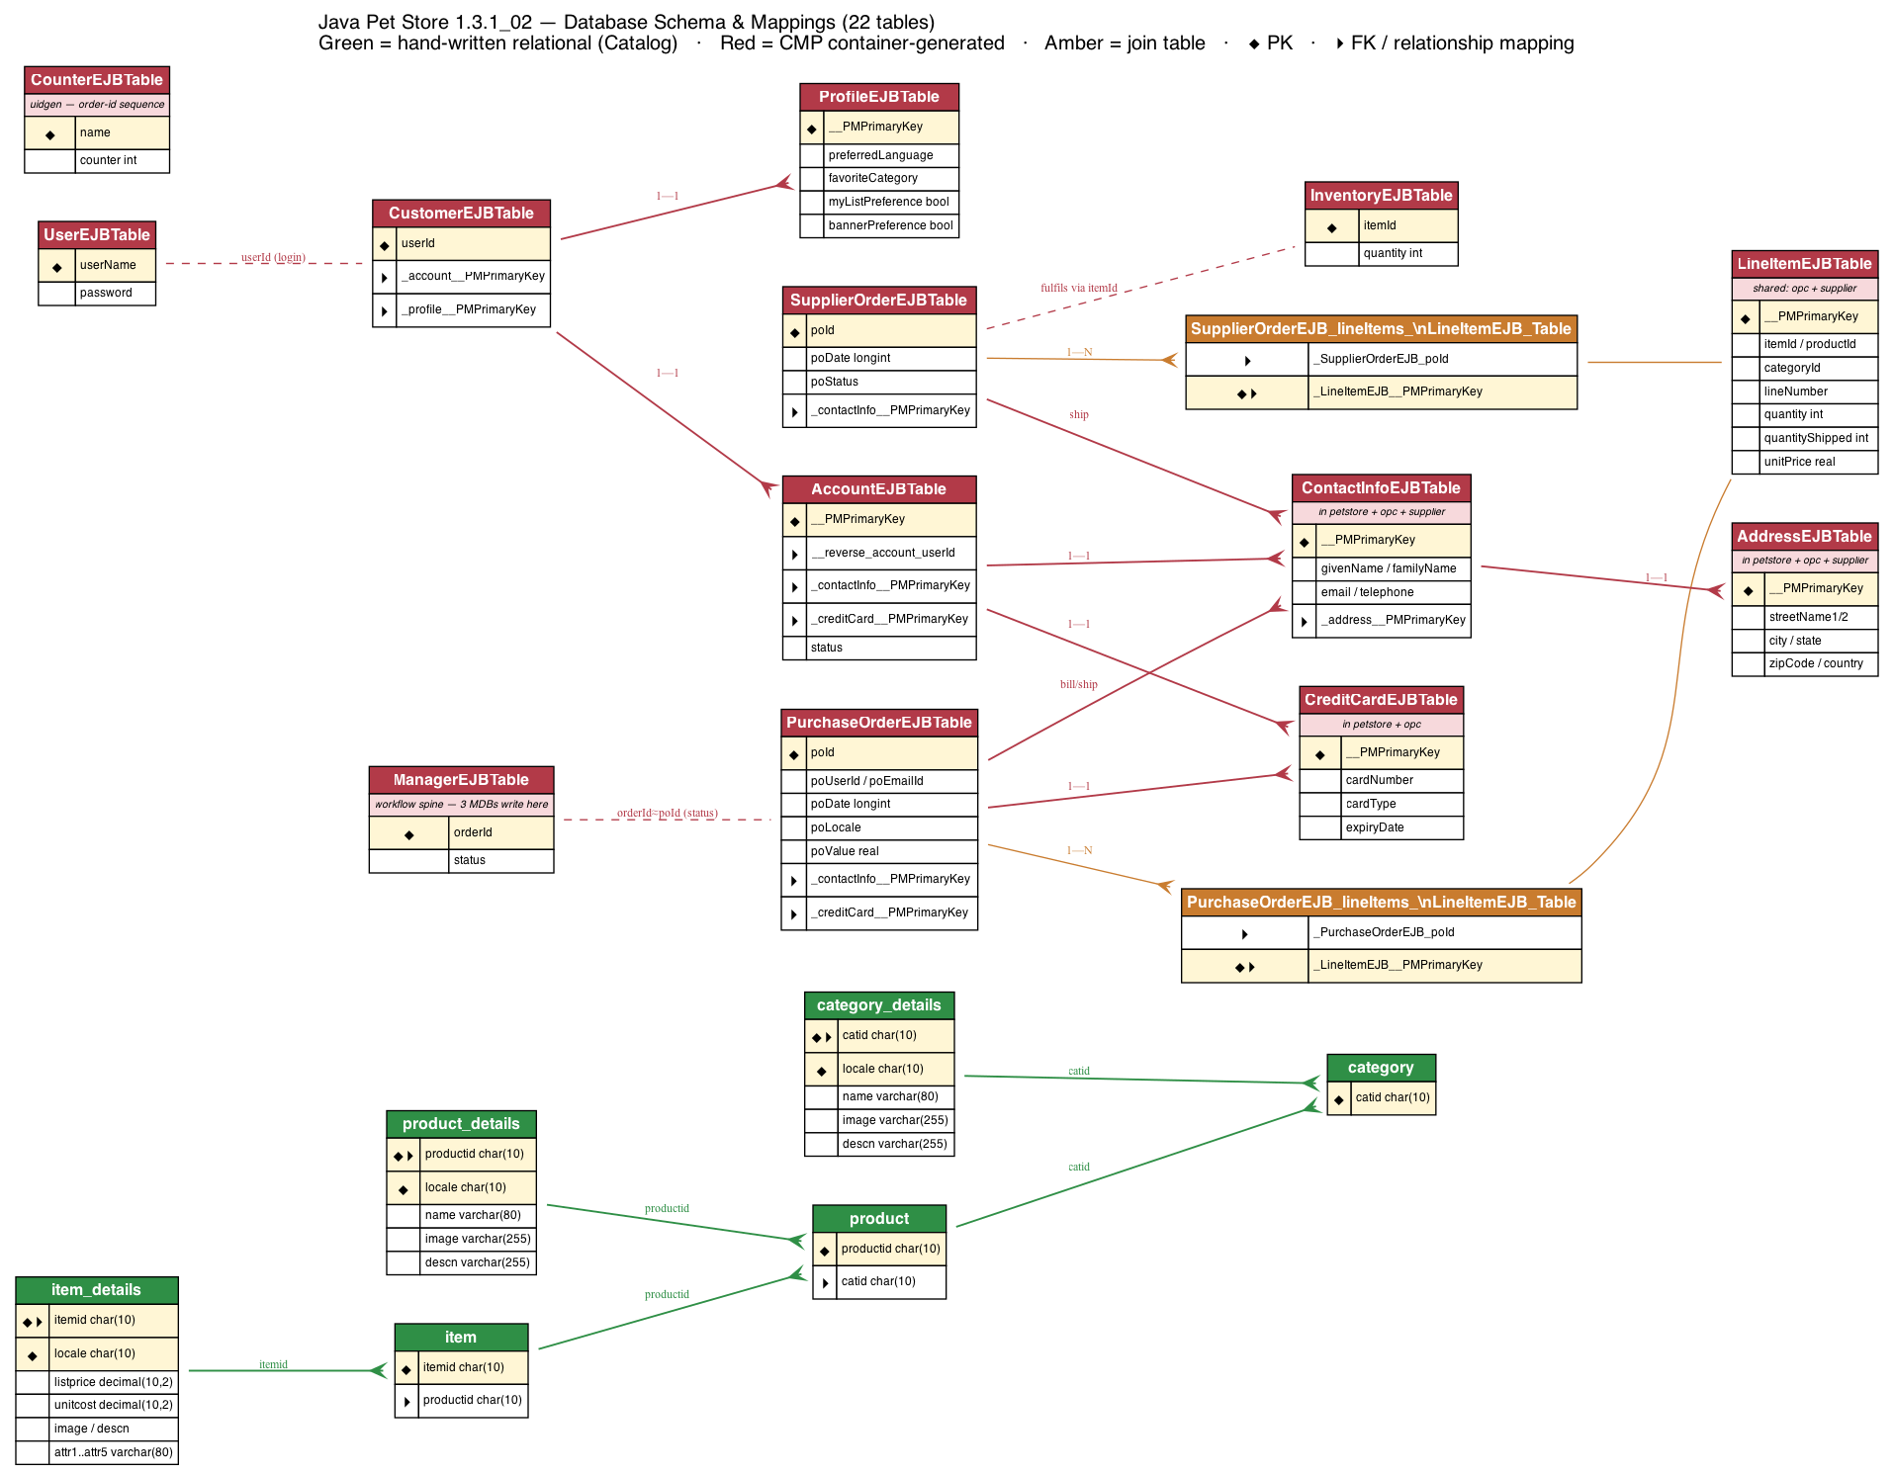
Database Schema & Mappings — Full ER Diagram
22 tables · green = relational (catalog) · red = CMP-generated · amber = join · ◆ PK ▸ FK

Slide 37
How the Schema Maps — Key Relationships
• Catalog (real FKs, locale-split):
– category ─< product ─< item ; each base table has a _details child keyed by (id, locale) for i18n
• Customer graph (CMP container-managed, via __PMPrimaryKey / __reverse_*):
– User (login) ┈ Customer 1—1 Account 1—1 ContactInfo 1—1 Address ; Customer 1—1 Profile ; Account 1—1 CreditCard
• Order graph:
– PurchaseOrder 1—N LineItem (via join table) ; PO 1—1 ContactInfo (bill/ship) & CreditCard
– ManagerEJBTable(orderId≈poId, status) = workflow spine — written by 3 MDBs
• Supplier graph:
– SupplierOrder 1—N LineItem (join) ; fulfils against Inventory via itemId
• Duplicated shared tables — the big migration flag:
– ContactInfo/Address (petstore+opc+supplier), CreditCard (petstore+opc), LineItem (opc+supplier) — each app has its own copy (database-per-app)
– Target: drop __PMPrimaryKey/__reverse_*, fix types (poValue REAL→DECIMAL, poDate LONGINT→timestamp), consolidate shared tables into one domain module

Slide 38
Decision Log (ADRs)
Every migration decision — the approaches we weighed and what we chose.
DECIDED = locked by user · RECOMMENDED = proposed, awaiting confirm · OPEN = to be decided

Slide 39
Decisions — DECIDED (locked)
Approaches considered → what we chose → why
Decision | Approaches considered | Chosen | Why
Source app | kitchensink · Pet Store · both | Pet Store only | User focus; kitchensink out of scope
Target runtime | Spring Boot · Quarkus | Spring Boot 3.x / Java 21 | Ecosystem, simple local run, exec JAR
Async messaging | Keep JMS (broker) · in-process events | Keep JMS (@JmsListener, InvoiceTopic) | User directive; faithful to distributed design
SOAP variant | Migrate it · drop it | Drop — JMS build only | Two builds are duplicates
Database (goal 1) | H2 · Postgres · MongoDB | H2 default + MongoDB (stretch DONE) | H2 = no install; Mongo adapter wired for OPC + catalog
Business logic | Refactor/improve · preserve exactly | Preserve exactly (char-tests) | User directive; parity first
Design approach | Ad hoc · SOLID + patterns | SOLID; ASK before choosing a pattern | User directive
Legacy code | Edit in place · new project | New petstore-app-v1/; legacy read-only | It's a re-platform, not edits

Slide 40
Decisions — Resolved During Implementation
Strategy/architecture + the pattern & technical calls made per phase
Decision | Approaches considered | Chosen
Migration strategy | Big-bang · Strangler Fig · lift-and-shift | Strangler Fig, characterization-tests-first
Architecture topology | Modular monolith · microservices | Modular monolith, ports & adapters
Local layout | Multi-Maven-module · single module + packages | Single module, strict package boundaries
JMS broker (local) | Embedded Artemis · standalone Artemis (Docker) | Standalone Artemis container (:61616)
Order workflow pattern | GoF State pattern · enum + guarded transitions | Enum + guarded transitions (right-sized)
Web action dispatch | Explicit Command pattern · thin controllers→services | Thin controllers → services (idiomatic Spring)
Inventory concurrency | Atomic conditional UPDATE · @Version · pessimistic lock | Pessimistic lock (SELECT…FOR UPDATE) — user-directed
Checkout consistency | Keep optimistic · real-time reservation | Keep optimistic (async fulfilment)
Admin client | Migrate Swing/JWS · REST endpoints | REST endpoints (Swing dead on modern JVM)
Approve→fulfil trigger | Publish inline in tx · AFTER_COMMIT event | AFTER_COMMIT transactional event (race fix)
Password storage | Hash now · preserve plaintext (parity) | Preserve plaintext (hashing = post-cutover)

Slide 41
Implementation Status — petstore-app-v1
Spring Boot 3.3 · Java 21 · file H2 (+MongoDB stretch) · standalone Artemis · 43 tests green
Phase | Delivered | Verified
0 Scaffold | Boot 3.3/Java 21, H2, embedded Artemis, char-test harness | boots on Java 21
1 Catalog | domain, CatalogRepository port + JPA adapter, browse UI | 9 tests · browsable
2 Customer/SignOn | auth, registration, profile (CMP→JPA) | 7 tests
3 Cart | @SessionScope cart, all edge-case quirks preserved | 10 tests
4 Order | checkout, PO aggregate, enum workflow, JMS publish | 7 tests
5 Fulfilment+JMS | @JmsListener, pessimistic inventory, idempotent | 5 tests · live async
6 Web+Admin | REST admin approve/deny, exception handler | 5 tests · live e2e
7 Cutover | documented plan (data migration, parallel-run, decommission) | PHASE7_CUTOVER.md
Two bugs caught by LIVE end-to-end testing (not unit tests): (1) large orders auto-shipped without approval; (2) approve→fulfil race (published before commit). Both fixed + regression-tested.
Ports proved it: the DB swap (H2→MongoDB) is DONE for OPC + catalog as a profile-selectable adapter — zero change to domain/services/tests; a broker swap (Artemis→Kafka) would be equally additive.

Slide 42
Legacy: How a Customer Adds to Cart & Checks Out
Reverse-engineered from the JSPs + mappings.xml + signon-config.xml
ADD TO CART (from item.jsp / product.jsp / search.jsp) Each item row shows an "Add to Cart" link: GET /cart.do?action=purchase&itemId=EST-1 → CartEvent(ADD_ITEM) → ShoppingCartLocalEJB.addItem() CHECKOUT (multi-step, sign-in gated) 1. cart.jsp → "Proceed to Checkout" → enter_order_information.screen 2. That screen is a PROTECTED resource → SignOnFilter forces sign-in first 3. enter_order_information.jsp = a FORM collecting Billing info + Shipping info + Credit card → POST order.do 4. order.do (OrderEJBAction) → build PO → JMS → order_complete.screen
Key legacy facts
Add-to-Cart link is on EVERY item — on the item page, product page, AND search results.
Checkout REQUIRES sign-in (SignOnFilter protects enter_order_information).
Checkout collects billing + shipping address + credit card on a form before placing the order.
The cart is a stateful session EJB — lost on sign-off / timeout.

Slide 43
Feature Comparison — Legacy vs Migrated
What's covered, and the remaining gaps
Feature | Legacy | Migrated | Gap?
Browse catalog (category→product→item) | yes | yes | —
Search | yes | yes | —
Add to Cart from item/product/search UI | yes (link per item) | backend only — NO UI link | UI GAP
Cart view / update / remove | yes | yes | —
Checkout requires sign-in | yes | yes (/checkout authenticated) | —
Checkout collects billing+shipping+card | yes (form) | only userId+email — no address/card capture | GAP
Order → async JMS fulfilment | yes | yes | —
Register / profile / address / credit card | yes | yes (REST endpoints) | —
Sign-on / logout | yes (SignOnFilter) | yes (Spring Security) | —
Admin approve / deny orders | yes (Swing/JWS) | yes (REST) | —
Inventory oversell → backorder | yes | yes (pessimistic lock) | —
i18n (en / ja / zh) | yes (full) | ?lang= param; only en_US seeded | Partial
Admin sales charts (getChartInfo) | yes | not migrated | Out of scope

Slide 44
Remaining Gaps After Comparison
Genuine functional gaps (worth closing for full parity):
• Add-to-Cart UI link — legacy had it on every item/product/search row; migrated has the /cart/add endpoint but no button, so the store isn't click-to-buy in the browser.
• Checkout form — legacy collects billing + shipping + credit card; migrated /checkout only takes userId+email and doesn't pull the saved account/card. Works, but thinner.
• i18n — legacy fully multilingual (en/ja/zh); migrated supports ?lang= but only en_US data is seeded.
Deliberately out of scope (documented):
• Admin sales charts (getChartInfo) — analytics
• Supplier queryOrderStatus + warehouse inventory-view UI — internal supplier tooling
• SOAP web-services variant — deliberately dropped (migrate JMS build only)
Everything else — browse, cart, checkout, fulfilment, registration, account, card, sign-on/logout, admin — is migrated & tested (55 tests).

Slide 45
customer-service
The extracted identity/accounts microservice — customer & auth endpoints only.
Endpoints: POST /register · POST /auth/login · GET /customer/{id} · PUT /customer/{id}/account|profile|card

Slide 46
Customer Endpoints — Legacy Problems vs Fixed
Scope: register / login / customer profile-account-card only
Legacy problem (customer endpoints) | Fixed? | How
Plaintext passwords (matchPassword = string equality) | FIXED | BCrypt hash at rest + encoder.matches
Username = customer identity (guessable, enumerable) | FIXED | Opaque RANDOM customerId (stored UUID), in JWT cid claim
Stateful sign-on (SignOnFilter + server session) | FIXED | Stateless JWT — issued on /auth/login, verified per request
Customer PII + card duplicated / __PMPrimaryKey / VARCHAR(255) | FIXED | One owned customer schema, consolidated + typed columns
Full card number returned on GET /customer | FIXED | cardMasked (**** **** **** 1111)
No validation on register/update (blank/garbage accepted) | FIXED | @Valid — NotBlank userName, pwd 4-25, @Email; 400 field map
Inconsistent error responses on customer endpoints | FIXED | @RestControllerAdvice — uniform {status,error,detail,correlationId}
Hard to debug a login/register request | FIXED | Correlation-id per request (MDC + X-Correlation-Id header) + actuator
No transport security on credentials (HTTP) | DEFERRED | TLS is gateway/infra — not fixed locally

Slide 47
Customer Endpoints — Further Enhancements
Next steps specific to auth + customer APIs
Auth / credential security
• TLS on /register and /auth/login so credentials aren't sent in clear
• JWT: RS256 asymmetric signing + JWKS (so services verify without holding the mint key)
• Refresh tokens + revocation denylist so /logout truly invalidates a token
• Rate limiting + account lockout on /auth/login (brute-force defence)
Customer data / ids
• Snowflake-style customerId option: 64-bit, collision-free across DB shards without coordination + time-sortable (vs random UUID). Trade-off: leaks signup time/node — random UUID preferred for a customer id.
• PCI: tokenize / vault the credit card instead of storing the PAN (even masked-on-read)
• Email verification + password-reset flow on registration
• Postgres for the customer DB + Flyway migrations (H2 today loses data on restart)

Slide 48
Service vs Library — When to Extract a Component
The rule we applied when splitting the monolith (cart is a library, not a service)
Deciding question: does the component own remote, shared, or durable state — or need to scale / deploy independently? If yes → service. If no → in-process library.
Component | Owns DB / shared durable state? | Independent scale / deploy? | Verdict
customer-service | Yes — accounts, credentials | Yes (identity/JWT issuer) | SERVICE
catalog-service | Yes — products (read-heavy) | Yes (cacheable, read-scaled) | SERVICE
admin-office-service | Yes — orders, inventory | Yes (different traffic/roles) | SERVICE
cart (cart-lib) | No — ephemeral per-session, in-memory | No independent reason; on hot path | LIBRARY
Why cart is a LIBRARY (in-process)
When cart would FLIP to a service
• Session-local, ephemeral state — no DB, no reason to be remote
• A standalone server = a network hop for a user's own scratchpad (pure latency tax)
• Stateful in-memory service is single-instance (or forces Redis) — extra distributed-state cost for no gain
• On the checkout hot path; not an independently-evolving bounded context
• Carts must survive across devices / sessions (durable)
• Storefront scales horizontally with carts shared across instances
• → then back it with Redis / a DB and extract — because it now owns SHARED state, not "for consistency"
• "Client" was the wrong frame: a client is a thin proxy to a remote owner; cart IS the state + logic

Slide 49
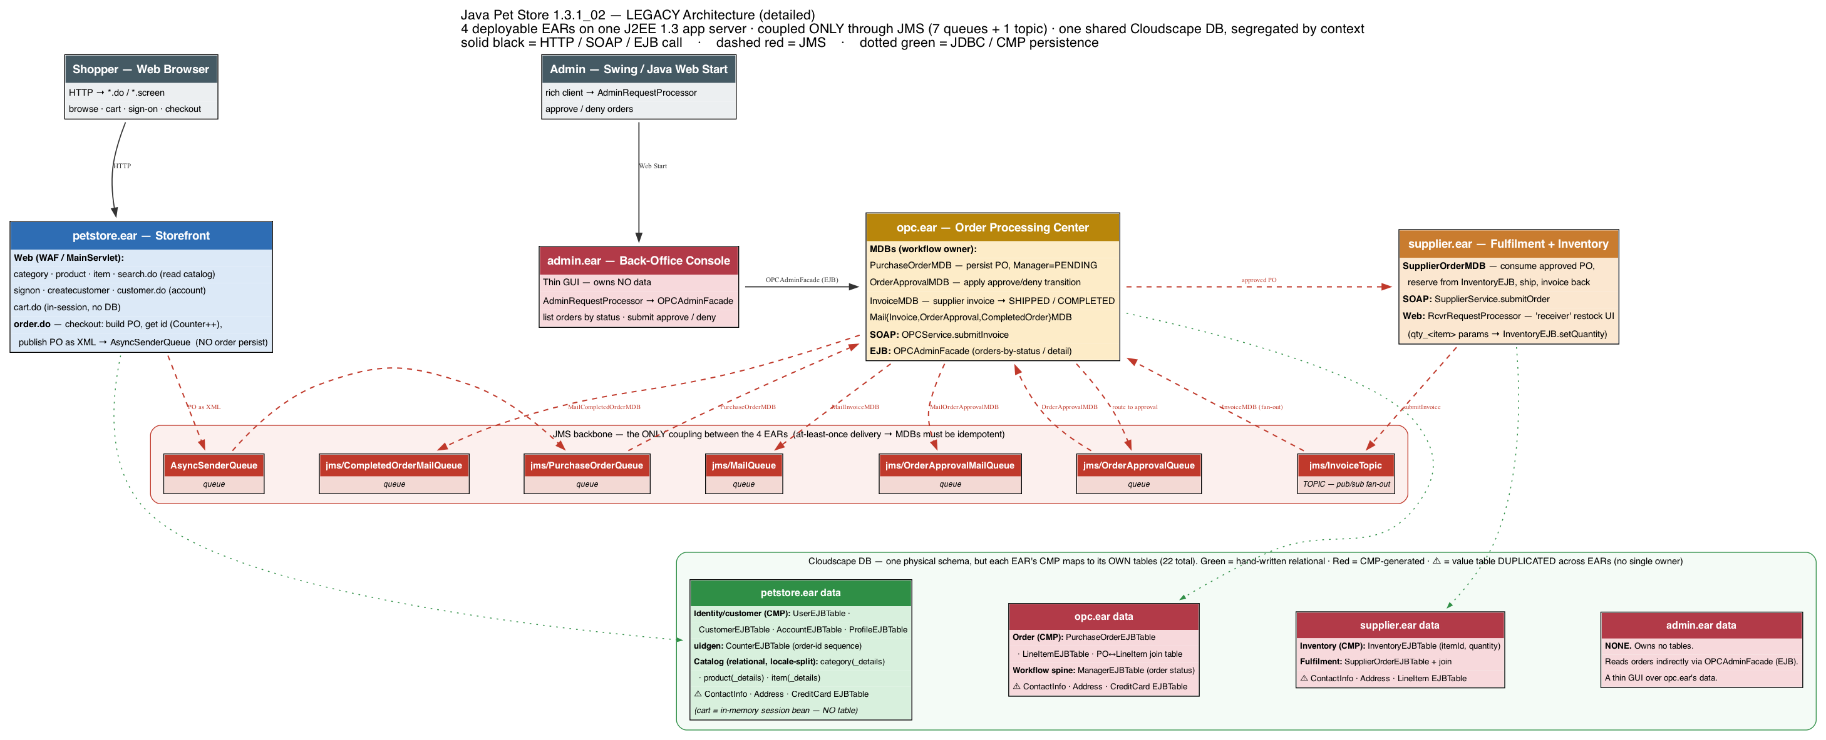
Legacy Architecture — Detailed
Actors · 4 EARs with their endpoints/MDBs/SOAP APIs · all 7 JMS queues + the InvoiceTopic · the DB shown PER EAR (which data each owns) · run: python3 petstore_legacy_highlevel.py

Slide 50
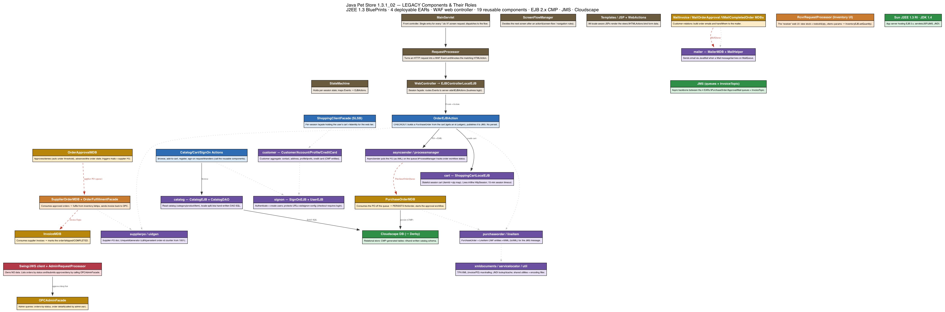
Legacy Components & Their Roles (annotated)
J2EE 1.3 · WAF web controller · 4 EARs · 19 reusable components · each box states its role · run: python3 petstore_legacy_components.py

Slide 51
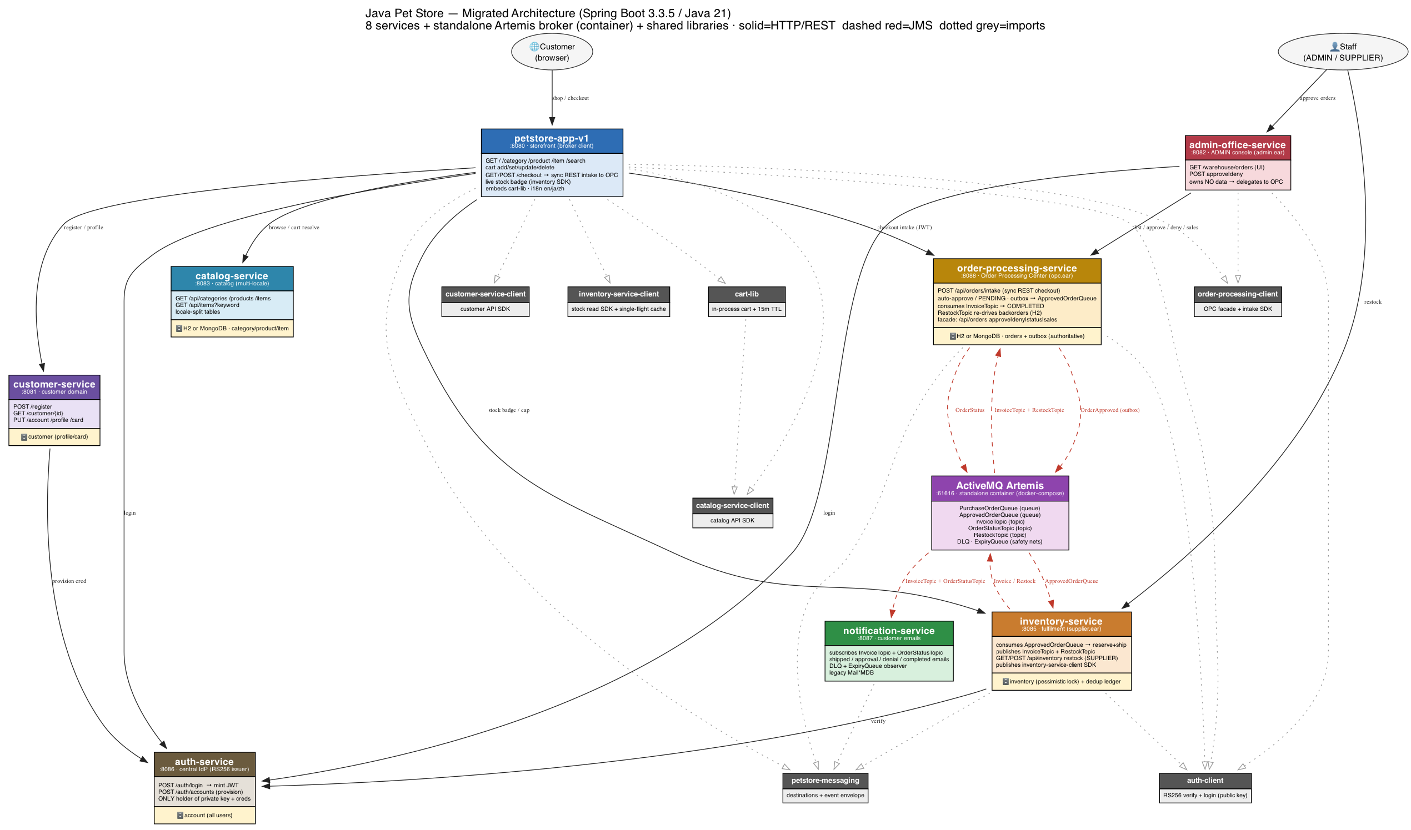
Migrated Architecture — As-Built (8 services + broker)
solid = HTTP/REST · dashed red = JMS · dotted grey = library/SDK imports · run: python3 petstore_architecture.py

Slide 52
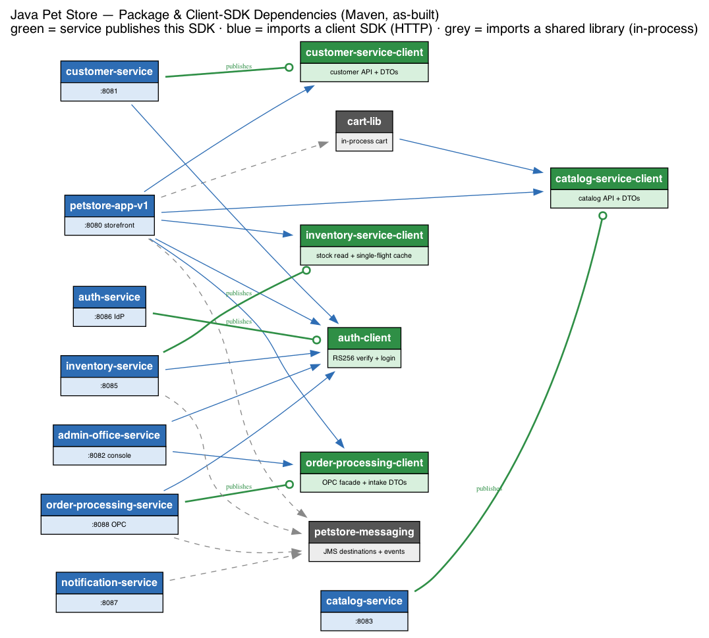
Package & Client-SDK Dependencies (Maven)
green = service publishes its SDK · blue = imports a client SDK (HTTP) · grey = imports a shared library (in-process)

Slide 53
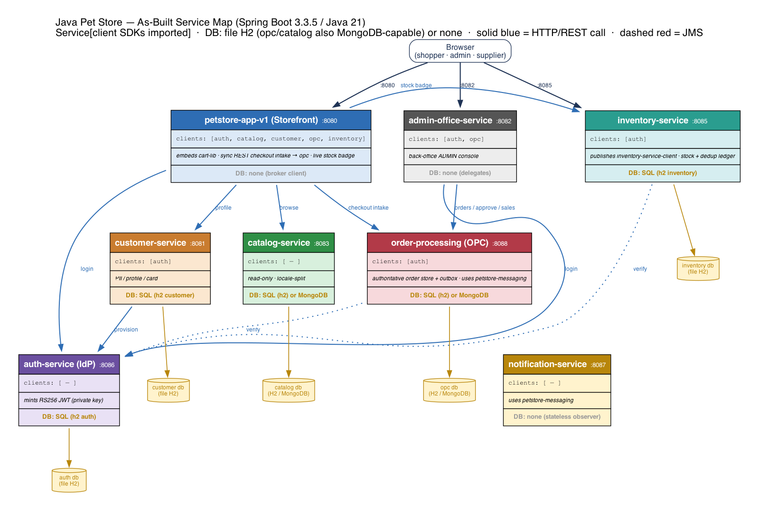
As-Built Architecture — Service Map
8 Spring Boot services · Service[imported client SDKs] · DB: file H2 (opc/catalog also MongoDB-capable) or none · HTTP=solid, JMS=async

Slide 54
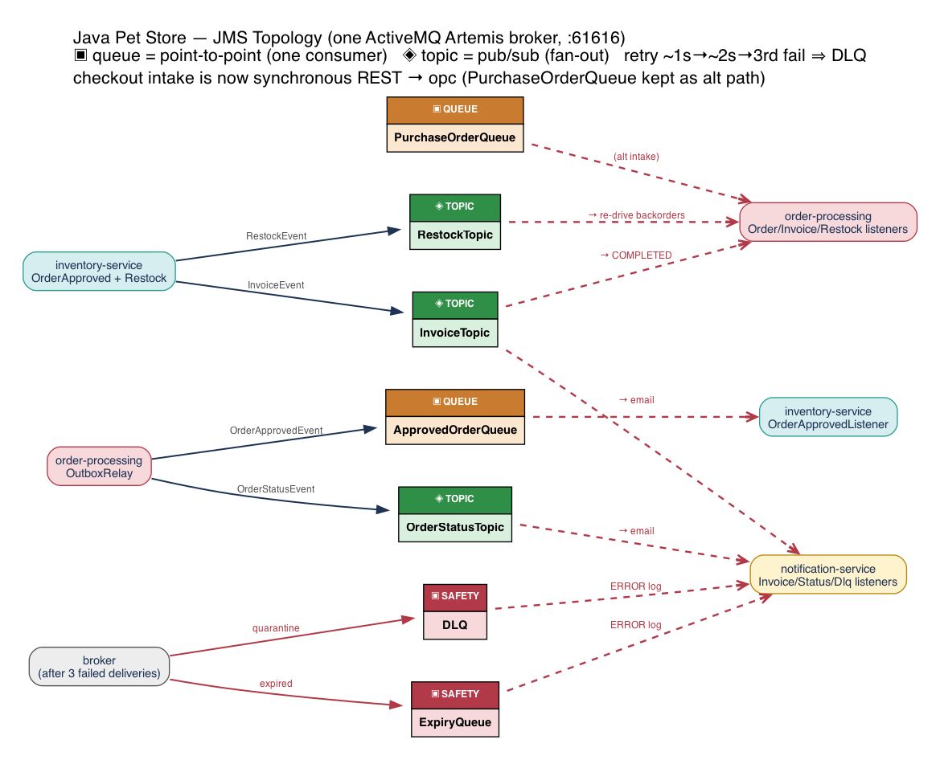
As-Built Architecture — JMS Topology
One ActiveMQ Artemis broker · 2 queues + 3 topics + 2 safety nets · producers → destinations → consumers

