Slide 1
PHASE I
Jiawei Ma
Xing Cai
Vishak Lakshman S M
Sai Shanoor
Omkar Bapat

Slide 2
What we do
* Clean the data
* Research
* Analyzing data
* Research again
* Final solutions

Slide 3
Data Wrangling in SAS Enterprise
Cleaned Data:
Correct Variables Data Type
Detect & Delete Outilers
Replace / Delete Missing Values
Delete Duplicated Records
Appended Datasets of Transactions_1 & Transactions_2
Created new variables, such as Total days of service, and Total PaymentAmount
Extended Claim Dataset with Useful Variables From Transactions

Slide 4
Key Challenges from Research
# Small injuries could be big factors
# Improper coverage for perennial diseases. Eg. cancer
# Coverage period could be less than the manifestation
# Many organizations lack a well-structured and productive data analytics team

Slide 5
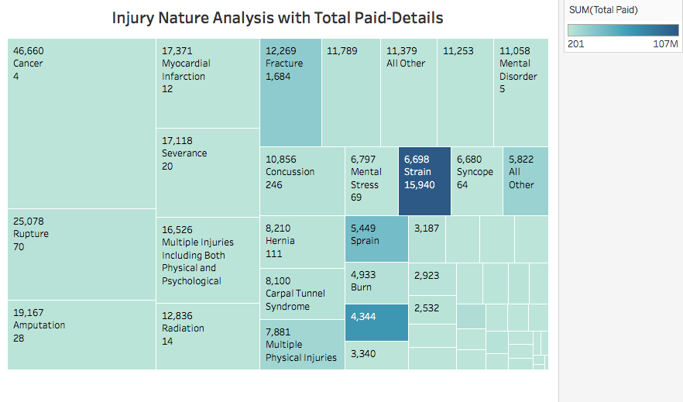
Small injuries could be big factors

Slide 6
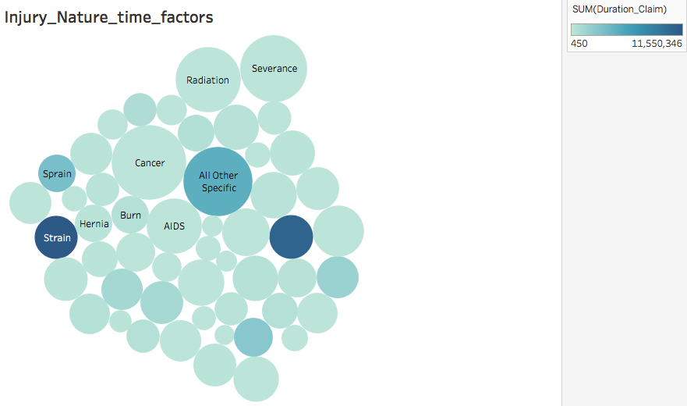
Small injuries could be big factors

Slide 7
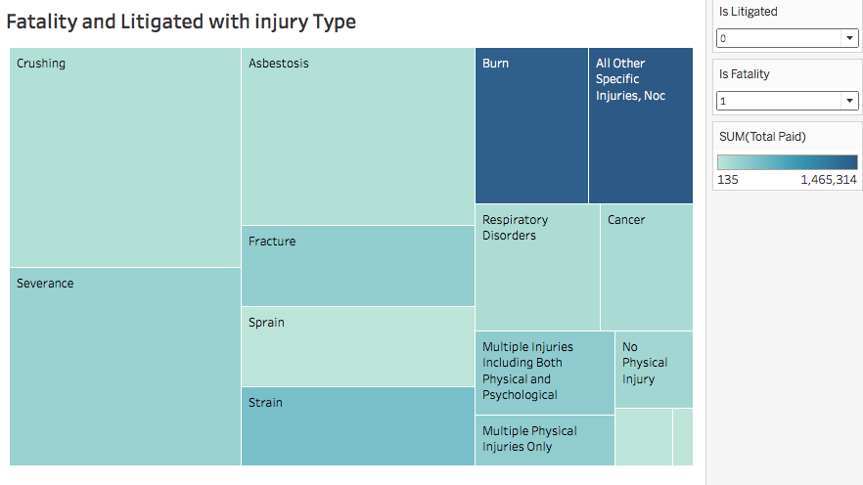
Fatality and Litigated

Slide 8
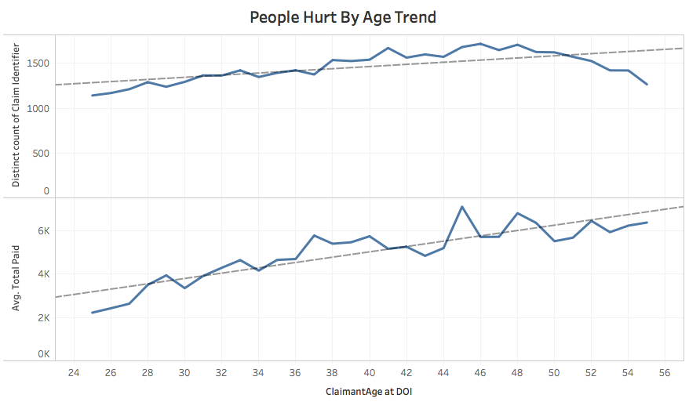
Other Finds

Slide 9
Solutions
Modifying duty by restrictions
“Compromised Treatment”
Build Teams
Moral Test
Data from Third part

Slide 10
Any Questions?

Slide 11
Thank you!

