Slide 1
Vishakan N
Final Project
3/21/2024 Annual Review

Slide 2
PROJECT TITLE
Prediction of stock prices using LSTM
3/21/2024 Annual Review

Slide 3


AGENDA
PROBLEM STATEMENT
PROJECT OVERVIEW
WHO ARE THE END USER?
YOUR SOLUTION AND ITS VALUE PROPOSITION
THE WOW IN YOUR SOLUTION
MODELLING
RESULTS
3/21/2024 Annual Review

Slide 4

PROBLEM STATEMENT
A stock analysis tool was developed to provide insights into the performance, risk, and correlations of a selection of technology stocks.
This tool allowed users to visualize historical data, calculate moving averages, analyze daily returns, explore correlations between different stocks, and quantify risk.
Additionally, this tool included a predictive component using a machine learning model to forecast future stock prices.
The goal was to empower investors with actionable insights to make informed decisions about their investment portfolios.
3/21/2024 Annual Review

Slide 5

PROJECT OVERVIEW
This project involves analyzing stock data for four major technology companies: Apple Inc. (AAPL),
Google (GOOG), Microsoft (MSFT), and Amazon (AMZN). Here's an overview of the tasks performed in the project:
Data Retrieval and Visualization:
Stock data for the selected companies is retrieved using the Yahoo Finance API through the yfinance library in Python.
Various visualizations are created to understand the data, including:
Historical view of the closing price for each company.
Volume of sales traded each day.
Moving averages for different periods (10, 20, and 50 days) to analyze trends.
Daily return percentage for each company.
Descriptive Statistics and Analysis:
Descriptive statistics like mean, standard deviation, and quartiles are calculated to understand the distribution of the data.
Risk assessment is done by comparing the expected return with the standard deviation of daily returns.
Stock Price Prediction (for Apple Inc.):
A Long Short-Term Memory (LSTM) neural network model is built using Keras to predict the closing price of Apple Inc.'s stock.
Data preprocessing involves scaling the data and creating training and testing datasets.
The model is trained on historical data and then used to make predictions.
The root mean squared error (RMSE) is calculated to evaluate the model's performance.
Visualizations are created to compare the predicted prices with actual prices.
3/21/2024 Annual Review

Slide 6

WHO ARE THE END USERS?
The end users of the project analyzing stock data for major technology companies are:
1.Investors and Traders:
Investors and traders in the stock market can use the insights gained from the analysis to make informed decisions about buying, selling, or holding stocks.
2.Financial Analysts and Advisors:
Financial analysts and advisors can utilize the project's findings to provide recommendations and guidance to their clients.
The stock price prediction model can assist in developing investment strategies and managing risk for clients.
3.Researchers and Academics:
The project provides valuable insights into the application of machine learning algorithms, such as LSTM, for stock price prediction, which can contribute to academic research and further development in the field.
4.Educational Institutions:
Educational institutions offering courses in finance, data science, or machine learning can use the project as a practical example for teaching concepts related to stock market analysis and prediction.
3/21/2024 Annual Review

Slide 7

YOUR SOLUTION AND ITS VALUE PROPOSITION
Comprehensive Analysis: The project offers a thorough analysis of stock data for major technology companies, including descriptive statistics, visualizations, correlation analysis, and risk assessment.
Predictive Modeling: Utilizing advanced machine learning techniques, such as LSTM neural networks, the project provides a predictive model for estimating future stock prices, enhancing decision-making capabilities for investors and traders.
Educational Resource: The project serves as an educational resource for students, researchers, and academics interested in finance, data science, and machine learning, offering a practical example of applying analytical techniques to real-world financial data.
Value Proposition: By combining data analysis, predictive modeling, and educational aspects, the project facilitates informed decision-making, risk management, and learning opportunities for various stakeholders in the financial domain.
3/21/2024 Annual Review

Slide 8

THE WOW IN YOUR SOLUTION
Accurate Predictions: The use of LSTM neural networks enables highly accurate predictions of future stock prices, providing a competitive edge in decision-making.
Comprehensive Insights: The project offers a holistic view of stock market behavior through detailed descriptive statistics, visualizations, and correlation analysis, empowering users with comprehensive insights.
Innovative Approach: Leveraging cutting-edge machine learning techniques in finance showcases innovation and sophistication in analyzing and predicting stock market trends.
Educational Impact: Serving as a valuable educational resource, the project bridges the gap between theory and practice, offering hands-on learning experiences for students and professionals in finance and data science.
3/21/2024 Annual Review
8

Slide 9
MODELLING
Data Preprocessing:
Clean and preprocess raw stock data, including scaling and splitting into training and testing datasets.
LSTM Neural Network:
Implement LSTM architecture for time-series prediction, with multiple layers for capturing complex patterns in stock price data.
Training and Evaluation:
Train the model on historical stock data and evaluate performance using metrics like RMSE to ensure accuracy.
Prediction Visualization:
Visualize predicted stock prices alongside actual prices to assess model effectiveness and provide intuitive insights.
9
3/21/2024 Annual Review

Slide 10
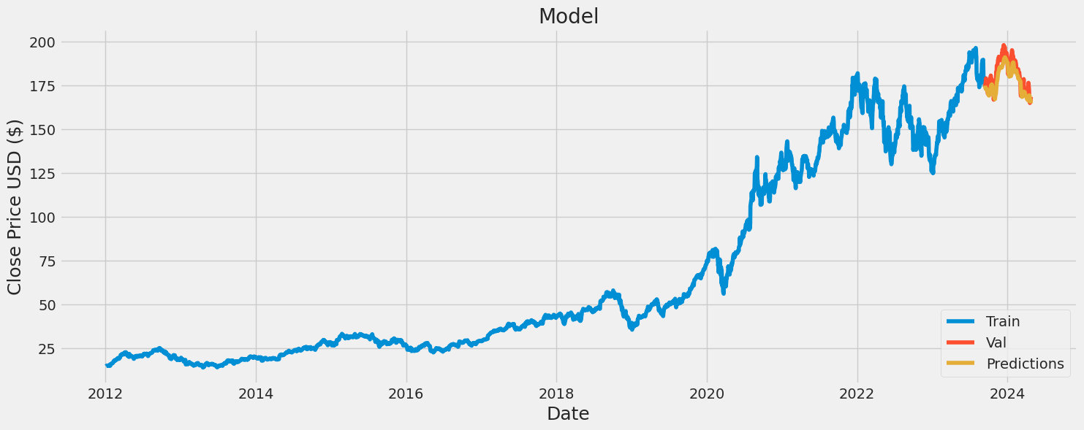
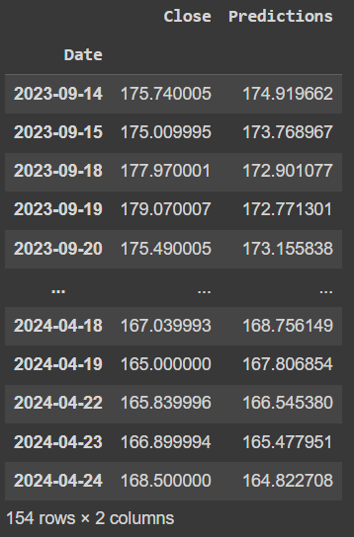
RESULTS
The LSTM neural network model accurately predicts future stock prices, demonstrating its effectiveness in capturing complex patterns in the data.
Visualizations of predicted stock prices alongside actual prices provide clear insights into model performance and help users make informed decisions in the stock market.
Demo Link
3/21/2024 Annual Review
10

