Slide 1
INVESTMENT ASSIGNMENT SUBMISSION
Name: Vishakh Mehta

Slide 2
Aim
Our aim was to provide the client with information on where to invest. We collected different data on investment trends in different sectors in different countries and have handpicked one fund type and three countries based on the requirements given by our clients.

Slide 3
How did we achieve it?
Business Understanding
Data Understanding
Data Preparation
Data Analysis + Visualization

Slide 4
Goals
The client wants to invest no less than 5 million USD and no more than 15 million USD.
The client wants to invest only in countries where English is an official language.

Slide 5
Process
We received the real time data about companies, investment rounds and sectors.
We removed all the unwanted data from companies and investment rounds.
We combined companies and rounds into one single dataframe.
We remove all the data of non English-speaking countries.
We keep only those funding types that the client needs to look at.
We find the average investment amount for each round type.

Slide 6
Process II
We find the most ideal investment type for the client and remove all the data about other investment types.
We find the top 9 countries according to the total amount invested and from that we get the top three countries for the client.
We map the category of the companies to the eight sectors given in mapping dataframe by merging it with the dataframe we were working.
We create three different dataframes, one for each country and find out the no of investments in each sector and the total amount of investment in each sector.
We find out what companies have the highest investment in the top 2 sectors in all three countries.
We plot graphs for average amount of investments in all four funding types, total amount of investment in top 9 countries with respect to the chosen funding type, and the no of investments in the top 3 sectors in the top 3 countries.

Slide 7
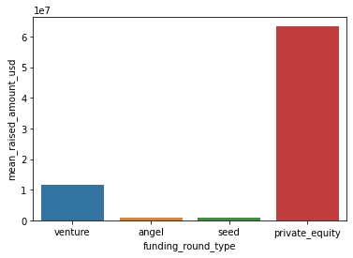
Type of Funding:
The following graph shows the trends of the favored funding types. The values of the amount are of the scale of 10 million dollars.
As you can see, private equity has an average investment of a little less than 70 million dollars, whereas angel and seed do not even exceed 5 million dollars. Venture on the other hand is ideal as it averages just over 10 million dollars.

Slide 8
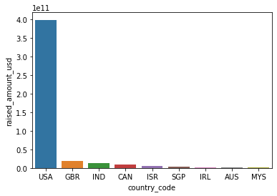
Top 9 Countries:
The following graph shows the top 9 English speaking countries that received funding in the funding type venture. The Y-axis shows amount in 100 billion dollars.
As you can see, USA has received the highest amount of funding at nearly 400 billion dollars followed by the United Kingdom with about 18 billion dollars and India with about 14 billion dollars.

Slide 9
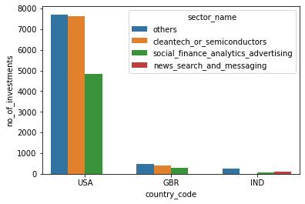
Top 3 Sectors in Top 3 Countries:
The following graph shows the top 3 sectors in the top 3 countries. The Y-axis shows the number of investments.
As you can see, the others sector has received the highest investment in all three countries.

Slide 10
Conclusions
The funding type suitable for the client according to the client’s requirement is Venture.
The top three English-speaking countries to invest in are USA, UK and India.
The top three sectors for USA and UK are Others, Cleantech or Semiconductors and Social, Finance, Analytics and Advertising.
The top three sectors for India are Others, News, Search and Message and Social, Finance, Analytics and Advertising.

