Slide 1

THIS PROJECT IS DONE BY
Vishakha Gandhi

Slide 2


Slide 3
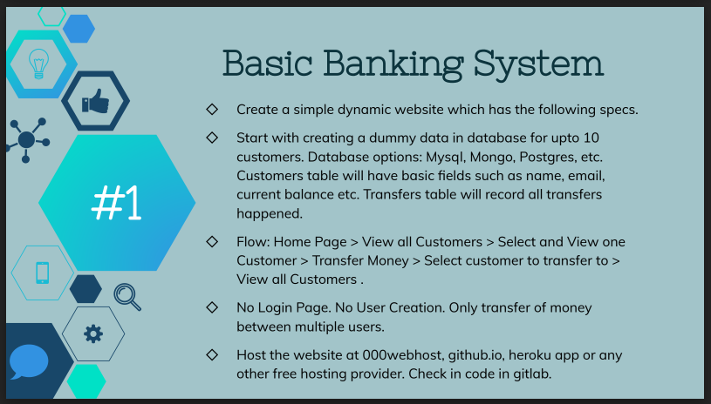

Slide 4


