Slide 1
NFS Performance graphs

Slide 2
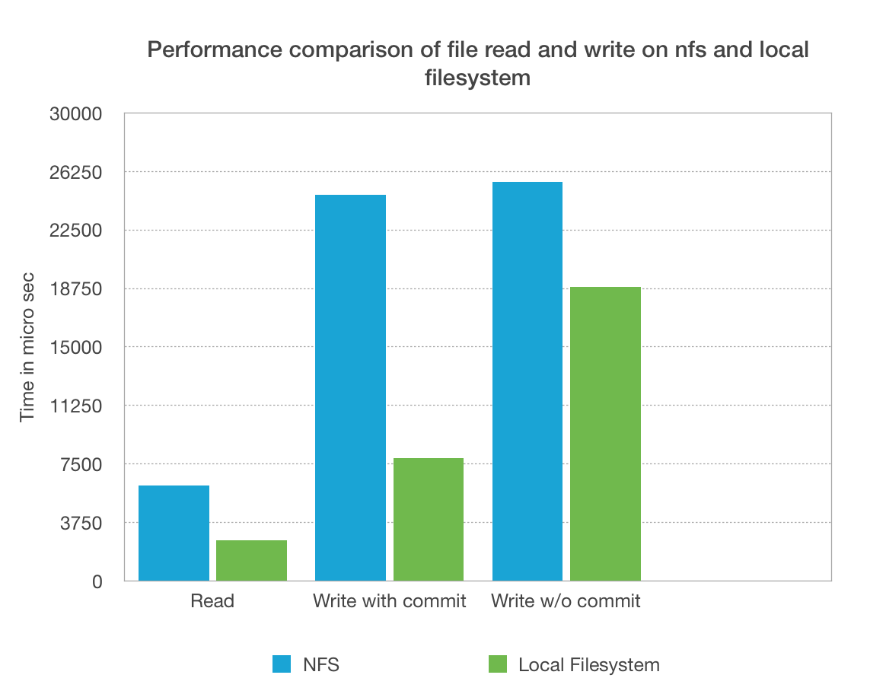

Slide 3
