Slide 1
Customer Response and Transaction Analysis
Key Insights
Vishakha Aggarwal

Slide 2
Executive Summary
Key Points:
- Response Rate: Overview of customer response rates.
- CLV Differences: Higher Customer Lifetime Value (CLV) for responders.
- Transaction Patterns: Increased frequency and amounts for responders.

Slide 3
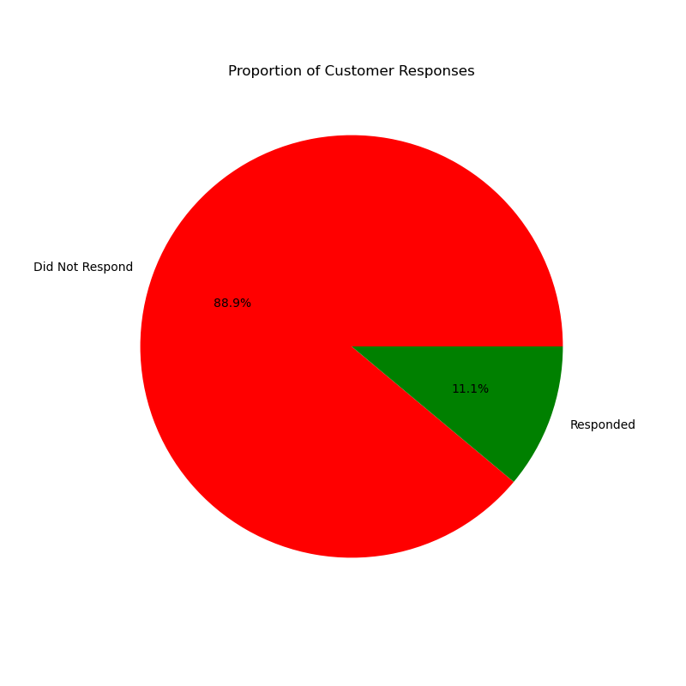
Customer Response Analysis
PROPORTION OF CUSTOMER RESPONSES
DID NOT RESPOND
88.9%
11.1%
RESPONDED

Slide 4
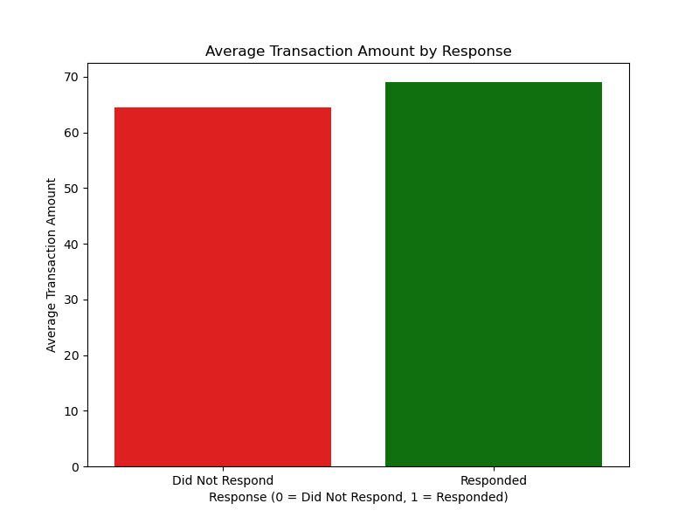
Average Transaction Amount by Response

Slide 5
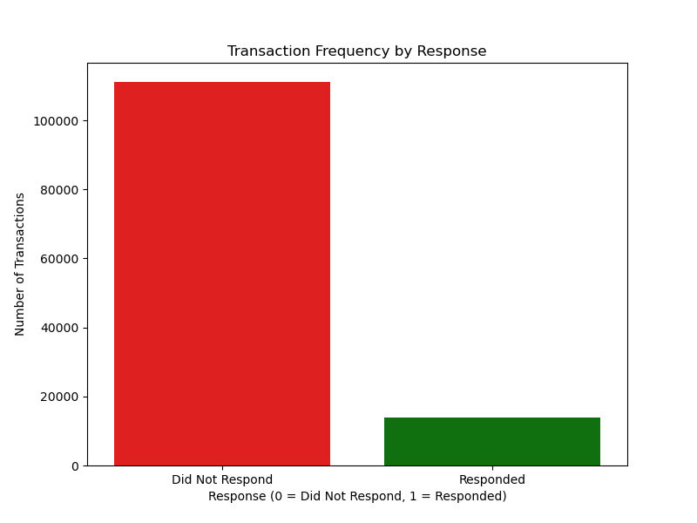
Transaction Frequency by Response

Slide 6
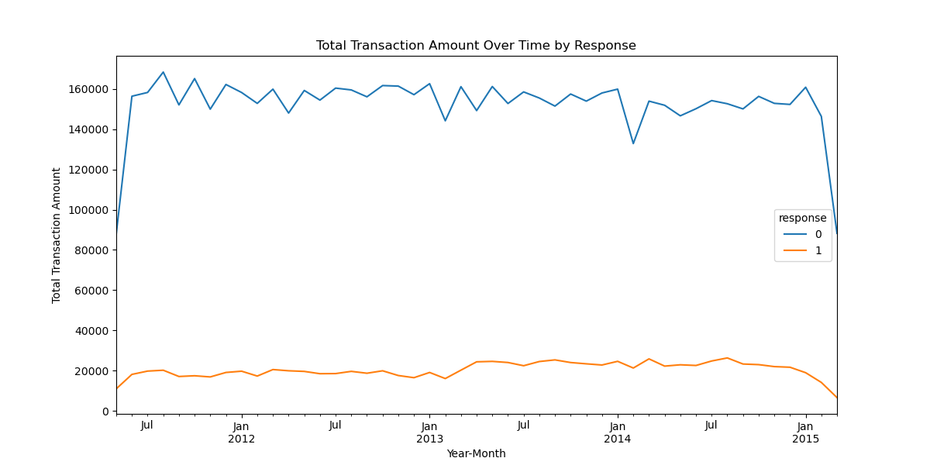
Total Transaction Amount Over Time by Response

Slide 7
Conclusion and Next Steps
Summary:
- Key Findings: Higher CLV and transaction amounts for responders.
- Strategic Actions: Implement targeted campaigns, enhance customer experience, optimize marketing spend, and ensure continuous monitoring.
Next Steps:
- Develop and launch targeted marketing campaigns.
- Implement loyalty and feedback programs.
- Allocate marketing budget strategically.
- Establish regular analysis and reporting processes.

