Slide 1

CODE REFACTORING AND BUG FIXING
ON
NOTE TAKING APPLICATION
VISHAKHA DESHMUKH IN1240031
28 FEB 2024

Slide 2
About me
Hello!!! I am Vishakha Deshmukh, Currently Pursing Masters of Science in Information Technology.
I am currently engaged in an internship at Innomatics Research Labs. This experience allows me to apply theoretical knowledge in a practical setting, contributing to my growth and understanding of real-world applications in the field of information technology and data science.

Slide 3
TASK:
Refactor the existing codebase and ensure the proper functioning of the Note Taking Application
OBJECTIVE:
The primary objective of this project is to fix the identified bugs in the Note Taking Application and ensure that is functions correctly. Goal is to fix the already existing codebase and make the application work as intended.
TECHNOLOGY STACK:
Python
Flask
HTML
CSS

Slide 4
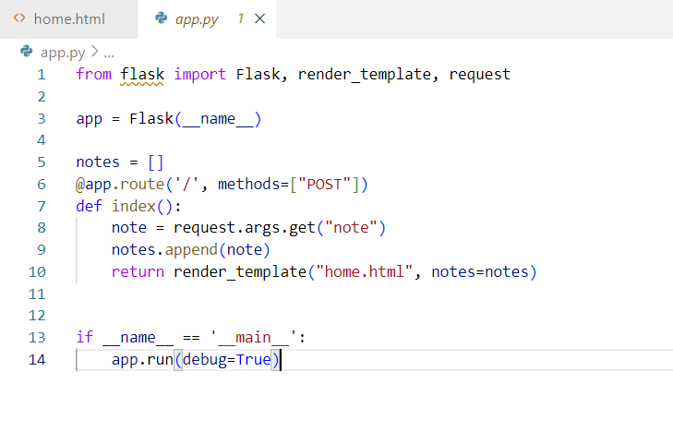
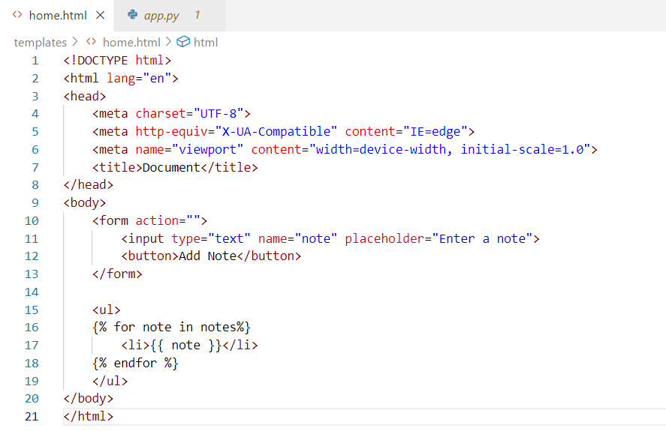
Here is the Initial Codebase:

Slide 5
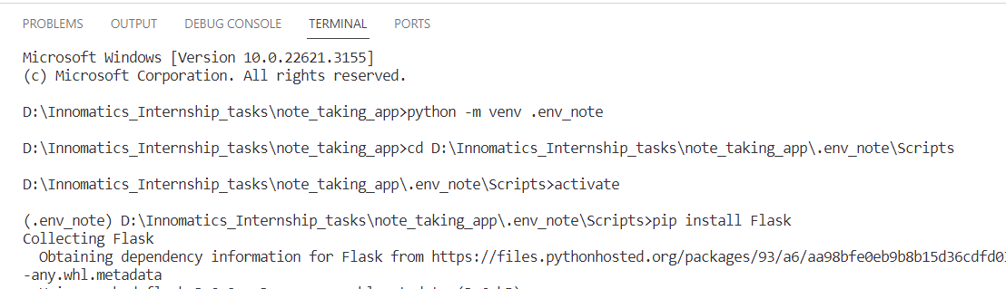
Bug Description:
Initially, the Flask framework was not installed in the project environment, leading to a failure to execute the Flask application.
Issue Identification:
The absence of Flask in the project environment prevented the application from running and required the installation of Flask to resolve the issue.
Changes –Initiated Virtual environment using commands..”pip install Flask”command

Slide 6
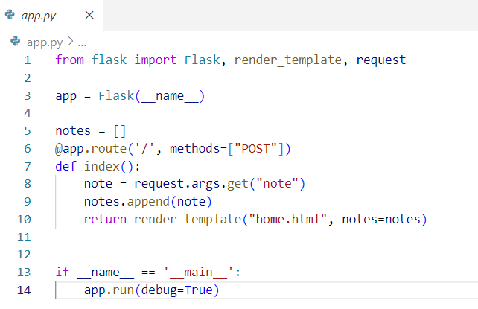
Resolved Code:

Slide 7
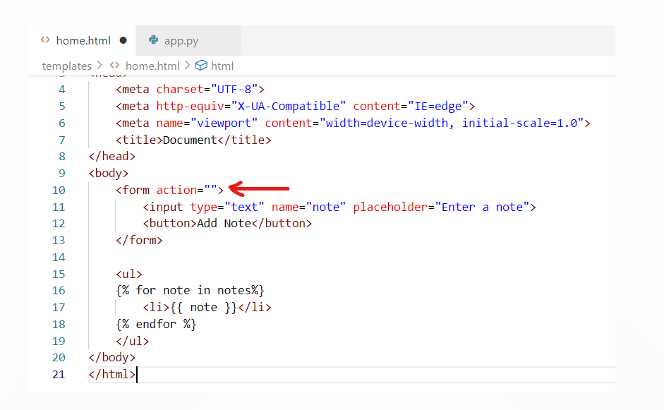
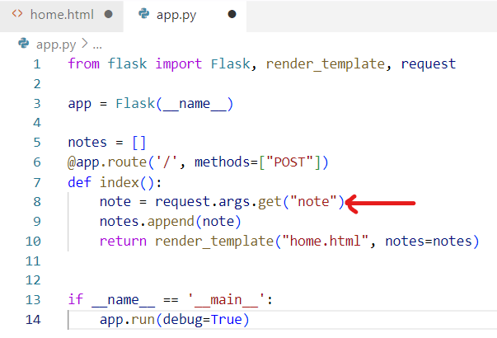
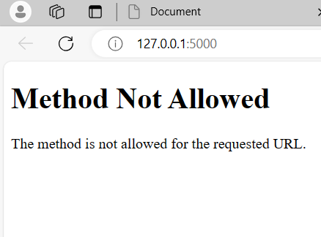
Bug Description:
Form Submission Method-Mismatch between the form submission method specified in the HTML code and the HTTP method expected by the Flask route handling the form data
Issue Identification:
When the form is submitted, it sends a GET request to the root URL ('/'), but the Flask route is configured to handle POST requests at the same URL.

Slide 8
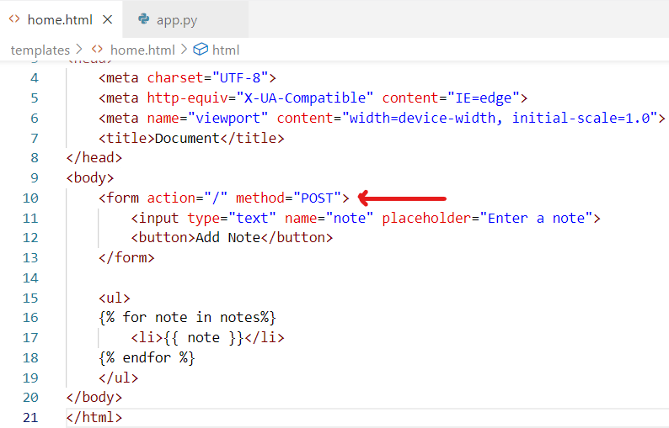
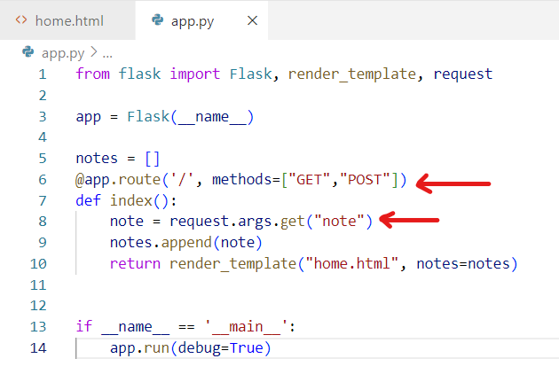
Changes :
Changed the accepted HTTP methods from only ["POST"] to ["GET", "POST"].
This modification allows the specified route to handle both GET and POST requests
Changed method="post" in the form tag.
This explicitly specifies that the form should be submitted using the POST method.
Resolved Code:

Slide 9
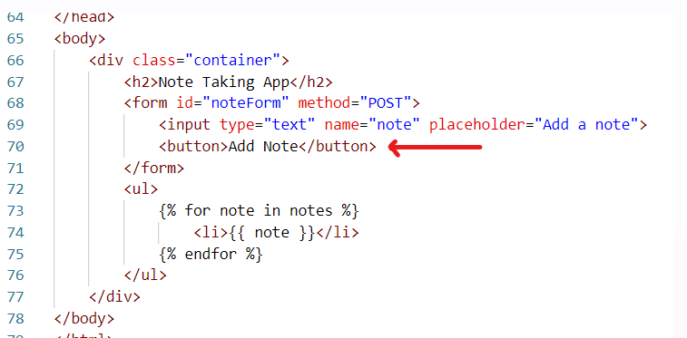
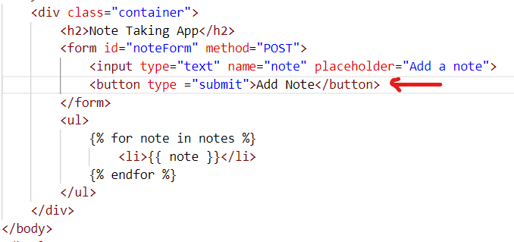
Bug Description:
Form Submission Button
In HTML form, the submit button doesn't have the type="submit" attribute.
Issue Identification
In HTML forms, the submit button does have the type="submit" attribute to specify that it is a submit button. The type attribute is crucial for defining the purpose of the <button> element within a form.
Resolved Code:

Slide 10
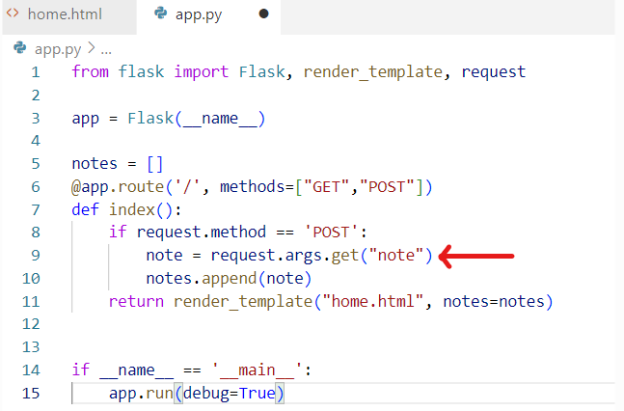
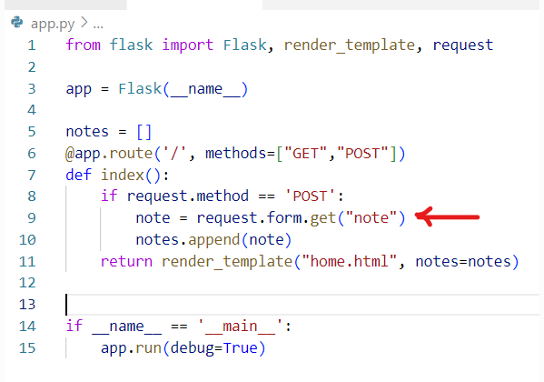
Bug Description:
The bug was related to the handling of form submissions and the incorrect usage of request.args instead of request.form to retrieve the submitted note.
Issue Identification
The HTML form used the POST method for submission, but the Flask route was attempting to retrieve the note using request.args. This inconsistency in handling form submissions led to the failure of adding notes to the list
Changes-To address the bug, the Flask route (index) was modified to correctly handle form submissions using request.form.get("note")
Resolved Code

Slide 11
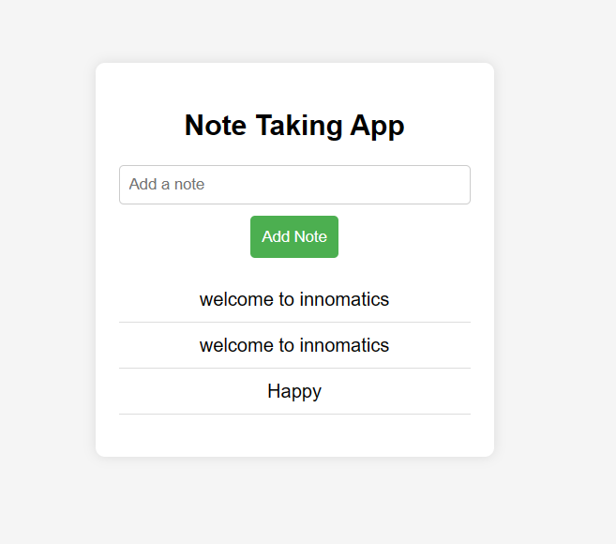
Added some formatting to make page look better
Here the fully working page :

Slide 12

THANK YOU

