Slide 1

Regex Matching Web App Development Project

Slide 2
About me
Greetings! I'm Vishakha Deshmukh,a currently pursuing a Master's of Science in Information Technology. Have a keen interest in data science field.
Currently working as Data Science Intern at Innomatics Research Lab.
Linkedin

Slide 3
Regex Matching Web App Development Project
Objective:
Is to replicate the core functionality of the website regex101.com. This entails creating a web application that allows users to input a test string and a regular expression (regex) and displays all the matches found.

Slide 4
Steps:
1. Create a new directory for your project and navigate into it.
2. Set up your virtual development environment:
- Install Flask, a Python web framework
$ pip install Flask
3. Initialize a new Flask application:
- Create a new Python file named `app.py`.
- Import Flask and create a new Flask app instance.
- Define a route for the home page ("/") where users can input the test string and regex.
- Render an HTML template containing a form with fields for the test string and regex, and a submit button.

Slide 5
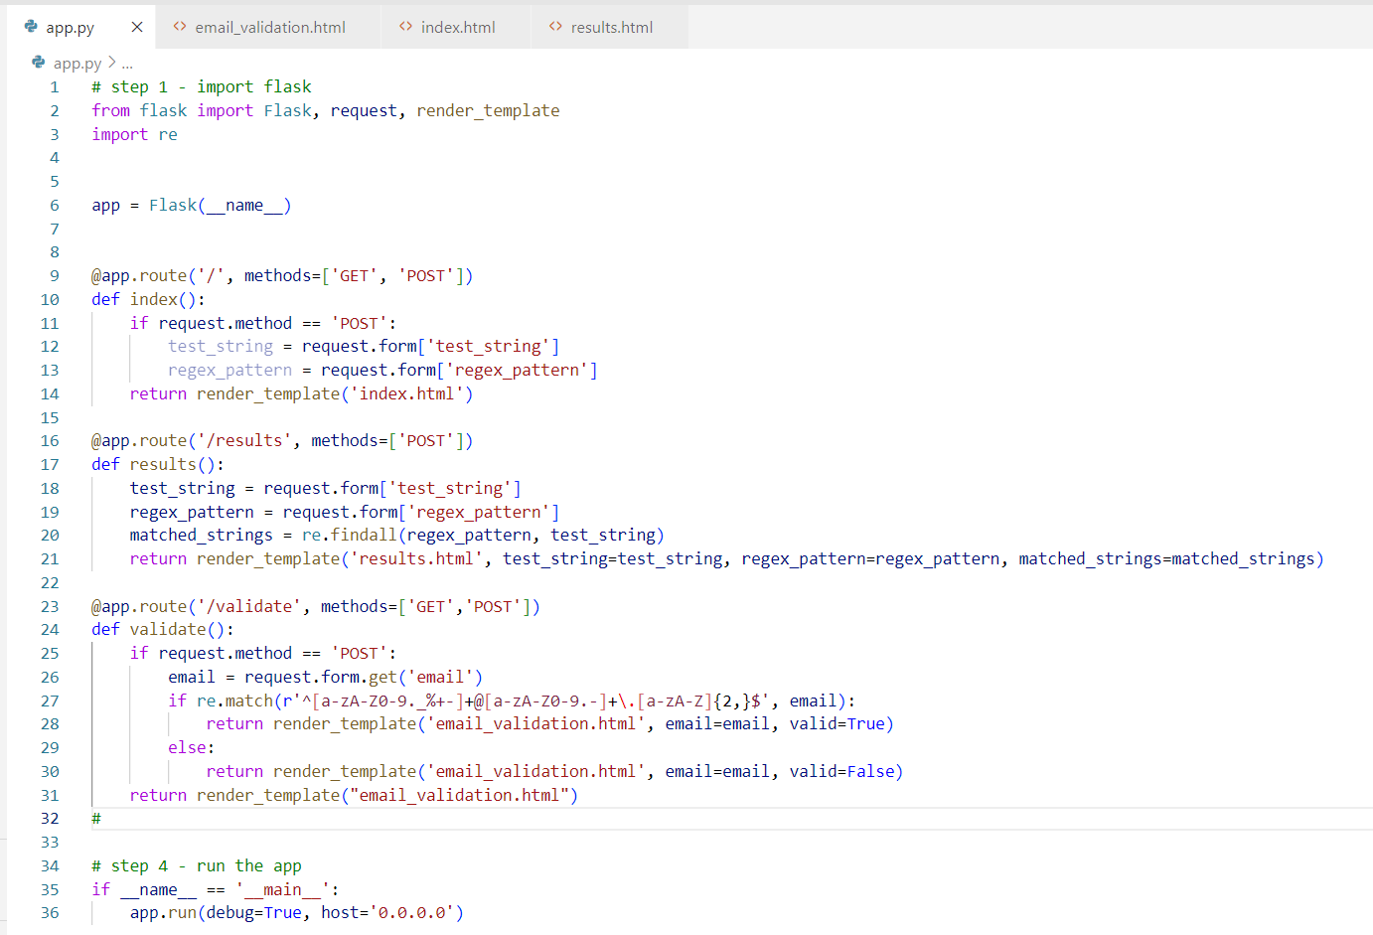
app.py

Slide 6
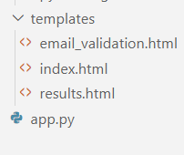
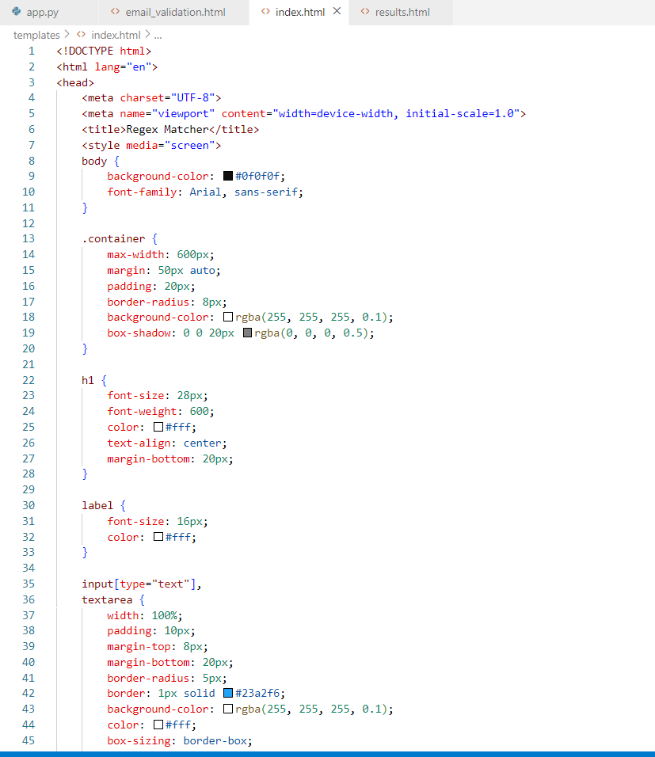
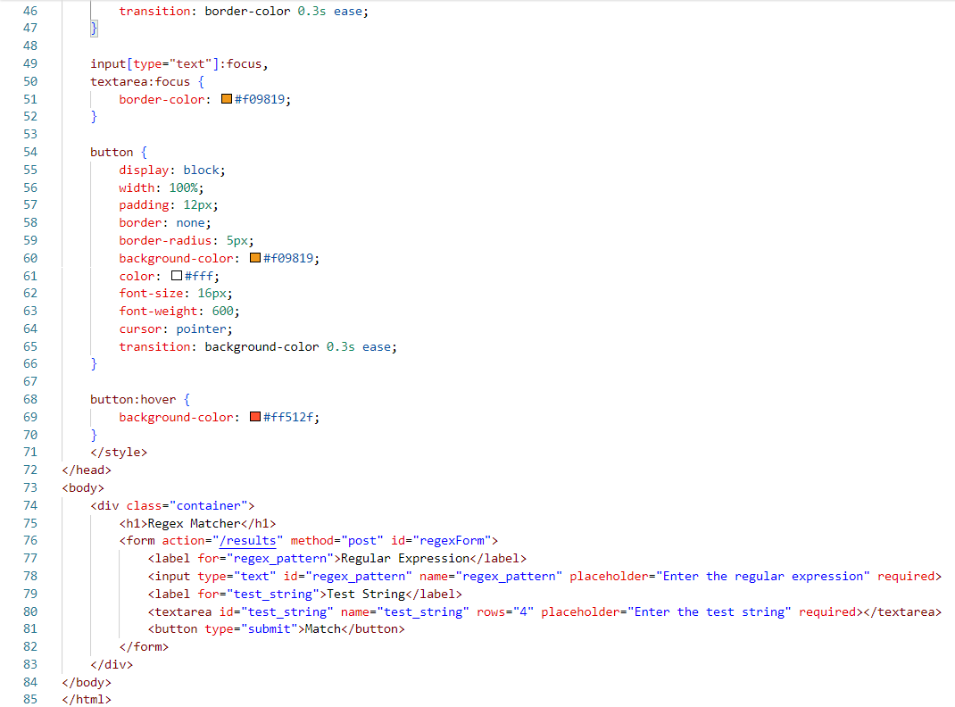
4.Create the HTML template:
- Create a new directory named `templates` within your project directory.
- Inside the `templates` directory, create a new HTML file named `index.html`.
- Design the HTML form with input fields for the test string and regex, and a submit button.

Slide 7
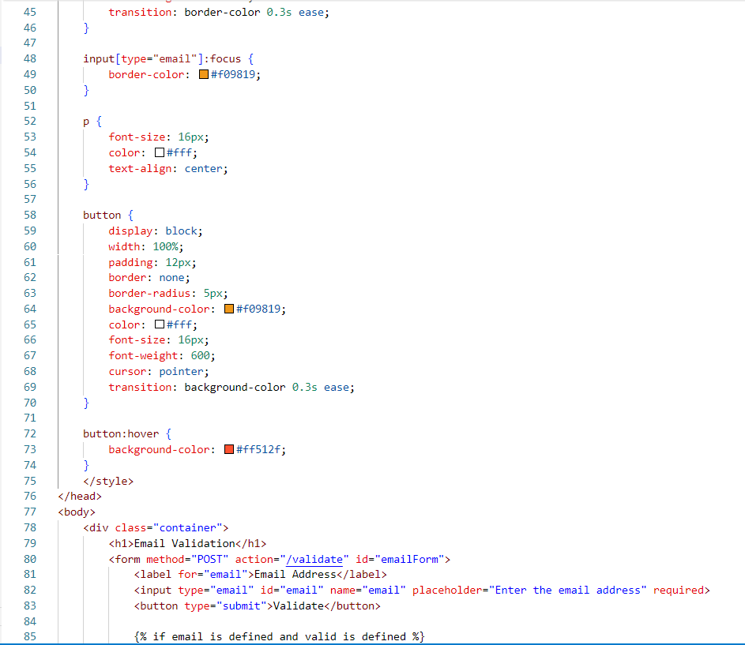
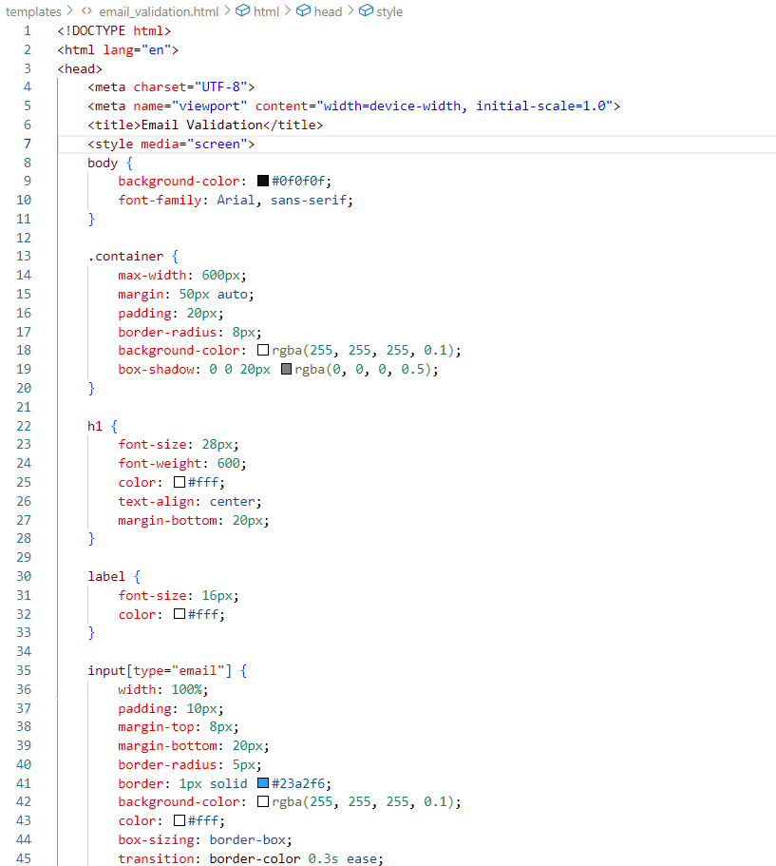
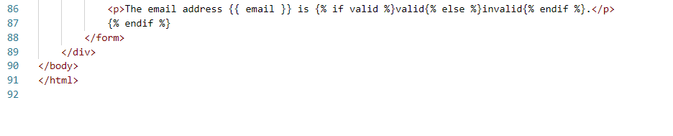
email_validation.html

Slide 8
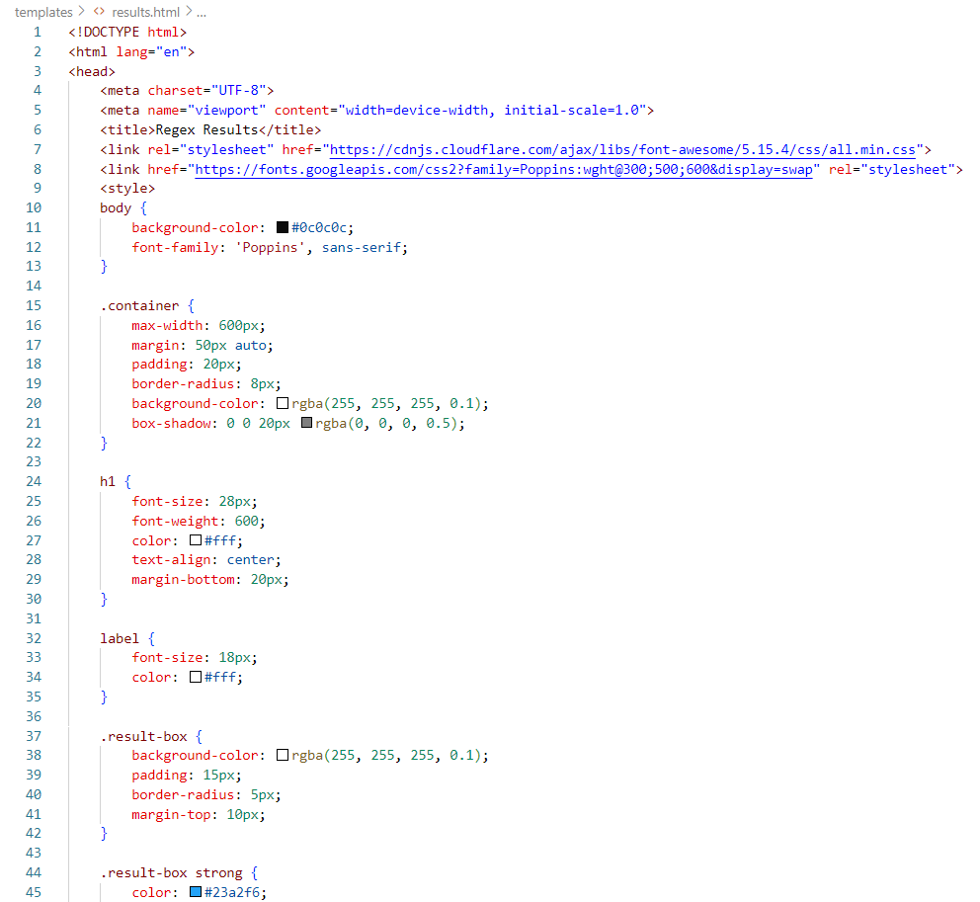
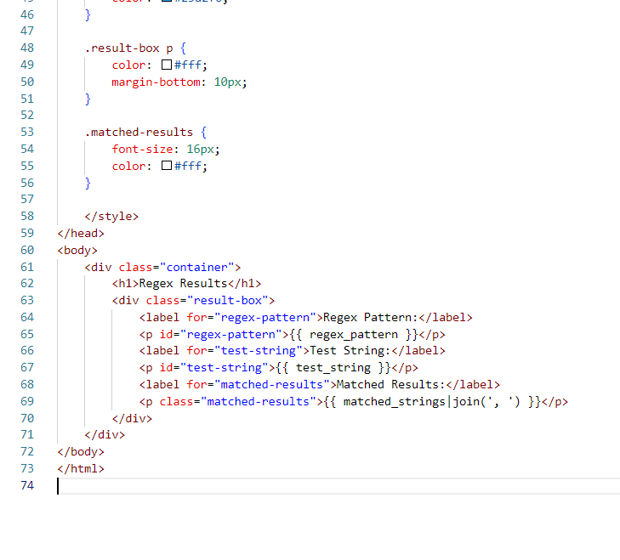
Results.html
Render the results:
- Pass the list of matched strings to the HTML template.
- Modify the HTML template to display the matched strings below the input form.

Slide 9
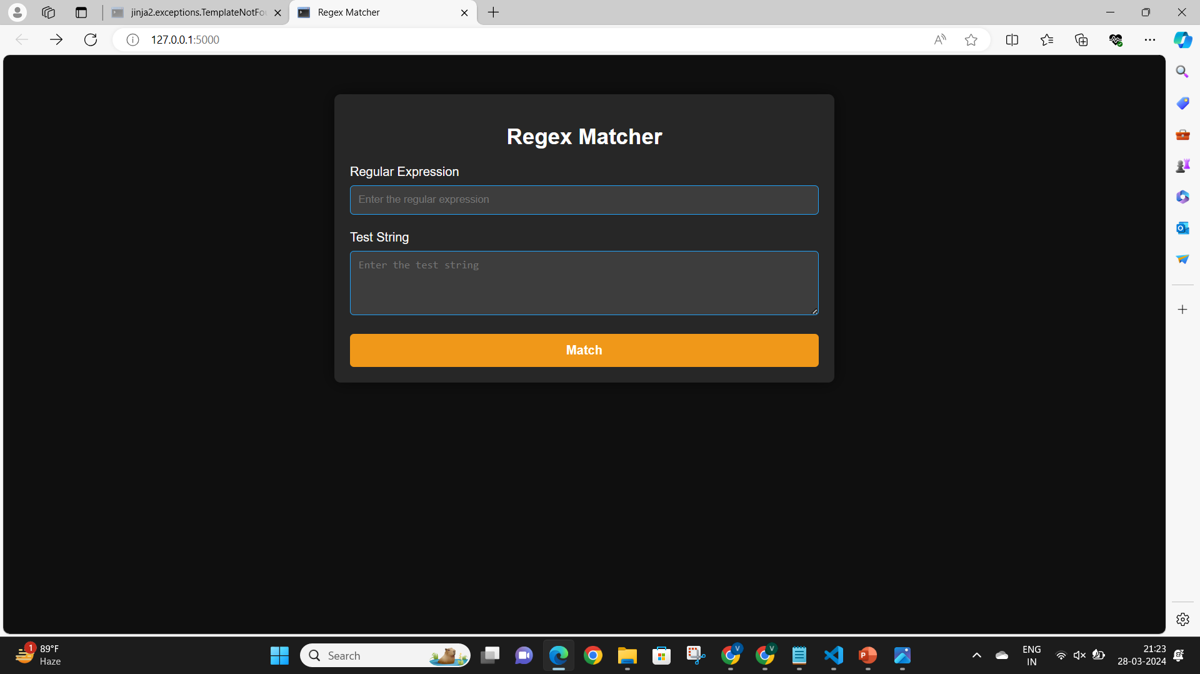
Run the Project
OUTPUT:

Slide 10
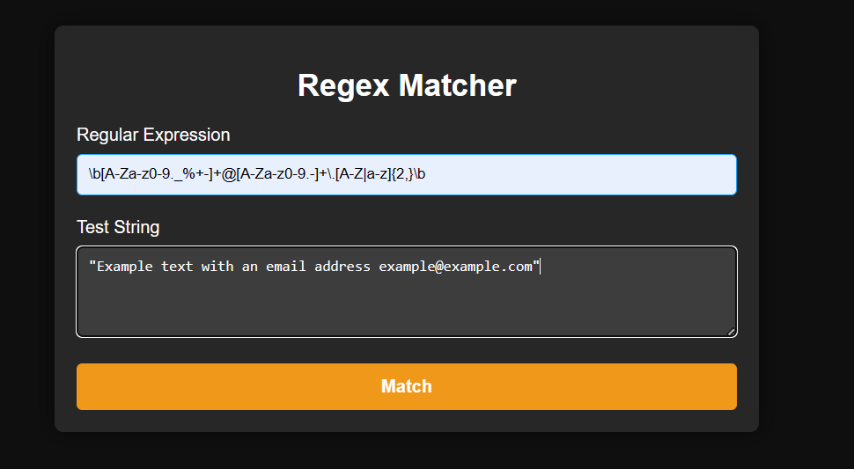
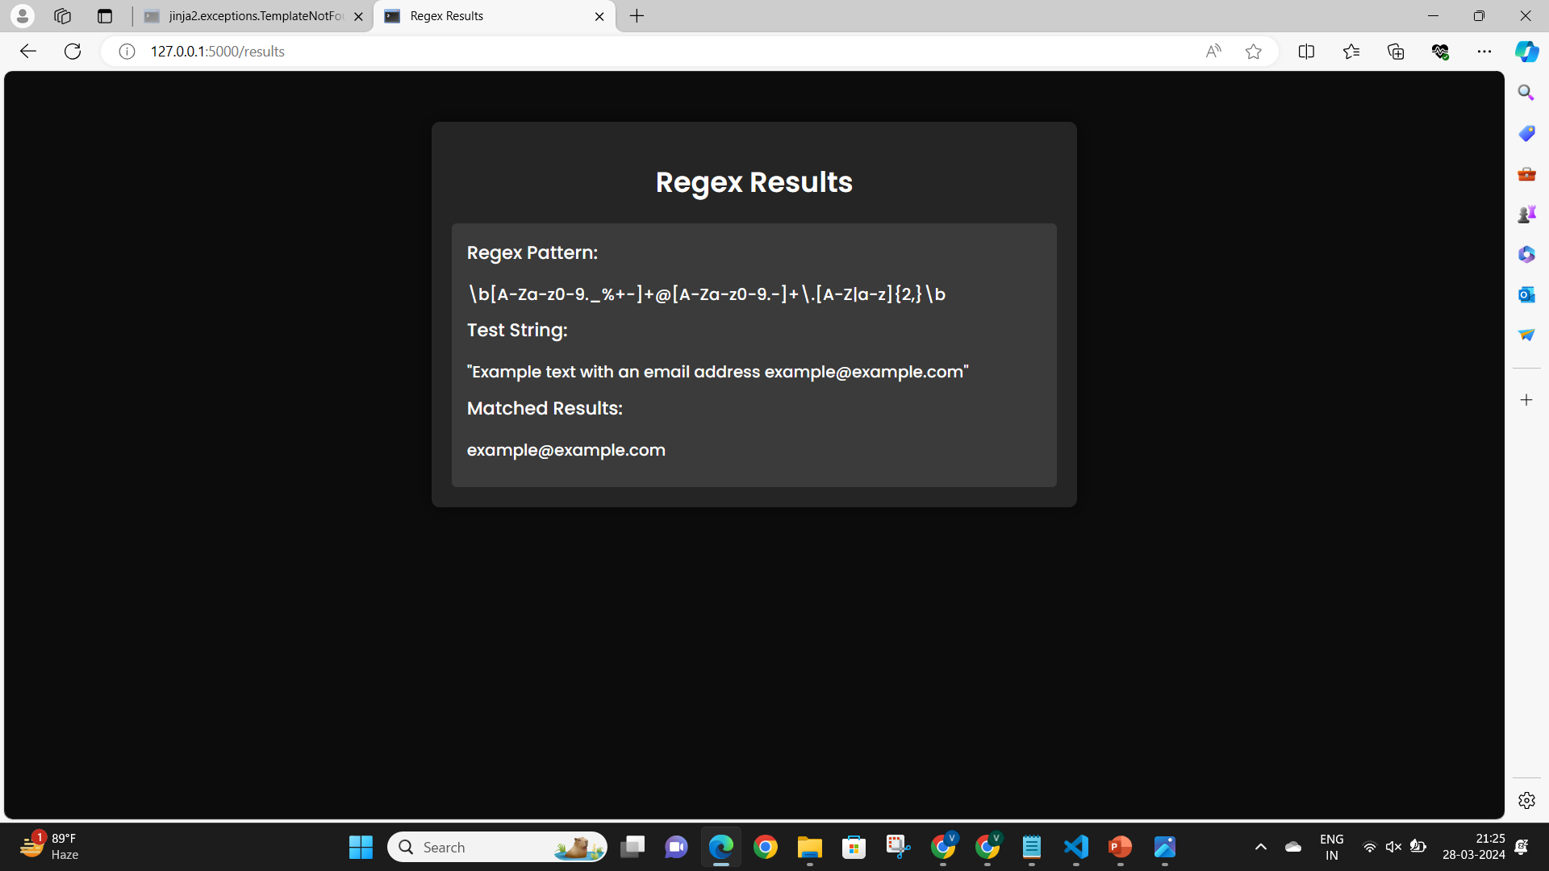
Enter the inputs :
Regular expression and pattern then click on Match
Example-
Here we are matching email pattern with email id

Slide 11
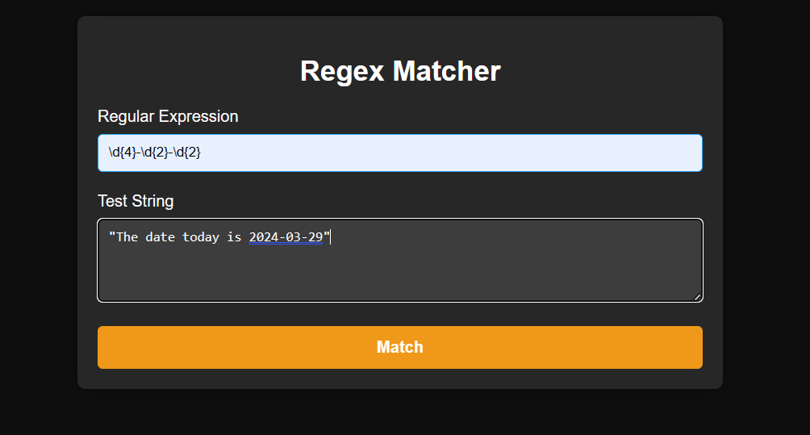
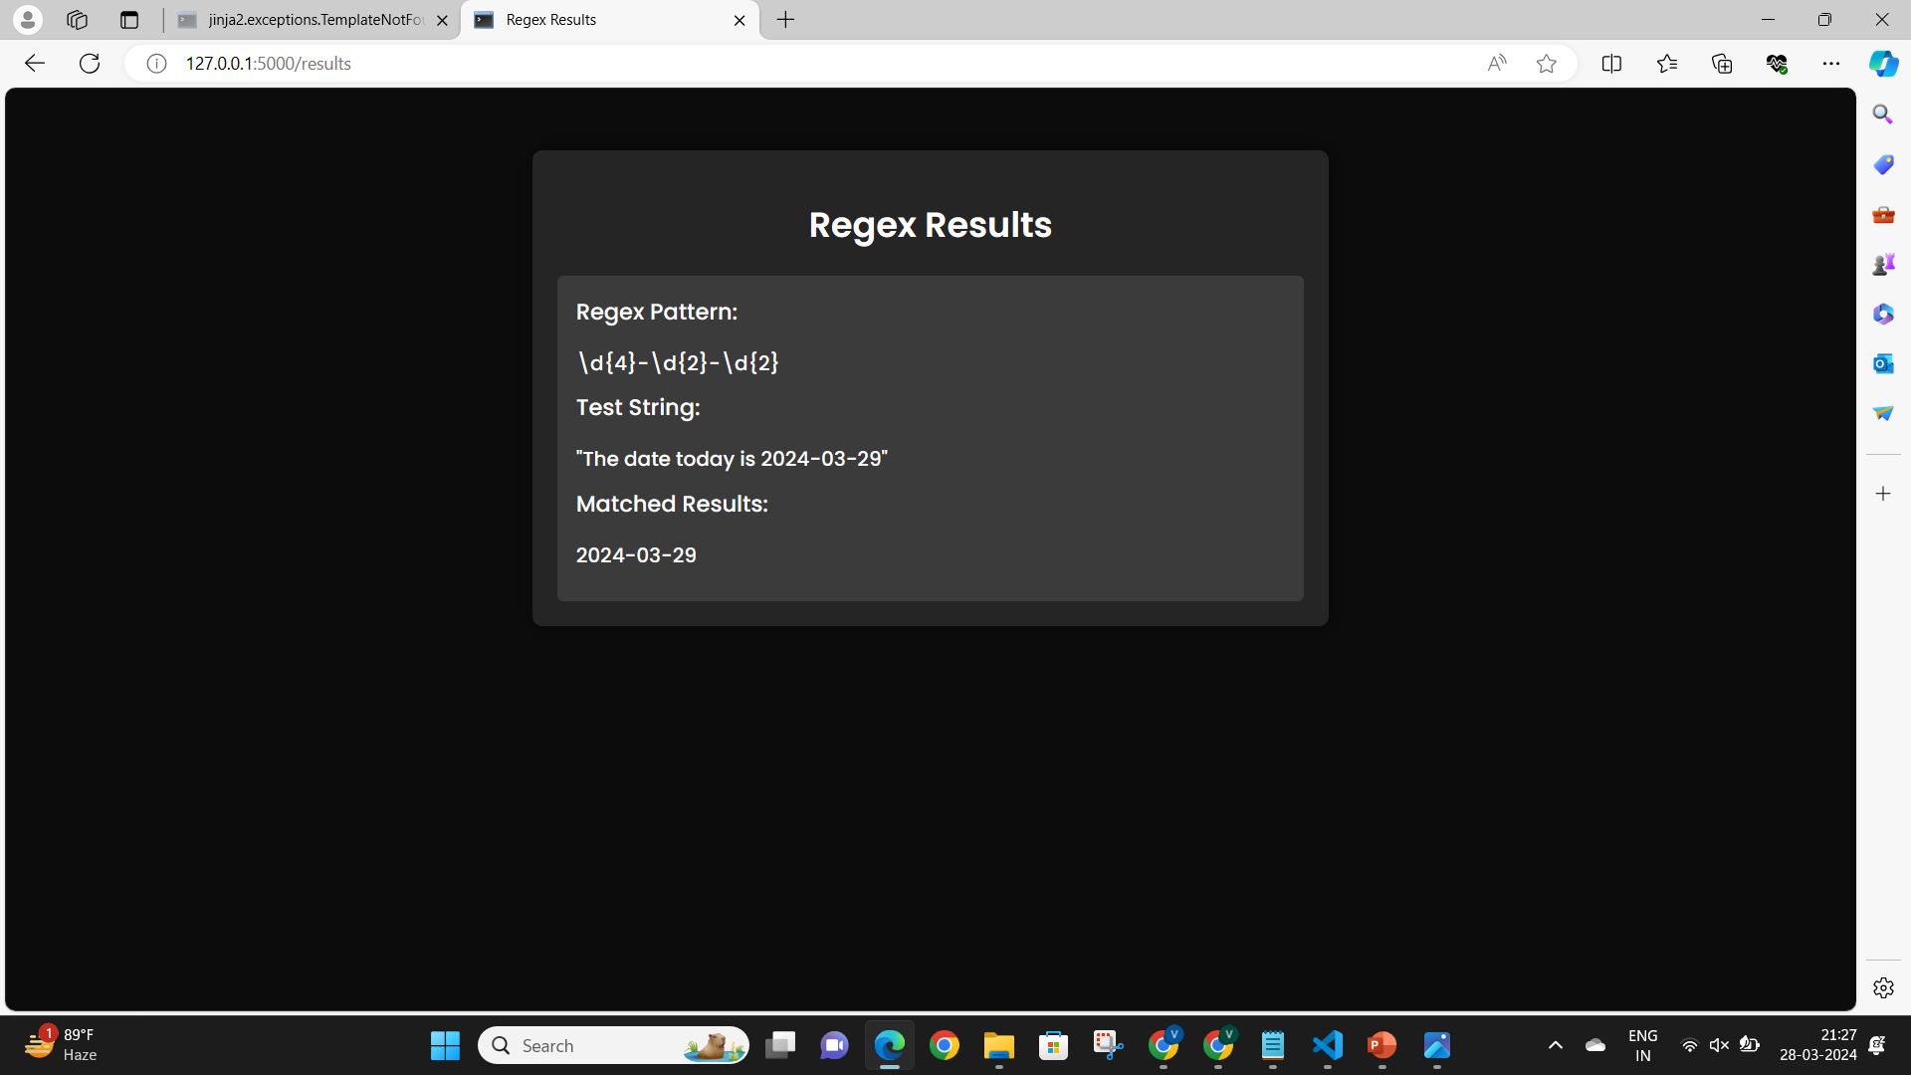
Date Pattern Input :

Slide 12

THANK YOU

