Slide 1



Shaping Future India
End-Term Examination Project: Computer Vision using Python

Slide 2
Team 4: Wound Healing Assessment from Smartphone Images
Design a mobile-friendly model that segments chronic wounds, measures area/perimeter, and classifies healing stages from patient-submitted photos.
Desai Ajay (20252001)
Anuj N Soni (20252004)
Antala Raj (20252036)
Vansh Shah (20252050)
Vishakha Chauhan (20252053)
Course: PGDM in Artificial Intelligence & Data Science
Year: 2025-27

Slide 3
Problem Statement
Manual measurement is inaccurate and inconsistent
High inter-observer variability (~40%)
Requires clinical expertise
Not scalable for remote healthcare / telemedicine
Deep learning solutions:
Require large labeled datasets
Lack interpretability (black-box models)
No accurate, automated, and explainable system for wound analysis from smartphone images

Slide 4
Proposed Hybrid AI System
We designed a system that accepts smartphone images
Performs:
Image preprocessing
Wound segmentation
Measurement (area & perimeter)
Healing stage classification
Core Idea: Combines
Computer Vision (OpenCV) + Image Processing (PIL) + Deep Learning (PyTorch)
Flexible System:
Works even without training data (CV mode)
Can upgrade to Deep Learning (trained models)

Slide 5
Technology Stack
Programming
Libraries
Deep Learning
PyTorch
EfficientNet-B0 (classification)
Attention U-Net
DeepLabV3 (segmentation)
OpenCV
NumPy
PIL
Scikit-image
Python

Slide 6
System Pipeline Overview
Instead of relying on a black-box Neural Network, our application uses a highly interpretable, Unsupervised Machine Learning and Heuristic Computer Vision approach. This means the algorithm actively calculates biological color logic on the fly.
01
02
03
04
05
Gaussian Filter
+ Color Space
K-Means++
Clustering
Morphological
Refinement
Contour
Measurement
Diagnosis
+ Overlay
GaussianBlur
HSV + LAB
cv2.kmeans
k=4 clusters
MORPH_OPEN
MORPH_CLOSE
findContours
contourArea
Heuristic
addWeighted

Slide 7
Stage 1: GAUSSIAN FILTERING & DUAL COLOR SPACE TRANSFORMATION
cv2.GaussianBlur — Noise Reduction
HSV — Skin Isolation
• Removes microscopic camera sensor noise
cv2.threshold on Saturation channel
• Eliminates specular reflections (sweat, exudate)
• High Saturation = skin/tissue (keep)
• Prevents pixel noise being mistaken for wound boundaries
• Low Saturation = white sheets, tables (discard)
• Preserves structural wound edges for contour detection
Result: Isolated hand/limb region only
CIELAB Color Space — Biological Tissue Discrimination (The Core Innovation)
L* Channel
a* Channel
b* Channel
Luminance / Darkness
Dark eschar & necrotic tissue
have low L* values
RED ←→ GREEN axis
Direct marker for blood,
inflammation & hemoglobin
YELLOW ←→ BLUE axis
Identifies fibrin slough
and necrotic tissue

Slide 8
Stage 2: K-MEANS++ UNSUPERVISED CLUSTERING
The Algorithm
Clustering
Inside the isolated hand area, the app runs *cv2.kmeans* (specifically using the highly stabilized KMEANS_PP_CENTERS initialization).
It forces all the pixels in the skin area to mathematically group themselves into exactly 4 dominant color families (Clusters).
Biological Anomaly Detection
Once the 4 clusters are generated, the app evaluates them using a custom biological scoring formula. It actively searches for the cluster that is the most intensely *Red* (high 'a') and the *Darkest* (low 'l'). It definitively labels the winning cluster as the "Wound Mask".

Slide 9
Stage 3: MORPHOLOGICAL REFINEMENT
MORPH_OPEN — Noise Scrubbing
MORPH_CLOSE — Gap Filling
Operation: Erosion → Dilation
Operation: Dilation → Erosion
• Removes red freckles and moles on healthy skin
• Fills holes from reflective wound exudate
• Eliminates blood vessel artifacts at periphery
• Bridges scar tissue gaps inside wound bed
• Clears single-pixel misclassification noise
• Creates one contiguous medically valid mask
• Structures smaller than kernel are fully erased
• Holes smaller than kernel are completely filled

Slide 10
Stage 4: GEOMETRIC CONTOUR EXTRACTION
cv2.findContours
cv2.contourArea
Traces exact outer wound boundary using RETR_EXTERNAL mode. Returns microscopic contour point array.
Computes pixel count enclosed within contour via Green's theorem on contour coordinates.
cv2.arcLength
Physical Conversion
Sums Euclidean distances between consecutive contour points to measure perimeter in pixels.
area_cm² = pixels/(45²)
perimeter_cm = pixels/45
Calibrated from reference marker.

Slide 11
Stage 5: HEURISTIC DIAGNOSIS & ALPHA-BLEND VISUAL OVERLAY
Heuristic Fallback: Based on exactly how massive the contour area is, the CV engine utilizes strict logical bounds to diagnose the severity and current healing stage of the wound, dynamically generating a 0-100% confidence percentage metric.
Alpha-Blend Visual Overlay — cv2.addWeighted(overlay, 0.4, original, 0.6, 0)
drawContours
fillPoly
addWeighted
0.4 + 0.6
Clinical
Transparency
3px bright green boundary line around exact wound perimeter
Neon-green fill on separate overlay layer covering wound interior
Alpha blend: 40% green overlay + 60% original image
Clinician sees exact analyzed region — not a black-box result

Slide 12
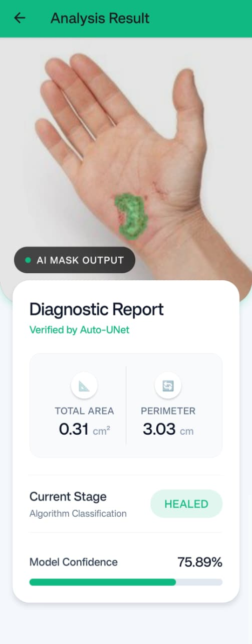
LIVE SYSTEM RESULTS - APPLICATION SCREENSHOTS
TEST CASE 1 — Palm Wound
Location
Palm of hand
Total Area
0.31 cm²
Perimeter
3.03 cm
Healing Stage
HEALED ✓
Confidence
75.89%
Mask
Neon-green overlay

Slide 13
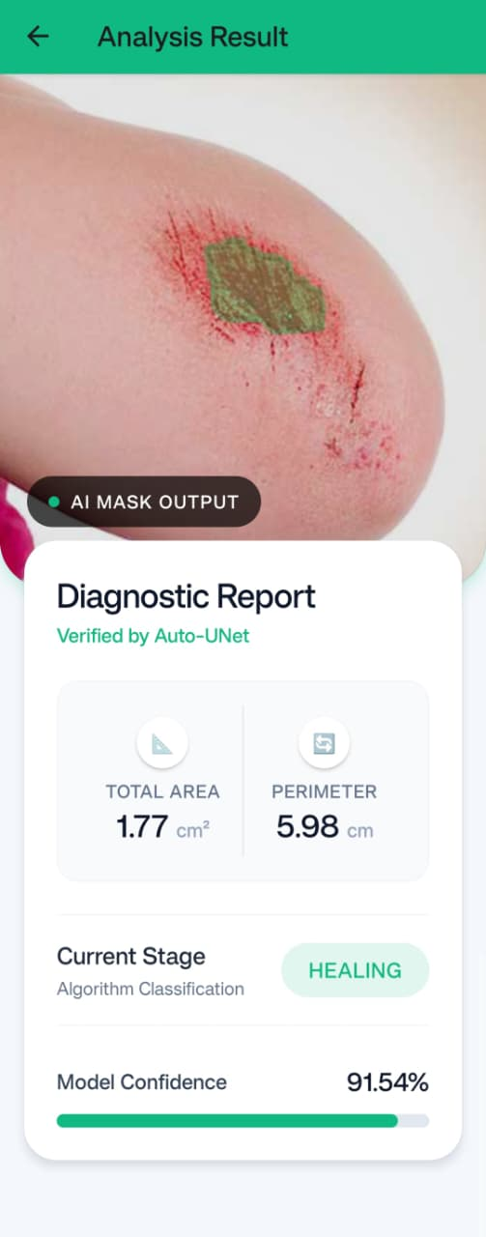
LIVE SYSTEM RESULTS - APPLICATION SCREENSHOTS
TEST CASE 2 — Elbow Wound
Location
Elbow region
Total Area
1.77 cm²
Perimeter
5.98 cm
Healing Stage
HEALING ~
Confidence
91.54%
Mask
Neon-green overlay

Slide 14
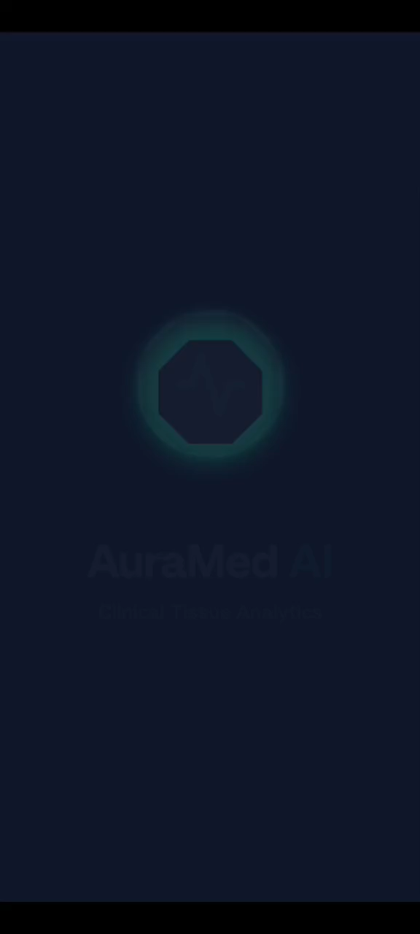
Demo Video

Slide 15
Advantages
Works without large labeled training datasets
Provides interpretable and transparent visual analysis results
Fast processing suitable for real-time applications
Scalable solution for remote healthcare and telemedicine
Flexible integration with deep learning models

Slide 16
LIMITATIONS
Performance affected by poor lighting and image quality
Requires calibration for accurate real-world measurements
Current system uses partially simulated model outputs
Limited availability of diverse medical training datasets
May struggle with complex or overlapping wound regions

Slide 17
CONCLUSION
Developed hybrid system combining computer vision and AI
Enables automated wound detection, measurement, and classification
Provides interpretable results suitable for medical decision support
Scalable approach for future telemedicine applications
Strong foundation for integrating advanced deep learning models

Slide 18
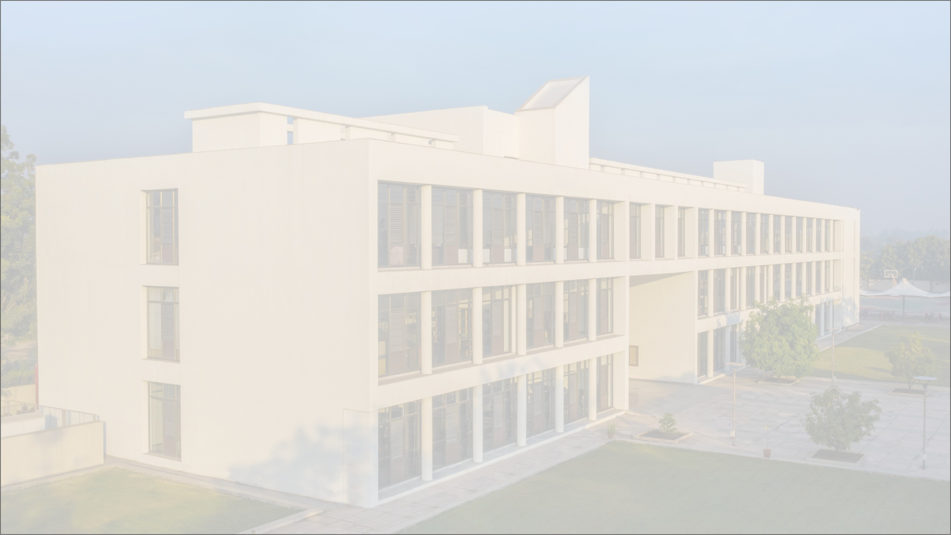
Thank You
Thank You

