Slide 1
MILESTONE 5
Model Evaluation & Analysis
Deep Learning-Based Human Face Authenticity Detection
Group 11 · Data Science & AI Lab Project
mobilenetv3_best.pth — final-mobilenet (1).ipynb

Slide 2
THE TEAM
Contributions — Milestone 5
V
Vishakha
Built the local web app (FastAPI + automated forensic report generation), diagnosed the preprocessing pipeline, and wrote Sections 1, 9 & 10.
Pipeline & Presentation Lead
R
Rohit
Quantitative benchmarking — training configuration and real held-out test set results (Section 4).
Training Stability
A
Aman
Dataset setup and metric justification with real, verified numbers (Sections 2 & 3).
Preprocessing & Transfer Learning
R
Raunak
Comprehensive error analysis — shortcut-learning root cause and cross-domain evaluation (Section 5).
Dataset & Bias Analysis
S
Somendu
Grad-CAM verification, model limitations, and actionable insights (Sections 6, 7 & 8).
Explainability & Optimisation
MILESTONE 5 · FACE AUTHENTICITY DETECTION
02 / 19

Slide 3
PROJECT TIMELINE
The Journey — Milestone 1 to 5
Proposed an explainable ViT + FFT/DCT frequency-fusion framework.
Architecture bake-off: selected MobileNetV3-Large — 4.2M params, 99.96% in-domain, 80% OOD (ChatGPT/Gemini).
Root-caused the issue, added a Stage 3 CelebA-HD fix, built the forensic web app, and ran a fully honest re-evaluation.
M1
M2
M3
M4
M5
Built the dataset foundation — FFHQ vs. StyleGAN/SD, 120,000+ images.
Delivered a 2-stage checkpoint, 99.06% test accuracy — faculty review flagged shortcut learning + a preprocessing mismatch.
MILESTONE 5 · FACE AUTHENTICITY DETECTION
03 / 19

Slide 4
SCOPE
Milestone 5 — Objectives
1
Final evaluation on a strictly held-out test set — Accuracy, Precision, Recall, F1, ROC-AUC
2
Investigate and document the root cause of the shortcut-learning misclassification issue
3
Verify preprocessing consistency between the training notebook and the deployed UI backend
4
Quantify robustness under real-world image manipulations — tints, JPEG, blur, noise
5
Verify explainability via Grad-CAM, confirming the model attends to facial regions
6
Assess deployment readiness — latency, model size, and quantization potential
7
Compile all findings into a viva-ready report and presentation
MILESTONE 5 · FACE AUTHENTICITY DETECTION
04 / 19

Slide 5
SECTION 2
Dataset & Evaluation Setup
DATA SOURCES
TRAIN / VAL / TEST SPLIT
FFHQ (real)
Split | Real | Fake | Total
Training | 12,000 | 7,200 | 19,200
Validation | 1,500 | 900 | 2,400
Test (held-out) | 1,500 | 901 | 2,401
70,000 available
Stable Diffusion (fake)
9,001 available
CelebA-HD (real, Stage 3 only)
8,000 added
Real:Fake ratio (~62.5:37.5) preserved identically across all three splits.
Sampled to 15,000 Real + 9,001 Fake = 24,001 images total, then split 80:10:10 (stratified, SEED=42).
Why CelebA-HD?
M4's faculty review flagged real, modern smartphone photos being misclassified as fake. 8,000 CelebA-HD real photos were added in Stage 3 specifically to correct this.
MILESTONE 5 · FACE AUTHENTICITY DETECTION
05 / 19

Slide 6
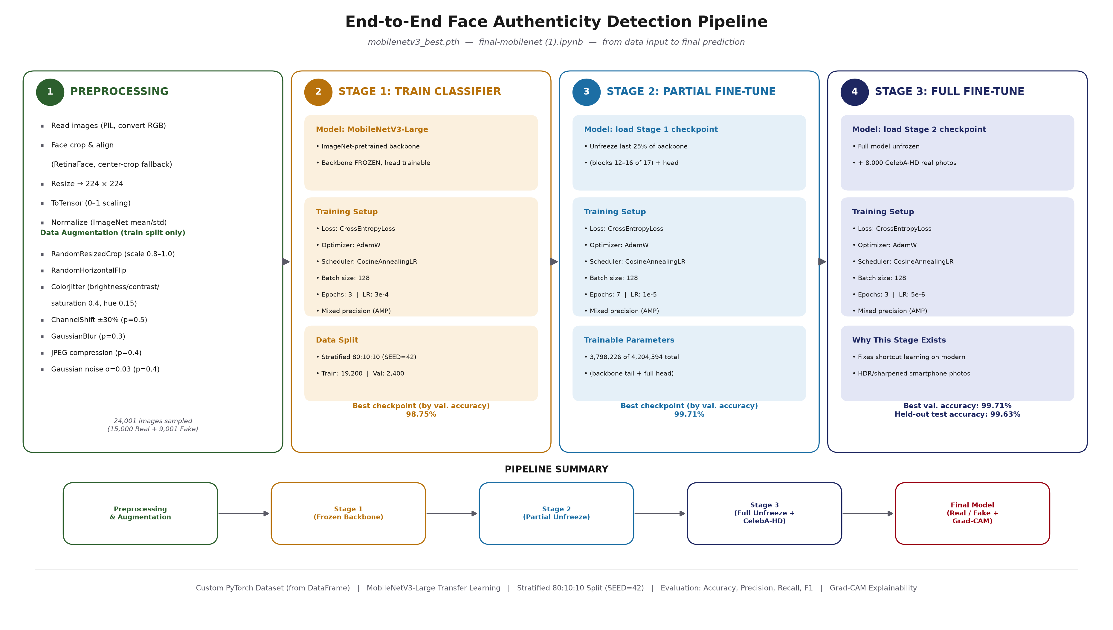
SECTION 1 · SECTION 4.1
Model Architecture & Pipeline — MobileNetV3-Large
MILESTONE 5 · FACE AUTHENTICITY DETECTION
06 / 19

Slide 7
SECTION 4.1
Three-Stage Transfer Learning Strategy
STAGE 1
STAGE 2
STAGE 3
Classifier head only
backbone frozen
Unfreeze last 25%
(blocks 12-16 of 17)
Full unfreeze
+ CelebA-HD real photos
3 epochs · LR 3e-4
7 epochs · LR 1e-5
3 epochs · LR 5e-6
98.75%
99.71%
99.71%
best val. accuracy
best val. accuracy
best val. accuracy
Stage 3 targets the modern-smartphone-photo shortcut-learning failure identified in Milestone 5.
MILESTONE 5 · FACE AUTHENTICITY DETECTION
07 / 19

Slide 8
SECTION 3
Metric Selection & Justification
Metric | Purpose | Result for this checkpoint
Accuracy | Overall balance | 99.63% (held-out) vs. 8.6% (Real-Latest OOD)
Precision | Cost of false alarms | 0.9993 Real (held-out) vs. 91.4% false-positive rate (OOD)
Recall | Cost of missed fakes | 0.9989 Fake — weak point is false alarms, not missed fakes
F1-score | Imbalanced-class trade-off | Real 0.9970 / Fake 0.9950 / Macro 0.9960
ROC-AUC | Threshold-independent ranking | Not computed on real test set (notebook gap) — 0.5856 on local sample
Cross-Domain Eval. | Generalization to unseen distributions | 100.0% (Real-Old) vs. 8.6% (Real-Latest) — central finding
MILESTONE 5 · FACE AUTHENTICITY DETECTION
08 / 19

Slide 9
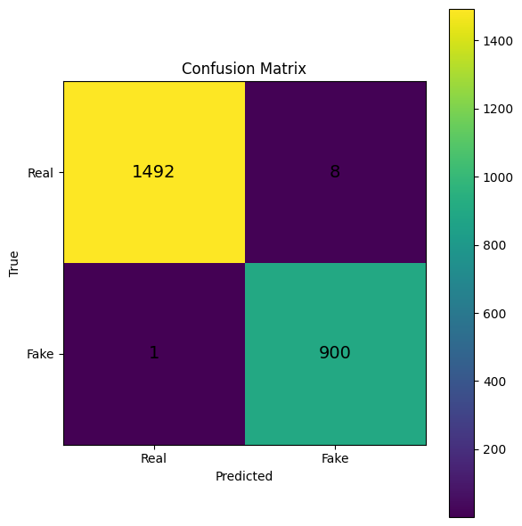
SECTION 4.2
Quantitative Performance — Held-Out Test Set
99.63%
99.53%
99.68%
99.60%
Test Accuracy
Macro Precision
Macro Recall
Macro F1-score
2,401-image test set — only 9 errors
8 Real images misclassified as Fake
1 Fake image misclassified as Real
Real: Precision 0.9993 · Recall 0.9947 · F1 0.9970
Fake: Precision 0.9912 · Recall 0.9989 · F1 0.9950
MILESTONE 5 · FACE AUTHENTICITY DETECTION
09 / 19

Slide 10
HOW TESTING IS DONE
Live Multi-Model Testing — The Web App
Pre-loaded samples from Test_real_vs_Fake/ — no upload needed, runs automatically against all 3 loaded checkpoints (best, noaug, manipulations).
Real (ground truth)
Fake (ground truth)
Model | Prediction | Real % | Fake %
best | Real | 91.11% | 8.89%
noaug | Fake | 19.46% | 80.54%
manipulations | Real | 99.99% | 0.01%
Model | Prediction | Real % | Fake %
best | Fake | 0.17% | 99.83%
noaug | Fake | 0.04% | 99.96%
manipulations | Fake | 0.41% | 99.59%
What this live check shows
All 3 models agree correctly on the Fake sample — high confidence (99.6%+) across the board.
On the Real sample, noaug is the only model that gets it wrong (misclassifies it as Fake, 80.54% confidence) — visible, direct evidence of the class-bias finding used to select best as the primary model over noaug elsewhere in this report.
This tool runs live against the actual deployed checkpoints, not a static offline script — the same numbers anyone testing the web app today would see.
MILESTONE 5 · FACE AUTHENTICITY DETECTION
10 / 19

Slide 11
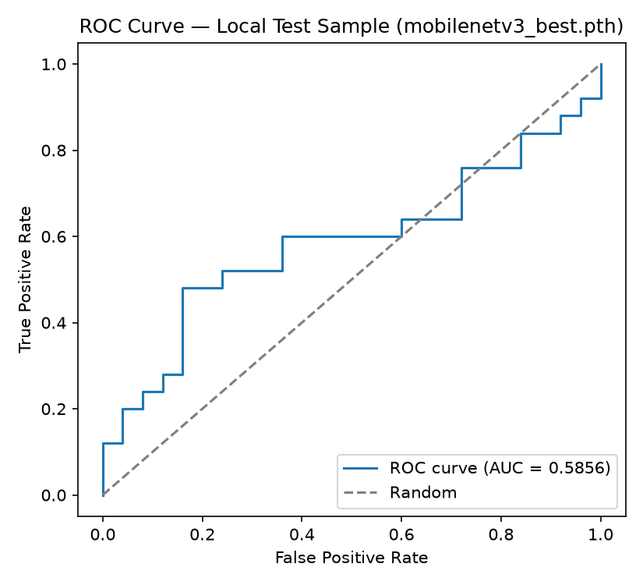
SECTION 4.5
ROC Curve
AUC = 0.5856
Only slightly better than random guessing (0.5).
What this ROC-AUC indicates
0.5856 means the model can barely rank a Fake image above a Real image on this sample — its confidence scores carry little discriminative signal here.
1.0 = perfect separation, 0.5 = random guessing — 0.5856 sits close to the random-guess line, visible in the curve tracking near the diagonal.
Consistent with the 62.0% accuracy on this same sample (Section 4.5) — this is the same domain-shift effect, reflected in the ranking metric, not just the raw accuracy number.
MILESTONE 5 · FACE AUTHENTICITY DETECTION
11 / 19

Slide 12
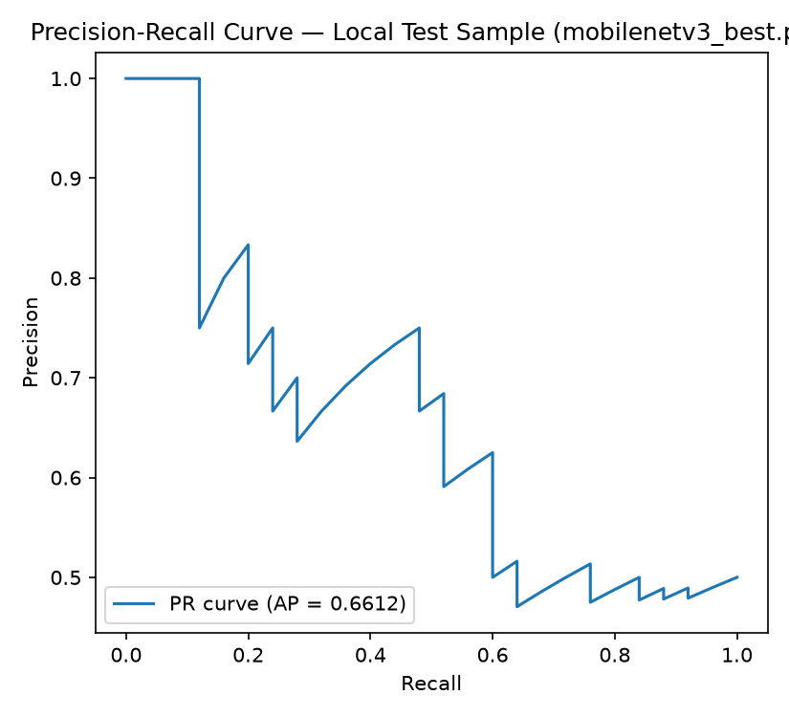
SECTION 4.5
Precision-Recall Curve
AP = 0.6612
Average Precision on the same local supplementary sample.
Why this still matters
62% accuracy on this same sample (Section 4.5) does not contradict the real 99.63% held-out result — it is independent confirmation of the exact domain-shift problem documented in Section 5, using a completely different image set.
MILESTONE 5 · FACE AUTHENTICITY DETECTION
12 / 19

Slide 13
SECTION 5
Comprehensive Error Analysis
Real-Old
Real-Latest
FFHQ-distribution images
Recent smartphone photos (2025-26)
100.0%
8.6%
accuracy on 73 images
accuracy on 70 images
Median P(Real): 0.99997
Median P(Real): 0.00060
The model correctly recognized every FFHQ-like image — resembles training data.
Genuine, high-confidence misclassifications, not uncertain borderline calls.
In plain terms: what "Real-Latest = 8.6%" means
Of 70 genuine, real, recent (2025–26) smartphone photographs tested, the model correctly identified only 6 of them as Real (8.6%) — it incorrectly flagged the other 64 as Fake (91.4%), despite every one of those 70 images actually being real people's genuine photos. Contrast with Real-Old (FFHQ-style images resembling training data), where it got 100% right. Same model, same checkpoint — only the photo's capture era/device differs. That gap is the central evidence for the shortcut-learning problem this milestone documents.
MILESTONE 5 · FACE AUTHENTICITY DETECTION
13 / 19

Slide 14
SECTION 5.4
Root Cause — Shortcut Learning
The model learned dataset-specific characteristics rather than intrinsic facial authenticity cues — a classic case of domain shift causing shortcut learning.
Learned Shortcut Feature | Effect on Prediction
FFHQ-style colour distribution | Classified as Real
Modern HDR processing | Classified as Fake
Strong sharpening / computational photography | Increased false positives
High colour saturation | Increased false positives
Modern device image statistics | Misclassified as AI-generated
100% accuracy on FFHQ-like images, dropping to 8.6% on recent real photographs — even though both datasets contain genuine human faces.
MILESTONE 5 · FACE AUTHENTICITY DETECTION
14 / 19

Slide 15
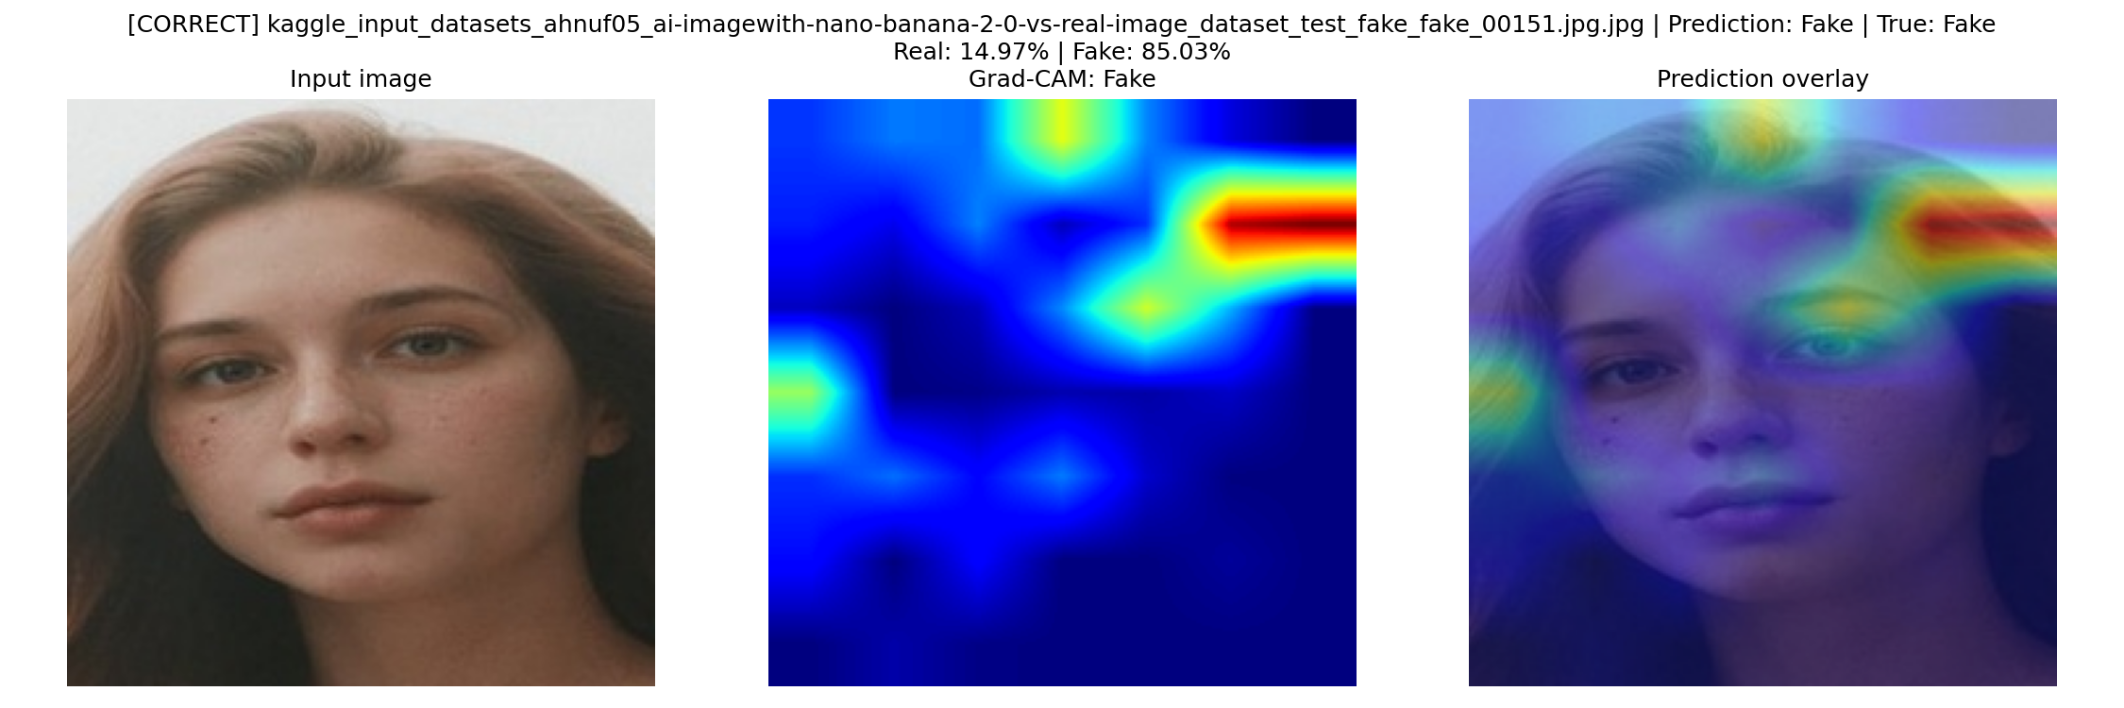
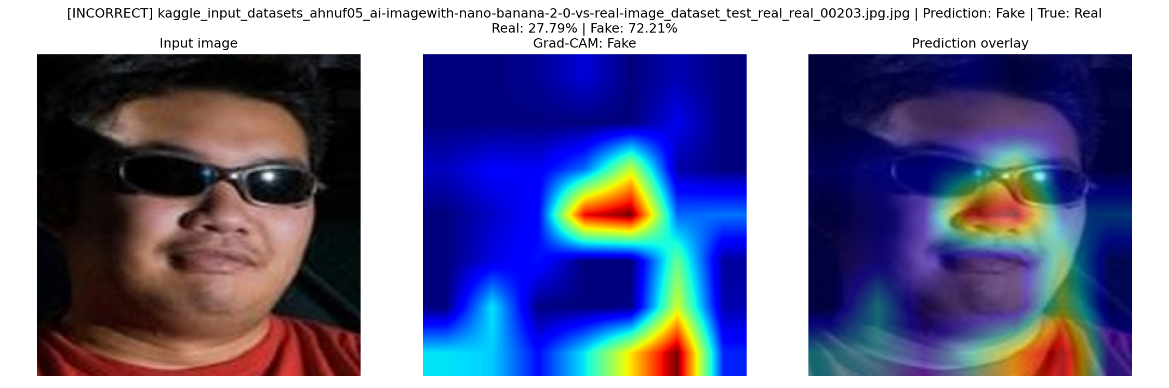
SECTION 6
Explainability — Grad-CAM
Correct prediction — true Fake
Failure case — true Real, predicted Fake
Heatmap concentrates on the eye/nose region — the model attends to facial structure, consistent with genuine synthesis artifacts.
A genuine photo misclassified as Fake — consistent with the model reacting to modern camera post-processing rather than real forgery evidence.
Reading a Grad-CAM heatmap
Brighter (red/yellow) regions contributed more to the predicted class — it visualizes where the model looked, not why in words.
Verified on both a correct case and a failure case, not just successes — a useful explainability check has to show where the model goes wrong too.
Correct predictions concentrate on facial structure (eyes, nose, mouth), evidence against pure background/edge shortcuts. The failure case's heatmap pattern is consistent with the model reacting to image-level properties (sharpening, HDR) rather than real forgery evidence — direct visual support for the Section 5.4 root-cause finding.
MILESTONE 5 · FACE AUTHENTICITY DETECTION
15 / 19

Slide 16
SECTIONS 6 & 7
Robustness & Out-of-Distribution Testing
Manipulation Stress Test
Out-of-Distribution: Non-Face Images
11 corruptions: tints, brightness, contrast, blur, JPEG, resize, crop, noise
10 real, license-clean CV test images — objects, animals, textures, landscapes
True-Real sample
4/10
6/10
86.7%
Held "Real" correctly across all 11 manipulations — genuine robustness.
predicted Real
predicted Fake
avg. confidence
No "I don't know" option — softmax always forces a confident decision. Close to a coin flip with no discernible pattern by content type. Any Real/Fake prediction on a non-face image is meaningless, not just low-confidence.
True-Fake sample
Stayed incorrectly "Real" across all 11 — the model can be stably wrong. Robustness is not correctness.
MILESTONE 5 · FACE AUTHENTICITY DETECTION
16 / 19

Slide 17
SECTION 9
Deployment Readiness
16.24 MB
15.53 ms
64.4 /s
332.6 MB
Model size on disk
CPU latency (measured)
CPU throughput (measured)
Process RAM (measured)
The model is not the bottleneck
Quantization potential
~140x gap between the raw forward pass (15.53 ms) and a full Grad-CAM-enabled request (~2.2 s). The overhead is Grad-CAM rendering, not classification.
FP16: ~22.6 MB, negligible accuracy loss
INT8: ~11-12 MB, well-suited to edge/mobile
Pruning/distillation: poor fit — already compact
Quantizing alone won't fix latency — Grad-CAM is the real bottleneck
GPU latency (est., not measured): ~7-8 ms GPU VRAM (est., not measured): low hundreds of MB
MILESTONE 5 · FACE AUTHENTICITY DETECTION
17 / 19

Slide 18
SECTIONS 8 & 10
Key Findings & Future Work
Headline Findings
Actionable Next Steps
99.63% in-distribution accuracy was never the problem — generalization was
8.6% / 62.0% accuracy on real photos, confirmed by two independent probes
Root cause identified: HDR, sharpening, saturation — not forgery signals
Grad-CAM, not the model, is the deployment latency bottleneck
Automated forensic report generation now built into the web app (/report)
SHORT-TERM
Recalibrate the decision threshold
Make Grad-CAM optional for latency
Run a proper demographic-fairness audit
LONG-TERM
Targeted HDR/sharpening augmentation
Hard-negative mining on Real-Latest failures
Complete cross-domain model training
MILESTONE 5 · FACE AUTHENTICITY DETECTION
18 / 19

Slide 19
Thank You
Group 11 · Deep Learning-Based Human Face Authenticity Detection
Vishakha · Rohit · Aman · Raunak · Somendu

