Slide 1
DEEPFAKE DETECTION
Deep Learning-Based Human Face
Authenticity Detection
Selected Architecture: MobileNetV3-Large
Milestone 3: Architecture Selection, Justification, Baseline Performance,
Hyperparameter Tuning, Pipeline & Explainability
Deepfake Detection — Milestone 3
1

Slide 2
TEAM
Task Distribution
R
Rohit
ConvNeXt / Dual-Stream Architecture Development & FFT Forensic Extraction
R
Raunak
MobileNetV3-Large Model Development, Training & Testing (Primary Architecture)
V
Vishakha
EfficientNet-B2 Model Development, Video Pipeline & Grad-CAM Explainability
A
Aman
Pipeline Optimization, Evaluation Scripting & Dataloader Hardware Integration
S
Somendu
FFT / DCT Frequency Analysis, Explainability Heatmaps & Diagram Visualization
Deepfake Detection — Milestone 3
2

Slide 3
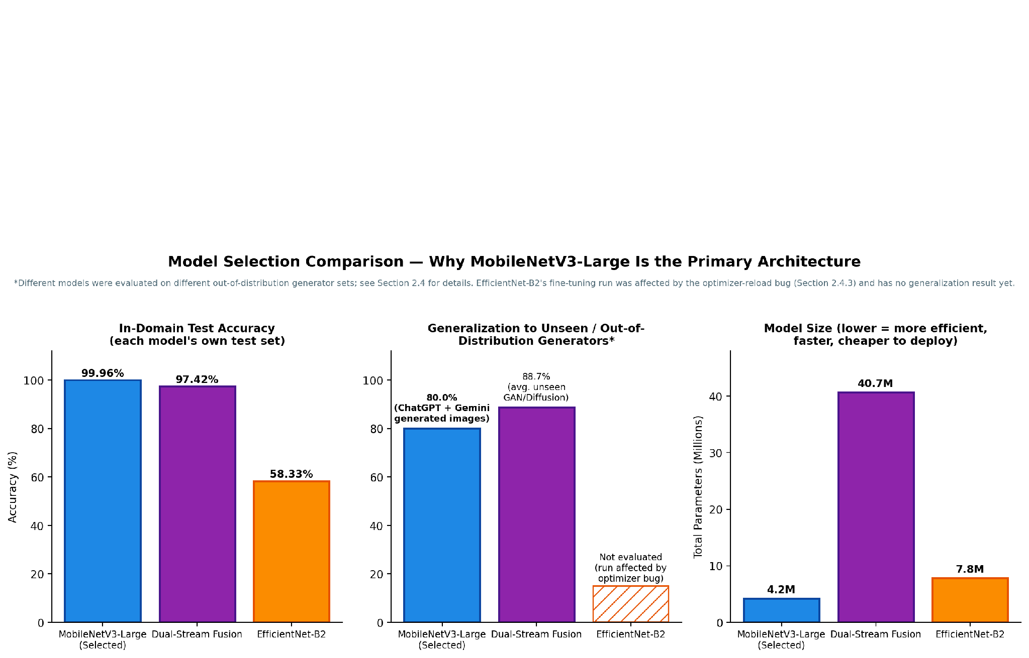
SECTION 1 · MODEL ARCHITECTURE SELECTION
Three Candidate Architectures
Model 1 — MobileNetV3-Large
99.96% in-domain accuracy · 4.2M params · SELECTED
Model 2 — Dual-Stream Fusion
97.42% accuracy · 40.7M params · Secondary
Model 3 — EfficientNet-B2
58.33% accuracy (bug-affected) · 7.8M params · Tertiary
Deepfake Detection — Milestone 3
3

Slide 4
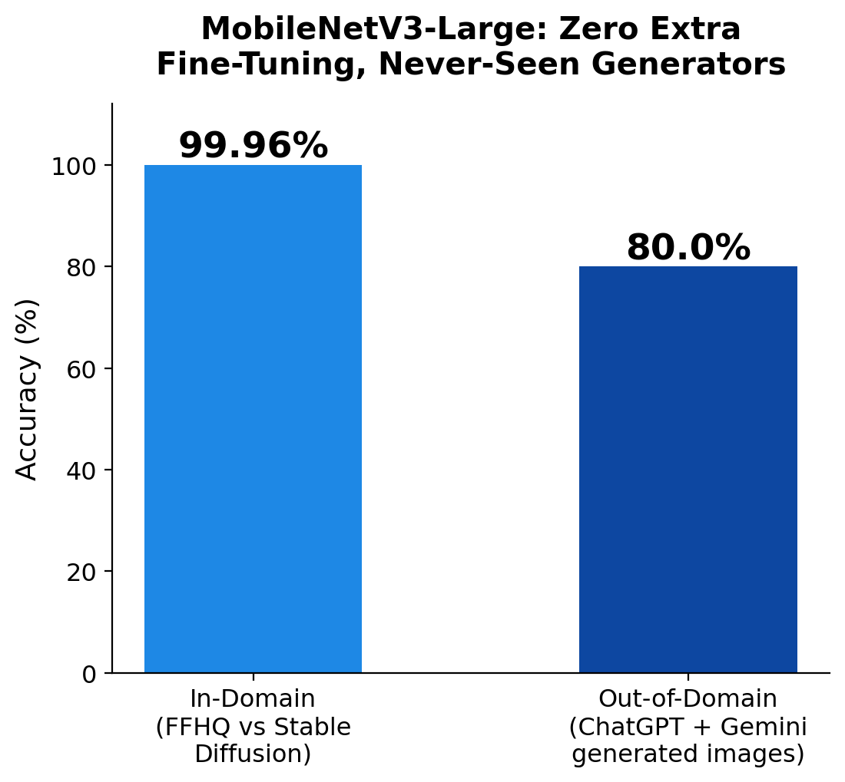
SECTION 1 · MODEL ARCHITECTURE SELECTION
Why MobileNetV3-Large Is Selected
Only model tested against unseen ChatGPT / Gemini images — 80% accuracy, zero extra fine-tuning
10x fewer parameters than Dual-Stream (4.2M vs 40.7M)
Real-time inference: ~8.2ms/image, ~112 img/sec on one T4 GPU
Single RGB stream — no FFT or video preprocessing required
99.96% in-domain accuracy — efficiency is not traded for accuracy
Deepfake Detection — Milestone 3
4

Slide 5
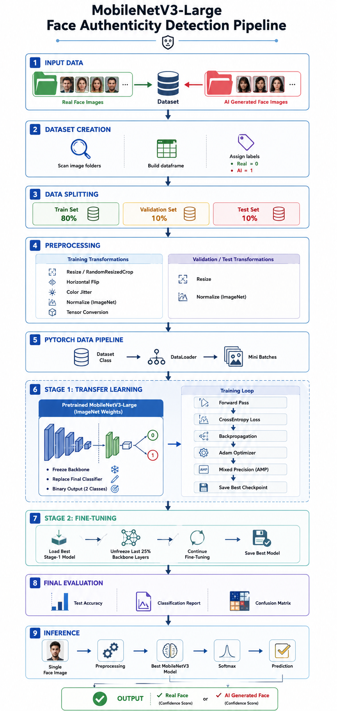
SECTION 2 · ARCHITECTURE JUSTIFICATION
Technical Design: Why It Fits the Problem
Deepfake artifacts are local (texture, blending seams) — not global shape changes
Inverted-residual blocks + squeeze-and-excitation attention target exactly this kind of local signal
ImageNet pretraining is parameter-efficient on a modest training set
Staged fine-tuning: freeze backbone (3 epochs) -> unfreeze last 25% at 30x lower LR (7 epochs)
Avoids the extra frequency-domain machinery Dual-Stream needs to catch the same artifact class
Deepfake Detection — Milestone 3
5

Slide 6
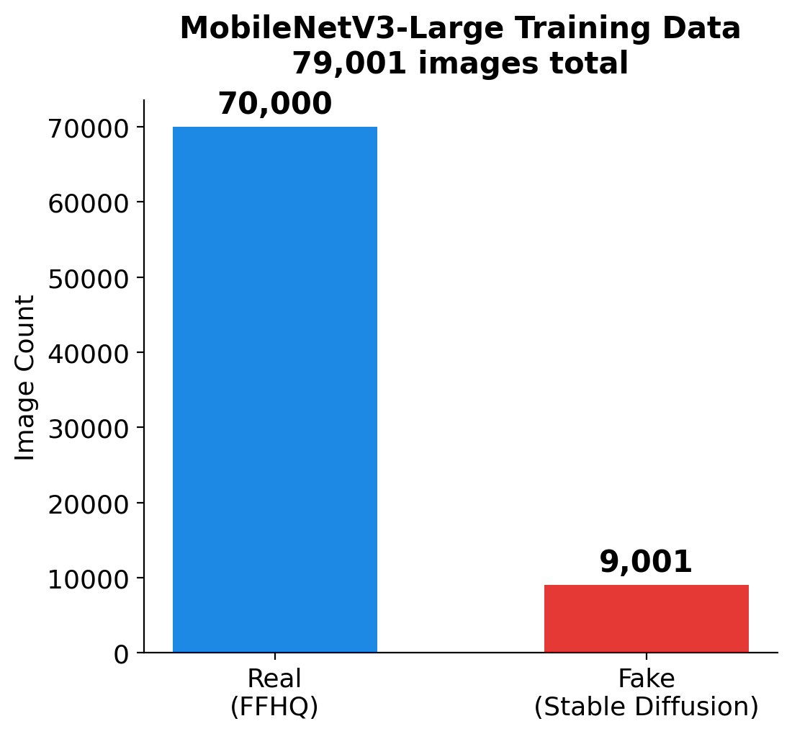
SECTION 3 · BASELINE MODEL PERFORMANCE
Dataset & Baseline Results
Candidate dataset: 24,001 images (15,000 Real + 9,001 Fake)
Stratified 80 / 10 / 10 train-val-test split, seed 42
Test results (2,401 images):
Accuracy 99.96% · Loss 0.0011
Precision & Recall ≥ 0.999 on both classes
Only 1 misclassification out of 2,401 samples
Deepfake Detection — Milestone 3
6

Slide 7
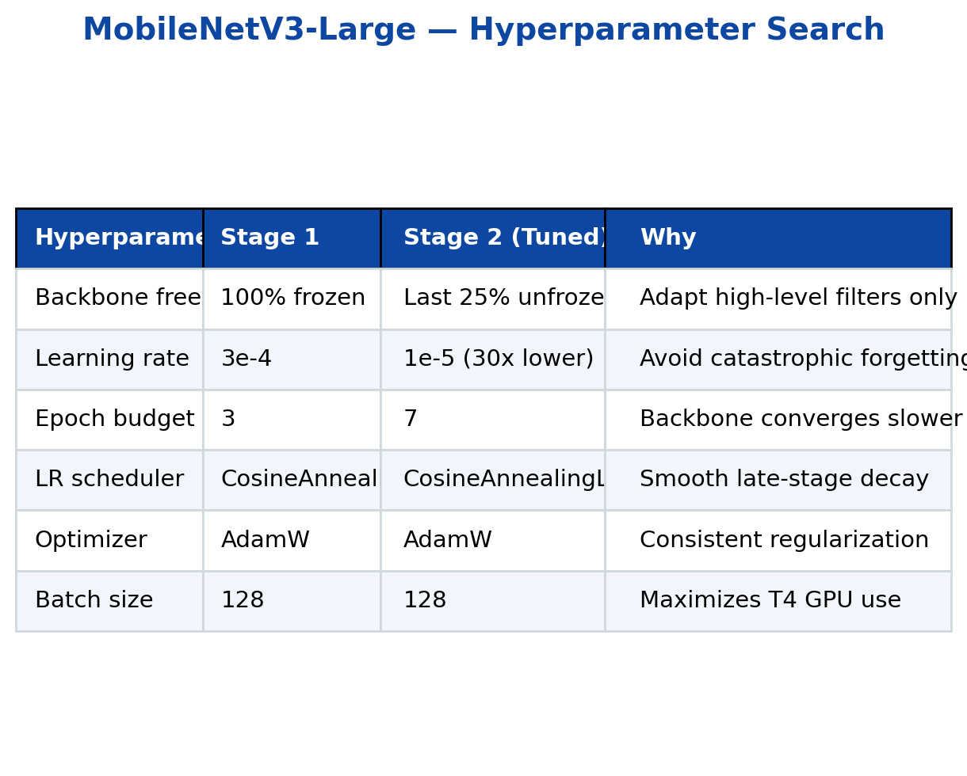
SECTION 4 · HYPERPARAMETER TUNING
What We Tuned — And Why
Two-stage staged fine-tuning, not a single training run
6 hyperparameters searched: freeze ratio, learning rate, epochs, scheduler, optimizer, batch size
Biggest lever: dropping the learning rate 30x between stages — prevents catastrophic forgetting of pretrained filters
Result: validation accuracy 99.75% -> 99.88%, validation loss cut by 60% (0.0103 -> 0.0041)
Deepfake Detection — Milestone 3
7

Slide 8
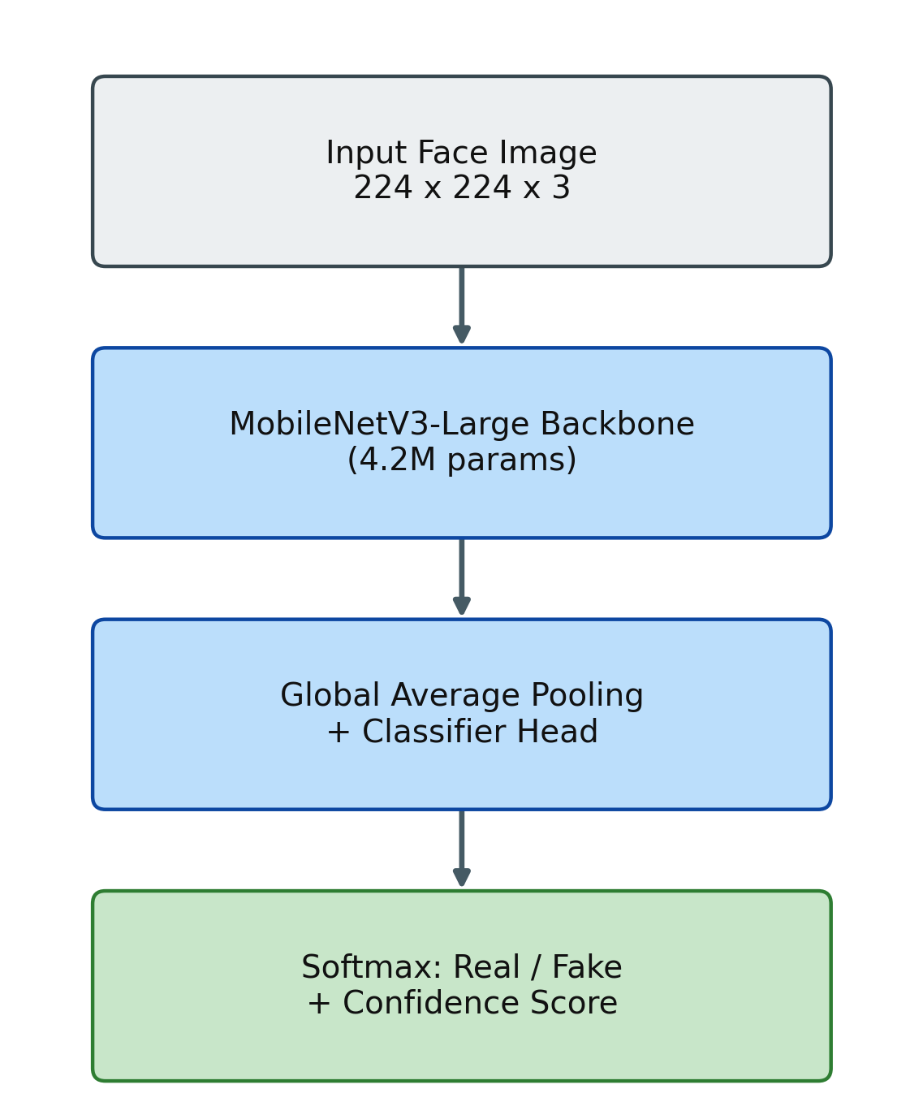
SECTION 5 · END-TO-END PIPELINE
MobileNetV3-Large: Primary Pipeline
Ingest & validate images -> assign Real/Fake labels
Resize to 224x224, ImageNet normalization
Training-only augmentation: crop, flip, color jitter
Backbone -> Global Average Pooling -> classifier head
Softmax output: Real/Fake + confidence score
This is the default path for every inference
Deepfake Detection — Milestone 3
8

Slide 9
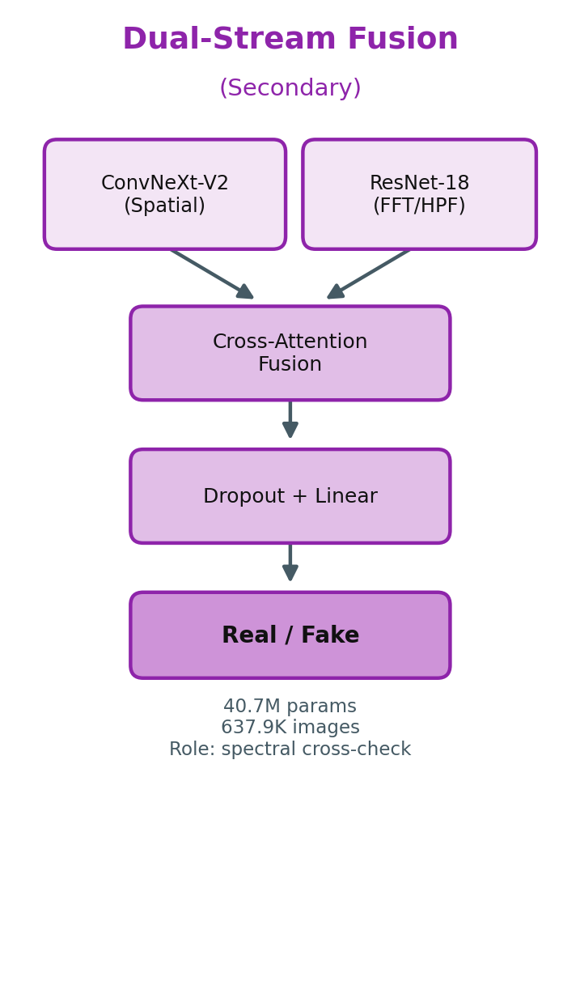
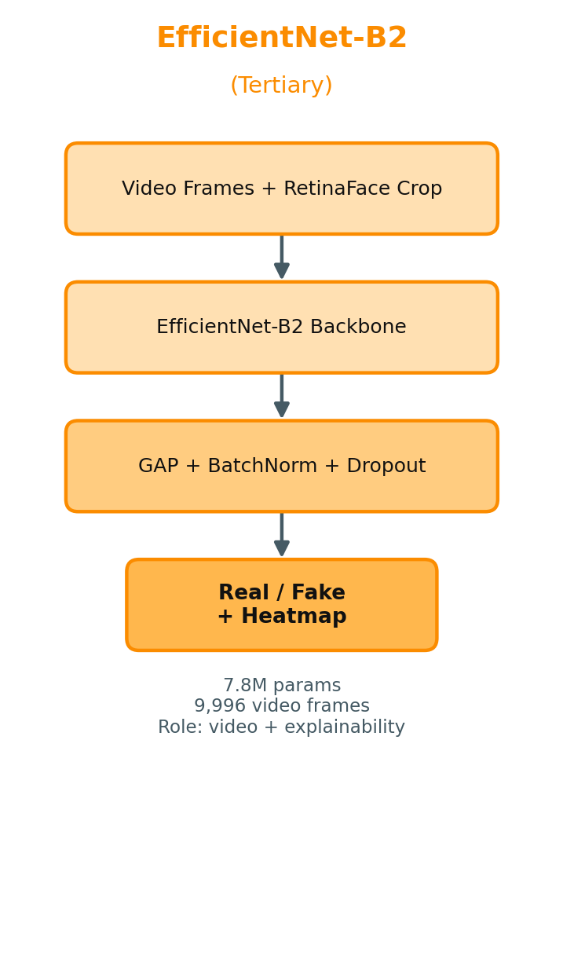
SECTION 5 · END-TO-END PIPELINE
Secondary & Tertiary Models
Not run on every request — invoked only when needed
Dual-Stream: spectral cross-check when confidence is low
EfficientNet-B2: handles video input + Grad-CAM
Both feed evidence back into the final decision
Deepfake Detection — Milestone 3
9

Slide 10
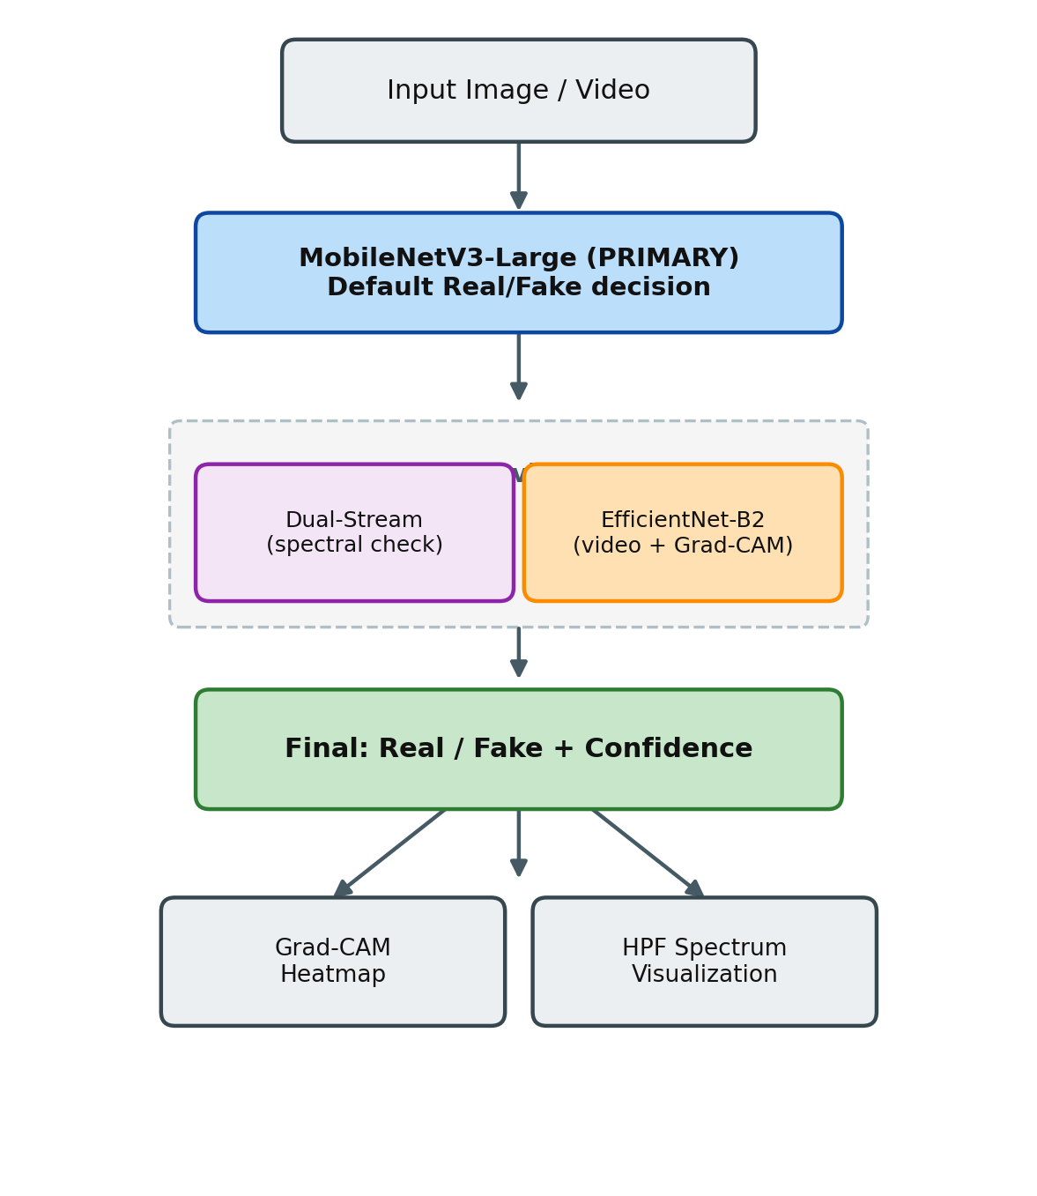
SECTION 6 · ARCHITECTURE VISUALIZATION
Unified Pipeline Flowchart
One flowchart, not three — primary model decides by default
MobileNetV3-Large output is the default Real/Fake decision
Secondary/tertiary models only trigger on low confidence or video input
Every decision can carry supporting evidence: Grad-CAM heatmap and/or HPF spectrum
Deepfake Detection — Milestone 3
10

Slide 11

SECTION 6 · ARCHITECTURE VISUALIZATION
Explainability: What Signals Matter?
Eyes / iris reflections — asymmetry is a common generator tell
Nose bridge & shading — frequent blending-seam location
Mouth / teeth boundary — irregular spacing, texture mismatch
Skin texture — over-smoothing, missing pore-level detail
Hairline / ear geometry — blur or asymmetric shape at crop edge
Deepfake Detection — Milestone 3
11

Slide 12

SECTION 6 · ARCHITECTURE VISUALIZATION
Grad-CAM in Practice: Live Workbench Output
Gradient of fake-probability backpropagated to the last conv layer
Produces a heatmap of which regions drove the decision
Concentrates on eyes, nose bridge, mouth/teeth boundary
A genuine computation, not a heuristic — can surface artifacts we didn't anticipate
Used by the tertiary (EfficientNet-B2) model for human-auditable output
Deepfake Detection — Milestone 3
12

Slide 13


SECTION 6 · ARCHITECTURE VISUALIZATION
Decision Saliency & Reconstruction Residual
Decision saliency — absolute input gradient of the final fake logit
Shows where small pixel changes would most move the decision
Reconstruction residual — absolute reconstruction error of the rebuilt image
Diagnostic evidence, not a learned manipulation mask
Both are explanation maps, not separate inputs to the Real/Fake decision
decision saliency
reconstruction residual
Deepfake Detection — Milestone 3
13

Slide 14
EMPIRICAL EVIDENCE
Generalization to Modern AI Generators
Tested on images never seen during training
ChatGPT & Gemini image generators — released after the original dataset
80% accuracy with zero additional fine-tuning
Strongest evidence the model learned generalizable artifacts, not a Stable-Diffusion-specific fingerprint
The key reason MobileNetV3-Large is the selected architecture
Deepfake Detection — Milestone 3
14

Slide 15
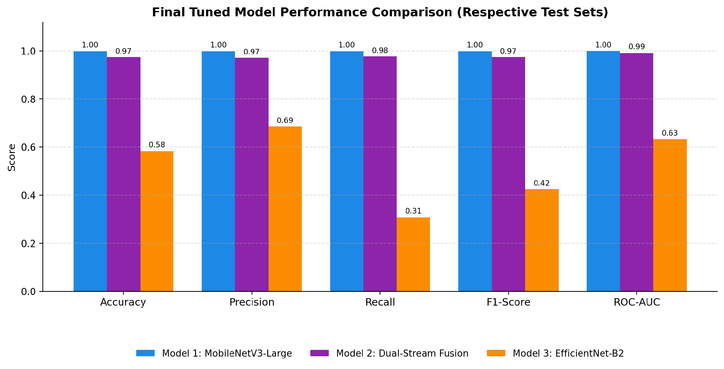
MODEL COMPARISON
Final Model Comparison — Which Is Better?
1. Highest real-world accuracy — works on images it never trained on
2. Smallest and fastest — 10x fewer parameters than Dual-Stream
3. Simplest to run — one image in, one answer out, no extra steps
4. Cheapest to host — smaller model, lower compute cost
5. Best overall balance — Dual-Stream and EfficientNet-B2 help only as backup checks
Deepfake Detection — Milestone 3
15

Slide 16
KEY TAKEAWAYS
MobileNetV3-Large: Selected Architecture
80%
99.96%
4.2M
8.2ms
Accuracy on unseen
ChatGPT/Gemini images
In-domain test accuracy
Parameters — 10x smaller
than Dual-Stream
Inference latency
per image
Secondary: Dual-Stream Fusion (spectral verification) | Tertiary: EfficientNet-B2 (video + Grad-CAM)
Deepfake Detection — Milestone 3
16

Slide 17
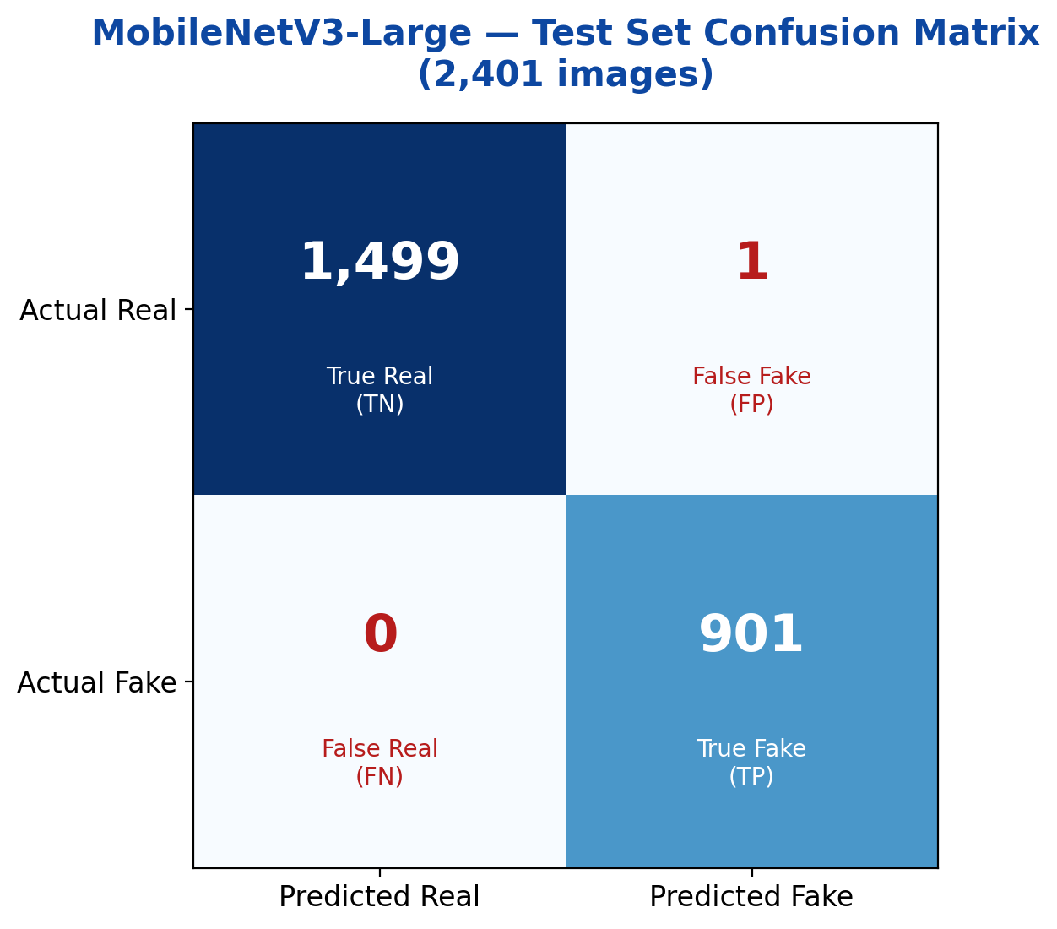
TEST SET RESULTS
Confusion Matrix — MobileNetV3-Large
2,401 test images — 1,500 Real, 901 Fake
1,499 Real correctly identified, only 1 missed as Fake
All 901 Fake images correctly caught — zero false negatives
Only 1 total error out of 2,401 predictions (99.96% accuracy)
Zero false negatives matters most: no fake image slips through undetected
Deepfake Detection — Milestone 3
17

Slide 18
Thank You
Deep Learning-Based Human Face Authenticity Detection
Questions & Discussion
Deepfake Detection — Milestone 3
18

