Slide 1

Cost of living project using Power BI
Name- vishakha sharma
Batch- MIP-DA-08

Slide 2
INTRODUCTION
This project revolves around the analysis of the cost of living in various cities and countries across the
globe. The dataset used for this analysis encompasses a wide range of economic indicators, from the
price of basic commodities to the cost of housing, transportation, and even entertainment. By
harnessing the power of Power BI, we aim to gain valuable insights into the economic disparities
between different regions and understand the factors that contribute to the varying costs of living. This
project serves as an exercise in data visualization, analysis, and interpretation, offering a comprehensive
view of the world's economic landscape.

Slide 3
PROBLEM STATEMENT
• What are the cities and countries with the highest and lowest costs of living?
• What are the major cost components contributing to the overall cost of living in a region?
• How do factors like average salary, housing costs, and transportation expenses correlate with the cost of living?
• Are there any trends or patterns in the data that can help individuals and organizations make strategic decisions?

Slide 4
Dataset Information:
The dataset utilized in this project is sourced from Numbeo, a collaborative online database that provides cost of living information worldwide. It contains 56 columns, including information about cities, countries, and a wide array of cost-related variables, ranging from grocery prices to real estate costs. The dataset is designed to offer a comprehensive view of the economic aspects of various locations, making it a valuable resource for conducting cost of living analyses.

Slide 5
Variable Description:
The dataset consists of the following variables:
• City: Name of the city.
• Country: Name of the country.
• ColumnDescription
• city Name of the city
• countryName of the country
• x1 Meal, Inexpensive Restaurant (USD)
• x2 Meal for 2 People, Mid-range Restaurant, Three-course (USD)
• x3 McMeal at McDonalds (or Equivalent Combo Meal) (USD)
• x4 Domestic Beer (0.5 liter draught, in restaurants) (USD)
• x5 Imported Beer (0.33 liter bottle, in restaurants) (USD)

Slide 6
x6 Cappuccino (regular, in restaurants) (USD)
• x7 Coke/Pepsi (0.33 liter bottle, in restaurants) (USD)
• x8 Water (0.33 liter bottle, in restaurants) (USD)
• x9 Milk (regular), (1 liter) (USD)
• x10 Loaf of Fresh White Bread (500g) (USD)
• x11 Rice (white), (1kg) (USD)
• x12 Eggs (regular) (12) (USD)
• x13 Local Cheese (1kg) (USD)
• x14 Chicken Fillets (1kg) (USD)
• x15 Beef Round (1kg) (or Equivalent Back Leg Red Meat) (USD)
• x16 Apples (1kg) (USD)
• x17 Banana (1kg) (USD)
• x18 Oranges (1kg) (USD)
• x19 Tomato (1kg) (USD

Slide 7
• x20 Potato (1kg) (USD)
• x21 Onion (1kg) (USD)
• x22 Lettuce (1 head) (USD)
• x23 Water (1.5 liter bottle, at the market) (USD)
• x24 Bottle of Wine (Mid-Range, at the market) (USD)
• x25 Domestic Beer (0.5 liter bottle, at the market) (USD)
• x26 Imported Beer (0.33 liter bottle, at the market) (USD)
• x27 Cigarettes 20 Pack (Marlboro) (USD)
• x28 One-way Ticket (Local Transport) (USD)
• x29 Monthly Pass (Regular Price) (USD)
• x30 Taxi Start (Normal Tariff) (USD)
• x31 Taxi 1km (Normal Tariff) (USD)
• x32 Taxi 1hour Waiting (Normal Tariff) (USD)

Slide 8
• x33 Gasoline (1 liter) (USD)
• x34 Volkswagen Golf 1.4 90 KW Trendline (Or Equivalent New Car) (USD)
• x35 Toyota Corolla Sedan 1.6l 97kW Comfort (Or Equivalent New Car) (USD)
• x36 Basic (Electricity, Heating, Cooling, Water, Garbage) for 85m2 Apartment (USD)
• x37 1 min. of Prepaid Mobile Tariff Local (No Discounts or Plans) (USD)
• x38 Internet (60 Mbps or More, Unlimited Data, Cable/ADSL) (USD)
• x39 Fitness Club, Monthly Fee for 1 Adult (USD)
• x40 Tennis Court Rent (1 Hour on Weekend) (USD)
• x41 Cinema, International Release, 1 Seat (USD)
• x42 Preschool (or Kindergarten), Full Day, Private, Monthly for 1 Child (USD)
• x43 International Primary School, Yearly for 1 Child (USD)
• x44 1 Pair of Jeans (Levis 501 Or Similar) (USD)
• x45 1 Summer Dress in a Chain Store (Zara, H&M, ...) (USD)
• x46 1 Pair of Nike Running Shoes (Mid-Range) (USD)

Slide 9
• x47 1 Pair of Men Leather Business Shoes (USD)
• x48 Apartment (1 bedroom) in City Centre (USD)
• x49 Apartment (1 bedroom) Outside of Centre (USD)
• x50 Apartment (3 bedrooms) in City Centre (USD)
• x51 Apartment (3 bedrooms) Outside of Centre (USD)
• x52 Price per Square Meter to Buy Apartment in City Centre (USD)
• x53 Price per Square Meter to Buy Apartment Outside of Centre (USD)
• x54 Average Monthly Net Salary (After Tax) (USD)
• x55 Mortgage Interest Rate in Percentages (%), Yearly, for 20 Years Fixed-Rate
• data_quality 0 if Numbeo considers that more contributors are needed to increase data
quality, else 1data_quality: A binary variable (0 or 1) indicating data quality, with 0 suggesting
the need for more contributors and 1 indicating satisfactory data quality.

Slide 10
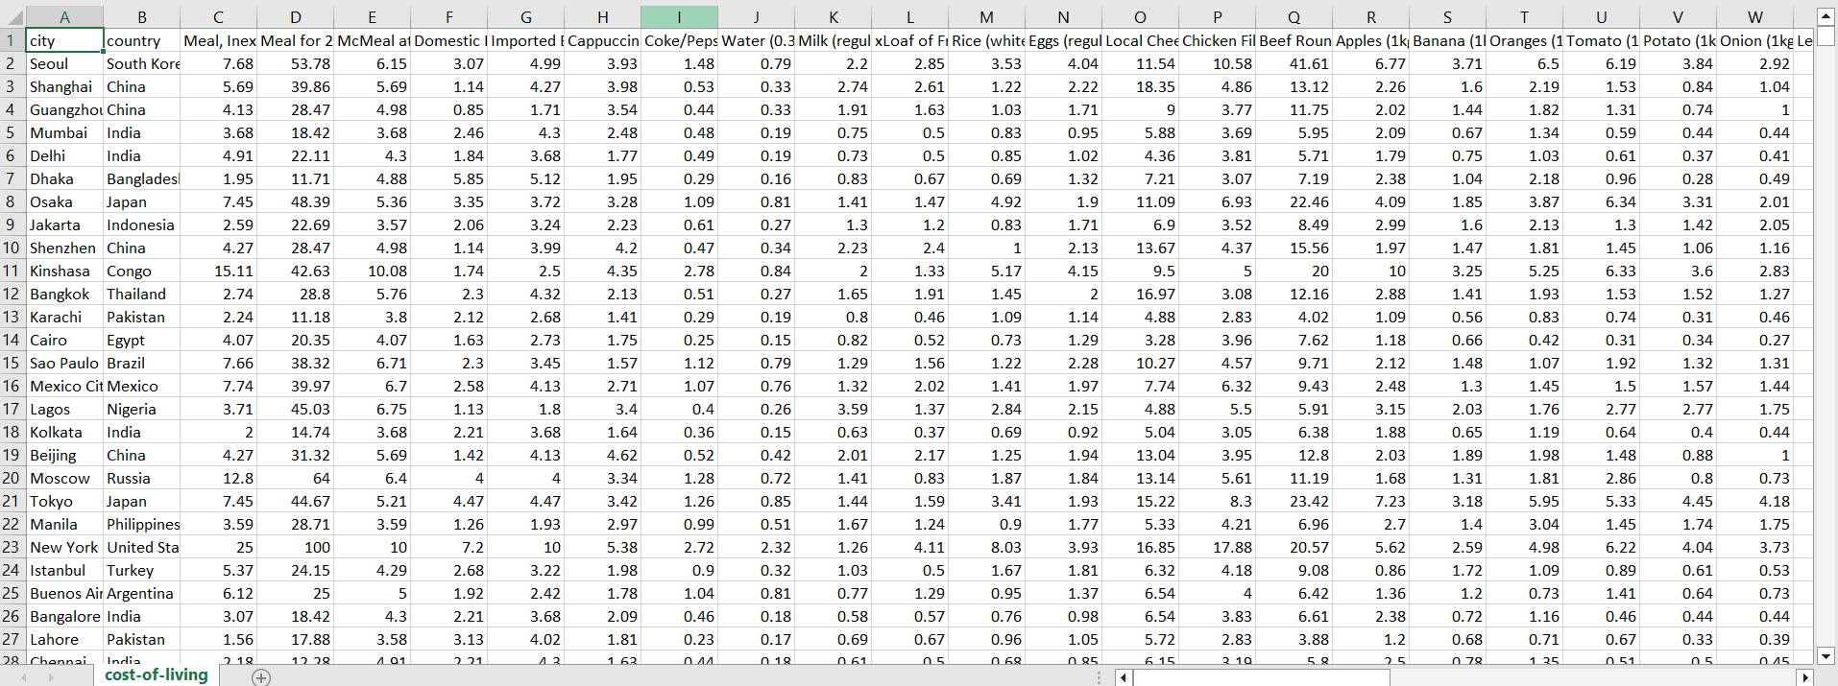
DATASET

Slide 11
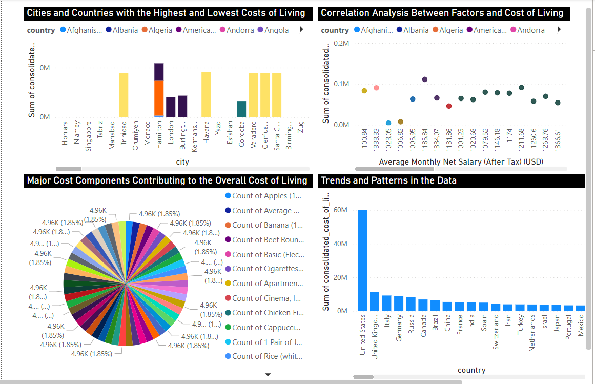
POWER BI DASHBOARD

Slide 12
LEARNING OUTCOMES
I have gained valuable experience in:
• Data preprocessing and cleaning techniques.
• Creating interactive data visualizations using Power BI.
• Conducting exploratory data analysis (EDA) to extract insights.
• Drawing meaningful conclusions from cost of living data.
• Communicating findings effectively through data visualization and interpretation.

Slide 13
THANK YOU

