Slide 1
SECURE DATA HIDING IN IMAGES USING STEGANOGRAPHY
CAPSTONE PROJECT
PRESENTED BY : VISHAL.B
STUDENT NAME : VISHAL.B
COLLEGE NAME & DEPARTMENT : LOYOLA-ICAM COLLEGE OF ENGINEERING AND TECHNOLOGY (B.TECH IT)

Slide 2
OUTLINE
Problem Statement
Technology used
Wow factor
End users
Result
Conclusion
Git-hub Link
Future scope

Slide 3
PROBLEM STATEMENT
With the increasing need for secure communication, conventional encryption methods alone may not be sufficient to protect sensitive data from interception. Steganography offers an additional layer of security by concealing data within digital images, making it less detectable. However, existing techniques often compromise image quality, are vulnerable to steganalysis, or have limited data-hiding capacity. There is a need for an efficient steganographic approach that ensures high imperceptibility, robust security, and minimal distortion. Additionally, the method should resist attacks while maintaining the integrity of the hidden information. This project aims to develop a secure and effective data-hiding technique using steganography in images. The goal is to enhance confidentiality, reliability, and resilience against detection and tampering.

Slide 4
TECHNOLOGY USED
LIBRARIES USED
OpenCV (cv2)
OS
NumPy
String
PLATFORMS USED
Operating Systems ( Windows ,Linux)
Development Environments ( Python IDE , VS Code)

Slide 5
WOW FACTORS
1.Dual Security with Steganography & Encryption
The project hides data inside an image and protects it with a passcode, making it highly secure against unauthorized access.
2.Invisible Data Hiding
The encrypted image looks almost identical to the original, ensuring no visual distortion, which makes detection difficult.
3.Fast & Lightweight Processing
Uses OpenCV & NumPy for efficient pixel manipulation, making encryption and decryption quick and memory-efficient.
4.Cross-Platform Compatibility
Works on Windows, macOS, and Linux, ensuring broad usability with minor modifications.

Slide 6
END USERS
1.Cybersecurity Professionals
2.Intelligence & Law Enforcement Agencies
3.Corporate & Government Organizations
4.Digital Content Creators & Copyright Holders
5.Ethical Hackers & Security Researchers
6.General Users & Privacy Enthusiasts

Slide 7
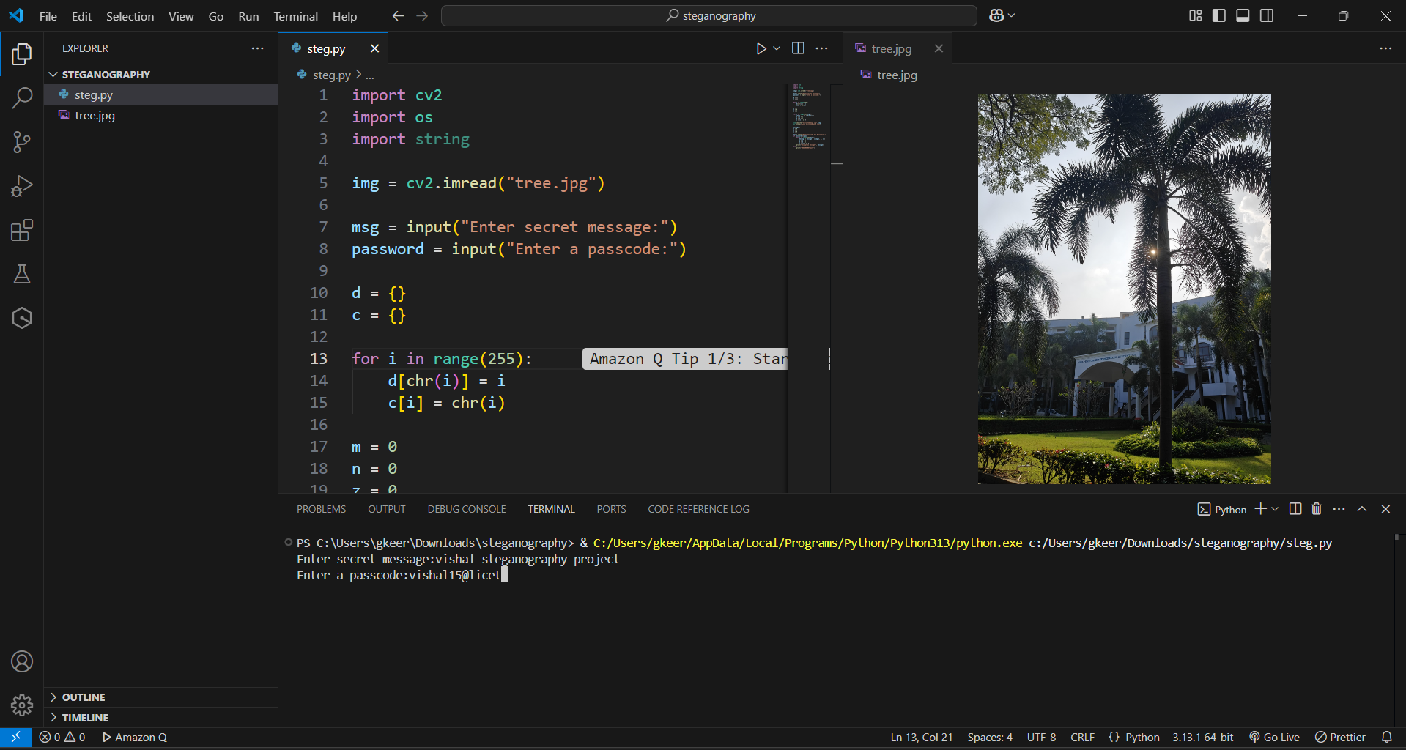
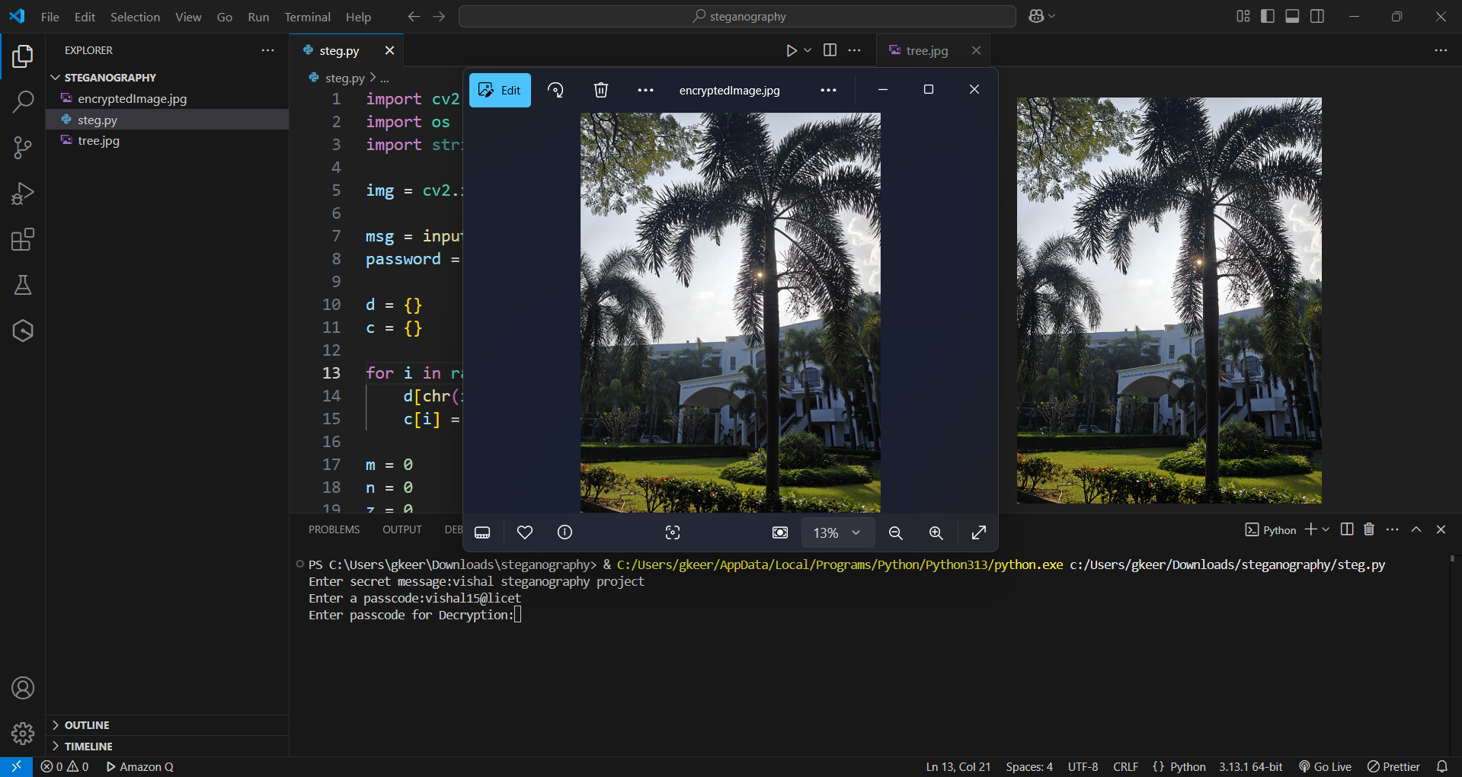
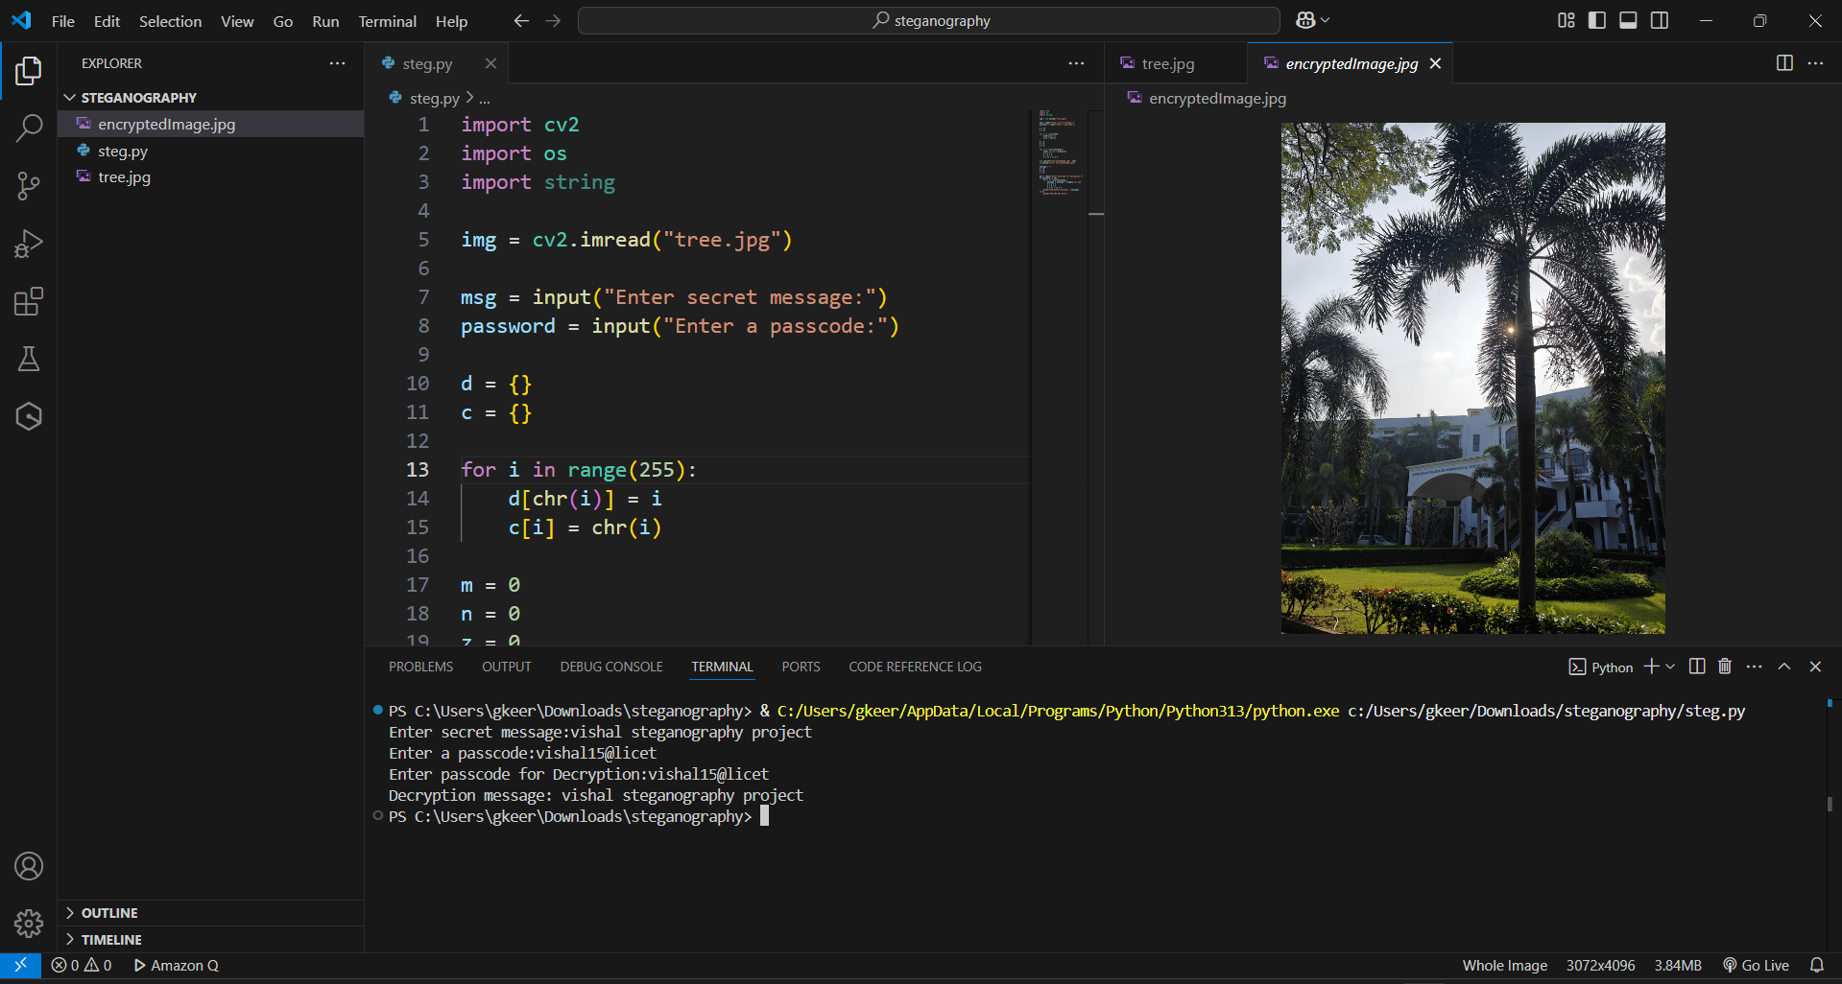
RESULTS

Slide 8
CONCLUSION
The Secure Data Hiding in Images Using Steganography project enables covert communication by embedding encrypted messages within images while preserving their visual integrity. Using OpenCV and NumPy, it ensures fast, efficient, and secure data concealment. This approach is valuable for cybersecurity, digital watermarking, and private messaging, making unauthorized detection difficult. With potential enhancements like advanced encryption algorithms and AI-based steganalysis resistance, this project provides a robust solution for secure data transmission in sensitive applications.

Slide 9
GITHUB LINK
https://github.com/Vishal-1574/steganography_vishal.git

Slide 10
FUTURE SCOPE(OPTIONAL)
The future scope of this project includes enhancing security with advanced encryption algorithms like AES-256 or RSA to strengthen data protection. AI-powered steganography and steganalysis using deep learning models can improve undetectability and detection mechanisms. Expanding steganography to audio, video, and GIF formats will increase versatility for different media. A cloud-based secure communication platform or a mobile application can make the system more accessible. Additionally, improving image quality preservation using DCT or DWT techniques can ensure minimal distortion while maintaining security and imperceptibility. These advancements will make the system more robust, efficient, and applicable to real-world cybersecurity challenges.

Slide 11
THANK YOU

