Slide 1


MACHINE LEARNING
MASTER CLASS
DAY – 10/30
Breast Cancer Detection Various ML Algorithm

Slide 2

01
Breast Cancer Detection Various ML Algorithm
Concept

Slide 3
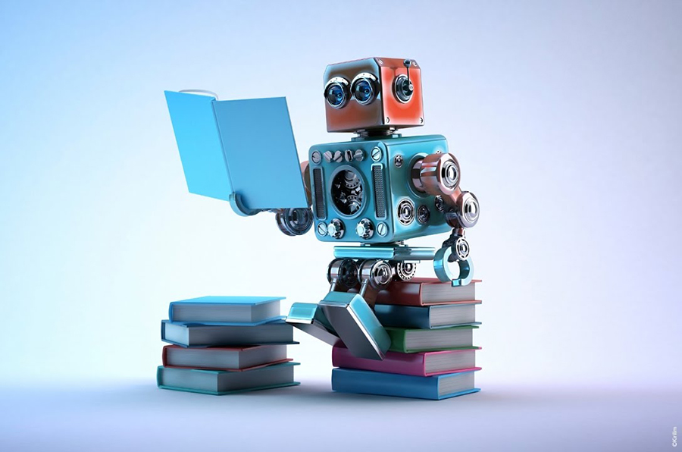
02
Breast Cancer Detection Various ML Algorithm
Project

Slide 4
Velpaari
🧠Book Suggestion💡

Slide 5
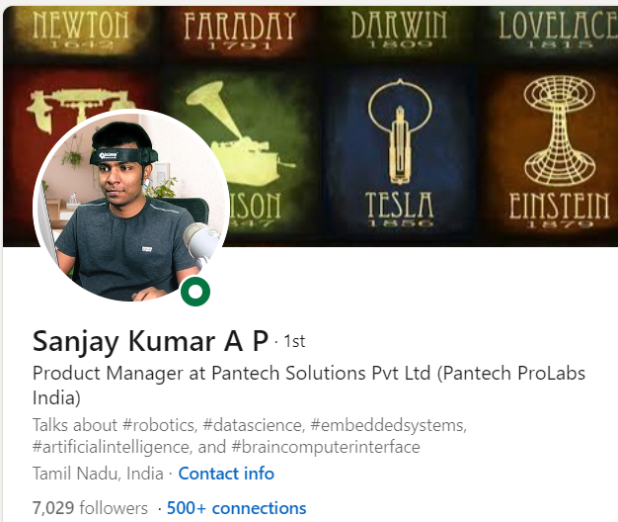
THANKS!
DO YOU HAVE ANY QUESTIONS?
Do you have
Course related questions?
+91 9363083283
Pantechsolutions.net
Follow Me on the LinkedIn – Link in Description

