Slide 1


MACHINE LEARNING
MASTER CLASS
DAY – 5/30
Hand written Digit Recognition - SVMClassifier

Slide 2

01
Hand written Digit Recognition - SVMClassifier
Concept

Slide 3
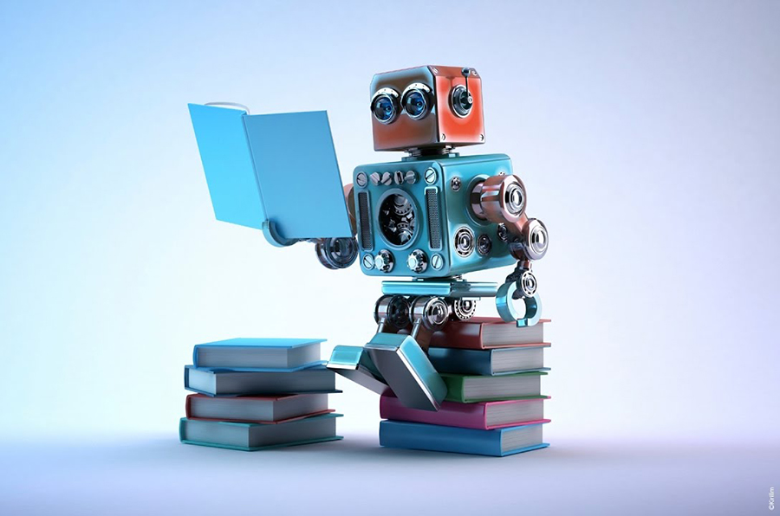
02
Hand written Digit Recognition - SVMClassifier
Project

Slide 4
Attitude is Everything
-Jeff Keller
🧠Book Suggestion💡

Slide 5
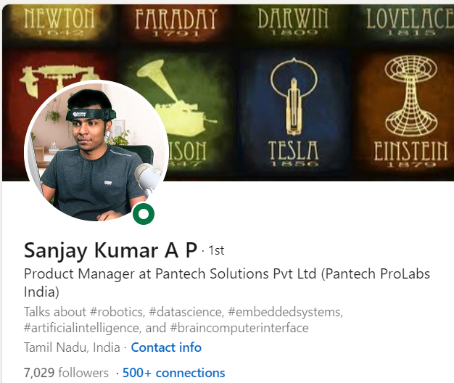
THANKS!
DO YOU HAVE ANY QUESTIONS?
Pantechsolutions.net
Follow Me on the LinkedIn

