Slide 1
Branchwise Operational Performance Analysis
A Data-Driven Exploration of Key Metrics

Slide 2
Introduction
This presentation explores branch-wise performance using key financial metrics such as sanctions, disbursement, recovery, and performance scores.

Slide 3
Key Metrics Analyzed
- Sanctions: Approved loan amounts
- Disbursement: Actual loans provided
- Recovery: Amounts recovered from loans
- Performance Score: Overall effectiveness
- Recovery Rate: Percentage of recovery vs loans
- Utilization Rate: How well the funds are used

Slide 4
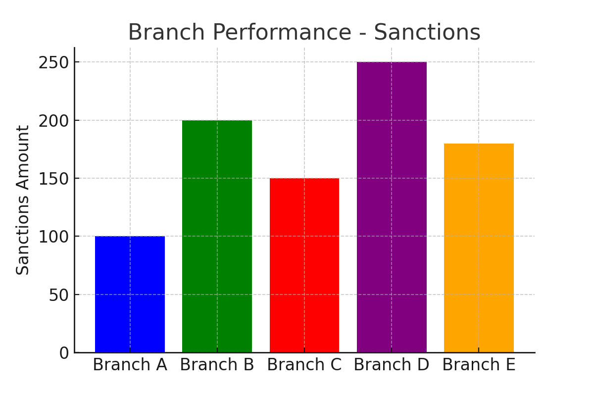
Bar Graph: Sanctions Across Branches

Slide 5
Explanation of Bar Graph
This bar graph illustrates the total loan sanctions provided to different branches. Branch D received the highest amount, indicating strong approval trends.

Slide 6
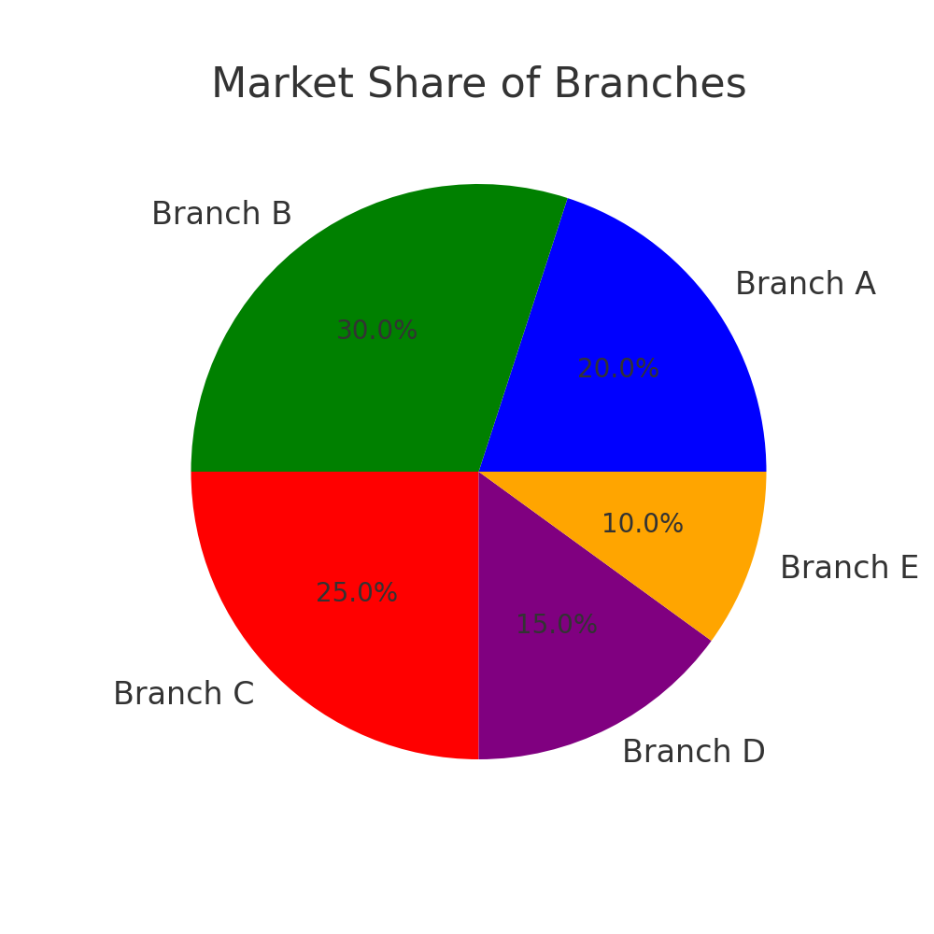
Pie Chart: Market Share of Branches

Slide 7
Explanation of Pie Chart
This pie chart represents the market share of each branch. Branch B has the largest share, followed by Branch C, indicating their dominance.

Slide 8
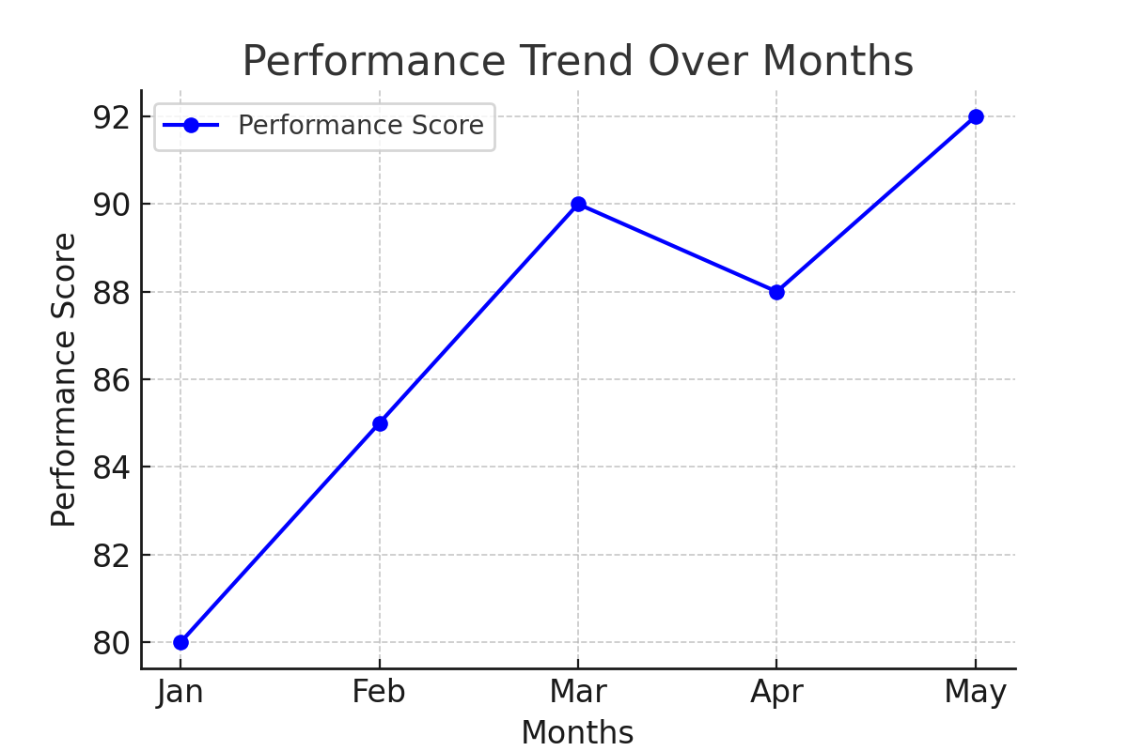
Line Chart: Performance Over Time

Slide 9
Explanation of Line Chart
The line chart illustrates the performance trend over five months. Performance scores have steadily increased, indicating consistent improvement.

Slide 10
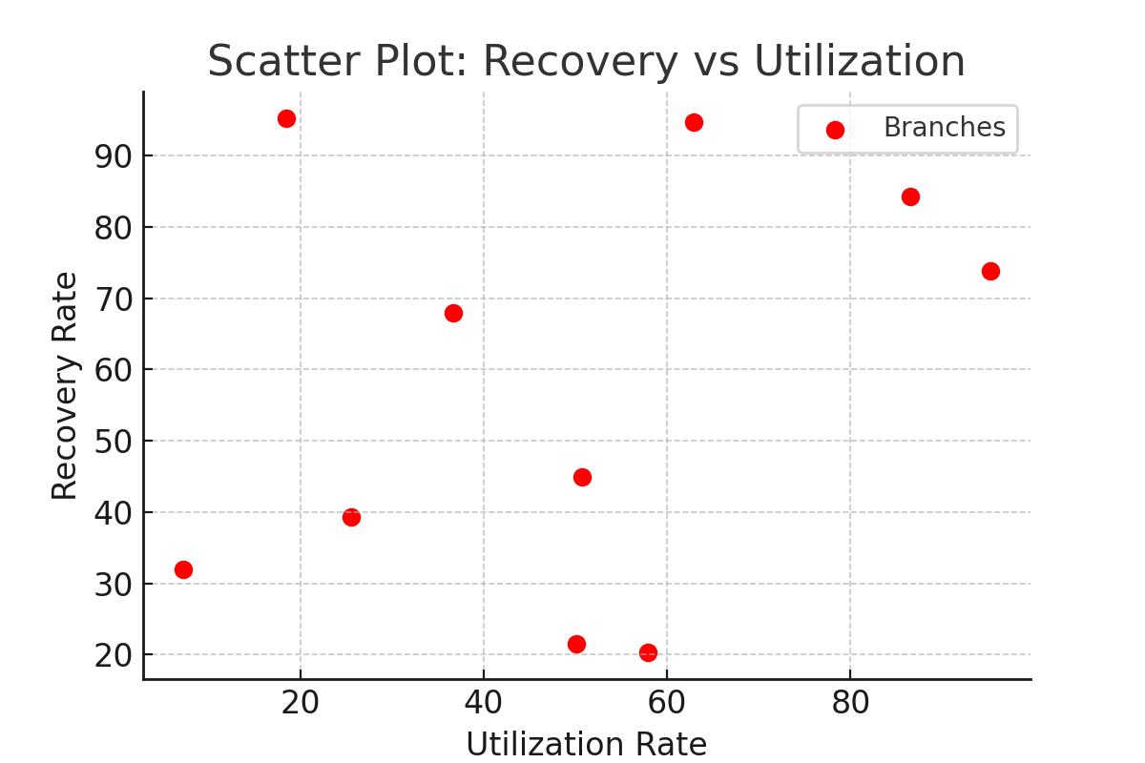
Scatter Plot: Recovery vs Utilization

Slide 11
Explanation of Scatter Plot
The scatter plot compares the recovery and utilization rates across branches. Higher utilization leads to better recovery in most cases.

Slide 12
Key Findings
- Branch D leads in sanctions but has a moderate recovery rate.
- Market share is dominated by Branch B and C.
- Performance trends are improving across months.
- Higher utilization is correlated with better recovery.

Slide 13
Conclusion
Data-driven insights enable strategic decision-making and performance improvement across branches.

