Slide 1
**DATA BASE MANAGEMENT SYSTEM PROJECT**
PROJECT TEAM MEMBERS :
21CSB0A38 : N.VISHAL 21CSB0A64 : V.SANJAY
Project Title :
Data Base Management System for Pharmacy.
PROBLEM STATEMENT :
Designing and developing a database that provides a platform for pharmacy to check the supply of medicines and to supply them.
Project-1:
ER-DIAGRAM

Slide 2
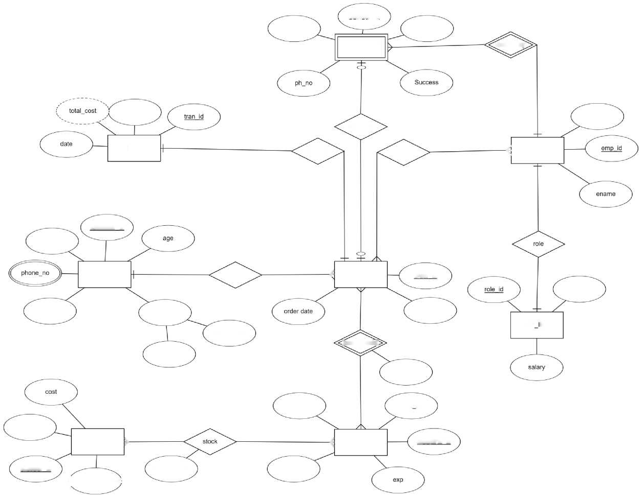
delivery_date
deli_very_i_d
d_boy_name
DELIVERY
deliver_by
mode
ephone
deliveres
BILL
payment
receives
^ EMPLOYEE
customer id
cname
CUSTOMER
ordered
£ ORDER
order id
role_name
gender
(Address)
order mode
Street_name
EMP NFO
Street_no
;med_detail£
med_quantity
mname
disease name
sname
medicine id
SUPPLIER >
^ MEDICINE
supplier id
[s_phone_number
stock_quantity
mprice

Slide 3
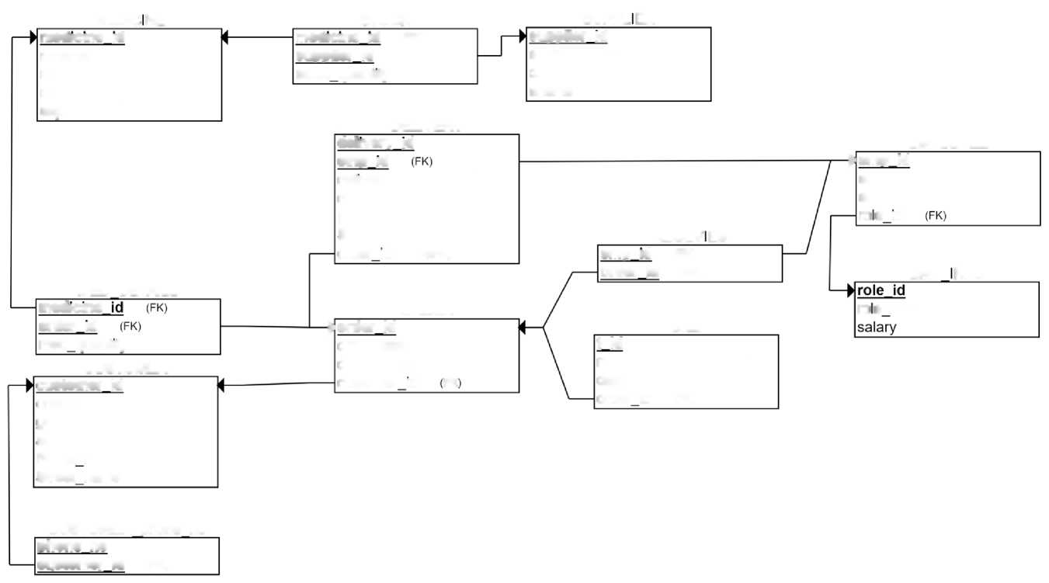
RELATIONAL MODEL
MEDIC NE
STOCK
SUPPLER
medicine id
medicine id (FK> supplier id (FK)
supplier id
s_phone_number
cost
mname
mprice
disease_name
exp
stock quantity
sname
delivery id
DELIVERY
EMPLOYEE
emp id
► emp id
delivery_date
ename
d_t>oy_name
ephone
ph_no
ro e id
Success
RECEV ES
order id
(0)(FK)
emp id (FK) order id (FK)
MED DETAILS
EMP NFO
medicine
ORDER
ro e name
order id
► order id
BILL
medquantity
order date
t id
mode
date
order id (FK)
CUSTOMER
order mode
customer id
customer id
FK
ename
gender
age
Street no
Street name
CUSTOMER phone no
phone no customer id (FK)

Slide 4
FUNCTIONAL DEPENDENCIES
1. CUSTOMER:
CUSTOMER_ID^{CNAME,AGE,GENDER,PHONENO}
PHONENO IS A MULTI-VALUED ATTRIBUTE SET
SINCE ALL THE FIELDS DEPEND ON CUSTOMER_ID, (CUSTOMER_ID)+ ">R HENCE, CUSTOMER_ID IS A PRIMARY KEY.
2. ORDER:
ORDER_ID^{ ORDER_MODE,ORDER_DATE }
SINCE ALL THE FIELDS DEPEND ON ORDER_ID, (ORDER_ID)+ ">R HENCE, ORDER_ID IS A PRIMARY KEY.
3. MEDICINE:
MEDICINE_ID^{ MNAME,MPRICE,DISEASENAME,EXP }
SINCE ALL THE FIELDS DEPEND ON MEDICINE_ID, (MEDICINE_ID)+ ">R

Slide 5
HENCE, MEDICINE_ID IS A PRIMARY KEY.
4. SUPPLIER:
SUPPLIER_ID^{ COST,SNAME,PHONE_NO }
SINCE ALL THE FIELDS DEPEND ON SUPPLIER_ID, (SUPPLIER_ID)+ ">R HENCE, SUPPLIER_ID IS A PRIMARY KEY.
5. BILL:
TRANS_ID^{MODE,DATE}
SINCE ALL THE FIELDS DEPEND ON TRANS_ID, (TRANS_ID)+ ">R HENCE, TRANS_ID IS A PRIMARY KEY.
6. DELIVERY:
DELIVERY_ID^{MODE,DATE}
DELIVERY IS A WEAK ENTITY SET
SINCE ALL THE FIELDS DEPEND ON DELIVERY _ID, (DELIVERY _ID)+ ">R

Slide 6
HENCE, DELIVERY _ID IS A PRIMARY KEY.
7. EMPLOYEE:
EMPLOYEE_ID^{ ENAME,EPHONE }
SINCE ALL THE FIELDS DEPEND ON EMPLOYEE _ID, (EMPLOYEE _ID)+ ">R HENCE, EMPLOYEE _ID IS A PRIMARY KEY.
8. EMP_INFO:
ROLE_ID^{ ROLE_NAME,SALARY }
SINCE ALL THE FIELDS DEPEND ON ROLE_ID, (ROLE_ID)+ ">R HENCE, ROLE_ID IS A PRIMARY KEY.
9. ORDERS:
ORDER_ID^{ order_date ,order_mode}
SINCE ALL THE FIELDS DEPEND ON ORDER_ID, (ORDER_ID)+ ">R HENCE ORDER ID IS A PRIMARY KEY.

Slide 7
10. MED DETAILS:
MEDICINE_ID ->{ med_quantity }
SINCE ALL THE FIELDS DEPEND ON MEDICINE_ID, (MEDICINE_ID)+ ">R HENCE, MEDICINE_ID IS A PRIMARY KEY.
11. RECEIVES
PRIMARY KEY: EMP_ID, ORDER_ID FOREIGN KEYS:
EMP_ID (REFERENCES EMPLOYEE(EMP_ID)) ORDER_ID (REFERENCES ORDERS(ORDER_ID)) ATTRIBUTES:EMP_ID,ORDER_ID
12. BILL
PRIMARY KEY: TRANS ID
FOREIGN KEYS:

Slide 8
ORDER_ID (REFERENCES ORDERS(ORDER_ID))
ATTRIBUTES:TRANS_ID,MODES,DATES,ORDER_ID
NORMALIZATION
IN 2NF - IF THERE ARE NO PARTIAL DEPENDENCIES.
IN 3NF - IF THERE ARE NO TRANSITIVE DEPENDENCIES.
IN BCNF - IF ALL DETERMINANTS ARE CANDIDATE KEYS OR SUPER KEYS. 1. CUSTOMER
(CUSTOMER,CNAME,AGE,GENDER)
CUSTOMER_ID "> {CNAME,AGE,GENDER}
NORMAL FORM: BCNF
2.ORDER
(ORDER,ORDERMODE,ORDERDATE)

Slide 9
ORDERJD "> {ORDERMODE,ORDERDATE}
NORMAL FORM: BCNF
3.MEDICINE
(MEDICINE_ID,MNAME,MPRICE,DISEASENAME,EXP)
MEDICINE_ID->{MNAME,MPRICE,DISEASENAME,EXP}
NORMAL FORM: BCNF 4.SUPPLIER
(COST,SNAME,SUPPLIER_ID,PHONE_NO)
SUPPLIER_ID->{COST,SNAME,PFIONE_NO}
NORMAL FORM: BCNF
5.BILL
(TRANSJD, MODE, DATE)
TRANS_ID->{MODE,DATE}

Slide 11
NORMAL FORM: BCNF
6. DELIVERY
(DELIVERY_DATE,DELIVERY_ID,DEV_BOY_NAME,SUCCESS,PHO_NO)
DELIVERY_ID^{DELIVERY_DATE,DEV_BOY_NAME,SUCCESS,PHO_NO}
NORMAL FORM: BCNF
7. EMPLOYEE
(EMP_ID,ENAME,EPHONE)
EMP_ID^{ENAME,EPHONE}
NORMAL FORM: BCNF
8. EMP_INFO
(ROLE_NAME,ROLE_ID,SALARY)
ROLE_ID^{ROLE_NAME,SALARY}
NORMAL FORM: BCNF

Slide 12
9.ORDERS:
(ORDER_ID)-> {ORDER_DATE, ORDER_MODE} NORMAL FORM: BCNF
10. MED_DETAILS:
(MEDICINEJD) -> {MED_QUANTITY}
NORMAL FORM: BCNF
11. RECEIVES:
EMPJD -> {ORDERJD}
ORDERJD -> {ORDER_DATE, ORDER_MODE} NORMAL FORM: BCNF
12. BILL:
TRANSJD -> {ORDERJD, ORDER_MODE, ORDER
NORMAL FORM: BCNF

Slide 13
DATE}

Slide 14
SQL CODE
CREATE TABLE CUSTOMER (
cname VARCHAR(225) NOT NULL, customer_id VARCHAR(225) NOT NULL, gender VARCHAR(225) NOT NULL, age INT NOT NULL,
Street_no VARCHAR(225) ,
Street_name VARCHAR(225),
PRIMARY KEY (customer_id)
);
insert into customer values ('rakesh','CUS1','M',28,'U01','UPPAL'); insert into customer values ('sohan','CUS2','M',18,'S01','SAMEERPET'); insert into customer values ('manikanta','CUS3','M',19,'M01','MAREDEPALLY'); insert into customer values ('suhas','CUS4','M',18,'R01','RAMPET'); insert into customer values ('sanjay','CUS5','M',20,'K01','KAZIPET');
CREATE TABLE MEDICINE (
medicine_id VARCHAR(225) NOT NULL, mname VARCHAR(225) NOT NULL, mprice INT NOT NULL, disease_name VARCHAR(225),
MANF DATE, expi DATE,
PRIMARY KEY (medicine_id)
);
insert into MEDICINE values ('MED1','PARACETAMOL',100,'FEVER','1-APR-22','1-APR-23'); insert into MEDICINE values ('MED2','DOLO',200,'BODYPAINS','1-MAY-22','1-MAY-23'); insert into MEDICINE values ('MED3','SETREGIN',150,'COFF','1-JUNE-22','1-JUNE-23');

Slide 15
insert into MEDICINE values ('MED4','COLDDACT',130,'COLD','1-JULY-22','1-JULY-23'); insert into MEDICINE values ('MED5','HEAD',90,'HEADAKE','1-JULY-22','1-JULY-23');
CREATE TABLE SUPPLIER (
supplier_id VARCHAR(225) NOT NULL, s_phone_number INT NOT NULL, cost INT NOT NULL, sname VARCHAR(225),
PRIMARY KEY (supplier_id)
);
insert into SUPPLIER values ('SUP1',1800018000,50,'RAHUL'); insert into SUPPLIER values ('SUP2',1800018001,50,'BHUVANESH'); insert into SUPPLIER values ('SUP3',1800018002,50,'VENKAT'); insert into SUPPLIER values ('SUP4',1800018003,50,'MAHI'); insert into SUPPLIER values ('SUP5',1800018004,50,'NISHANTH');
CREATE TABLE EMP_INFO (
role_name VARCHAR(225) NOT NULL, role_id VARCHAR(225), salary INT,
PRIMARY KEY (role_id)
);
INSERT INTO EMP_INFO VALUES ('cashier','ROL1',6000);
INSERT INTO EMP_INFO VALUES ('security','ROL2',5000);
INSERT INTO EMP_INFO VALUES ('Manager','ROL3',8000);
INSERT INTO EMP_INFO VALUES ('worker','ROL4',9000);
INSERT INTO EMP_INFO VALUES ('billchecker','ROL5',8000);
CREATE TABLE stock (
stock_quantity INT,

Slide 16
medicine_id varchar(225) NOT NULL, supplier_id varchar(225) NOT NULL,
PRIMARY KEY (medicine_id, supplier_id),
FOREIGN KEY (medicine_id) REFERENCES MEDICINE(medicine_id), FOREIGN KEY (supplier_id) REFERENCES SUPPLIER(supplier_id)
);
INSERT INTO stock VALUES (50, 'MED1', 'SUP1');
INSERT INTO stock VALUES (20, 'MED3', 'SUP3');
INSERT INTO stock VALUES (70, 'MED4', 'SUP2');
INSERT INTO stock VALUES (30, 'MED2', 'SUP5');
INSERT INTO stock VALUES (40, 'MED5', 'SUP4');
CREATE TABLE CUST OMER_PHONE_N O (
phone_no INT NOT NULL, customer_id varchar(225) NOT NULL,
PRIMARY KEY (phone_no, customer_id),
FOREIGN KEY (customer_id) REFERENCES CUSTOMER(customer_id) );
INSERT INTO CUSTOMER_PHONE_NO VALUES (1234567891, 'CUS1'); INSERT INTO CUSTOMER_PHONE_NO VALUES (1234567892, 'CUS3'); INSERT INTO CUSTOMER_PHONE_NO VALUES (1234567893, 'CUS4'); INSERT INTO CUSTOMER_PHONE_NO VALUES (1234567894, 'CUS2'); INSERT INTO CUSTOMER_PHONE_NO VALUES (1234567895, 'CUS5');
CREATE TABLE EMPLOYEE (
ename VARCHAR(225) , emp_id VARCHAR(225), ephone INT NOT NULL, role_id VARCHAR(225),

Slide 17
PRIMARY KEY (emp_id),
FOREIGN KEY (role_id) REFERENCES EMP_INFO(role_id)
);
INSERT INTO EMPLOYEE VALUES ('JohnDoe', 'EMP1', 1800019000, 'ROL1'); INSERT INTO EMPLOYEE VALUES ('JOHN', 'EMP2', 1800019001, 'ROL4'); INSERT INTO EMPLOYEE VALUES ('RAM', 'EMP3', 1800019003, 'ROL2'); INSERT INTO EMPLOYEE VALUES ('KRISHNA', 'EMP4', 1800019003, 'ROL3'); INSERT INTO EMPLOYEE VALUES ('RAMU', 'EMP5', 18000190004, 'ROL5');
CREATE TABLE DELIVERY (
delivery_date DATE , delivery_id VARCHAR(225), d_boy_name VARCHAR(225) , d_ph_no INT NOT NULL,
Successs varchar(225), emp_id varchar(225),
PRIMARY KEY (delivery_id, emp_id),
FOREIGN KEY (emp_id) REFERENCES EMPLOYEE(emp_id)
);
INSERT INTO DELIVERY VALUES (TO_DATE('2023-05-12','YYYY-MM-DD'),'DLV1','Adam Smith',9191919191,'Successful','EMP 1');
INSERT INTO DELIVERY VALUES (TO_DATE('2023-05-11','YYYY-MM-DD'),'DLV2','Emily Davi s',9191919192,'F ailed','EMP3');
INSERT INTO DELIVERY VALUES (TO_DATE('2023-05-13','YYYY-MM-DD'),'DLV3','Jack Smith',9191919193,'F ailed','EMP2');
INSERT INTO DELIVERY VALUES (TO_DATE('2023-05-14','YYYY-MM-DD'),'DLV4','Maggie Lee',9191919194,'Successful','EMP5');
INSERT INTO DELIVERY VALUES (TO_DATE('2023-05-15','YYYY-MM-DD'),'DLV5','Henry Brown',9191919195,'Pending','EMP4');
CREATE TABLE ORDERS

Slide 18
(
order_id varchar(225) , order_date date , order_mode varchar(225) , customer_id varchar(225), delivery_id varchar(225) , emp_id varchar(225),
PRIMARY KEY (order_id),
FOREIGN KEY (customer_id) REFERENCES CUSTOMER(customer_id),
FOREIGN KEY (delivery_id,emp_id) REFERENCES DELIVERY(delivery_id, emp_id)
);
INSERT INTO ORDERS VALUES ('ORD1',TO_DATE('2023-06-12','YYYY-MM-DD'),'Online','CUS1',^{r}DLV1','EMP1'); INSERT INTO ORDERS VALUES ('ORD2',TO_DATE('2023-06-n','YYYY-MM-DD'),'Phone','CUS2','DLV3','EMP2'); INSERT INTO ORDERS VALUES ('ORD3',TO_DATE('2023-06-13','YYYY-MM-DD'),'In-person','CUS3','DLV4','EMP5'); INSERT INTO ORDERS VALUES ('ORD4',TO_DATE('2023-06-15','YYYY-MM-DD'),'Online','CUS5','DLV2','EMP3'); INSERT INTO ORDERS VALUES ('ORD5',TO_DATE('2023-06-14','YYYY-MM-DD'),'Phone','CUS4',^{r}DLV5','EMP4');
CREATE TABLE med_details (
med_quantity INT , medicine_id VARCHAR(225), order_id VARCHAR(225),
PRIMARY KEY (medicine_id, order_id),
FOREIGN KEY (medicine_id) REFERENCES MEDICINE(medicine_id),
FOREIGN KEY (order_id) REFERENCES ORDERS (order_id)
);
INSERT INTO med_details VALUES (50,'MED2','ORD1');
INSERT INTO med_details VALUES (20,'MED1','ORD4');
INSERT INTO med_details VALUES (30,'MED3','ORD2');
INSERT INTO med_details VALUES (10,'MED5','ORD5');
INSERT INTO med_details VALUES (5,'MED4','ORD3');

Slide 19
CREATE TABLE receives (
emp_id VARCHAR(225), order_id VARCHAR(225),
PRIMARY KEY (emp_id, order_id),
FOREIGN KEY (emp_id) REFERENCES EMPLOYEE(emp_id), FOREIGN KEY (order_id) REFERENCES ORDERS (order_id)
);
INSERT INTO receives VALUES ('EMP1','ORD2');
INSERT INTO receives VALUES ('EMP3','ORD1');
INSERT INTO receives VALUES ('EMP5','ORD5');
INSERT INTO receives VALUES ('EMP4','ORD4');
INSERT INTO receives VALUES ('EMP2','ORD3');
CREATE TABLE BILL (
trans_id VARCHAR(225), modes VARCHAR(225), dates DATE,
order_id VARCHAR(225),
PRIMARY KEY (trans_id),
FOREIGN KEY (order_id) REFERENCES ORDERS(order_id)
);
INSERT INTO BILL VALUES ('TR1','Card',TO_DATE('2023-07-12','YYYY-MM-DD'),'ORD1'); INSERT INTO BILL VALUES ('TR2','Cash',TO_DATE('2023-07-11','YYYY-MM-DD'),'ORD3'); INSERT INTO BILL VALUES ('TR3','Card',TO_DATE('2023-07-13','YYYY-MM-DD'),'ORD2'); INSERT INTO BILL VALUES ('TR4','Online',TO_DATE('2023-07-14','YYYY-MM-DD'),'ORD5'); INSERT INTO BILL VALUES ('TR5','Cash',TO_DATE('2023-07-15','YYYY-MM-DD'),'ORD4');

Slide 20
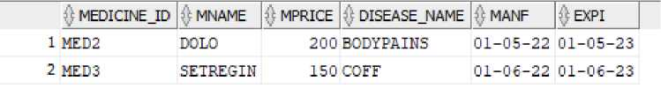
QURIES:
1.SELECT * FROM CUSTOMER;
$ CNAME | ^ CUSTOMER_ID | $ GENDER | 0AGE | $ STREET_NO | $ STREET_NAME
1 rakesh | CUS1 | M | 23 | U01 | UFFAL
2 sohan | CUS2 | M | 13 | 301 | SAMEERPET
3 manikanta | CUS3 | M | 15 | HOI | MARE DE PALLY
4 suhas | CUS4 | M | 13 | R01 | RAMPET
5 sanjay | CUSS | M | 20 | KOI | KAZIFET
2. SELECT * FROM MEDICINE WHERE MPRICE >= 150;
3. SHOW THE CREATED DATA OF BILL
$ COLUMN_NAME | 0 DATAJTYPE |  | $ NULLABLE | DATA_DEFAULT | ) COLUMN_ID | $ COMMENTS|
1 TRANS_ID | VAROEiAR2(225 | BYTE) | No | (null) | 1 | (null)
2 MODES | VARCHAR2 (225 | BYTE) | Yes | (null) | 2 | (null)
3 DATES | DATE |  | Yes | (null) | 3 | (null)
4 ORDER_ID | VARCHAR2 (225 | BYTE) | Yes | (null) | 4 | (null)
4. RETRIEVE THE NAME OF THE SUPPLIER WHO SUPPLIES MEDICINE "MED1":
SELECT SNAME FROM SUPPLIER S JOIN STOCK ST ON S.SUPPLIER_ID = ST.SUPPLIER_ID WHERE ST.MEDICINE_ID = 'MED1';

Slide 21

$ SNAME 1 RAHUL
5. SELECT THE TOTAL NUMBER OF ORDERS: SELECT COUNT(*) FROM ORDERS;
6.RETRIEVE THE ROLE NAME AND SALARY OF ALL EMPLOYEES WHO EARN MORE THAN 6000 AND LESS THAN 9000:
1 | $ ROLE_NAME | $ SALARY|
 | cashier | €000
2 | Manager | sooo
3 | worker | sooo
4 | billchecker | SOOO
7. DISPLAY THE TOTAL COST OF ALL MEDICINE IN STOCK:
SELECT SUM(STOCK_QUANTITY * MPRICE) AS TOTAL_COST FROM STOCK INNER JOIN MEDICINE ON STOCK.MEDICINE_ID = MEDICINE.MEDICINE_ID;

Slide 22
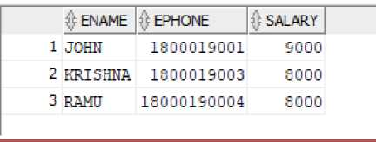
$ TQTAL_CQST 1 26700
8. SHOW THE DATA TABLE FOR MEDICINE DETAILS
MED_QUANTTTY MEDICINE _ID ORDERJD
1 | 50 | HED2 | ORD1
2 | 20 | HED1 | ORD4
3 | 30 | HED3 | ORD2
A | 10 | HED5 | ORD5
5 | 5 | MED4 | ORD3
9. DISPLAY THE NAME, PHONE NUMBER, AND SALARY FOR ALL EMPLOYEES WHO MAKE MORE THAN $7000 PER MONTH:
SELECT ENAME, EPHONE, SALARY FROM EMPLOYEE INNER JOIN EMP_INFO ON EMPLOYEE.ROLE_ID = EMP_INFO.ROLE_ID WHERE SALARY > 7000;

Slide 23
10. RETRIEVE ALL MEDICINES AND THEIR SUPPLIERS:
SELECT MNAME, SNAME FROM MEDICINE INNER JOIN STOCK ON MEDICINE.MEDICINE ID
INNER JOIN SUPPLIER ON STOCK.SUPPLIER ID =
1 | $ MNAME | $ SNAME
 | PARACETAMOL | RAHUL
2 | COLDDACT | BHUVANESH
3 | SETREGIN | VEHKAT
4 | HEAD | MAHI
5 | DOLO | NISHAHTH

Slide 24
= STOCK. MEDICINEJD SUPPLIER.SUPPLIER ID

