Slide 1
Naukri Job Market Analysis

Slide 2
Team Members
Syeda Daniya Iman
Arsalan Bilal
Prajwal rotte
Prathap BD
Bontha Tharun
Chegondi Bhanu Prakash
Vishal Rathod
Mentor’s Name Stephy John

Slide 3
OBJECTIVE
To analyze job postings on Naukri.com to understand the current job market trends.
Extract insights about top hiring companies, in-demand skills, experience requirements, and salary trends.
Support job seekers and HR professionals with data-driven insights.

Slide 4
Dataset Description
Dataset Overview
Dataset : Naukri.csv
Rows: 560 job listings
Columns: 11
Key Columns : Company, Experience, Location, Ratings, Salary, Skills, Title

Slide 5
PROCESS
Data Understanding & Preprocessing
Exploratory Data Analysis (EDA)
Feature Engineering
Model Training & Evaluation
Deployment & Future Improvements

Slide 6
Data Understanding & Preprocessing
Insights
The dataset contained unstructured fields like salary ranges, experience, and multi-value skills requiring cleanup.
Skills were extracted from free-text using tokenization and keyword matching techniques.
Inconsistent formats in salary, experience, and location fields were standardized for uniform analysis.
Conclusion
Preprocessing transformed messy, semi-structured data into usable formats.
Cleaned features enabled reliable grouping, comparison, and insights generation.
The structured dataset provided a strong base for visual analytics and job trend evaluation.

Slide 7
Exploratory Data Analysis (EDA)
Insights
Experience: Most job postings demand 2–5 years of experience, indicating a focus on mid-level professionals.
Locations: Chennai, Mumbai, Pune, and Hyderabad are top job hubs, dominating the tech hiring landscape.
Skills: Python, SQL, Machine Learning, and AWS are the most frequently requested skills across postings.
Conclusion
The job market is centered around metro cities and technical skill sets.
There’s high demand for professionals with data and cloud expertise.
EDA highlights key factors for job seekers to align with market trends.

Slide 8
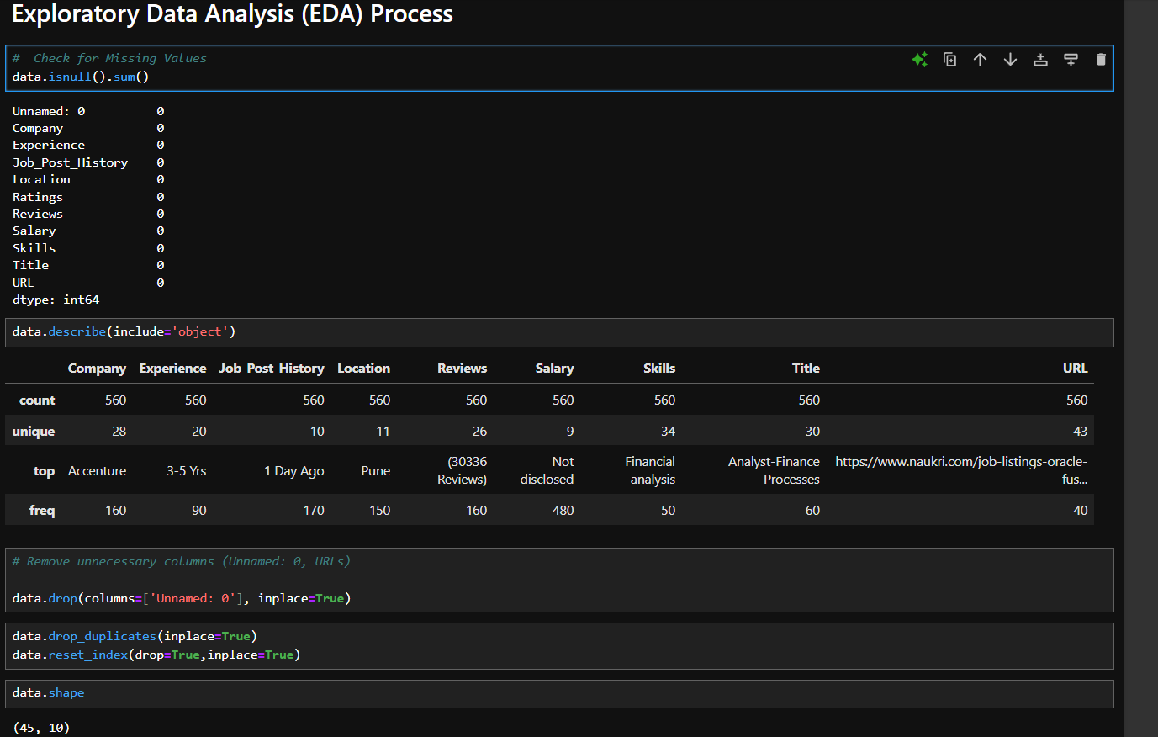

Slide 9
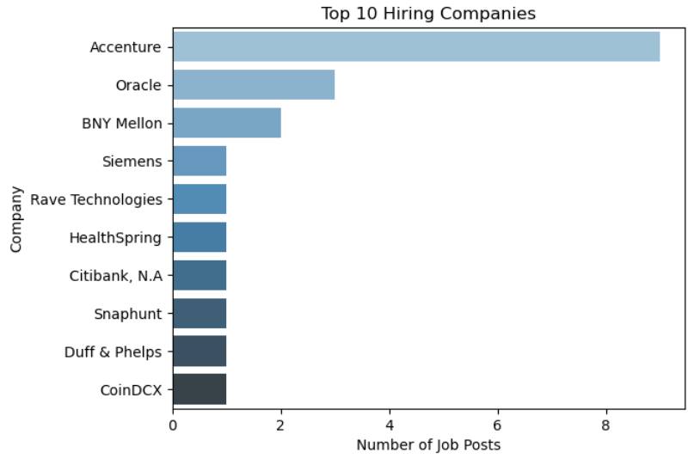
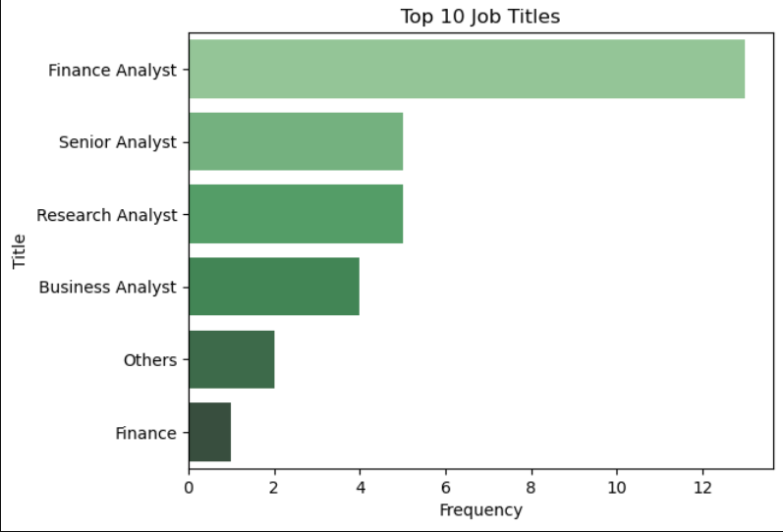
UNI-VARIATE ANALYSIS
Top Hiring Companies: Accenture leads with the highest number of job postings, significantly outpacing others like Oracle and BNY Mellon, indicating it's a major recruiter in this dataset.
Top Job Titles: The most in-demand role is Finance Analyst, followed by Senior and Research Analyst positions, highlighting a strong demand for analytics and finance-related expertise.

Slide 10
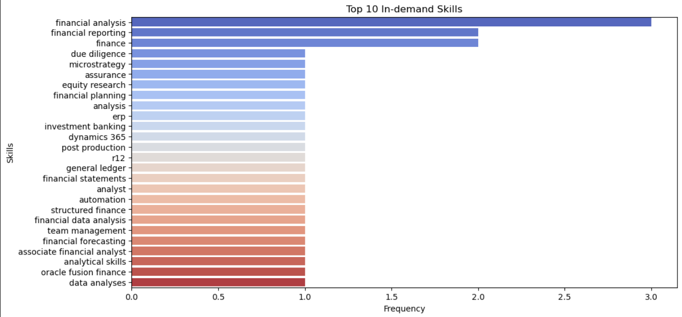
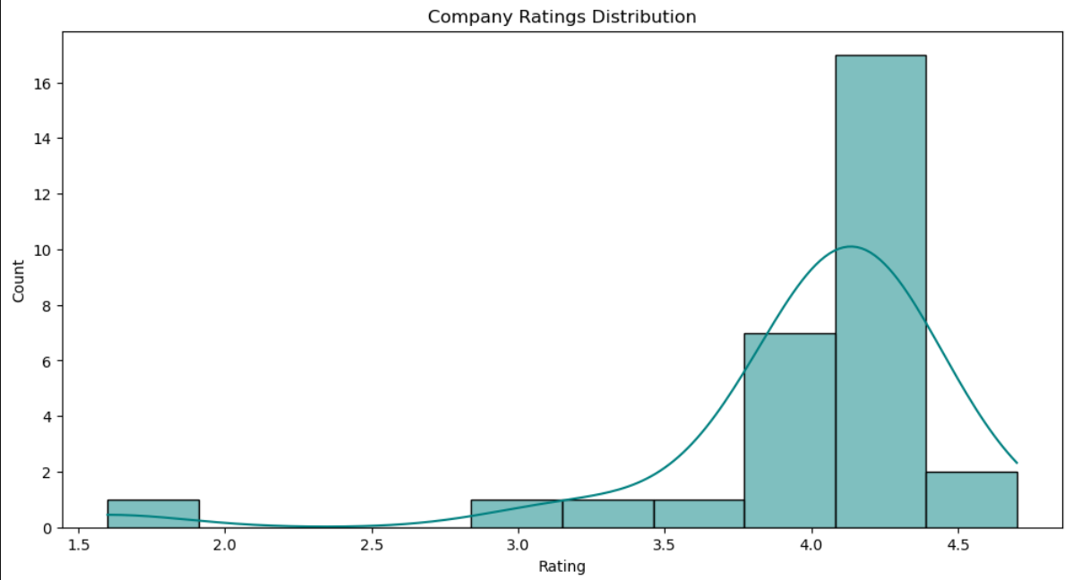
Top In-demand Skills: Skills like financial analysis, financial reporting, and finance are most sought after, emphasizing the importance of finance domain expertise in job postings.
Company Ratings Distribution: Most companies have ratings clustered between 4.0 and 4.5, suggesting a generally favorable perception of employers among job seekers or employees.

Slide 11
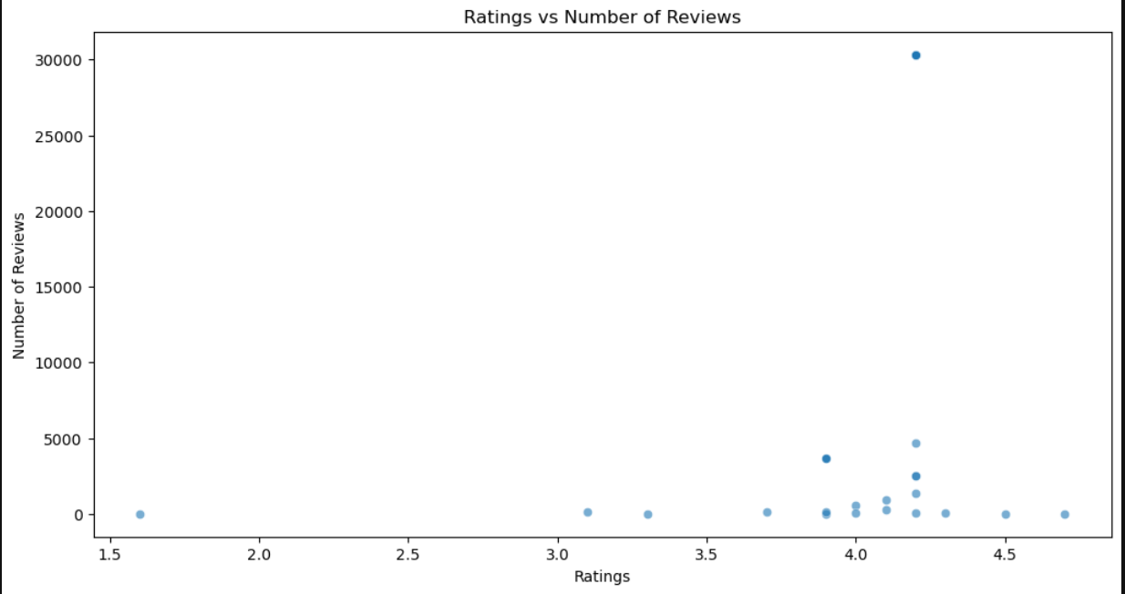
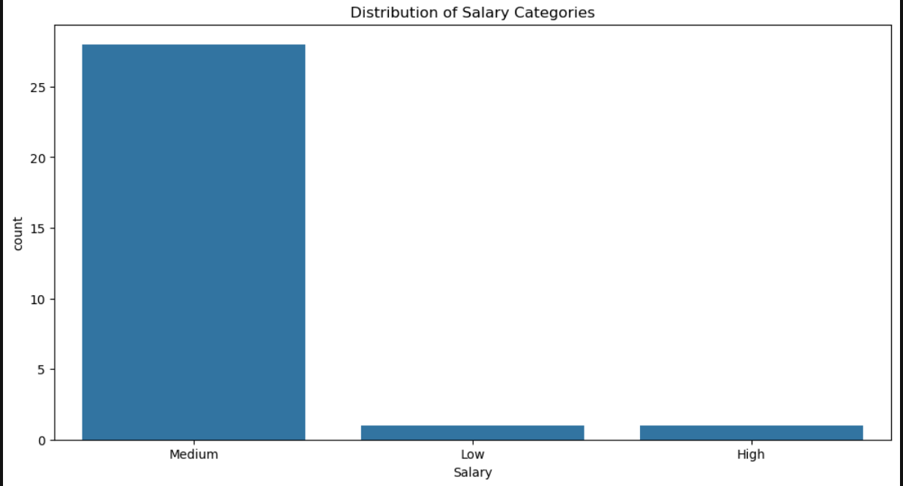
Ratings vs Number of Reviews: Most companies with high ratings (around 4.0–4.5) have fewer reviews, while one company with a 4.1 rating stands out with over 30,000 reviews, likely a major employer.
Salary Category Distribution: The majority of job postings fall under the Medium salary range, with very few in the Low and High categories, indicating a central tendency in offered compensation.

Slide 12
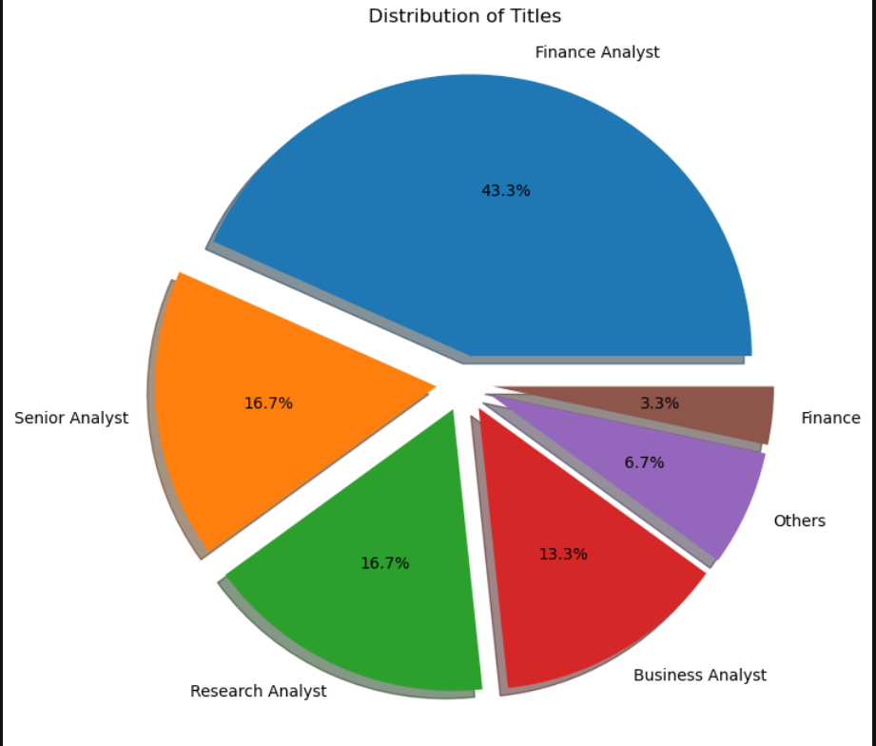
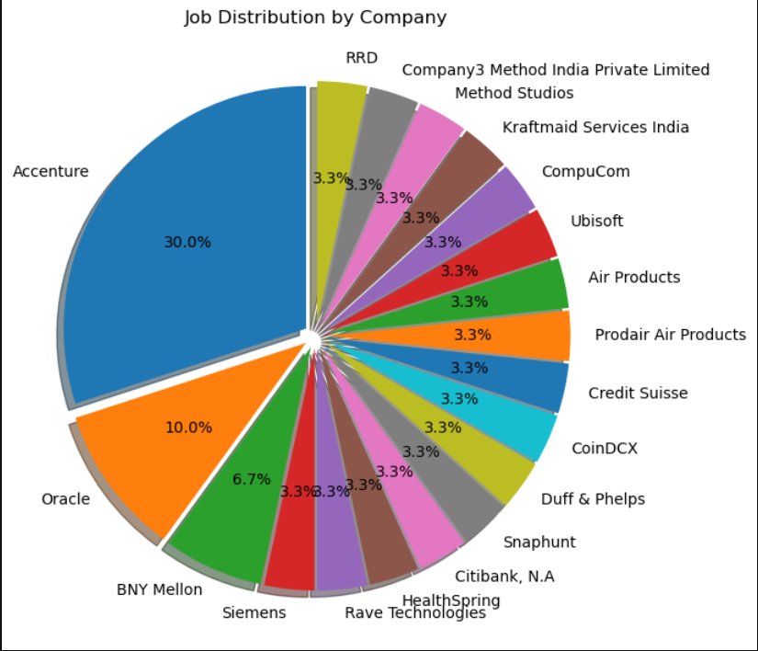
Distribution of Titles: Finance Analyst roles dominate the job market at 43.3%, followed by Senior Analyst and Research Analyst positions, indicating strong demand in financial and analytical roles.
Job Distribution by Company: Accenture alone accounts for 30% of job postings, significantly more than other companies like Oracle (10%) and BNY Mellon (6.7%), reflecting Accenture’s major hiring activity.

Slide 13
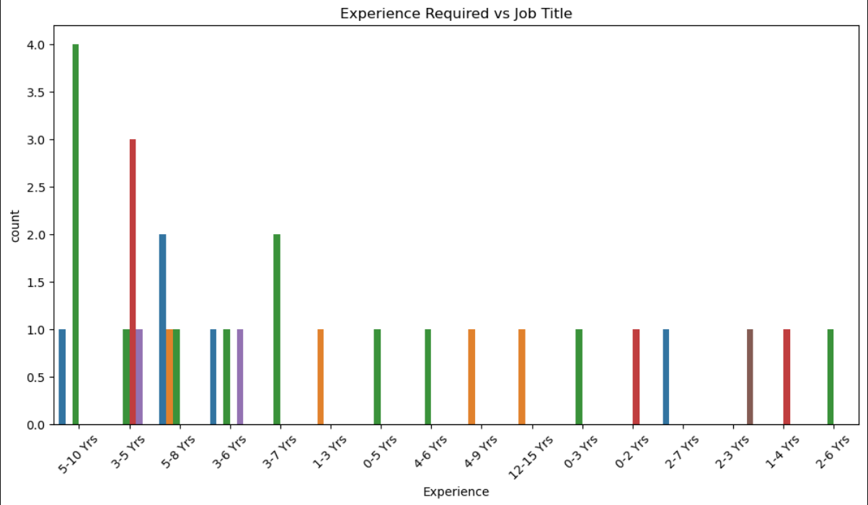
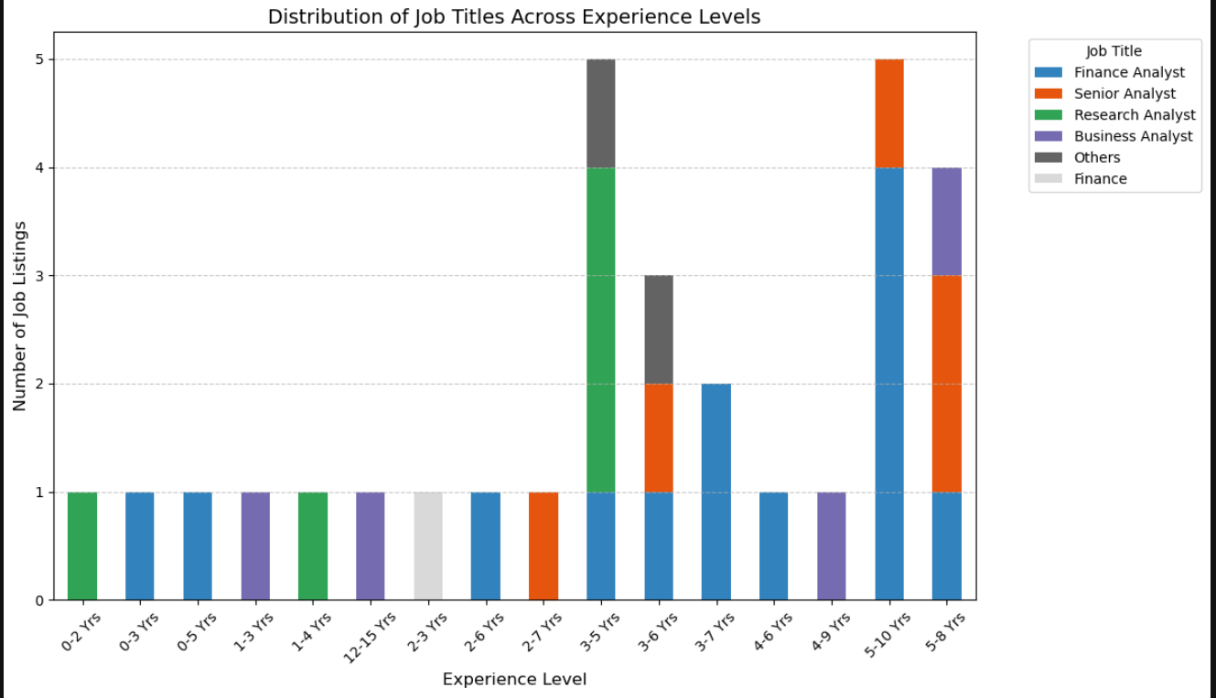
BI-VARIATE ANALYSIS
Experience Required vs Job Title: Most job titles demand experience in the 3–5 years range, especially for Business Analyst and Finance Analyst roles, highlighting a preference for mid-level professionals.
Job Titles Across Experience Levels: The highest number of job listings are in the 3–10 years experience bracket, particularly for Finance Analyst and Senior Analyst roles, suggesting that employers are targeting candidates with substantial yet not senior-level experience.

Slide 14
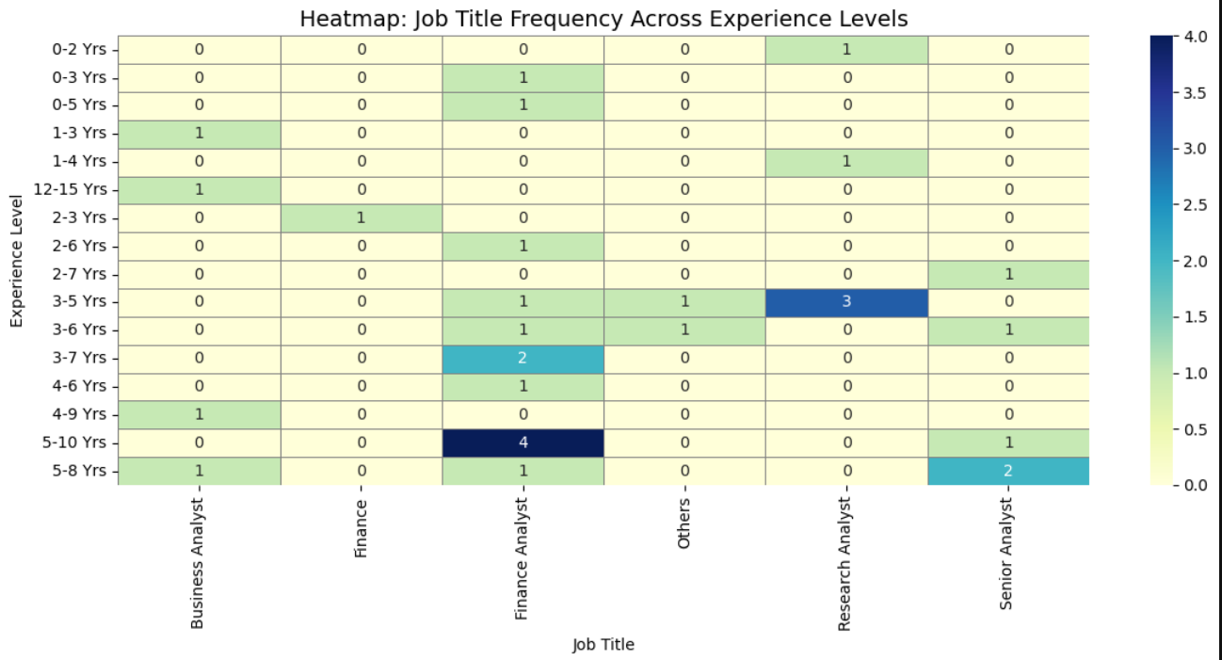
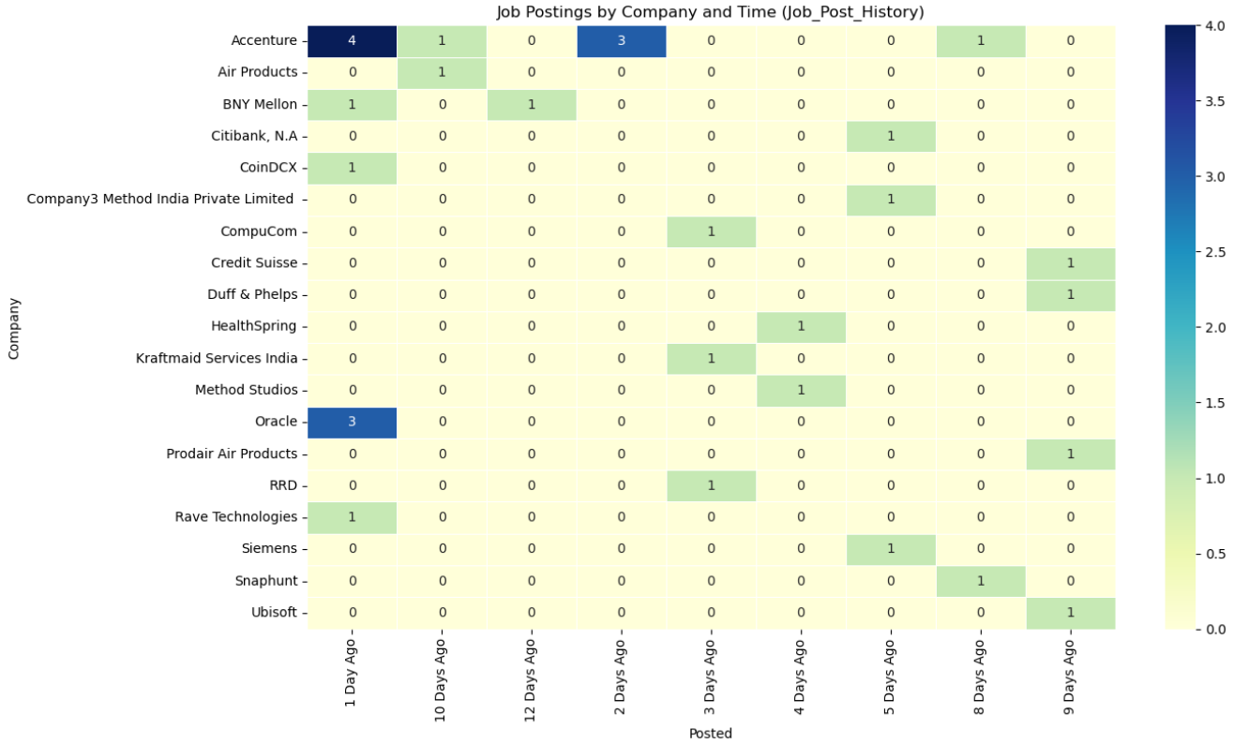
Most frequent roles by experience are "Finance Analyst" and "Research Analyst," notably at 3–6 years and 5–10 years respectively. Entry-level roles (0–2 years) are sparse, suggesting fewer junior openings or less data for those roles.
Accenture and Proddar Air Products had the highest job postings, particularly in the last 1–3 days. Job activity is mostly concentrated in a few companies, with recent surges indicating fresh hiring efforts.

Slide 15
Model Building
Insights
Data split into 77% training and 23% testing to prevent overfitting.
Standard Scaler used for normalization, ensuring consistent feature scaling.
Label encoder for categorical column
Conclusion
Proper data splitting prevents information leakage, ensuring reliable model evaluation.
Standardizing features helps classification-based models perform better.

Slide 16
Training a Classification Models
Insights
Multiple classification models (Logistic Regression, Random Forest, SVM, etc.) were trained to predict job titles.
Categorical features were label-encoded. data was split into 77% training and 23% testing.
Models were evaluated using accuracy scores and classification reports.
Random Forest and Gradient Boosting performed best and were fine-tuned using GridSearchCV.
Hyperparameter tuning improved accuracy for the selected best model.
Further improvements could include feature importance analysis and handling class imbalance.

Slide 17
Model Evaluation Metrics
Accuracy Score was the primary metric for comparing overall model performance.
Classification Report provided detailed metrics: precision, recall, F1-score, and support for each class (job title).
Evaluation focused on per-class performance, helping identify underperforming job categories.
Macro and weighted averages from the classification report can offer more insight, especially with imbalanced classes.
The best-performing model showed improved metrics after hyperparameter tuning with GridSearchCV.

Slide 18
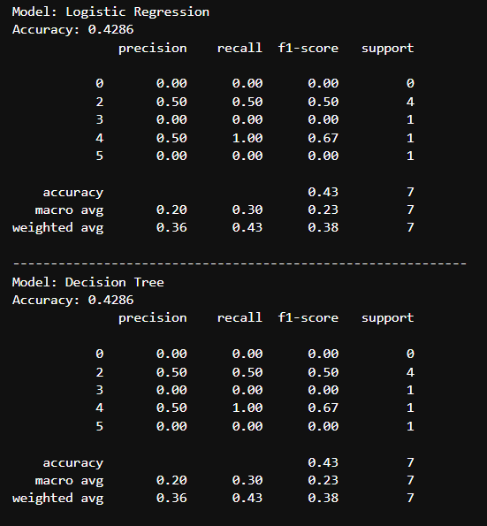
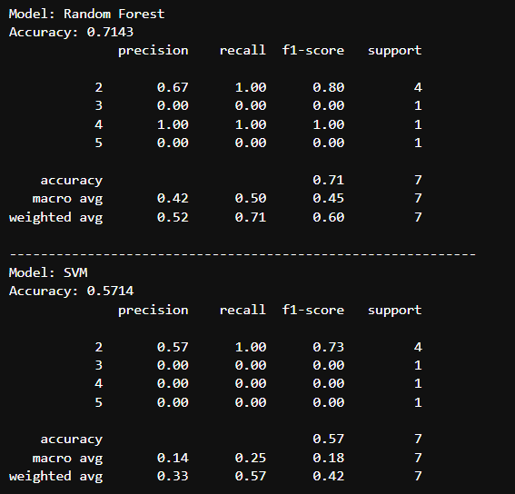

Slide 19
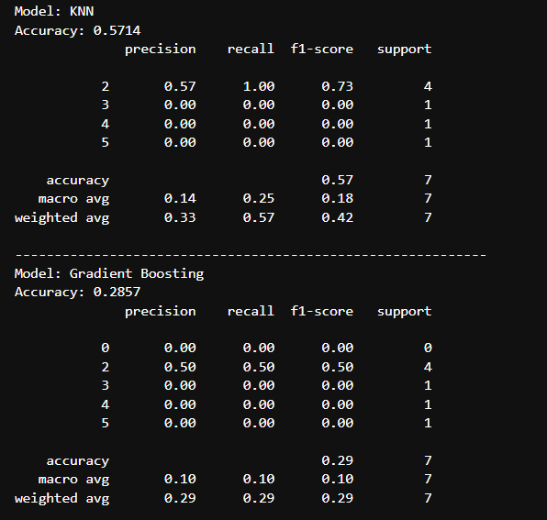
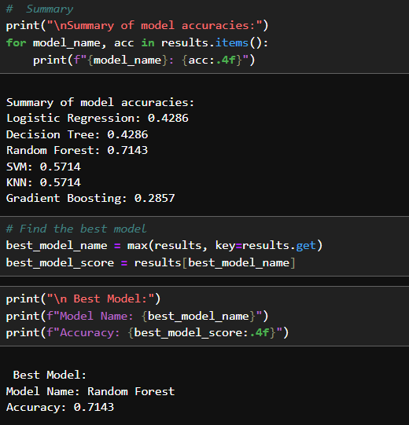

Slide 20
Model deployment is the process of taking a trained machine learning model and making it available for use in a real-world application or production environment. This allows the model to make predictions on new, unseen data in real-time or in batch processes.
Model Deployment
Insights
User-Friendly Design: The notebook provides a no-code interface through Streamlit, letting users choose a target column and make predictions with minimal technical effort.
Generic Framework: The same code can handle both regression and classification problems depending on the selected target.
Minimal Evaluation: No performance metrics (accuracy) are shown. Consider adding model evaluation for better feedback.
No Feature Engineering or Scaling: It's using basic label encoding and default model hyperparameters. This works for demo purposes but may limit accuracy.

Slide 21
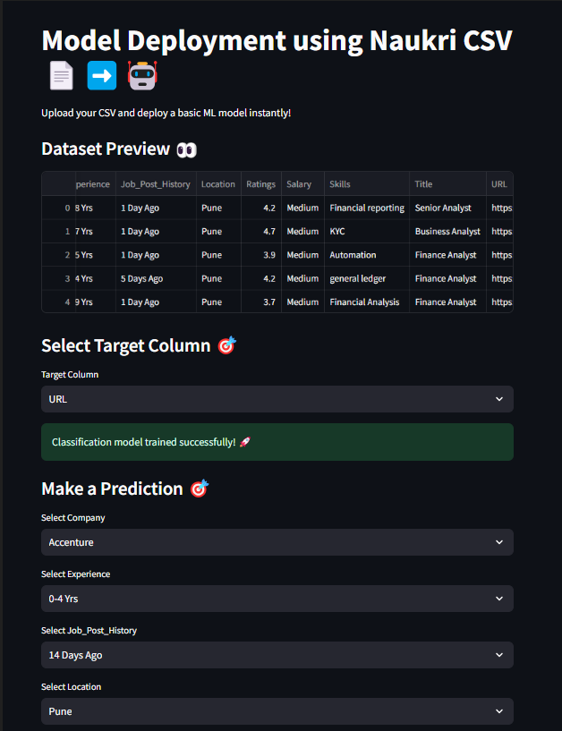
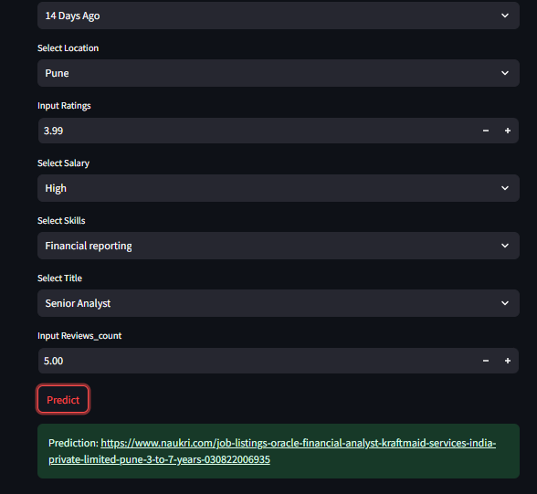
The interface allows users to train a classification model on a Naukri dataset by selecting a target column (in this case, URL). After successful training, the user can input features like company, experience, job post date, etc., to make predictions.
The model predicts the corresponding job URL from the dataset, showcasing effective deployment and inference from structured input fields.

Slide 22
Final Conclusion
Data preprocessing is essential for handling missing values, duplicates and feature scaling.
EDA plays a vital role in understanding data distributions and correlations.
Model evaluation ensures that the chosen approach provides reliable predictions.
Random Forest with Hyperparameter Tuning proved to be the most effective model.
Deployment allows real-world application, making Naukri job Analysis accessible and actionable.

Slide 23
Challenges Faced in the Project
Inconsistent Data Formats: Variability in how experience, salary, and skills were entered made preprocessing complex and time-consuming.
High Dimensional Categorical Variables: Columns like company and title had many unique values, making modelling harder without dimensionality reduction or encoding techniques.
Limited Skill Extraction Logic: Skills were extracted using basic token matching, which may miss variations and reduce model accuracy.
Overfitting Risk: With a small dataset (560 rows), complex models like Random Forest and Gradient Boosting risked overfitting without regularization or cross-validation.

Slide 24
Thank You

