Slide 1

AWS KIRO HACKATHON · CHALLENGE 8
AutoSpec
AI Agent That Writes Its Own Spec, Builds & Tests
Brief → Spec → Code → Test → Review
A multi-agent pipeline that turns plain English into a documented, tested, working prototype — autonomously.
Notes:
Hook (0:00-0:30): What if a PM could type three sentences and get back a documented, tested, working prototype? No engineers needed, no waiting — just AI agents building software for you.

Slide 2


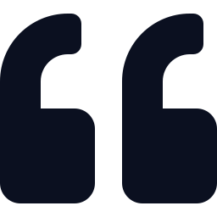
The Problem
Priya
Product Manager, software consultancy
“I just want to type what I need and get back something that works.”
Describes what she wants in plain English
Has no engineering background at all
Needs a working prototype - documented, coded, tested
Has to demo it to clients the SAME DAY
— every non-technical founder, ever
Notes:
Priya is our persona. The gap: great ideas, no way to turn them into tested code fast. Today she waits days for an engineer.

Slide 3





Our Solution: AutoSpec
Hand it a 2–3 sentence brief. It autonomously produces four artifacts — end to end:
Structured Spec
Working Code
Passing Tests
Alignment Verdict
Numbered requirements + Given/When/Then criteria
A single, clean, documented Python module
Real pytest suite with measured coverage %
ALIGNED / NOT ALIGNED with the exact gaps
Zero human intervention mid-run
Notes:
Architecture (0:30-1:00): four AI agents in a relay. One brief in, four artifacts out, no human touches it mid-run.

Slide 4



Architecture: 4 Specialized Agents
→
→
→
Spec Agent
Build Agent
Test Agent
Review Agent
Brief →
requirements
Spec →
code
writes +
runs pytest
checks →
verdict
Self-Correcting Loop
NOT ALIGNED → gaps fed back to the Build Agent → re-run Build · Test · Review automatically (up to 3×)
Notes:
The relay is linear — but the Review Agent can send work BACK. That loop is the heart of the system.

Slide 5
The Innovation: Self-Correcting Loop
1
2
3
4
Identify gaps
Feed back
Re-run
Repeat ×3
Review Agent pinpoints exactly which acceptance criteria are unmet
The specific gaps are handed back to the Build Agent
Build → Test → Review execute again, automatically
Up to three retries — no human ever steps in
“The pipeline doesn’t just fail — it fixes itself.”
Notes:
Most pipelines fail and stop. Ours diagnoses the exact unmet criteria and retries until aligned — bounded at 3 so it never loops forever.

Slide 6

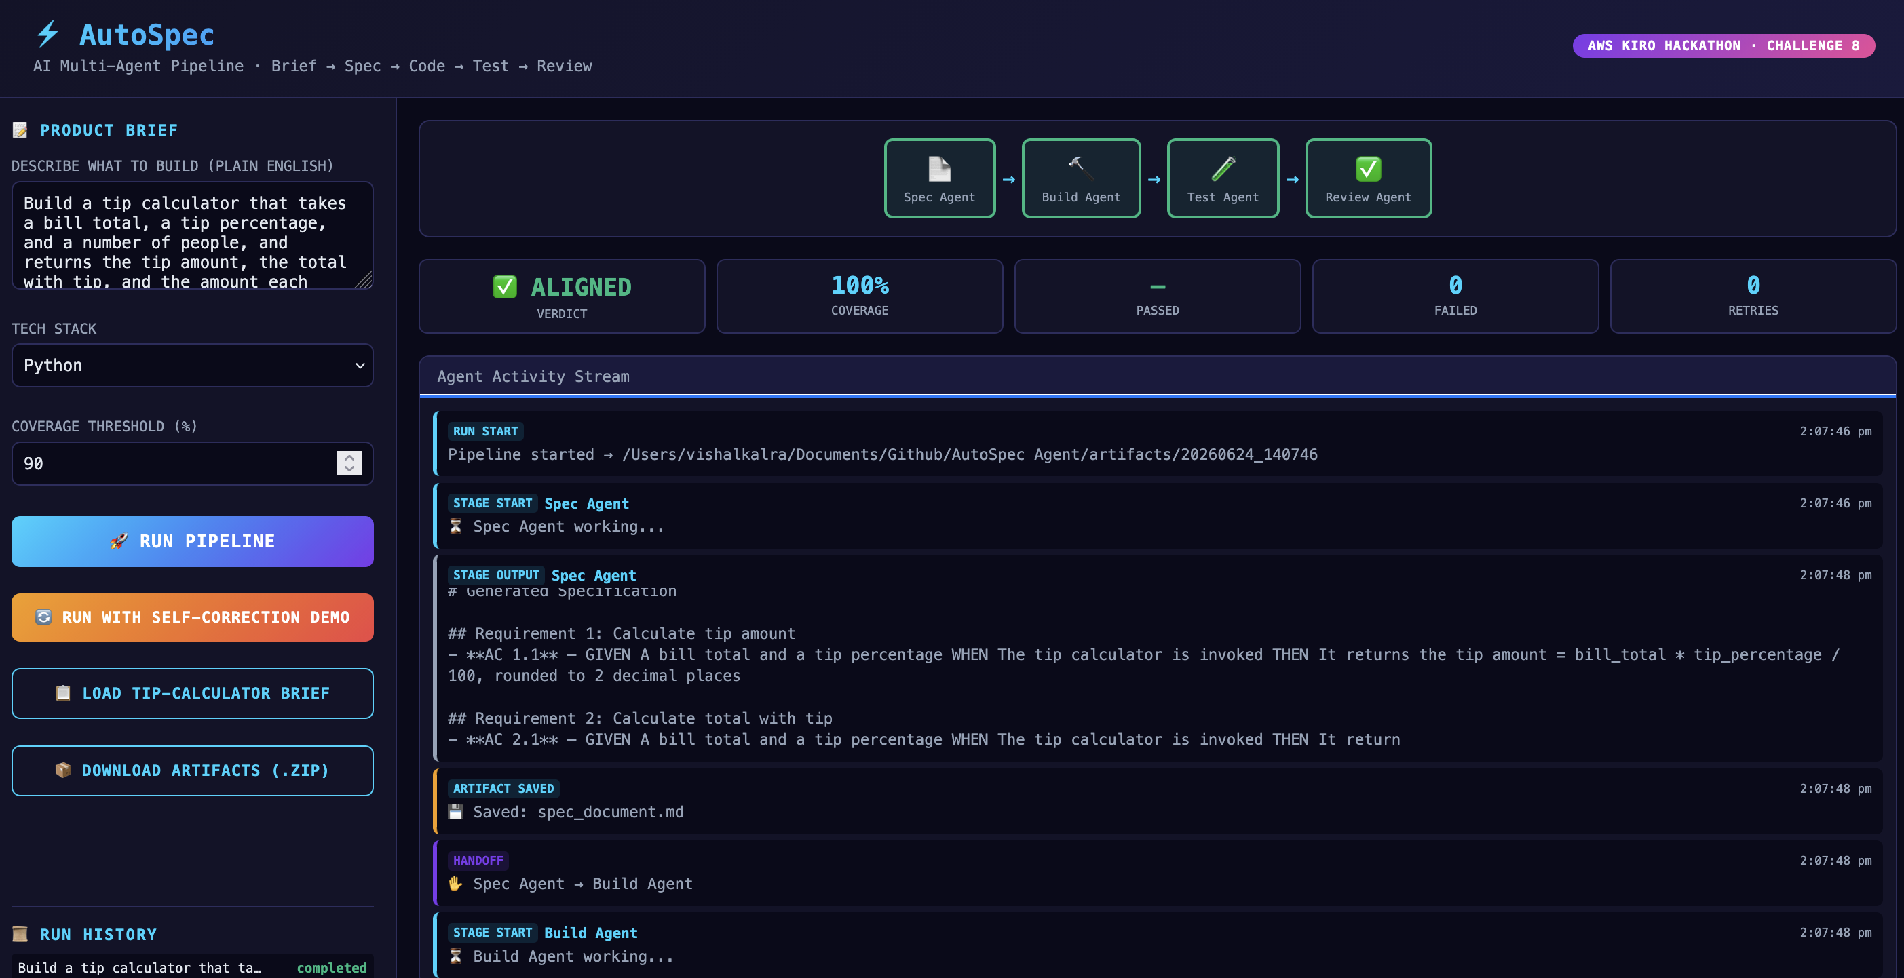
Live Demo
What the judges see:
Type a brief, hit Run
4 agents light up in sequence
Live streaming via SSE
Real pytest runs — coverage measured
ALIGNED verdict, artifacts to .zip
python3 app.py · :5000
Notes:
Demo (1:00-2:30): click Run, narrate as agents light up. Spec wrote 6 requirements... Build generated a module... Test ran 8 tests, all passing, 100% coverage... Review says ALIGNED. Then click Self-Correction Demo to show the loop fixing a gap live.

Slide 7

Results — Tip-Calculator Sample Run
6
8 / 8
100%
ALIGNED
~8s
Requirements
Tests passed
Coverage
Verdict
End to end
One plain-English brief in. A spec, working code, a green test suite, and a verdict out — in about eight seconds.
Notes:
These are real numbers from a live run — pytest actually executes, coverage is parsed from the report. Not mocked.

Slide 8

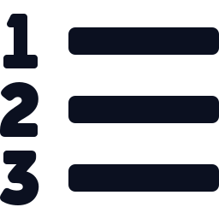


Built With Kiro — Spec-Driven, All The Way Down
requirements.md
design.md
tasks.md
13 formal requirements in EARS format, with a glossary
Full architecture, mermaid diagrams, 26 correctness properties
Incremental implementation plan with a dependency graph
“We used Kiro’s spec workflow to build a tool that does spec-driven development. It’s spec-ception.”
Notes:
The meta-story judges love: Kiro turns English into specs and code. We used exactly that workflow to build a system that does the same thing.

Slide 9

Why This Wins
Spec quality
13 EARS requirements, Given/When/Then criteria, glossary, full traceability
25%
Working demo
Live web UI, real pytest execution, 100% coverage, downloadable artifacts
30%
Innovation
Self-correcting retry loop, live SSE streaming, 4-agent architecture
20%
Pitch & story
You watch the agent relay happen live in the browser
25%
Notes:
Map every point back to the rubric. We hit all four criteria deliberately — the demo and the spec are our strongest cards.

Slide 10
AutoSpec
Type it - and it builds, tests, and reviews itself.
python3 app.py → localhost:5000
Python · Flask · pytest · AWS Bedrock · Kiro
Thank you
Notes:
Close (2:30-3:00): We built this with Kiro's spec workflow — and the tool does exactly what Kiro does: plain English into working, tested software. That's AutoSpec.

