Slide 1

CAPSTONE PROJECT
JUKEBOX
Created By: Vishal Prakash

Slide 2
Contents
Objective
Introduction
Overall Flow
Data Base Main Tables
Methods List
Future Scope

Slide 3
Objective
To create a menu driven Jukebox
To provide options like Login and Signing.
To give option to create there own playlists and play songs from there playlist.

Slide 4
Introduction
A Jukebox is a music application that allows users to play music.
A user can create its own multiple playlist according to his/her choice.
He/she can create a playlist by choosing song name from all songs or on the basis of artist and genre.
In this project, we are going to see the user signing and login methods. These credentials will be saved and can be used in the future.
A DBconnection class connects the Jukebox Java Project to the Database.
Music playing using Audio Input Stream.
Testing case.

Slide 5
JukeboxImpl
Overall Flow
Contains 4 Major classes
JukeboxImpl
User
Jukebox
Play
And the essential one
DBConnection class
User
Jukebox
Play

Slide 6
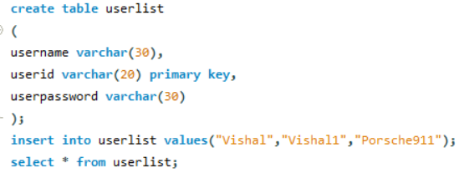
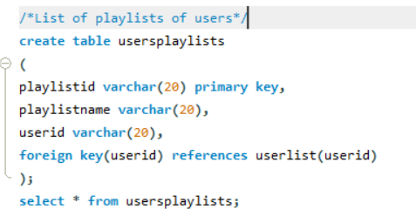
Database Tables
userList Table
usersplaylists

Slide 7
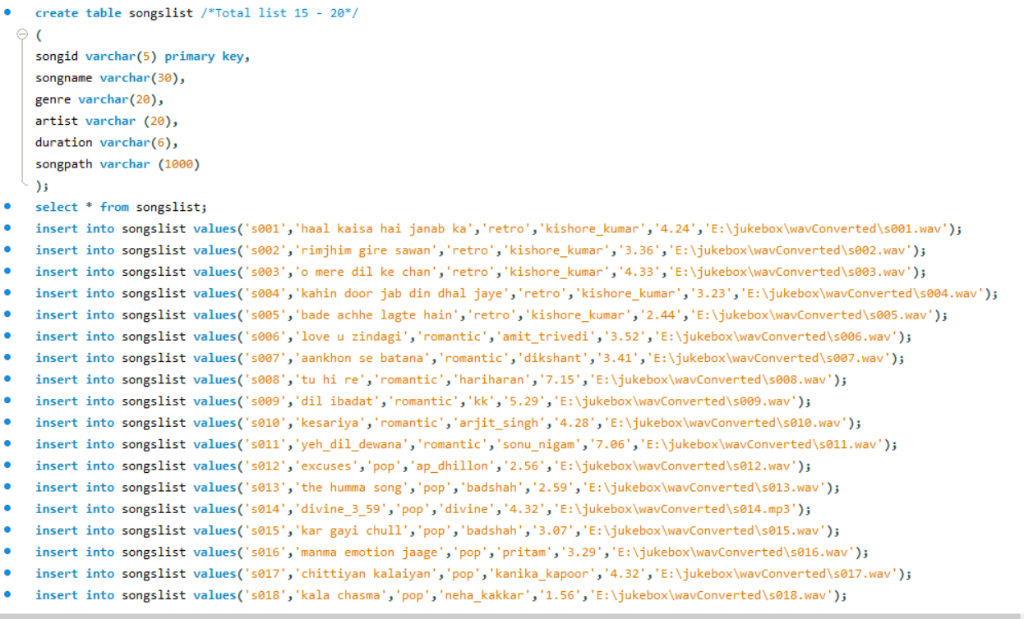
Songslist table

Slide 8
List of Methods and uses
Jukeboximpl class
Main() – To give options for logged in users.
User class
createAccount() – To create account for new user.
checkuserId() – To check given userId is new or with the same it is there in DB.
addUser() – Add the given the credentials by new user in DB.
login() – To help user to get access of Jukebox features.

Slide 9
Jukebox class
existinguserOption()- to show and create playlists.
printSongListTable() – to show songs list
createPlaylist() – to create a new playlist for user.
checkPlaylistID() – to check playlist is already given by users or not.
insertPlaylistInUserPlaylistTable() – to register the playlist in the name of user.
addsongInPlaylist() – In this method we have three options to select songs. On basis of All songs list, genre and artist.
showYourPlaylists() – to show playlist created by you.
playsongsFromPlaylist() – to pass playlist table name to to Play method
Play class
Playsong()- songId is passed to play that song.

Slide 10
Thank You

