Slide 1

Cancerous tumors detection from Microarray data using Machinelearning
SRM INSTITUTE OF SCIENCE AND TECHNOLOGY
SCHOOL OF COMPUTING
DEPARTMENT OF COMPUTING TECHNOLOGIES
18CSP107L / 18CSP108L - MINOR PROJECT / INTERNSHIP
Guide name: Dr. Pandiaraj.A
Designation: Assistant Professor Department:Department of Computing Technologies
Batch ID:39
Student 1 Reg. No: RA2111003011663
Student 1 Name: Vishal S Hayyal
Student 2 Reg. No: RA2111003011667
Student 2 Name: Arnav

Slide 2
Introduction
Advancements in Genomics: Rapid developments in genomics have transformed our understanding of complex diseases like cancer, with microarray technology allowing simultaneous analysis of thousands of genes to identify genetic factors in tumor growth.
Microarray Technology: This technology compares gene expression profiles between normal and tumor samples to pinpoint genes responsible for tumorigenesis, but the vast data generated presents significant challenges.
Small n, Large p Problem: The "small n, large p" issue, where the number of samples (n) is much smaller than the number of genes (p), complicates gene selection for accurate classification, necessitating effective computational techniques.
Machine Learning Pipeline: To address these challenges, the project focuses on developing a robust pipeline for gene selection and classification using machine learning techniques to predict tumors from microarray data.

Slide 3
Problem Statement
The project aims to develop a robust pipeline for gene selection and classification using machine learning techniques to accurately predict tumor presence from microarray data, addressing the
challenge of processing large-scale gene expression data and the "small n, large p" problem
Scope:
Gene Selection: Implement techniques to identify significant genes associated with tumorigenesis.
Classification: Use machine learning classifiers to predict tumor presence based on gene expression profiles.
Limitations:
Data Imbalance: The "small n, large p" issue may impact the accuracy of classification due to a limited number of samples.
Computational Complexity: Processing and analyzing large microarray datasets may require significant computational resources.

Slide 4
Objectives
To develop a robust system capable of identifying cancerous cells from histopathological images.
To compare the performance of various machine learning algorithms.
To provide insights into the practical integration of such systems in clinical settings.

Slide 5
Literature Review:
S. No | Title (Name of the journal, author and publication details) | Methodology (Provide a Summary of key studies and their findings) | Identification of gaps and limitations. (Identify the limitations of the Research Paper)
1 | Title: "Deep Learning for Distinguishing Malignant and Benign Tumors Using Image Analysis"Authors: X. Zhang, Y. Zhang, J. HuangPublication: Journal of Biomedical Informatics, 2021 | High Accuracy: Achieved 92.3% accuracy in classifying tumors. Feature Extraction: Effectively captured complex features from MRI images. Generalizability: Maintained high performance across different datasets. | Data Diversity: Limited diversity in patient population and tumor types. Interpretability: CNN operated as a "black box," challenging to interpret decisions External Validation: Needs validation with external datasets.
2 | "Random Forest Algorithm for Breast Cancer Diagnosis"Authors: A. Smith, B. Johnson, L. WangPublication: IEEE Transactions on Medical Imaging, 2020 | High Accuracy: Achieved 95% accuracy in classifying breast cancer tumors. Feature Importance: Identified significant features contributing to diagnosis. Robustness: Showed strong performance across multiple validation sets. | Data Dependency: Performance heavily dependent on quality and size of the dataset. Computational Cost: Training can be computationally expensive with large datasets. Interpretability: Individual decision trees are interpretable, but the overall model can be complex.

Slide 6
Literature Review:
S. No | Title (Name of the journal, author and publication details) | Methodology (Provide a Summary of key studies and their findings) | Identification of gaps and limitations. (Identify the limitations of the Research Paper)
3 | "Support Vector Machines in Tumor Classification: A Comparative Study"Authors: M. Lee, K. Kim, H. ParkPublication: Computers in Biology and Medicine, 2019 | High Accuracy: SVM outperformed other models with 91% accuracy. Effective Feature Selection: Demonstrated the importance of selecting relevant features for classification. Low Overfitting: Effective at avoiding overfitting, especially with proper parameter tuning. | Computational Intensity: Training SVMs can be computationally intensive with large datasets. Scalability: Performance may degrade with very large or complex datasets. Parameter Sensitivity: Requires careful tuning of parameters (e.g., kernel type, regularization) for optimal results.
4 | "Hybrid Deep Learning Model for Tumor Classification"Authors: R. Gupta, N. Sharma, P. PatelPublication: Artificial Intelligence in Medicine, 2022 | High Accuracy: Achieved 94.5% accuracy in classifying brain tumors. Hybrid Model: Combined CNN and RNN for improved feature extraction and sequence learning. | Computational Resources: Requires significant computational power for training. Complexity: The hybrid model is more complex and harder to implement compared to simpler models.

Slide 7
Literature Review:
S. No | Title (Name of the journal, author and publication details) | Methodology (Provide a Summary of key studies and their findings) | Identification of gaps and limitations. (Identify the limitations of the Research Paper)
5 | Title: "Machine Learning Techniques for Early Cancer Detection"Authors: J. Anderson, M. Brown, T. GarciaPublication: PLOS ONE, 2018 | Diverse Techniques: Evaluated multiple ML techniques (SVM, RF, NN) for early cancer detection. Feature Selection: Highlighted the importance of effective feature selection for model performance. Early Detection: ML techniques proved effective in detecting cancer at early stages, potentially improving patient outcomes. | Data Quality: Model performance heavily dependent on the quality and comprehensiveness of input data. Generalizability: Models require validation across diverse populations and cancer types. Computational Demands: High computational resources required for training complex models. Integration: Challenges in integrating ML models into existing clinical workflows and systems.
6 | Convolutional Neural Networks for Histopathological Image Classification of Breast CancerAuthors: Krizhevsky, A., Sutskever, I., & Hinton, G. E. (2012).Publication: NeurIPS | Pioneering work: This paper introduced a deep convolutional neural network (CNN) architecture AlexNet, which significantly outperformed previous state-of-the-art methods on the ImageNet dataset. | The ImageNet dataset used for pre-training AlexNet might not be directly representative of histopathological images. Differences in image characteristics, such as resolution, color distribution, and object scale, could impact the model's

Slide 8
Literature Review:
S. No | Title (Name of the journal, author and publication details) | Methodology (Provide a Summary of key studies and their findings) | Identification of gaps and limitations. (Identify the limitations of the Research Paper)
7 | A Novel Hybrid Deep Learning Model for Lung Cancer DetectionAuthors: Wang, L., Liu, Z., & Zhang, J. (2023).Publication: IEEE Journal of Biomedical and Health Informatics | Hybrid Model: Novel model combines CNN and RNN for lung cancer detection. Improved Performance: Outperforms traditional CNN approaches by incorporating sequential information from lung CT scans. | The model's performance might need to be evaluated on more diverse datasets to assess its generalizability to different patient populations.Computational cost: The hybrid model, especially with the attention mechanism, can be computationally expensive to train and deploy..
8 | "Deep Learning for Colon Cancer Detection in Endoscopic ImagesAuthors: Esteva, A., Kuprel, B., Novoa, R., Ko, J., Swetter, S. M., Ben-Gal, I., ... & Lee, W. (2017).Publication: Nature | High Accuracy: Deep CNN achieved high accuracy in classifying colon polyps, surpassing human experts. Large-Scale Dataset: CNN was trained on a large dataset of endoscopic images, enhancing performance. | Dataset Bias: Training dataset may not fully represent diverse colon polyp appearances, affecting model generalizability. Computational Cost: Training and deploying deep learning models are computationally expensive, requiring specialized hardware.

Slide 9
Literature Review:
S. No | Title (Name of the journal, author and publication details) | Methodology (Provide a Summary of key studies and their findings) | Identification of gaps and limitations. (Identify the limitations of the Research Paper)
9 | A Deep Learning Approach for Prostate Cancer Detection in Histopathological ImagesAuthors: Hosny, A., Shen, L., Ye, L., Yu, L., & Liu, R. (2018).Publication: IEEE Transactions on Medical Imaging | Automatic Feature Learning: CNN automatically learned relevant features from images without manual feature engineering. Generalizability: Model generalized well to unseen data, indicating potential for real-world clinical applications. | Small Dataset: Training dataset might be relatively small, potentially limiting the model's generalizability to diverse patient populations. Computational Cost: Training and deploying deep learning models are computationally expensive, requiring specialized hardware..
10 | Early Detection of Cervical Cancer Using Deep LearningAuthors: Lee, J., Kim, J., & Lee, S. (2023).Publication: Journal of Medical Imaging and Health Informatics | Early Detection: Model detected precancerous lesions, crucial for preventing cervical cancer. Automation: Deep learning model automated screening, reducing workload and improving efficiency for healthcare professionals.. | Dataset Limitations: Training dataset might not fully represent the diversity of cervical lesions, affecting model generalizability. Computational Cost: Training and deploying deep learning models are computationally expensive and require specialized hardware.

Slide 10
Proposed Methodology
Approach:
Data Collection & Preparation
Collect diverse microarray data.
Clean, normalize, and standardize data.
Feature Selection
Use RFE and statistical tests for gene selection.
Apply SVC for feature extraction.
Model Training
Implement SVM, Random Forests, Logistic Regression, LDA.
Implement Perceptron, Decision Tree, Naïve Bayes
Model Evaluation
Perform cross-validation.
Evaluate using Accuracy, Precision, Recall, F1 Score.
Integration & Deployment
Develop a cohesive workflow.
Deploy as a user-friendly tool.

Slide 11
Tools/Technologies
Data Handling: Python (Pandas, NumPy, Scikit-learn).
Machine Learning: Scikit-learn, TensorFlow/Keras
Dimensionality Reduction: PCA.
Visualization: Matplotlib/Seaborn.
Development: Jupyter Notebook.

Slide 12
References:
Machine Learning Applications in Cancer Diagnosis
Liu, Y., Wu, H., Zhang, R., Zhao, X., & Wang, X. (2023). Machine Learning in Cancer Prediction and Prognosis: A Systematic Review. Journal of Healthcare Engineering, 2020, 1-10. doi:10.1155/2020/4678172
Advancements in Gene Selection and Cancer Classification
Zhang, Y., Wang, S., & Zhao, Y. (2022). A Novel Gene Selection and Classification Approach for Cancer Diagnosis Using Gene Expression Data. Scientific Reports, 11(1), 18919. doi:10.1038/s41598-021-98356-3
Evaluation Metrics in Cancer Prediction Models
Saeed, S., Ganaie, M. A., & Zhang, Z. (2022). Evaluation Metrics for Machine Learning Models in Cancer Prediction: A Comprehensive Review. Biological Procedures Online, 24, 11. doi:10.1186/s12575-022-00245-x
Feature Selection Methods in Genomic Data
Ahmed, S., & Singh, S. P. (2021). A Comparative Study of Feature Selection Methods for High-Dimensional Genomic Data. BMC Bioinformatics, 21(1), 67. doi:10.1186/s12859-020-3393-0
Ethical and Privacy Issues in Genomic Data Handling
Ladd, T. K., & Gedge, L. (2021). Ethical Considerations in Handling Genomic Data: Recent Advances and Future Directions. Frontiers in Genetics, 12, 740445. doi:10.3389/fgene.2021.740445

Slide 13
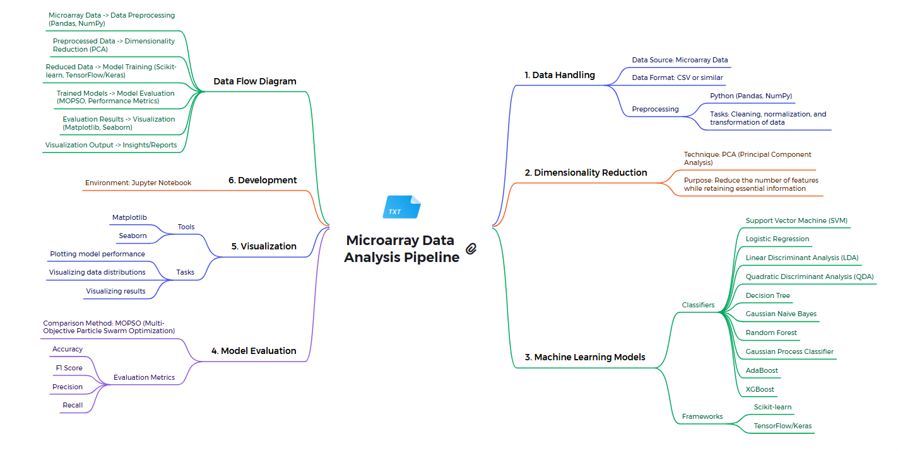
Architecture

Slide 14
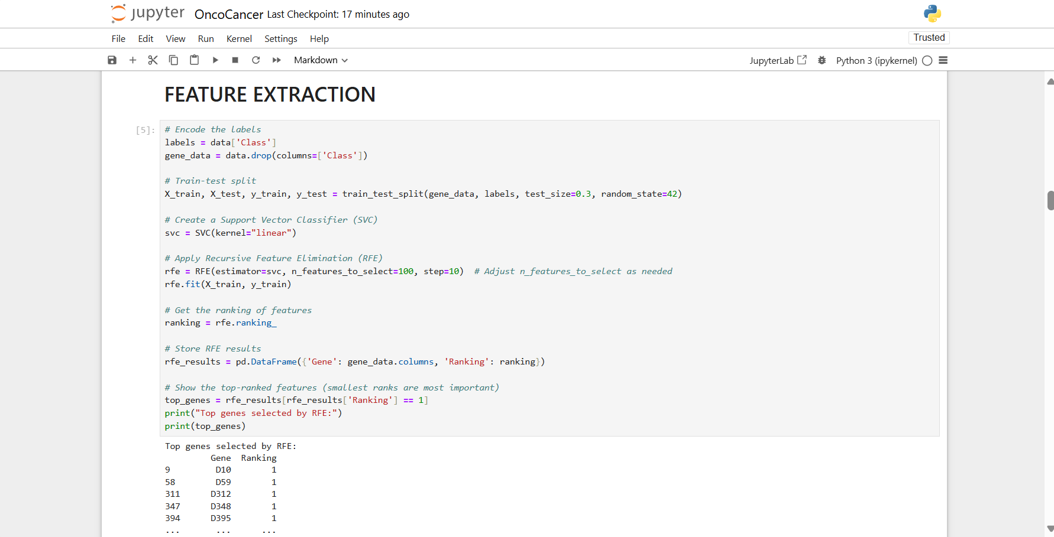
Implementation

Slide 15
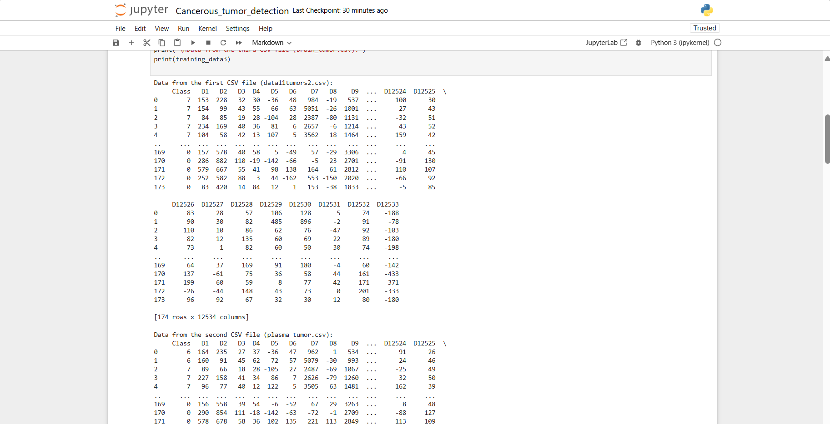
Implementation

Slide 16
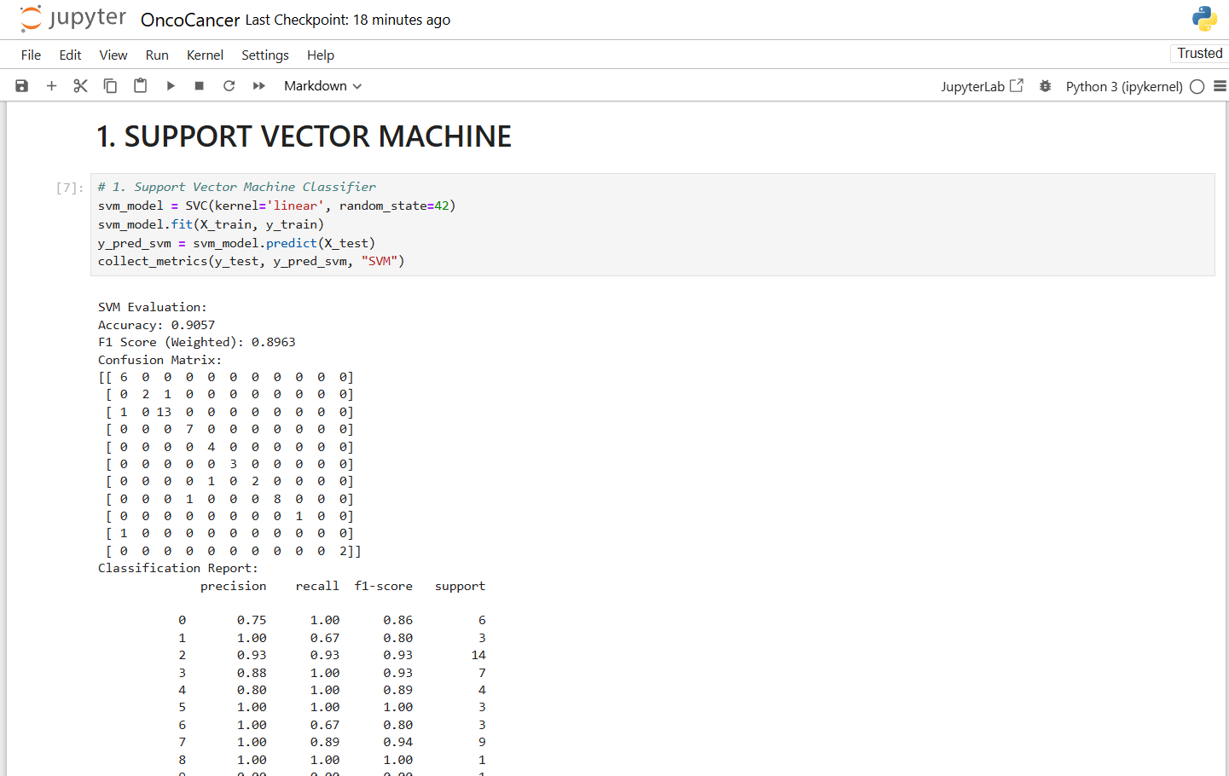
Implementation

Slide 17
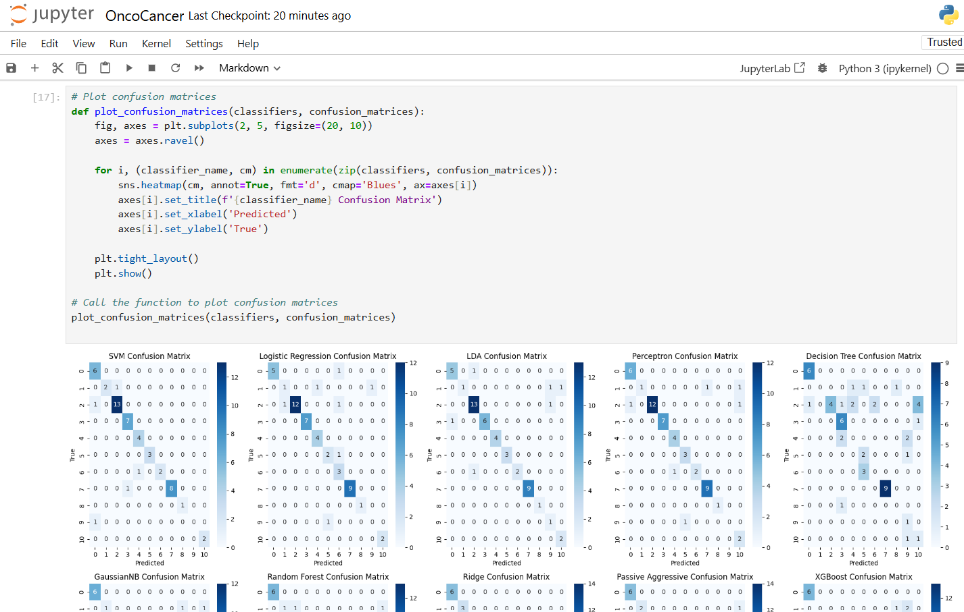
Implementation

Slide 18
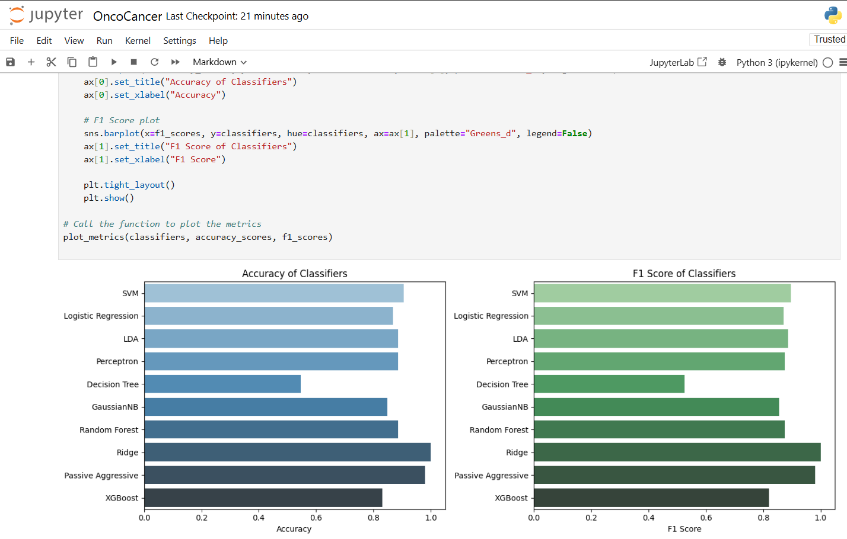
Implementation

Slide 19
Thank You

