Slide 1
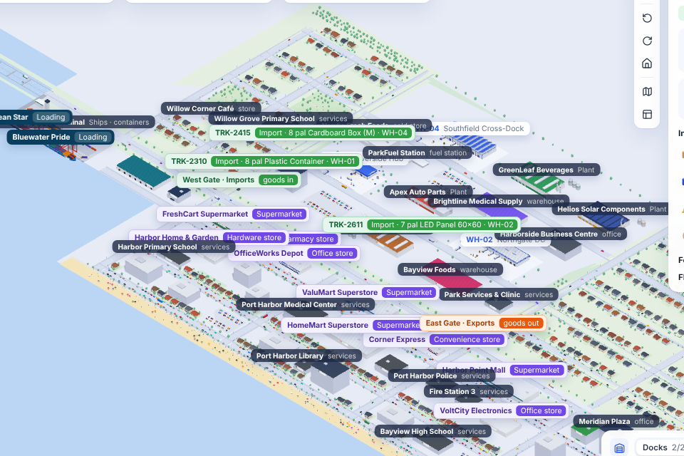
CargoVerse
DBMS Project
3D logistics operations on Oracle Database
From ship to shelf, every movement is a row
Live 3D city: port, park, warehouses, stores and houses
Notes:
Introduce CargoVerse: a logistics operations system whose backbone is an Oracle database. Everything you will see in the 3D city, ships, trucks, pallets and store shelves, is stored and checked in Oracle.

Slide 2




One product passes through five record systems
A box travels from a ship to a store shelf, and each step is usually tracked somewhere else.
Scattered data
No single source of truth
Port, yard, warehouse and store records sit in separate systems and drift apart.
Stock counts disagree between the warehouse and the shop.
Weak accountability
Hard to see
Changes are not traced to a person and a time.
Tables of numbers do not show where ships, trucks and pallets are.
Notes:
The problem: in small and mid-sized logistics operations each party keeps its own records. Nobody can say with confidence where a container is, how much stock is really on the shelf, or who changed a record.

Slide 3
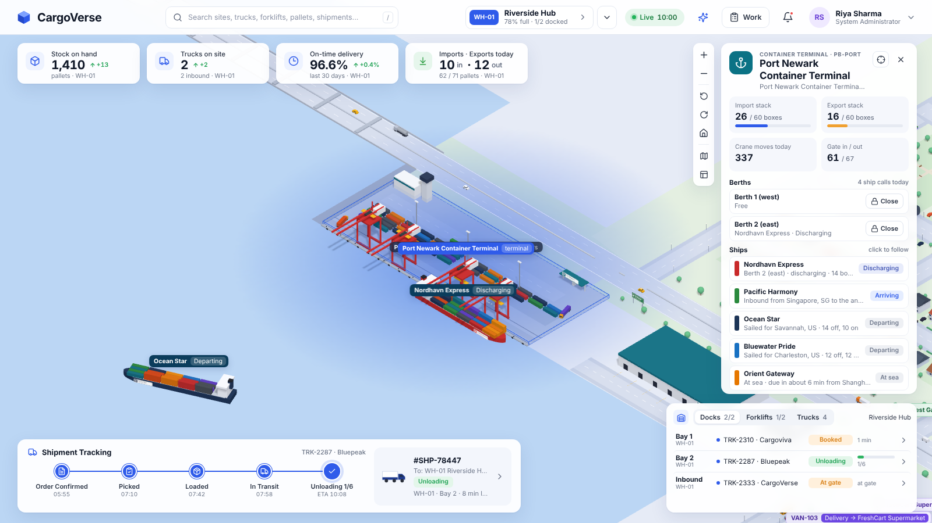
CargoVerse keeps the whole chain in one database
1
One Oracle schema
Port, gates, warehouses, transport and stores share 44 related tables.
2
Rules inside the database
Constraints, PL/SQL and triggers refuse invalid data from any program.
3
Every change is traceable
An audit trail records who changed what, and when.
4
Data you can see
The container terminal: ships, cranes and stacks, with live figures read from Oracle
A live 3D city draws the database as it changes.
Notes:
Our solution in four points. The screenshot is the live terminal: every crane lift you see is a new row in CONTAINER_MOVES, and the panel on the right reads straight from the database.

Slide 4
Six objectives shaped the design
01
02
03
Normalised schema
Integrity in the DB
Business rules in PL/SQL
One 3NF Oracle schema for port, yard, gates, sites, transport and stores
Keys, check and unique constraints, virtual columns
Packages and triggers every program must go through
04
05
06
Full audit trail
Role-based access
Reports and 3D view
User, time, site and before/after values for each change
Administrator, Operations Manager and Operator
Analytical SQL for managers and a live 3D city
Notes:
These six objectives guided every design decision: the data model, where the rules live, how changes are traced, who may do what, and how the data is reported and shown.

Slide 5



A three-tier architecture with Oracle at the core
Web browser
Node.js API server
Oracle Database 23ai
requests
SQL
React + TypeScript
Three.js 3D city
Sign-in, panels, forms
Reports and AI assistant
Sign-in and role checks
REST API (JSON)
Simulation engine
Live stream (SSE)
64 tables, 27 views
10 PL/SQL packages
26 triggers
Flashback, VPD, blockchain
live data
rows
The browser never talks to the database directly. Because the rules live in Oracle, other tools can read the same tables live.
SQL Developer and other apps
Notes:
Three tiers. The browser shows the data, the Node.js server handles sign-in and roles and runs the simulation, and Oracle stores everything and enforces the rules. SQL Developer can connect to the same database and see the data change live.

Slide 6







Technology stack
Oracle Database 23ai
Docker Desktop
SQL Developer
Node.js + node-oracledb
Data, PL/SQL, triggers, views
Runs Oracle on macOS
Browse tables, run reports
API server, Thin mode driver
React 18 + TypeScript
Three.js
Server-Sent Events
scrypt + signed tokens
Screens, panels and forms
The interactive 3D city
Live updates every second
Passwords and sessions
Notes:
The stack. Oracle Database 23ai Free runs in Docker. The server is Node.js with the official node-oracledb driver. The interface is React with Three.js for 3D, and updates are pushed to the browser with Server-Sent Events.

Slide 7
The database at a glance
64
27
10
tables
views
PL/SQL packages
26
136
26
triggers
check constraints
SQL reports
Every table has a primary key; foreign keys link related tables; identity and virtual columns fill values automatically.
Notes:
The size of the database. 64 tables in third normal form, 27 views, 10 PL/SQL packages, 26 triggers, 136 check constraints and 26 analytical reports, plus a property graph, a blockchain table and an event queue. In total about 30,700 lines of SQL, PL/SQL and TypeScript.

Slide 8
Nine areas, 44 core tables
Security
People
Sites
roles · permissions · role_permissions · app_users · user_sessions · user_facility_access
employees · job_titles
facilities · docks · chargers
Stock
Transport
Work and audit
skus · inventory · pallets · stock_movements
carriers · drivers · trucks · shipments · forklifts
tasks · task_updates · operation_events · audit_log · sim_state
Logistics park
Port
Retail
park_companies · park_buildings · park_routes · park_vehicles · park_gates · park_gate_log
shipping_lines · port_berths · vessels · quay_cranes · vessel_calls · yard_blocks · container_moves · yard_containers
stores · store_stock · delivery_vans · store_orders · store_order_history
Notes:
The 44 core tables group into nine areas; four more belong to the Database Lab and sixteen to the Smart Warehouse. Security and people; the three warehouse sites and their stock; transport; work and audit; the logistics park with its gates; the container port; and the retail stores.

Slide 9






Ship to shelf: every movement is a row
Ship berths
Crane unloads
Truck at gate
Warehouse stock
Store reorders
Van delivers
VESSEL_CALLS
CONTAINER_MOVES
PARK_GATE_LOG
STOCK_MOVEMENTS
STORE_ORDERS
STORE_ORDER_HISTORY
Traceable end to end. Report 21 joins the CONTAINER_MOVES ledger to itself to follow any container from the ship that discharged it to the warehouse that received it, with the minutes it spent in the yard.
Notes:
This is the heart of the project. Each physical step writes a row in a specific table. Because the rows are linked, we can trace any container from the ship to the shelf with a single SQL query.

Slide 10
Business rules live in PL/SQL and triggers
WT_CORE
permission checks, audit logging, KPIs
CREATE OR REPLACE TRIGGER trg_container_moves_ai
AFTER INSERT ON container_moves FOR EACH ROW
BEGIN
IF :NEW.move_type IN ('DISCHARGE', 'GATE_IN') THEN
MERGE INTO yard_containers y
USING (SELECT :NEW.container_no AS container_no
FROM dual) s
ON (y.container_no = s.container_no)
WHEN NOT MATCHED THEN INSERT (...)
ELSE
DELETE FROM yard_containers
WHERE container_no = :NEW.container_no;
END IF;
END;
WT_AUTH
users, sessions, site access
WT_WORK
tasks and allowed status changes
WT_PARK
buildings, gates, trade balance
WT_PORT
ISO 6346 check digit, ship holds, berths
WT_RETAIL
store orders, best supplier, cover hours
Example trigger: each crane move keeps the yard stock up to date automatically
Notes:
Six PL/SQL packages hold the business rules, so the web app, SQL Developer or any other program must follow them. On the right is a real trigger: when a crane discharges a container, the yard table is updated automatically, and when the box leaves, it is removed.

Slide 11



Three roles, and every change is traceable
Administrator
Operations Manager
Operator
All 14 permissions: user accounts and site access, all sites, audit trail, run SQL, park, port and stores
Assign tasks, reports, team, audit trail, hold ships, close berths, place store orders
Dashboard and their own tasks only: forklift operators, dock supervisors, inventory clerks
Hashed passwords
Signed sessions
Site access
Audit trail
salted scrypt, never plain text
expiring tokens, logged in USER_SESSIONS
users see only their sites
DBMS_SESSION identifier → AUDIT_LOG
All queries use bind variables, which prevents SQL injection.
Notes:
Access is role-based with 14 permissions. Passwords are hashed, sessions are signed and recorded, and before each change the server tells Oracle who the user is, so triggers can write that user into the audit log.

Slide 12
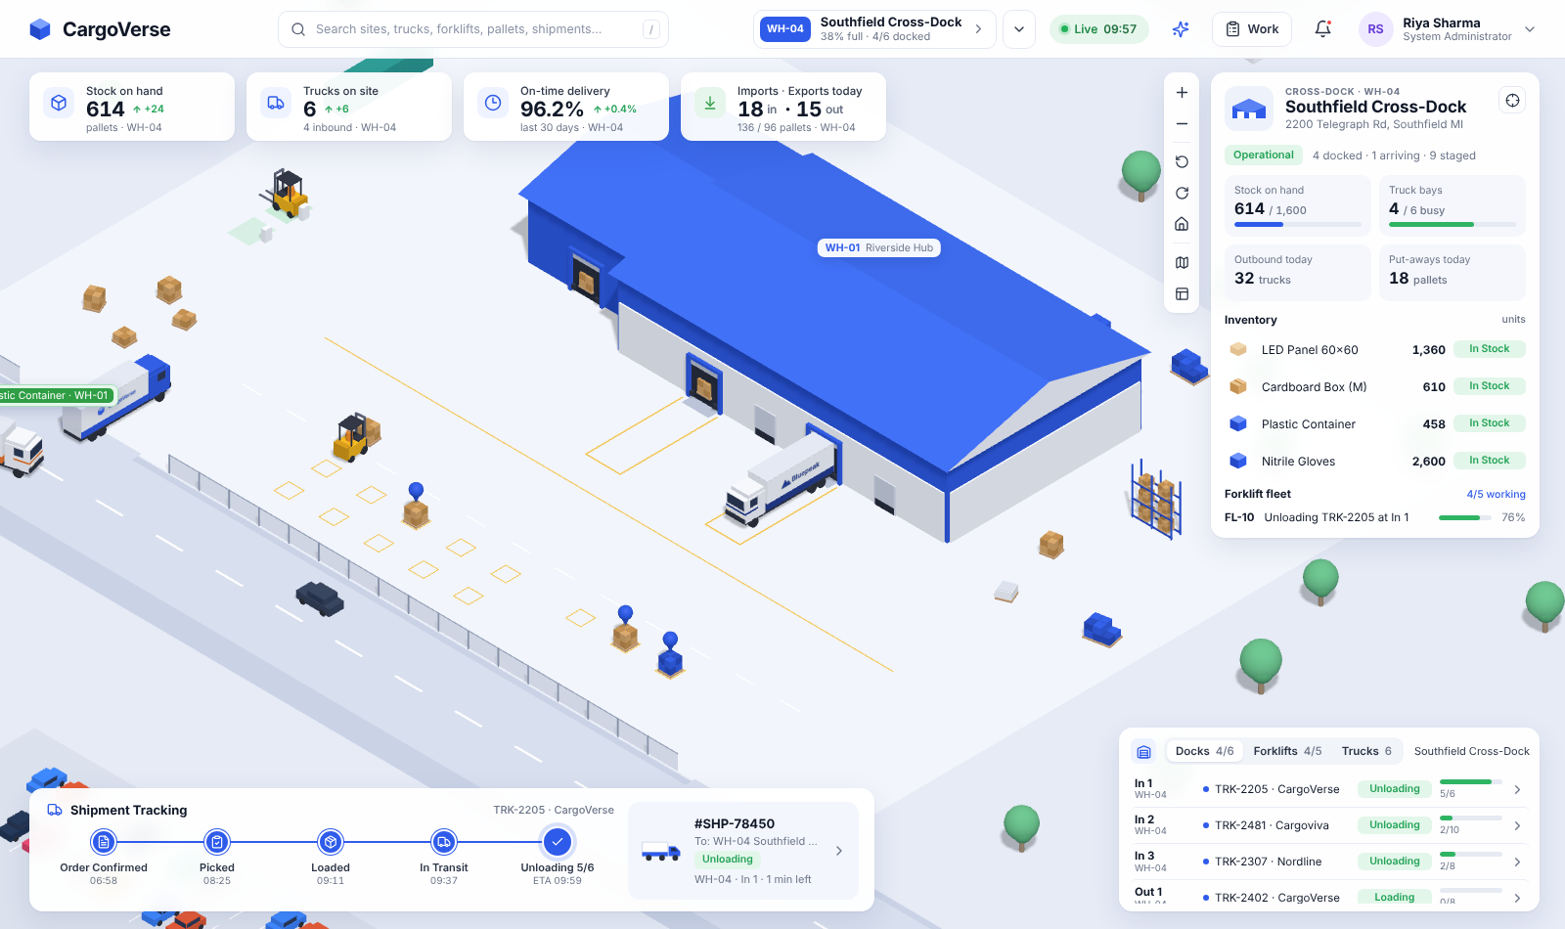
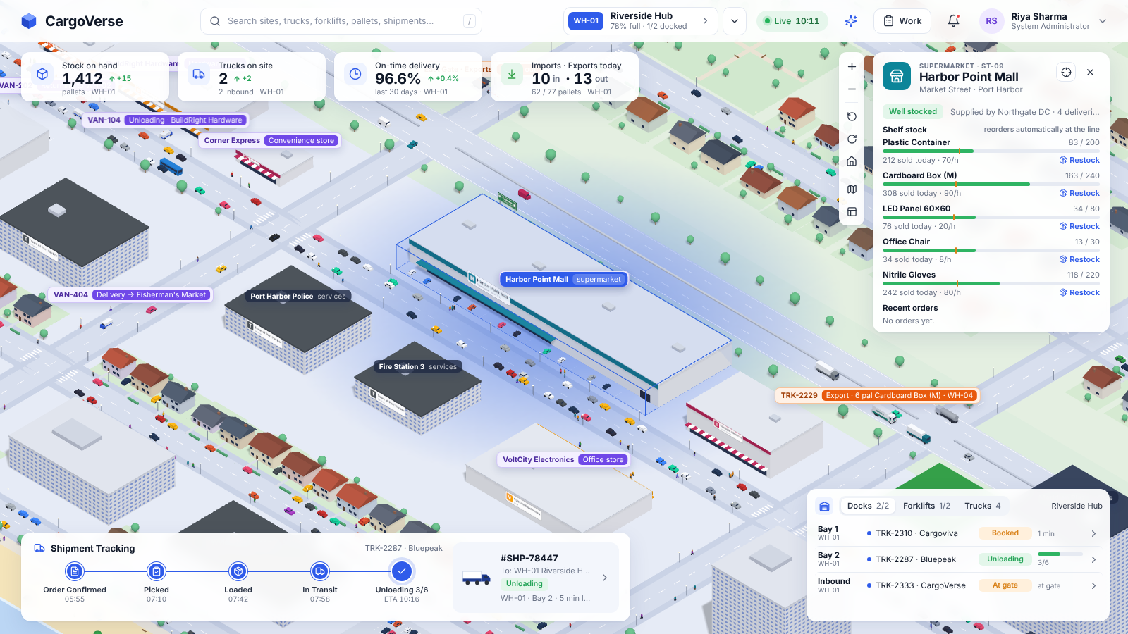
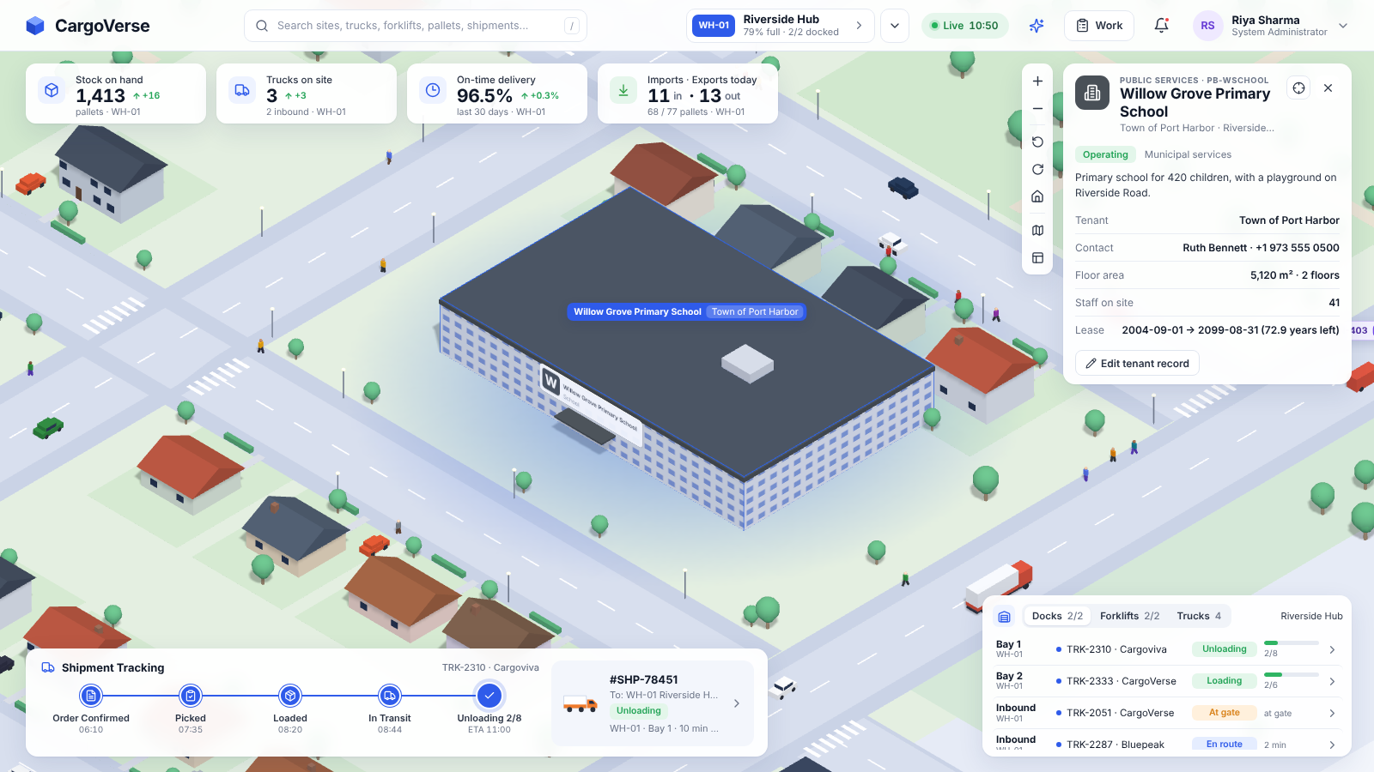
The live system: warehouse, port and stores
Warehouse: docks, trucks, forklifts and stock
Port: ships, cranes and the container yard
Stores: shelf stock and automatic reorders
A whole small city. Two housing estates, 11 vendor stores, a school, hospital, police and fire stations, a beach, people walking and over 100 vehicles. Click anything to see its database record.
Notes:
Screens from the running system. Each panel reads live data from Oracle. Clicking a ship, a truck, a store or a building opens its record.

Slide 13
26 reports put advanced SQL to work
SQL technique | Example report
GROUP BY ROLLUP | On-time delivery by site, with subtotals
Analytic window functions | Running stock level per site from the ledger
PIVOT | Gate traffic per hour; store deliveries by status
MINUS set operation | Trucks that came in but have not left yet
NOT EXISTS anti-join | Employees with no open work
Self-join of a ledger | Trace a container from ship to warehouse
Interval arithmetic | Ship turnaround minutes per port call
SELECT d.container_no, v.name AS vessel,
g.facility_id AS delivered_to,
ROUND((CAST(g.created_at AS DATE)
- CAST(d.created_at AS DATE))
* 24 * 60, 1) AS minutes_in_yard
FROM container_moves d
JOIN container_moves g
ON g.container_no = d.container_no
AND g.move_type = 'GATE_OUT'
JOIN vessels v ON v.vessel_id = d.vessel_id
WHERE d.move_type = 'DISCHARGE';
Report 21: trace import containers from ship to warehouse
Notes:
The 26 reports in 05_reports.sql exercise a wide range of SQL. They can be run in SQL Developer while the app is running, and the numbers change as the city moves.

Slide 14
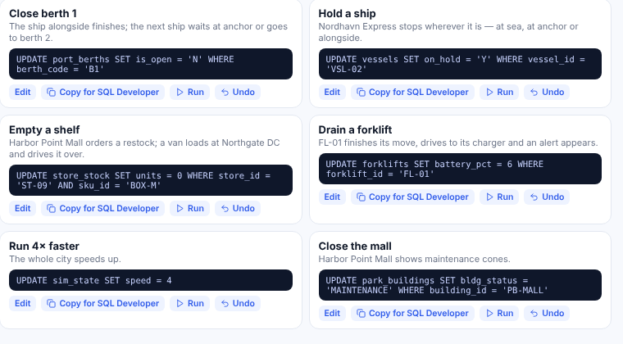
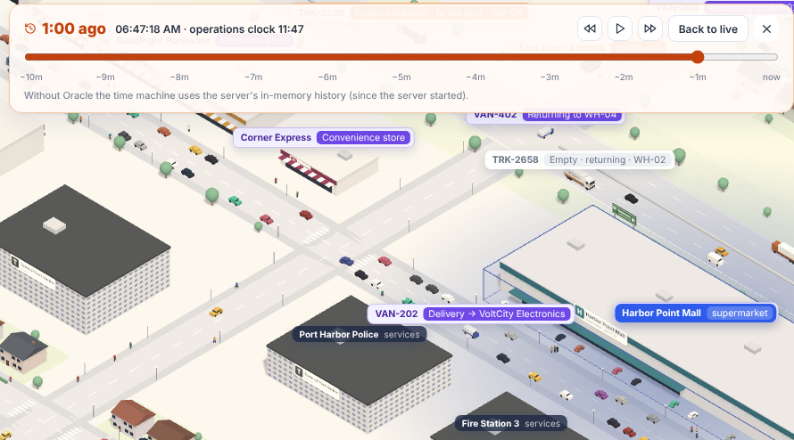
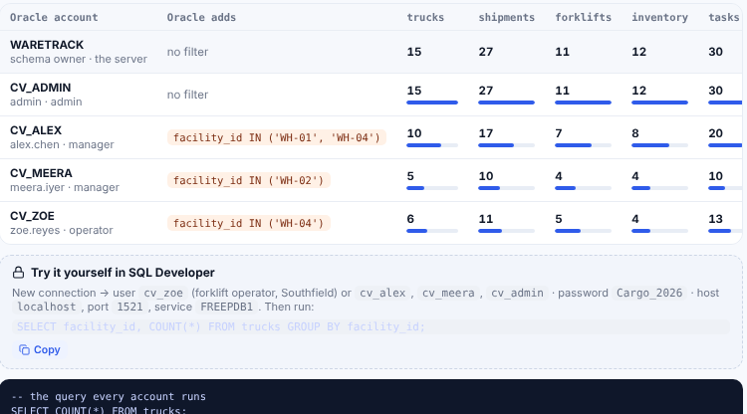
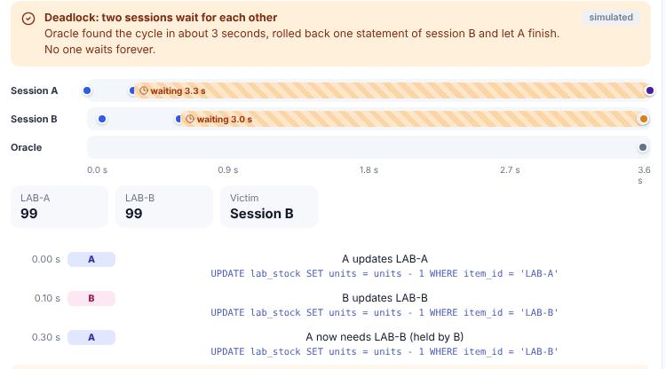
Database Lab: four things only a database can do
Control the city from SQL
Time machine
UPDATE port_berths SET is_open = 'N' …
SELECT … FROM trucks AS OF SCN :scn
Row triggers spot changes made outside the app and queue them; the berth closes in 3D within a second.
Oracle Flashback rewinds every ship, truck and pallet up to 10 minutes, with no history tables.
Row-level security
Concurrency lab
WHERE facility_id IN ('WH-04')
ORA-00060: deadlock detected
A Virtual Private Database policy: each SQL Developer account sees only its own sites.
Two real sessions: double booking prevented, lost update shown and fixed with FOR UPDATE.
Notes:
The Database Lab answers the question: why does this need a database at all? One: an UPDATE typed in SQL Developer changes the live 3D city, because triggers queue changes that did not come from the server. Two: Oracle Flashback Query rewinds the whole city up to ten minutes using undo data, with no history tables. Three: a Virtual Private Database policy gives each operator a database account that only sees their own sites, enforced by Oracle itself. Four: a concurrency lab runs two real sessions to show a double booking being prevented, a lost update, the FOR UPDATE fix and a deadlock detected by Oracle. npm run db:selftest checks all four.

Slide 15
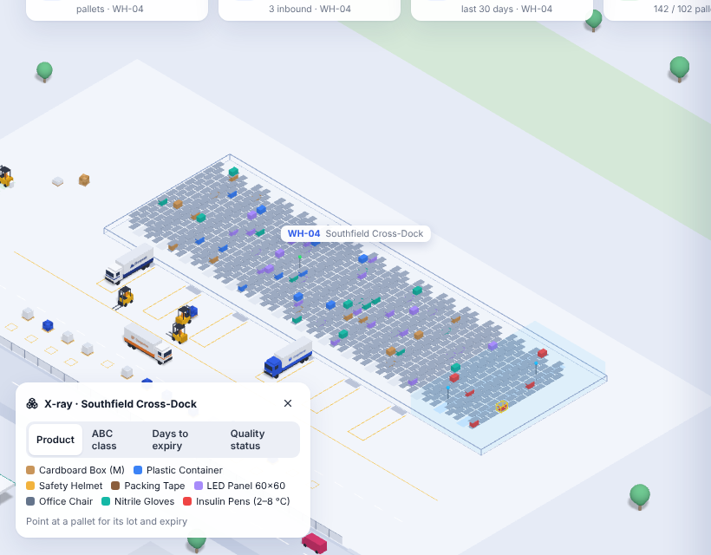
Smart Warehouse: the database runs the building
ABC slotting
FEFO picking
RATIO_TO_REPORT · running SUM() OVER
RANK() OVER · audit of every pick
Recall trace
Cold chain
recursive WITH … SEARCH DEPTH FIRST
MATCH_RECOGNIZE on sensor readings
Tamper-proof ledger
Forecast and reorder
BLOCKCHAIN TABLE · VERIFY_ROWS
MODEL clause · REGR_SLOPE · EOQ
GS1 pallet labels
Event stream
SSCC check digit as a CHECK constraint
Transactional Event Queue
X-ray: every pallet in its rack bin, coloured by product, ABC class, expiry or hold
Shortest pick route
Semantic search
Dijkstra in PL/SQL · GRAPH_TABLE
VECTOR(384) · VECTOR_DISTANCE
Notes:
The Smart Warehouse adds sixteen tables for bins, lots, pallets, sensors and events, and uses ten Oracle features that a plain file or spreadsheet cannot. Analytic functions rank products so fast movers are stored next to the docks. Every pick takes the lot that expires first. A recursive query traces a lot from the ship to every store that received it. MATCH_RECOGNIZE finds three warm readings in a row and a scheduler job holds the stock on its own. Stock movements are kept in a blockchain table that even the owner cannot change. The MODEL clause forecasts demand. Pallet labels are GS1 barcodes whose check digit is enforced by a CHECK constraint. Events travel through a transactional queue, pick routes are computed with Dijkstra in PL/SQL and a property graph, and damage reports are searched by meaning with vectors.

Slide 16
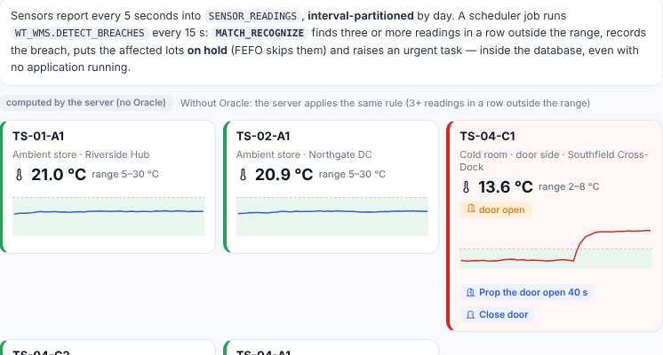
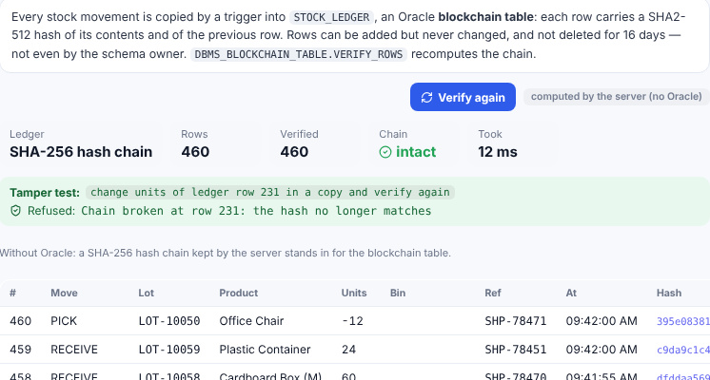
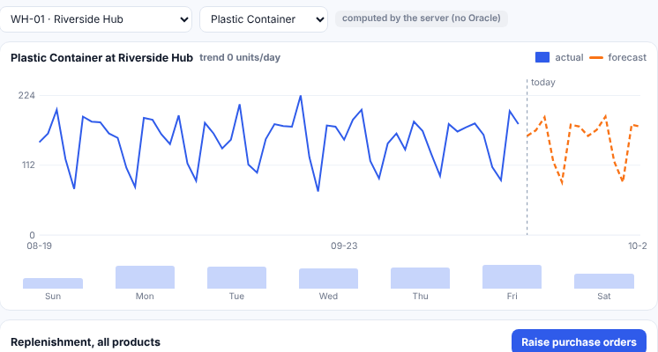
Smart Warehouse in action
Cold chain
Tamper-proof ledger
Forecast and reorder
PATTERN (out_of_range{3,})
ORA-05715: operation not allowed on the blockchain table
MODEL … RULES (trend[ANY] = …)
A door left open: three warm readings in a row → insulin lots on hold and an urgent task, raised by the database itself
Any UPDATE of the stock ledger is refused; the chain of hashes is verified on demand
Trend and weekday pattern from the demand history; reorder point and order size for every product
Notes:
Three of the features at work. On the left, a cold-room door is left open; within a minute the scheduler job detects the breach with MATCH_RECOGNIZE, puts the insulin lots on hold and raises an urgent task, without the application. In the middle, the ledger: an UPDATE is refused by Oracle and the hash chain verifies. On the right, the demand forecast and the replenishment table with reorder points and economic order quantities.

Slide 17
Built in ten steps
1
2
3
4
5
Requirements
ER model and 3NF
Schema DDL
PL/SQL and triggers
Views and reports
entities, events, roles
normalised design
keys, constraints, comments
rules in the database
17 views, 26 queries
6
7
8
9
10
Seed data
Server and 3D interface
Simulation
Database Lab and tests
Smart Warehouse
realistic starting data
Node.js, React, Three.js
saves to Oracle every 2 s
Flashback, VPD, locks; db:selftest
lots, bins, sensors, graph
Setup is scripted: npm run db:up starts Oracle, npm run db:reset loads the schema, npm run dev starts the app.
Notes:
The project was built step by step, each part on a working base. Every SQL statement was checked automatically, the code was type-checked, and the screens were checked with automated browser screenshots.

Slide 18





Results
Complete working system
Ship to shelf, stored in one Oracle schema and running live
~30,700
Integrity enforced in the database
Invalid data is refused, whatever program sends it
Full traceability
lines of SQL, PL/SQL and TypeScript
Any container, any change, back to a user and a time
Open to other tools
An UPDATE in SQL Developer changes the live city
64 tables · 27 views · 10 packages · 26 triggers · 26 reports
The database remembers
Flashback rewinds the city; VPD and locks keep it safe
A smart warehouse
Lots, FEFO, cold chain, recalls and routes decided in SQL
Notes:
What we achieved. A complete system with the rules in the database, full traceability, and data that any tool can read. The project is about 30,700 lines of code.

Slide 19





Future scope
Real devices
Billing and customs
Machine learning
RFID gates, IoT sensors and GPS trackers instead of the simulation
Invoices, payments and customs documents
Oracle Machine Learning models trained inside the database
Mobile app
Cloud database
High availability
Operators update tasks on the warehouse floor
Oracle Autonomous Database for many sites
Data Guard and scheduled RMAN backups
Notes:
Where the project can go next: real devices in place of the simulation, billing and customs, machine-learning models trained inside the database, a mobile app, a cloud database and high availability.

Slide 20
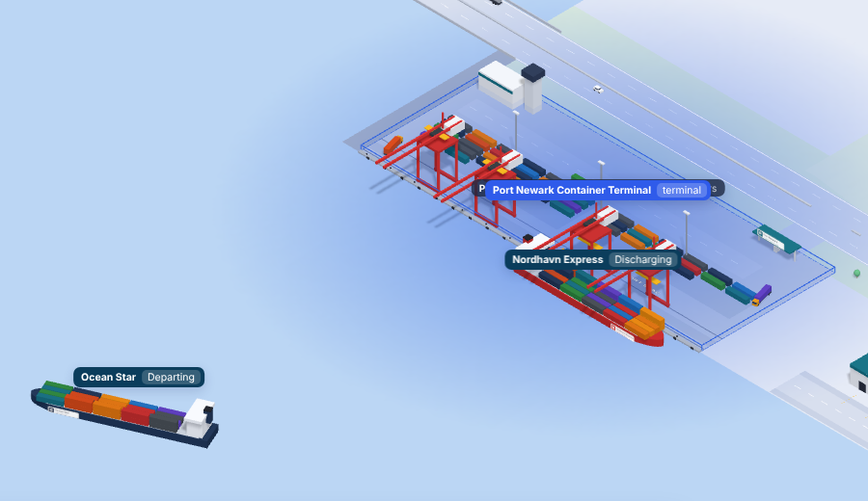
Conclusion
Correct
keys, constraints, PL/SQL and triggers keep the data valid
Secure
roles and the audit trail make every change accountable
Useful
views and reports turn the data into decisions
Visible
the 3D city shows the database as it changes
Thank you
Everything on the screen is a row in Oracle.
Questions welcome
Notes:
To conclude: a well-designed relational database can be the backbone of a real logistics operation. Thank you; we are happy to take questions or show a live demo.

