Slide 1


Climate Resilient Agriculture
Team Leader: Shambharkar Tanmay
1)Devkate Vishal
2)Raika Pramila
3)Pawar Darshana
Mentor Name: Mr. Mario Thokchom
College Name – PES Modern College Of Engineering, Pune

Slide 2

Project Objectives
Problem Statement
Project Overview – Introduction
End Users
Wow Factor in Project
Modelling/Block Diagram/Flow of Project
Result/outcomes
Conclusion
Future Perspective

Slide 3
Climate Resilient Agriculture
Problem Statement:
To develop a machine learning model that predicts crop yield by integrating climate, soil, water, and pollution factors for climate-resilient agriculture.

Slide 4
Project Overview - Introduction
Climate-resilient agriculture is essential to sustain crop productivity under changing environmental conditions. This project develops a machine learning–based system to predict crop yield using climate, soil, water, and pollution parameters.
Focuses on climate-resilient agriculture through data-driven yield prediction
Integrates climate, soil, water, and pollution parameters in a single model
Uses machine learning techniques (Random Forest & XGBoost) for accurate prediction
Analyzes the impact of climate stress factors such as heatwaves and dry spells
Supports sustainable agricultural planning and decision-making

Slide 5
End Users
Farmers
Agricultural extension services
Government & policy makers
Researchers and agri-tech developers

Slide 6
Wow Factors in Project:
Integrated multi-domain data:
Combines climate, soil, water, pollution, and agricultural parameters in a single predictive model.
Climate-resilience focused prediction:
Goes beyond yield prediction by analyzing the impact of climate stress factors like heatwaves and dry spells.
Advanced machine learning models:
Uses Random Forest and XGBoost, which outperform traditional statistical methods.
Decision-support oriented:
Helps farmers, planners, and policymakers make data-driven, climate-resilient decisions.

Slide 7
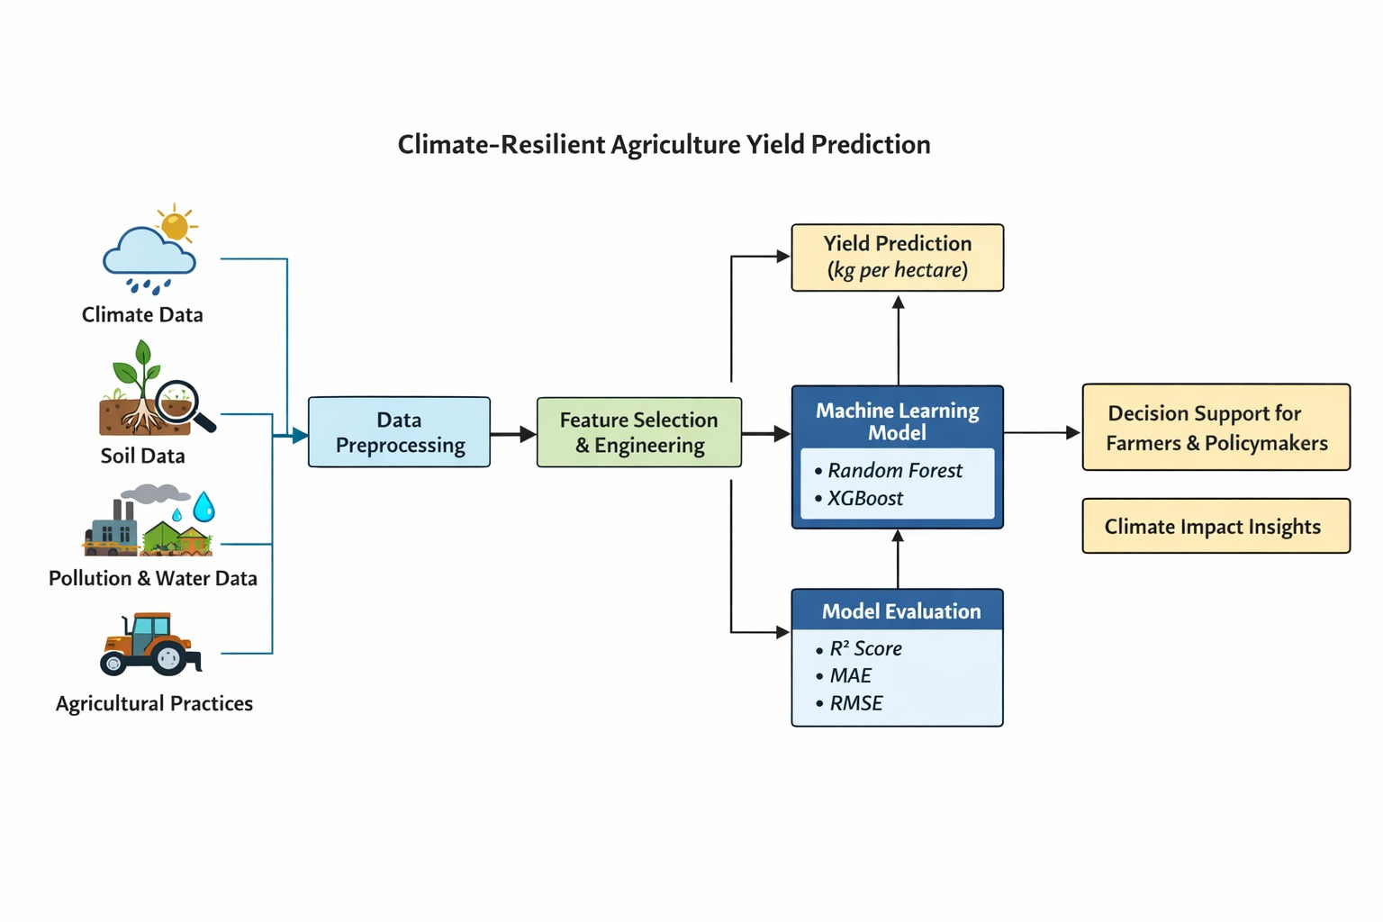
Modelling/Block Diagram/Flow of Project

Slide 8
Technology Stack:
Python
Core Programming Language
Python Libraries
Pandas
Numpy
Matplotlib
Seaborn
Scikit-Learn
Model Handling
Joblib
Algorithms Used
RandomForest
XGBoost

Slide 9
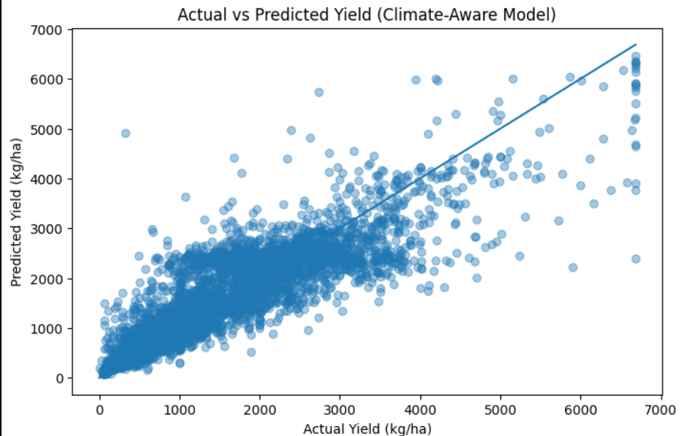
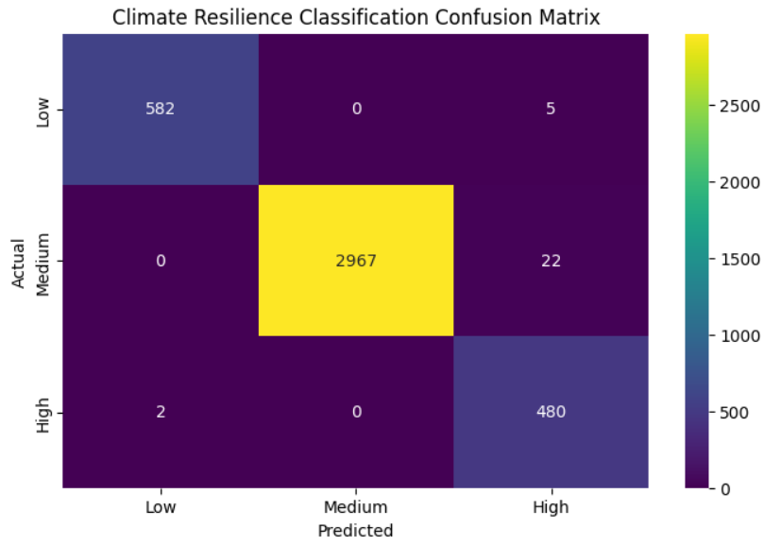
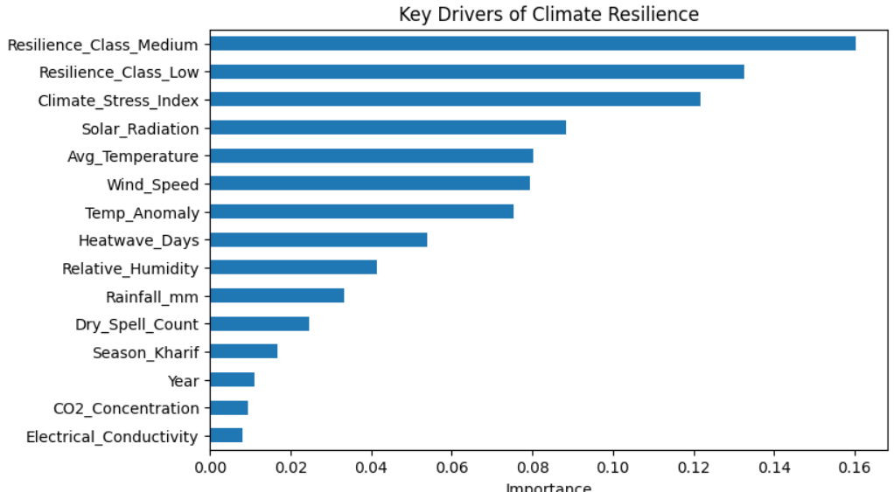
Result/Outcomes

Slide 10
Conclusion
Log transformation improved yield distribution and model stability.
Machine learning models (Random Forest) effectively captured non-linear climate–yield relationships.
The system enables early risk identification, supporting climate-resilient agricultural planning.
Crop yield is strongly influenced by climate stress factors such as heatwaves, dry spells, and rainfall variability.
Yield data shows high variability, with extreme climate events leading to significant productivity loss.

Slide 11

Future Perspective
Integrate real-time climate data from IMD and satellite sources for live yield prediction
Deploy a farmer-friendly mobile/web application for decision support
Incorporate early warning alerts for heatwaves and dry spells

Slide 12
Thank You
Notes:
Thank You !!

