Slide 1

AirBnB Home Rental Analysis
Presented By :
Indrajeet Gupta
Vishal Tyagi
Saurav Avhad
Shubham Upadhyay
Guide: Dr. Nidhi Chahal

Slide 2
Project analysis slide 2
Contents
Introduction
Problem Statement
EDA
Time Series Analysis
Classification
Conclusion
References

Slide 3
Project analysis slide 3
Project Flow
PROBLEM STATEMENT
DATA UNDERSTANDING & PREPROCESSING
EDA
PROPERTY PRICE
FORECASTING
PROPERTY TYPE PREDICTION
Performing EDA to get insights & forming story on basis of visuals which can be helpful for hosts to understand the business & customers to take better decision while renting.
Analyzing trends & seasons when customer book their accommodations. Forecasting future property prices by building time series model.
Building a Classification model that will predict the ‘property type given a set of input features
Understanding the Problem statement to meet business objective.
Forming data dictionary to understand the features, dataset & dealing with null/missing values.

Slide 4
Project analysis slide 2
Introduction
Introduction
Since 2008, guests and hosts have used Airbnb to expand on traveling possibilities and present a more unique, personalized way of experiencing the world. Data analysis on millions of listings provided through Airbnb is a crucial factor for the company. These millions of listings generate a lot of data - data that can be analyzed and used for security, business decisions, understanding of customers' and providers' (hosts) behaviour and performance on the platform and much more.
Problem Statement 1
To get various insights into the home rental business from the perspective of
Property owner (hosts)
Customer
About dataset
Seattle dataset is used for analysis.
It has required data to build Time series model & Classification model.
Seattle is a city on the west coast of the United States.
There are two dataset which has 3818 rows, 33 columns & 3818 rows, 92 columns respectively.
Pre-processing
After shortlisting relevant features for further analysis, dataset was found with 25 missing rows which is around 0.6% of overall dataset, thus it is dropped.

Slide 5
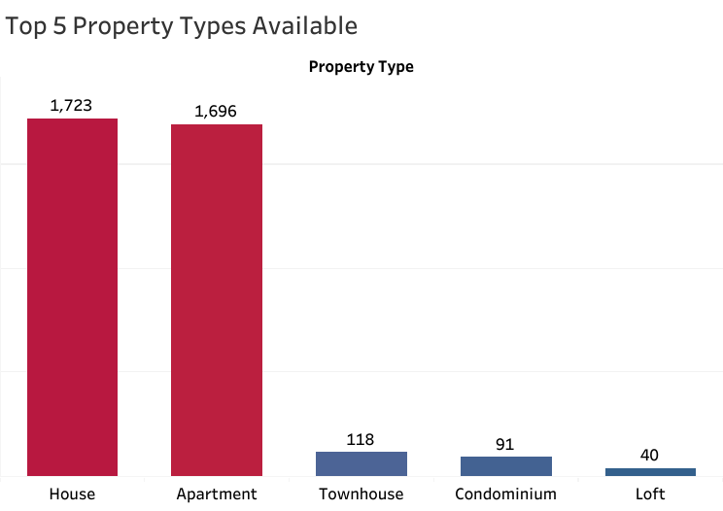
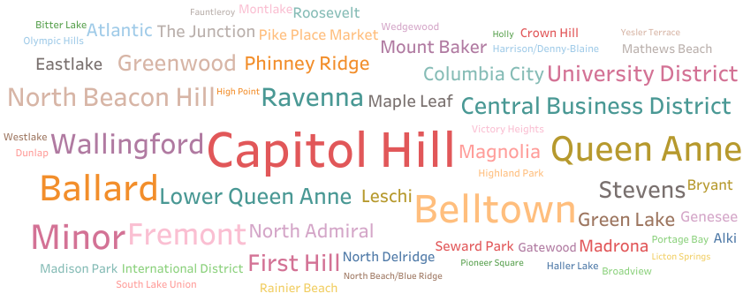
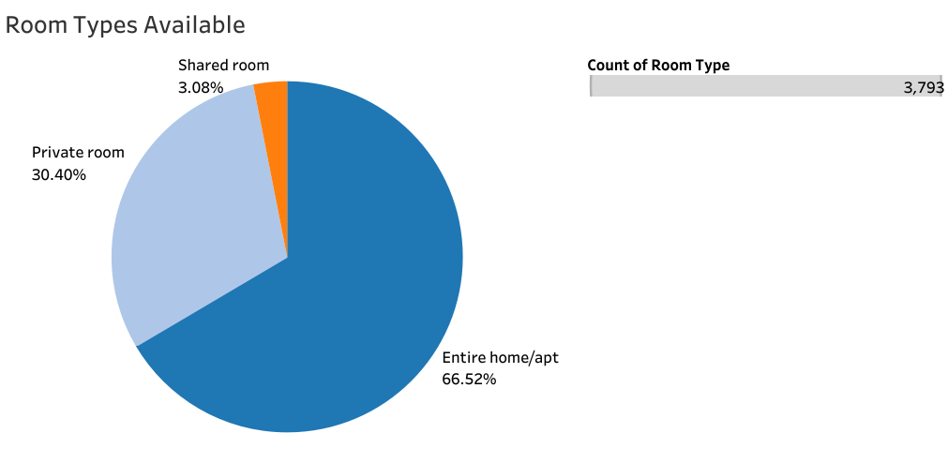
Project analysis slide 2
Part 1: Analysis With Respect to Customer
Most Populated Area with respect to Properties
Count of Property types
Property types
Visual 1: House and apartment are the top most property types available in Seattle.
Visual 2: Capitol Hill is the most populated area with respect to properties.
Visual 3: 97% of the data belongs to either Home/Apartment or Private room in Seattle.

Slide 6
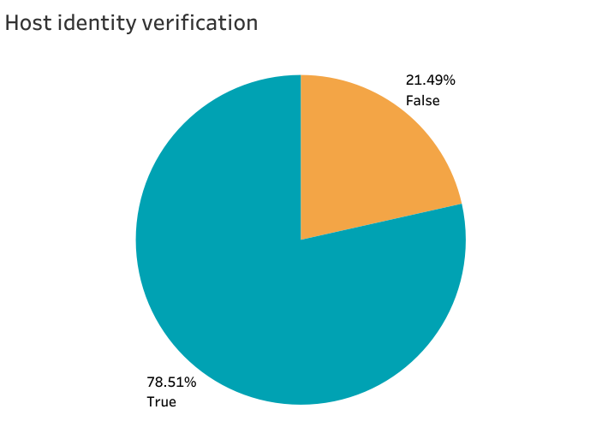
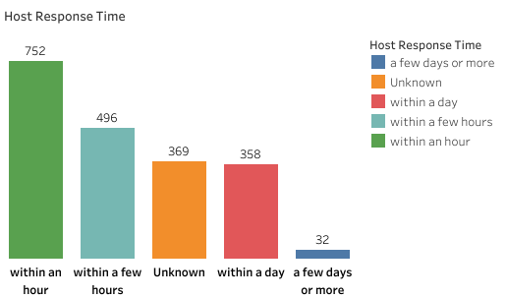
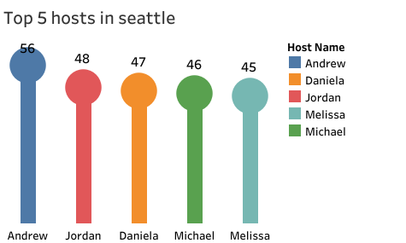
Project analysis slide 2
Part 1: Analysis With Respect to Host
Count of Response Time Category
Response Time
Top 5 hosts in Seattle City
Visual 1:Mostly hosts response within an hour.
Visual 2: More than 75% hosts are verified on the platform.
Visual 3: It shows the top 5 hosts in Seattle who have maximum properties listed on Airbnb.
Count of listing / properties

Slide 7
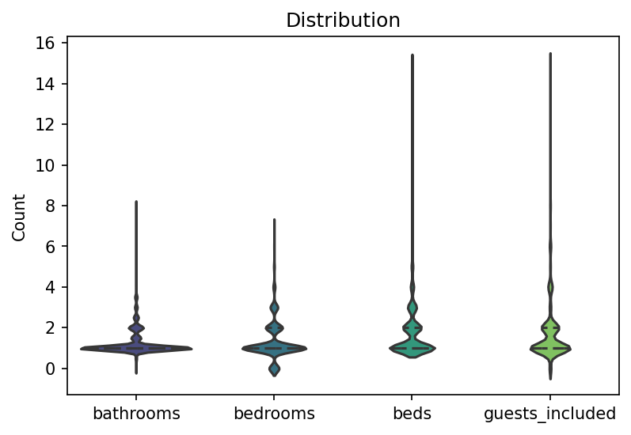
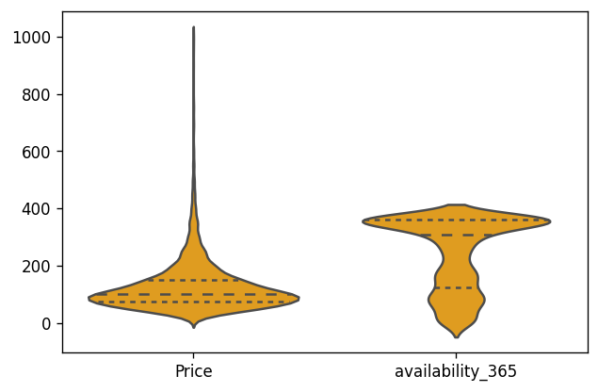
Project analysis slide 2
Distribution of Numerical Data
Distribution
For Numerical features the violin plots gives better insights as it depict summary statistics as well as density of points

Slide 8
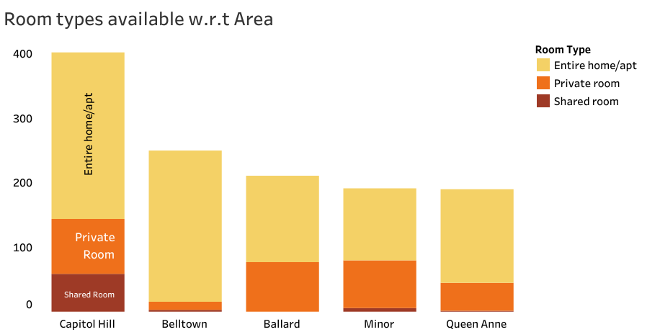
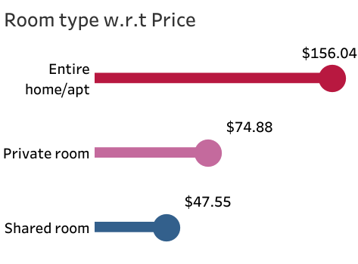
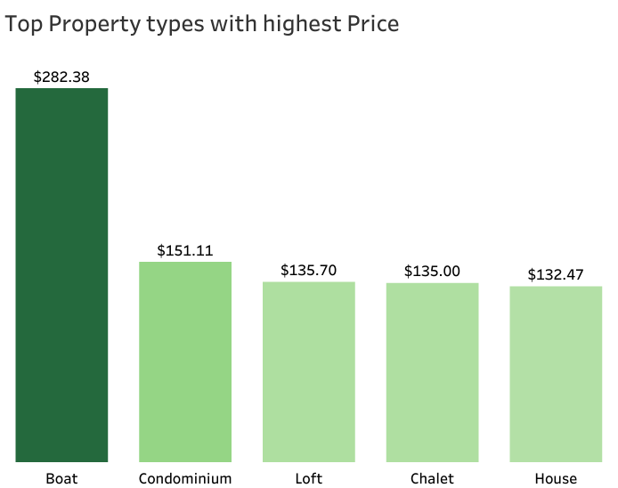
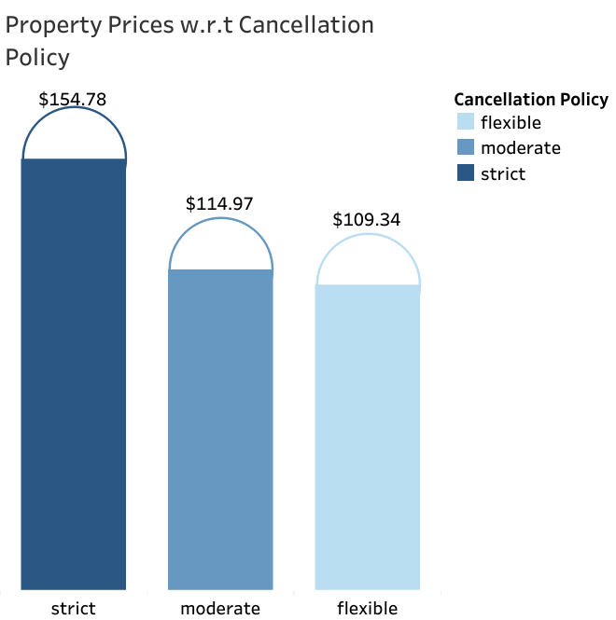
Project analysis slide 2
Part 2: Analysis With Respect to Customer
Room types available with respect to area
Room types with respect to price
Count of rooms
Room type
Area
Top property types with highest price
Property prices with respect to cancellation policy
Price
Price

Slide 9
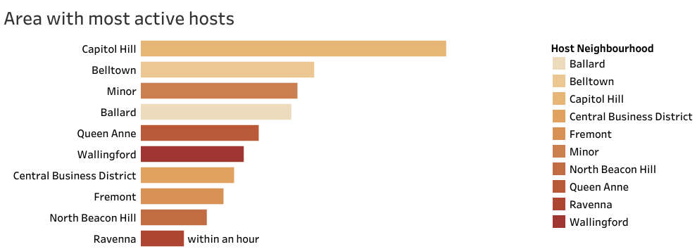
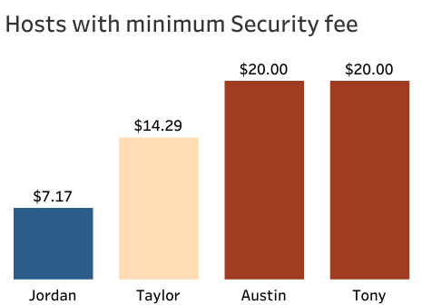
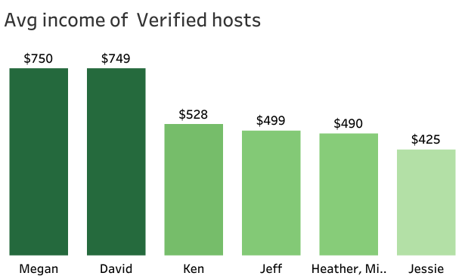
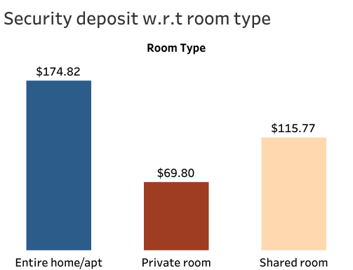
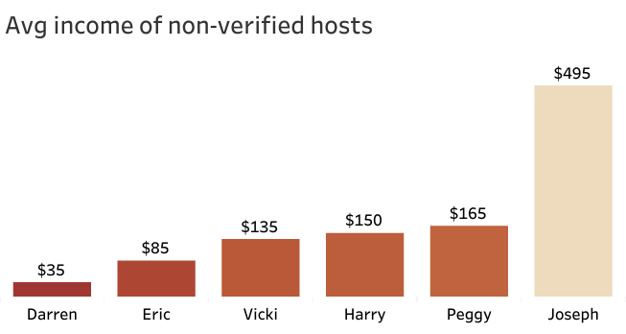
Project analysis slide 2
Part 2: Analysis With Respect to Host
Area with most active hosts
Hosts with minimum security fee
Security Deposit
Area
Response Time
Host Names
Average income of verified hosts
Average income of non - verified hosts
Security deposit with respect to room type
Price
Security Deposit
Host Names

Slide 10
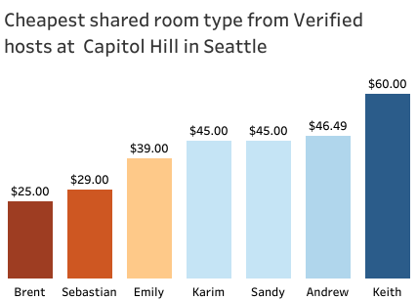
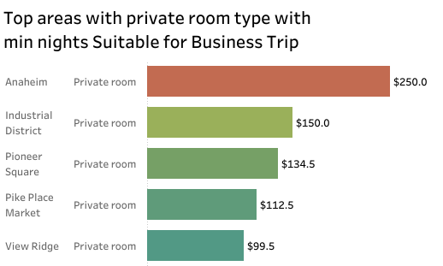
Project analysis slide 2
Part 3: Analysis With Respect to Customer
Verified hosts offering cheapest shared rooms at Capitol Hill in Seattle
Top areas with private room with minimum nights suitable for business trips
Area
Room Type
Price
Host Names
Price
Capitol Hill as most populated area - Presenting top 7 verified hosts offering cheapest shared rooms.
Presenting the top 5 posh areas for private rooms having 1 minimum nights.

Slide 11
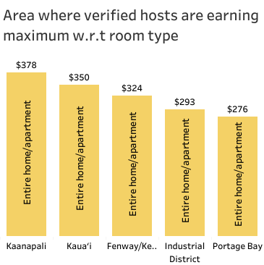
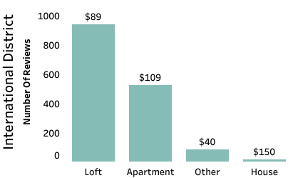
Project analysis slide 2
Part 3: Analysis With Respect to Hosts
Property type with respect to area with maximum people engagement along with their price
Area where verified hosts are earning maximum with respect to room type
Price
Area
Property type
International District (area) with maximum people engagement - presenting the most preferred property types along with their prices.
From all over the Seattle city- Presenting the top 5 areas where verified hosts are earning maximum due to respective room types.

Slide 12
Project analysis slide 2
EDA – Insights / Conclusion
For Customers
Someone looking for shared room which are cheapest and owner must be verified to avoid any security issues can contact Brent, Sebastian or Emily who offers such kind of rooms in Capitol Hill.
Person or company planning business trip to Seattle and wants to save money in possible ways & same time wants to rent top quality private rooms can look in the areas like Anaheim / Industrial district / Pioneer square (as they are offering luxurious private rooms & minimum no of nights to be booked is 1).
For Hosts
Most of the property type offered by different hosts are houses or apartment but people are showing more response for Loft (property type) & specially in the International district area of Seattle so new upcoming hosts can invest in such properties.
More than 75% hosts are verified & earning greater than non verified hosts.
Some of the top areas where verified hosts are earning maximum are Kaanpali, Kaua’I, Fenway/Kenmore, Industrial district, etc & ‘Entire Home/apartment’s the most preferred room type among them.

Slide 13
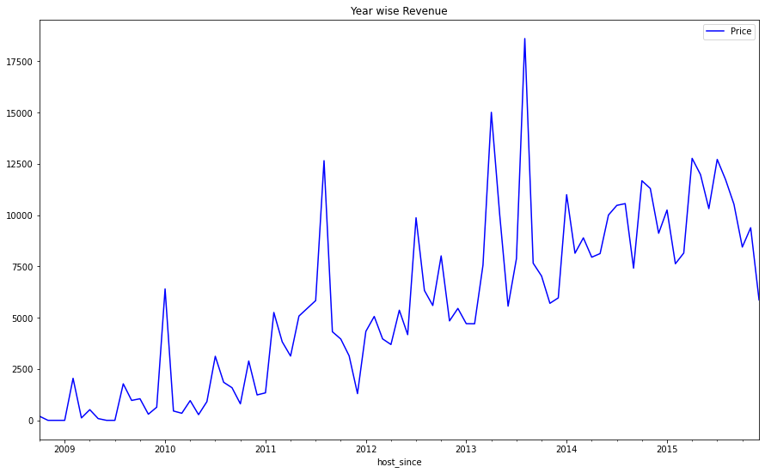
Project analysis slide 2
Property Revenue Forecast
Problem Statement 2: Build a time series model that will forecast the future property prices based on the past
data.
Available Past Data: From October 2008 to December 2015
Features Selected: Host Since (date) and Property Price (revenue)
Price
Oct 2008
Date
Dec 2015

Slide 14
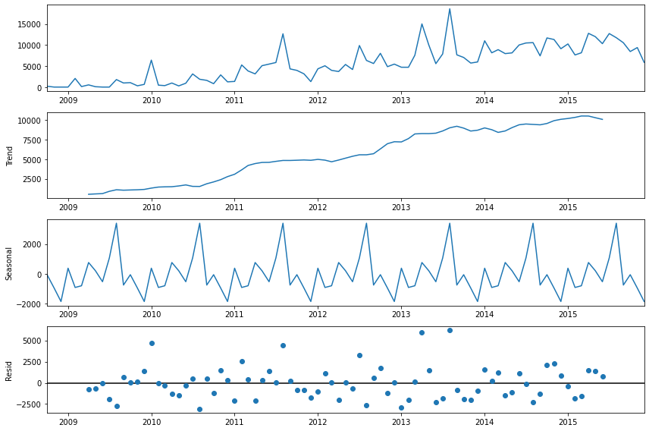
Checking Trend & Seasonality
Data shows gradual upward trend and seasonality.
Each year, during August, bookings increases & thus its showing peak which confirms presence of seasonality.

Slide 15
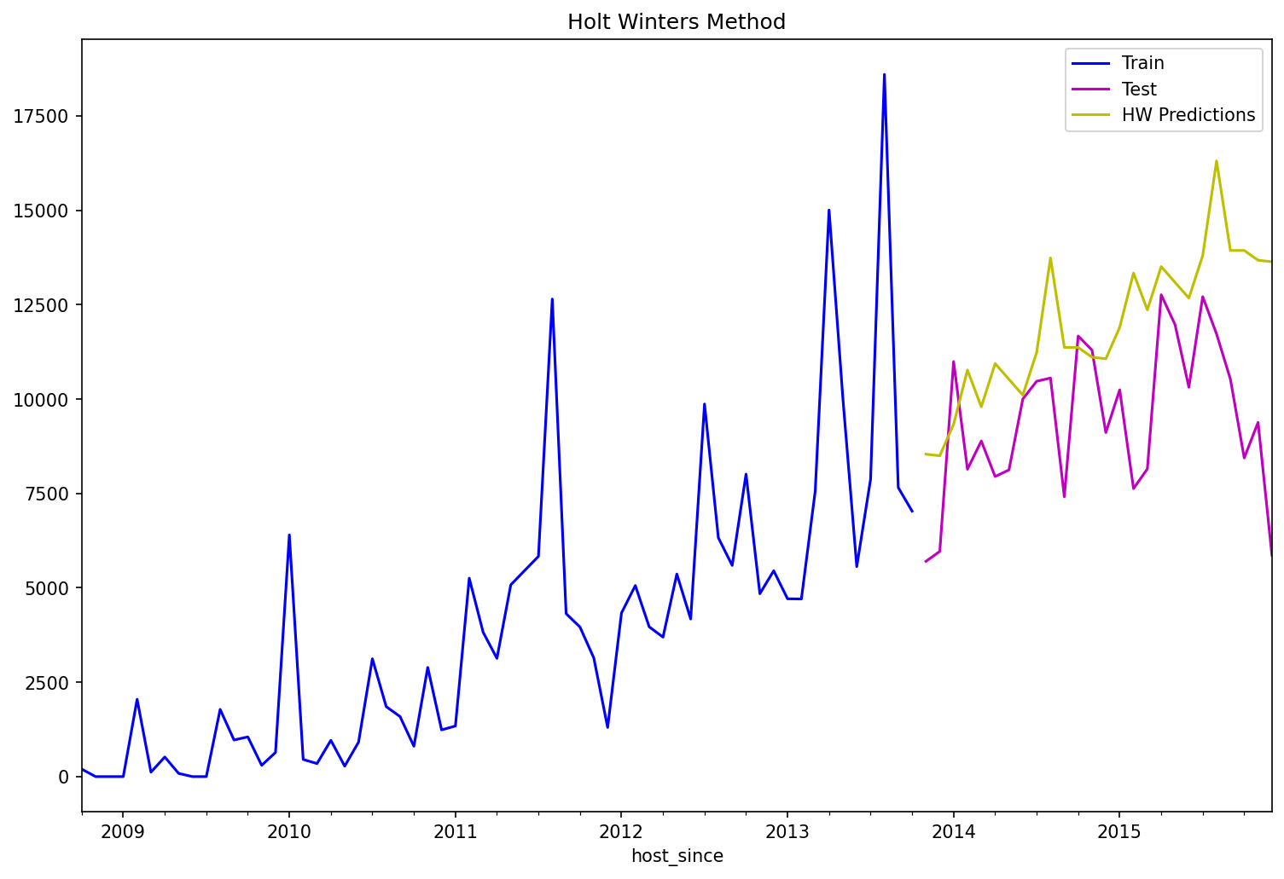
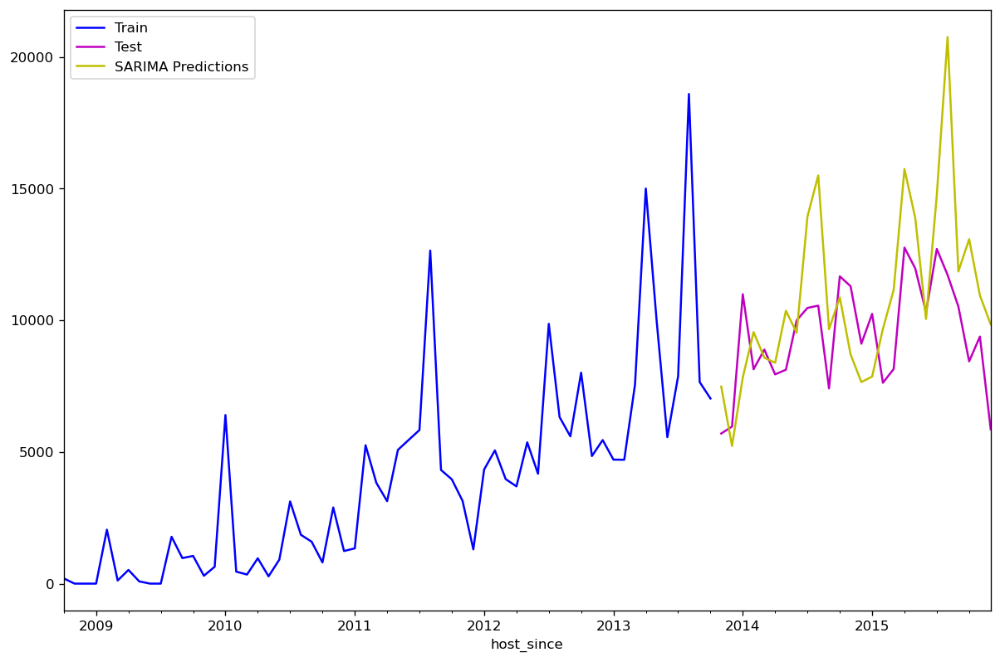
Project analysis slide 2
Model 1: Triple Smoothening Method
Model 2: SARIMA
Graph of Host Since VS Actual and
Predicted Price
Graph of Host Since VS Actual and
Predicted Price
Price
Price
Oct 2008
Dec 2015
Dec 2015
Date
Date
AIC (Akaike Information Criterion) | 986.1
MAE (Mean Absolute Error) | 2647.98
RMSE (Root Mean Square Error) | 3241.71
AIC (Akaike Information Criterion) | 1375.9
MAE (Mean Absolute Error) | 2356.05
RMSE (Root Mean Square Error) | 2962.43

Slide 16
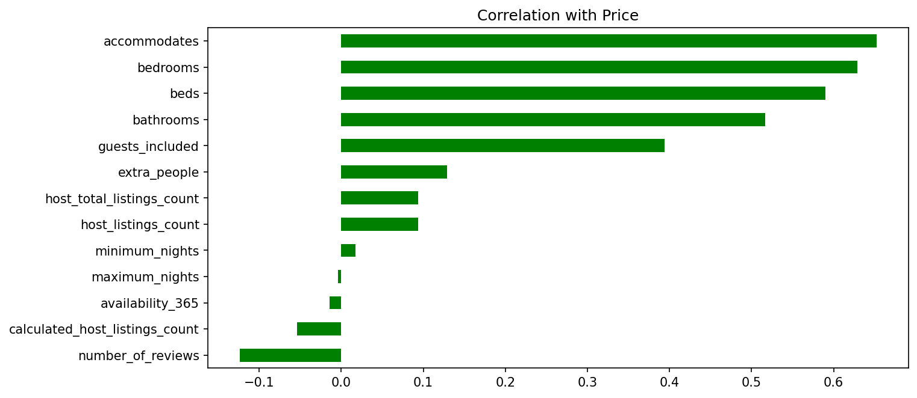
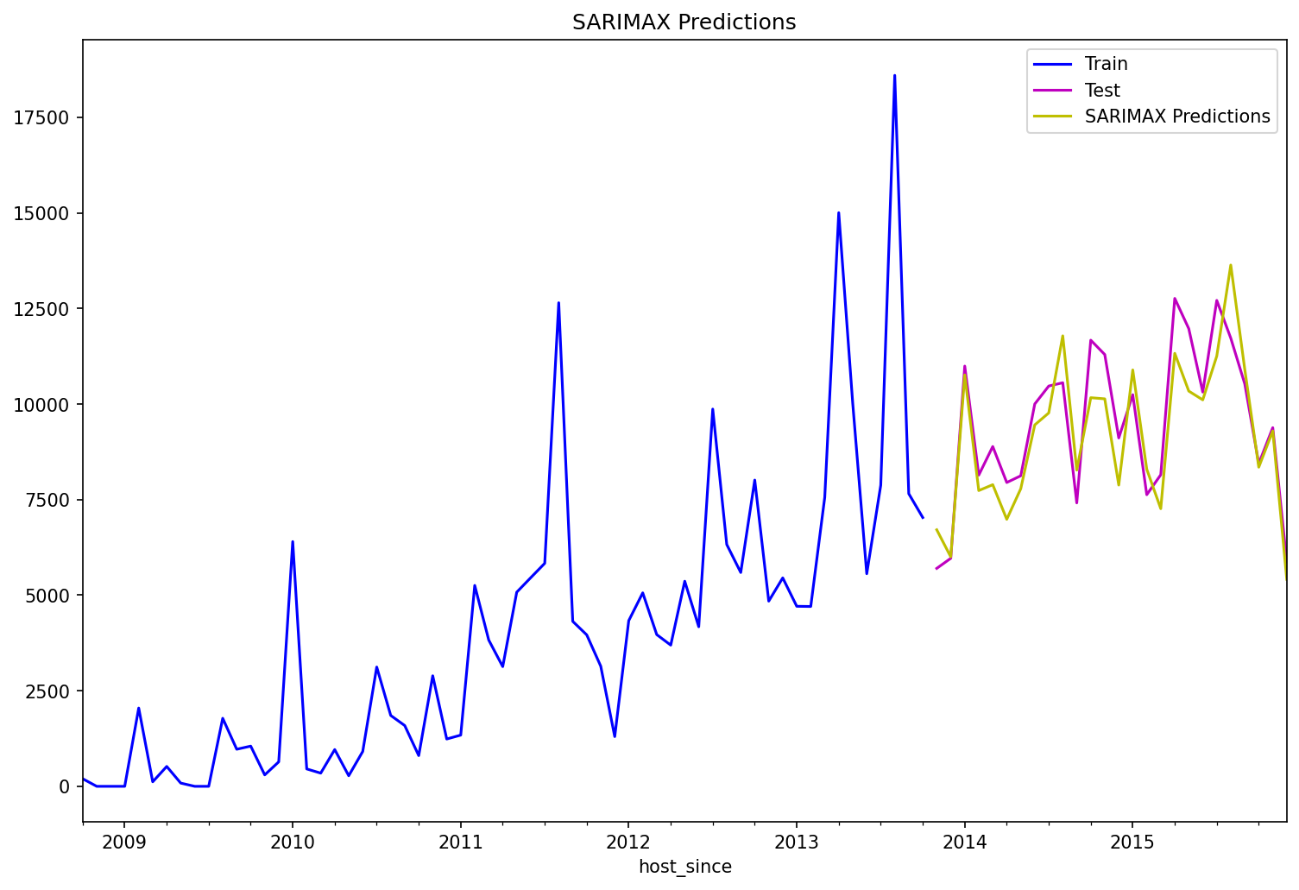
Model 3: SARIMAX Method
Correlation with Price
Graph of Host Since VS Actual and
Predicted Price
Price
Oct 2008
Dec 2015
Date
Exogenous variables: accommodates, bedrooms, beds, bathrooms, guests.
AIC (Akaike Information Criterion) | 794.5
MAE (Mean Absolute Error) | 810.28
RMSE (Root Mean Square Error) | 960.94

Slide 17
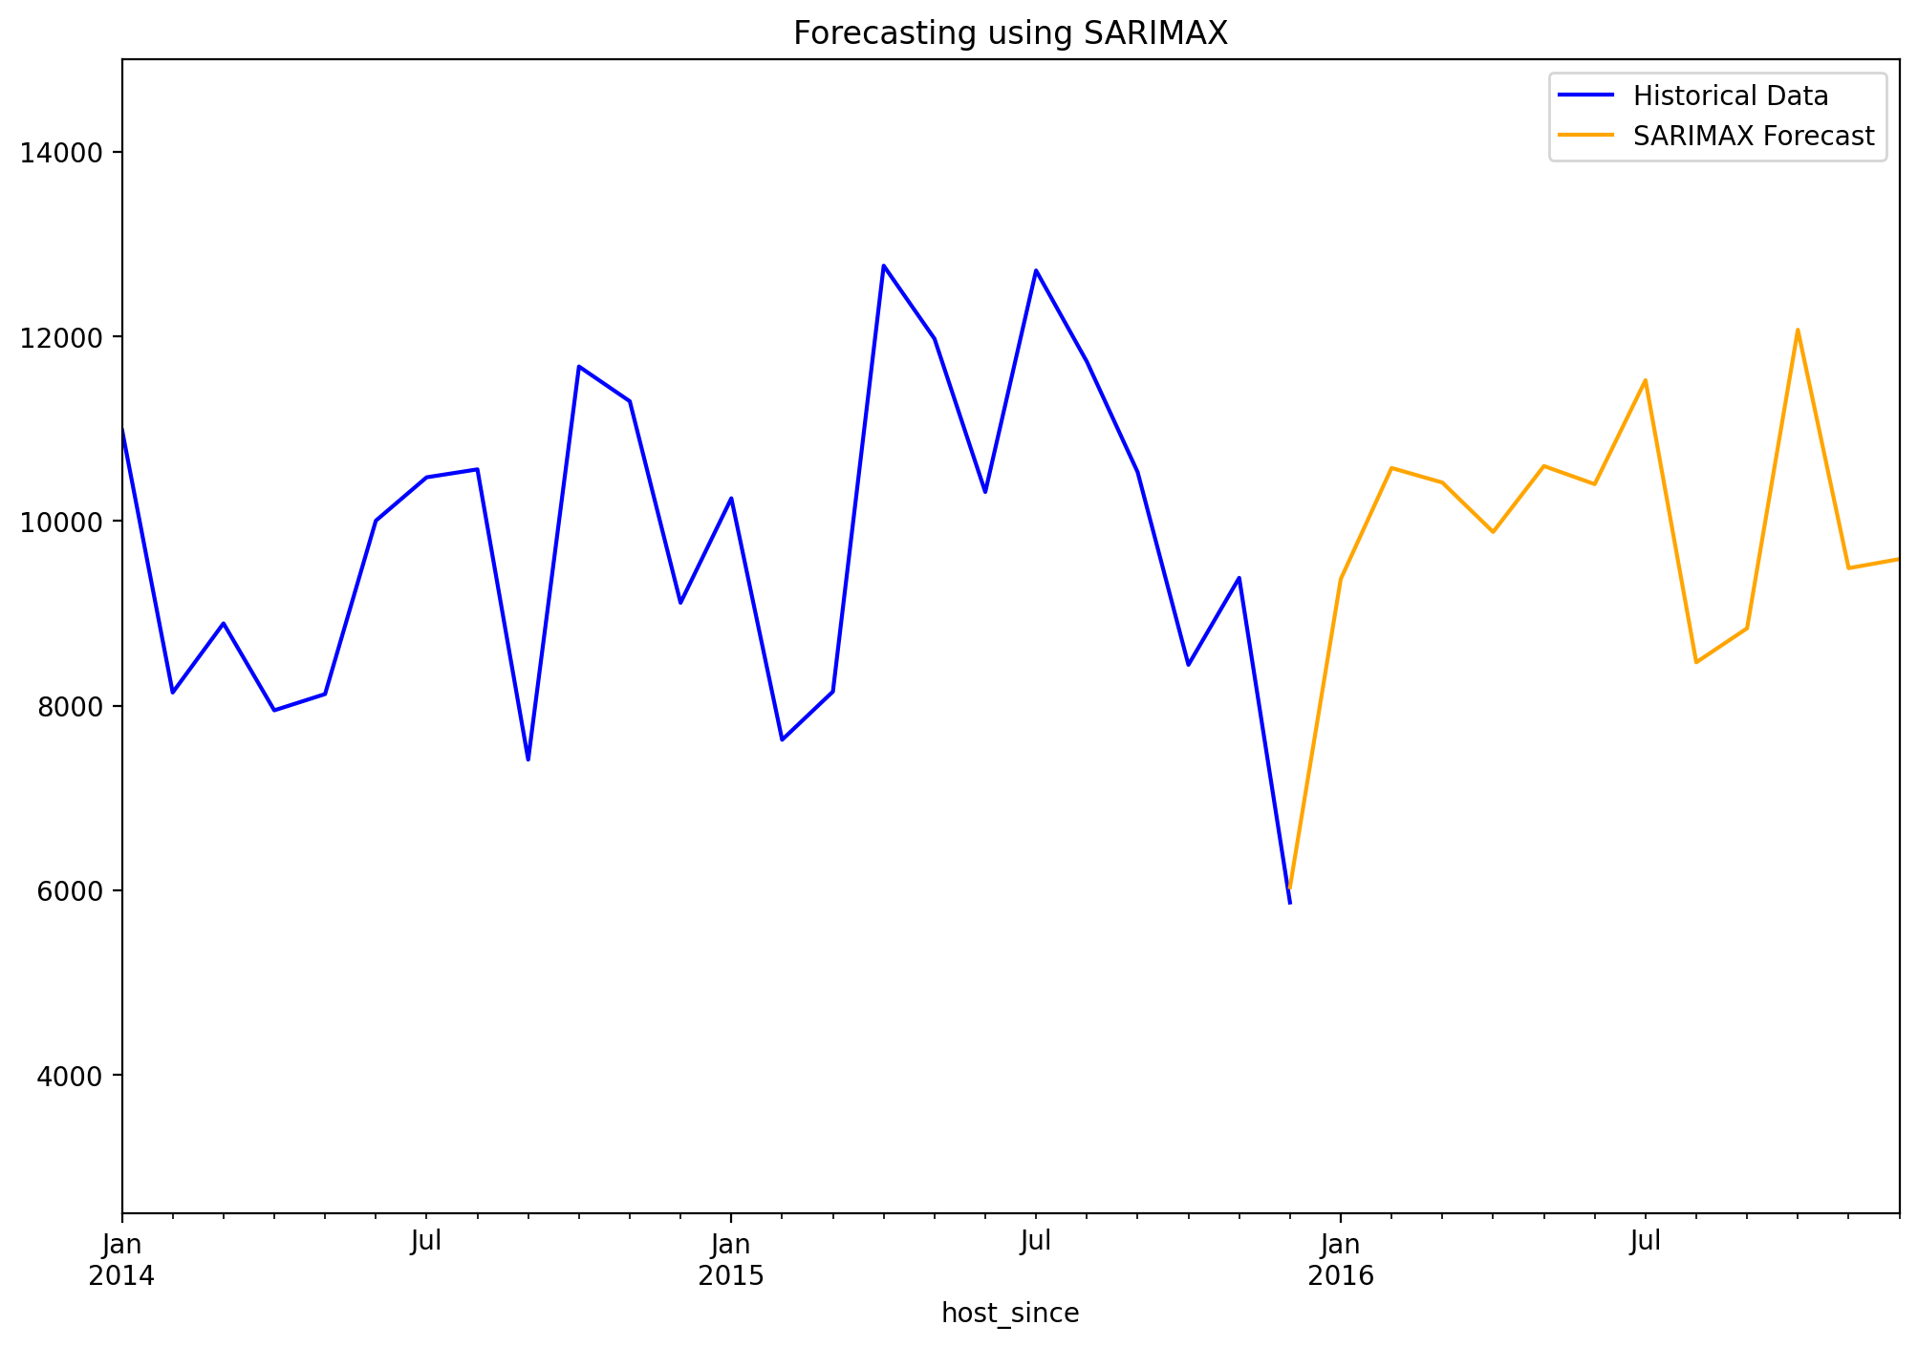
Forecasting of next one year using SARIMAX
Conclusion
SARIMAX model algorithm has yielded minimum error and AIC and thus finalized SARIMAX model for revenue forecasting.
Seasonality shows that more bookings were done in the month of August maybe due to the warm weather and especially to attend Sea fair festival where people majorly come to watch the hydroplane races and the Blue Angels which is a Seattle tradition.
MODEL COMPARISON
Price
MODEL | AIC (Akaike Information Criterion) | MAE (Mean Absolute Error) | RMSE (Root Mean Square Error)
Holt-Winters (Triple Exponent Smoothening) | 986.1 | 2647.98 | 3241.71
SARIMA | 1375.9 | 2356.05 | 2962.43
SARIMAX | 794.5 | 810.28 | 960.94
Dec
2016
Date

Slide 18
Project analysis slide 2
Property Type Prediction
Problem Statement 3: Build a classification model that will predict the ‘property type’ a customer is most
likely to select, given a set of input features.
Types of Properties | Number of available types
House | 1723
Apartment | 1696
Townhouse | 118
Condominium | 91
Loft | 40
Bed & Breakfast | 37
Cabin | 21
Other | 21
Camper/RV | 13
Bungalow | 13
Boat | 8
Tent | 5
Treehouse | 3
Dorm | 2
Yurt | 1
Chalet | 1
Property type Townhouse, Loft, Bed & Breakfast, Cabin, Camper/RV, Bungalow, Boat, Tent, Treehouse, Yurt, Chalet is merged with House.
Property type Condominium and Dorm is merged with Apartment.
Property types selected for prediction
Types of Properties | Number of available types
House | 1983
Apartment | 1789

Slide 19
Project analysis slide 2
Features Selection Methods
Methods
Recommended features
Extra Tree Selector | Price, room type private room, availability 365, number of reviews, bedrooms
Forward selector | Host total listings count, bedrooms, room type private room, room type shared room
Chi2 selector | Host total listings count, number of reviews, availability 365, Price
Features shortlisted for Property type prediction
Host total listings count
Bedrooms
Price
Room type Private room
Classification models used for Property Type Prediction
Logistic Regression
K Nearest Neighbor (KNN)
Random Forest Classifier
Support Vector Classifier (SVC)
Gradient Boosting Classifier

Slide 20
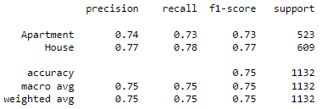
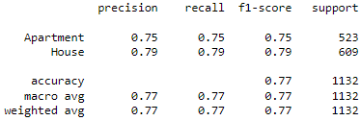
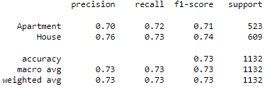
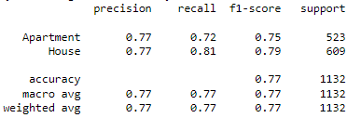
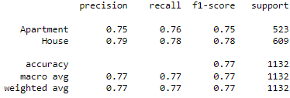
Results (Model Evaluation)
Logistic Regression
K Nearest Neighbor (KNN)
Random Forest Classifier
Support Vector Classifier (SVC)
Gradient Boosting Classifier
From all the 5 models, Gradient Boosting Classifier gives the maximum accuracy of 77.8%.
Property_type_recommendation_Demo

Slide 21
References
www.kaggle.com
www.medium.com
https://public.opendatasoft.com
https://towardsdatascience.com
https://www.niit.com/india/knowledge-centre/ML-algorithms

Slide 22
Thank You

