Slide 1
COMPUTATIONL MATHEMATICS
Vishal Arora

Slide 2
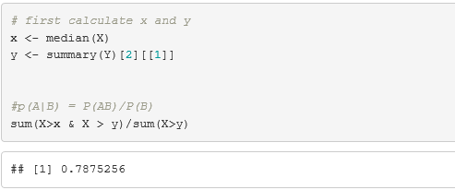
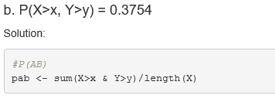
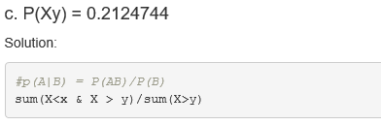
Problem 1.
5 points
P(X>x | X>y) = 0.7875256
The probability of X greater than median value of X given that X is greater than first quartile of y is 0.78.
b. P(X>x, Y>y) = 0.3754
The probability of X greater than median value of X
and Y is greater than first quartile of y is 0.3754.
c. P(X<x | X>y) = 0.2124744
The probability of X less than median value of X given
that X is greater than first quartile of y is 0.2124744.

Slide 3
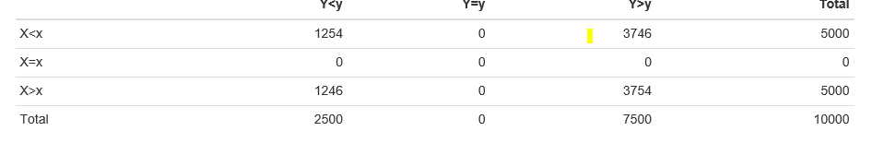
5 points. Investigate whether P(X>x and Y>y)=P(X>x)P(Y>y) by building a table and evaluating the marginal and joint probabilities
We’ve built the following marginal and joint probability table first
From the above marginal and conditional probability table we can see that the condition holds
P(X>x and Y>y) = # P(X>x and Y>y) 3754/10000 → 0.3754
P(X>x)P(Y>y) = ((5000)/10000)*(7500/10000)
0.375 are approximately equal.

Slide 4
5 points. Check to see if independence holds by using Fisher’s Exact Test and the Chi Square Test. What is the difference between the two? Which is most appropriate?
We ran fisher’s exact test and chi square tests. From which we found that independence holds here.
Fisher's exact test the null of independence of rows and columns in a contingency table with fixed marginals.
Chi-squared test tests contingency table tests and goodness-of-fit tests.
Fisher's exact test is appropriate here. Since the contingency table are fixed here in the table.
The r code and output are on the next slides

Slide 5
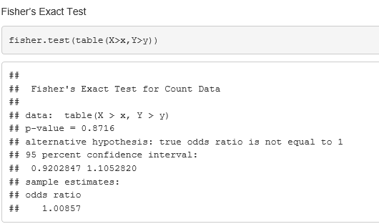
Answer:
Fisher’s Exact Test
fisher.test(table(X>x,Y>y))
## ## Fisher's Exact Test for Count Data ## ## data: table(X > x, Y > y) ## p-value = 0.8716 ## alternative hypothesis: true odds ratio is
not equal to 1 ## 95 percent confidence interval: ## 0.9202847 1.1052820## sample estimates: ## odds ratio ## 1.00857
The p-value is greater than zero we reject the null hypothesis. Two events are independent.
The Chi Square Test

Slide 6
The Chi Square Test
chisq.test(table(X>x,Y>y))
## ## Pearson's Chi-squared test with Yates' continuity correction ## ## data: table(X > x, Y > y) ## X-squared = 0.026133, df = 1, p-value = 0.8716
The p-value is greeter than zero we reject the null hypothesis. Two events are independent.
Fisher’s exact test the null of independence of rows and columns in a contingency table with fixed marginals.
Chi-squared test tests contingency table tests and goodness-of-fit tests.
Fisher’s exact test is appropriate here. Since the contingency table are fixed here in the table.
The p-value is greater than zero we don’t reject the null hypothesis. Two events are independent.

Slide 7
Problem 2
You are to register for Kaggle.com (free) and compete in the House Prices: Advanced Regression Techniques competition. https://www.kaggle.com/c/house-prices-advanced-regression-techniques . I want you to do the following.
Load the libraries

Slide 8
5 points. Descriptive and Inferential Statistics.
Provide univariate descriptive statistics and appropriate plots for the training data set.
Provide a scatter-plot matrix for at least two of the independent variables and the dependent variable.x
Derive a correlation matrix for any three quantitative variables in the data-set.
Discuss the meaning of your analysis. Would you be worried about family-wise error? Why or why not?

Slide 9
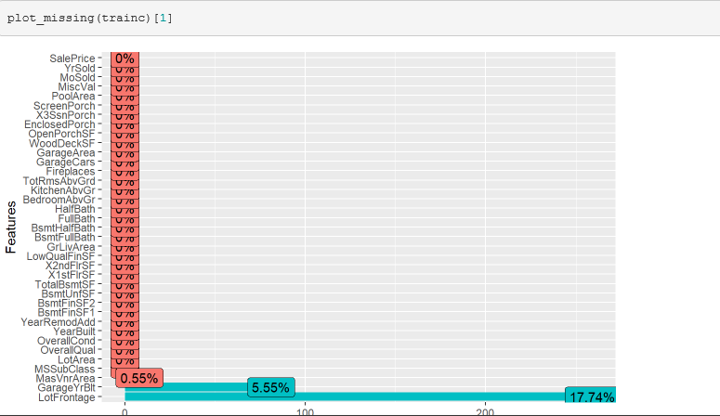
Using plot_missing function from DataExplorer package to see the missing values for each individual columns and what is the missing data profile.

Slide 10
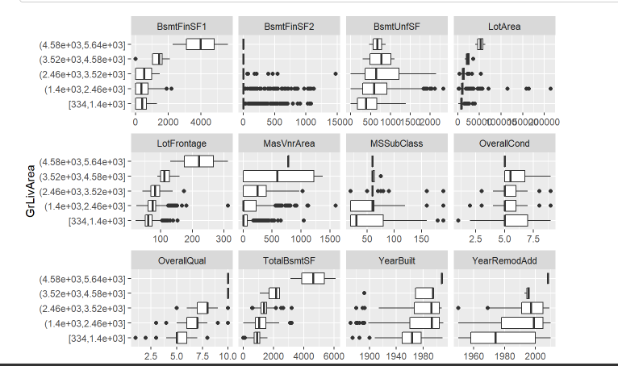
Understanding of the data distribution.Now assume we are interested in GrLivArea, and would like to build a model to predict it. Let’s plot it against all other variables

Slide 11
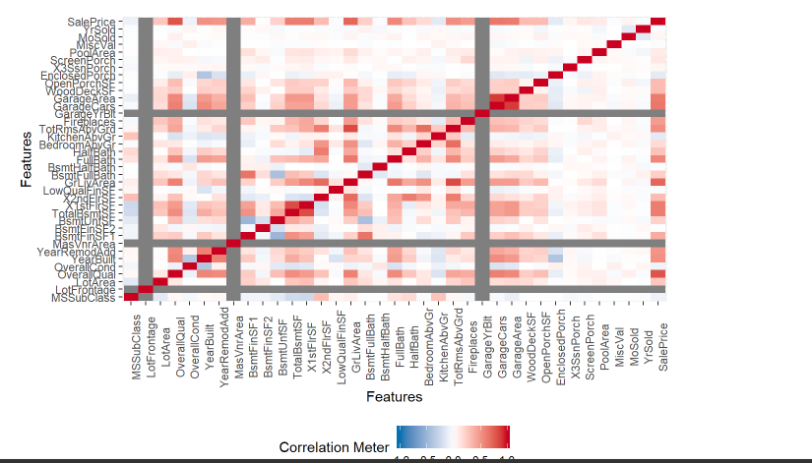
Correlation Heatmap

Slide 12
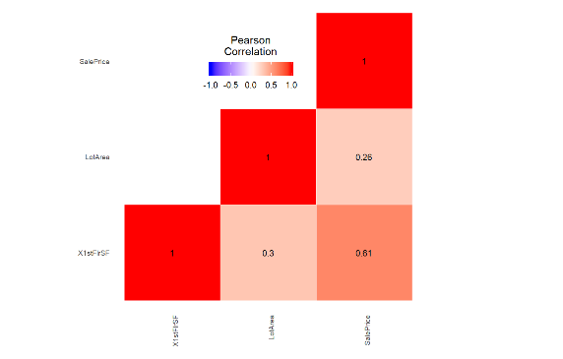
Test the hypotheses that the correlations between each pairwise set of variables is 0 and provide a 80% confidence interval.

Slide 13
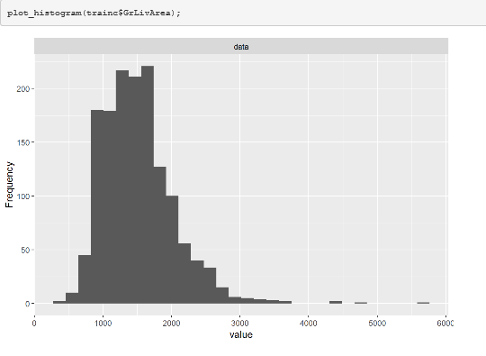
Gr Living Area does not have a minimum of zero, therefore we do not need to shift the variable.

Slide 14
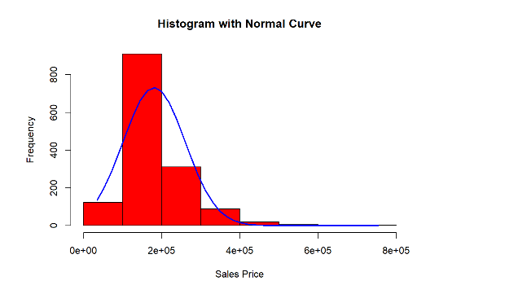
It seems that no major transformation needs to be done on the response variable, however we will confirm with diagnostics.

Slide 15
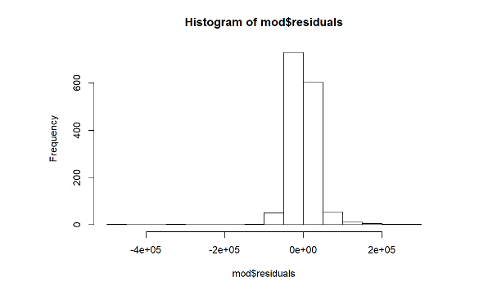
The residuals seem to follow a close to normal distribution. We need to check constant variance.

Slide 16
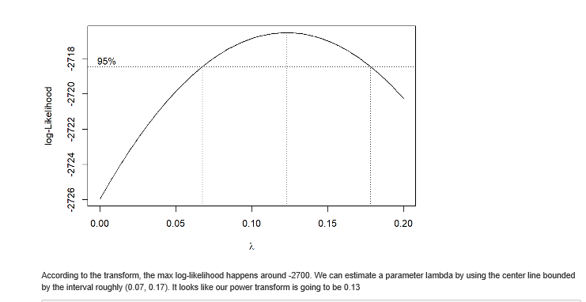

Slide 17
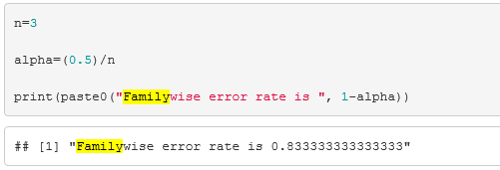
family wise error
The familywise error rate (FWE or FWER) is the probability of a coming to at least one false conclusion in a series of hypothesis tests . In other words, it’s the probability of making at least one Type I Error. The term “familywise” error rate comes from family of tests, which is the technical definition for a series of tests on data.The FWER is also called alpha inflation or cumulative Type I error.

Slide 18
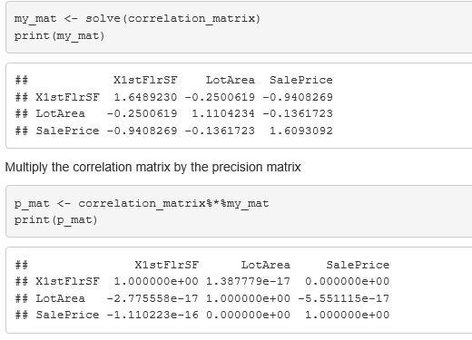
5 points. Linear Algebra and Correlation. Invert your correlation matrix from above. (This is known as the precision matrix and contains variance inflation factors on the diagonal.) Multiply the correlation matrix by the precision matrix, and then multiply the precision matrix by the correlation matrix. Conduct LU decomposition on the matrix.

Slide 19
5 points. Calculus-Based Probability & Statistics. Many times, it makes sense to fit a closed form distribution to data. Select a variable in the Kaggle.com training dataset that is skewed to the right, shift it so that the minimum value is absolutely above zero if necessary. Then load the MASS package and run fitdistr to fit an exponential probability density function. (See https://stat.ethz.ch/R-manual/R-devel/library/MASS/html/fitdistr.html ).

Slide 20
10 points. Modeling. Build some type of multiple regression model and submit your model to the competition board. Provide your complete model summary and results with analysis. Report your Kaggle.com user name and score.
Model Building Steps:
Prepare the data.
Fit multiple logistic regression model
Do Stepwise regression
Find the best fitted model
Do residual Analysis
Predict the output of test data using final model.
Submit the submission.csv file to Kaggle.com for scoring.

Slide 21
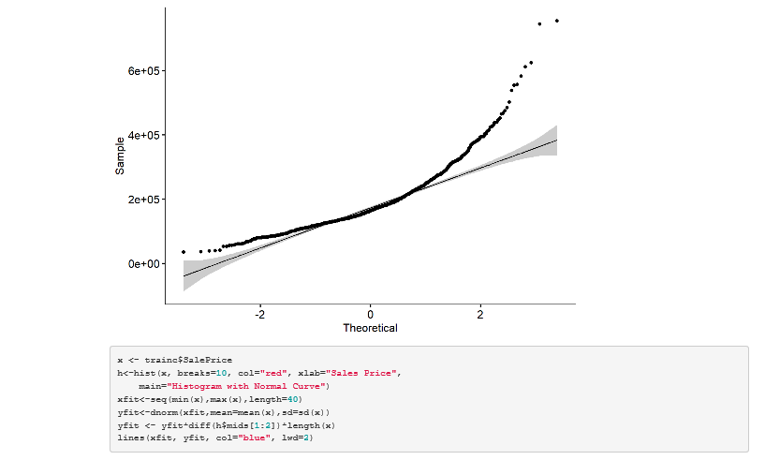

Slide 22
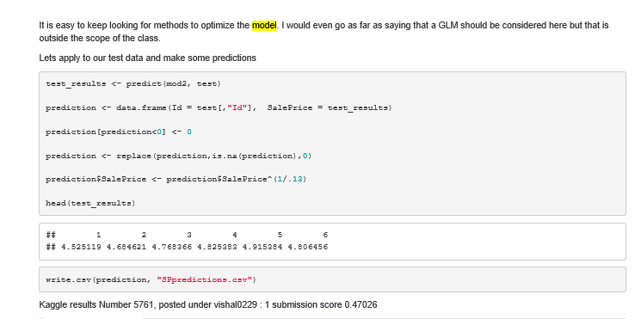
Our Final model

Slide 23
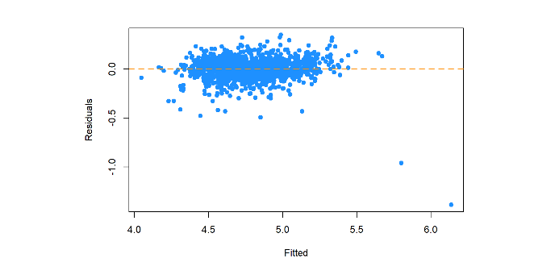
From the residuals plot we can see that the assumptions of multiple regression model are satisfied. The residuals are approximately normally distributed. There is not heteroscedastic and pattern in the residuals. Do prediction

Slide 24
Kaggle Submission
Kaggle username is vishal0229. Final score is 0.47026.

Slide 25
Q&A | Thank You

