Slide 1
IBM University Engagement Project Submission
“Exploring the Power of Agentic AI with IBM Granite and LangFlow”

Slide 2

Project Tile – AgriGenAI :The Crop Saver
Domain of Project – Agriculture
Student Name | Recent Passport Photo | Email ID | Mobile number [WhatsApp]
Vishalkumar M. Patel |  | ivishalce37@gmail.com | 9106457214

Slide 3
Problem Statement -
Problem Statement : AgriGenAI :The Crop Saver
The Challenge :
Farmers often struggle with low crop yield, unpredictable weather, pest infestations, and limited access to timely expert advice. Traditional farming advisory services are fragmented, slow, and not personalized to the farmer’s specific land, crop, or climate conditions. With the rise of climate change, data-driven smart farming solutions are needed to empower farmers with actionable insights.
The Objective:
Develop an AI-powered Smart Farming Agent that provides personalized, real-time, and sustainable agricultural advice.
The solution should:
Agricultural Knowledge Retrieval (RAG) – Use Retrieval-Augmented Generation to fetch best practices, crop-specific guidelines, and government advisory updates.
Weather & Soil Insights – Integrate real-time weather forecasts, soil health data, and irrigation needs to optimize farm planning.
Pest & Disease Detection – Enable multimodal support where farmers upload crop images for early pest/disease identification and get instant recommendations.
Personalized Advisory Agent – Suggest seeds, fertilizers, irrigation schedules, and harvesting timelines based on farmer profile and land conditions.
Market & Cost Optimization – Forecast demand, suggest market prices, and recommend cost-efficient practices for better income.
Multi-Agent Collaboration –
Crop Advisory Agent
Weather & Irrigation Agent
Pest/Disease Detection Agent
Market Insights Agent

Slide 4
Technology Used
Use any one of the following approaches:
LangFlow + IBM watsonx.ai + Granite Models
IBM Cloud Agentic Lab with IBM Granite Models
Replicate with LangChain + RAG + IBM Granite Models
I used LangFlow + IBM watsonx.ai + Granite Models

Slide 5
Proposed Solution -
Proposed Solution: AgriGenAI :The Crop Saver
The proposed solution is a multi-agent AI-powered Smart Farming Agent built using LangFlow, IBM watsonx.ai, and Granite Models to provide personalized, real-time agricultural advisory services. The system addresses key challenges in modern agriculture such as low crop yield, unpredictable weather conditions, pest infestations, and lack of timely expert guidance through an intelligent and modular AI architecture.
At its core, the solution uses a Retrieval-Augmented Generation (RAG)-inspired pipeline to utilize agricultural knowledge from trusted sources such as ICAR guidelines, government agriculture advisories, crop production manuals. This knowledge is processed and used by Granite models to generate accurate, context-aware farming recommendations.
The system consists of four key agents:
Crop Advisory Agent retrieves agricultural best practices and provides recommendations for crop selection, fertilizer usage, irrigation scheduling, and yield improvement techniques.
Weather & Irrigation Agent analyzes weather patterns and environmental conditions to suggest optimal irrigation schedules, rainfall-based planning, and water conservation strategies.
Pest & Disease Detection Agent identifies crop health issues based on symptoms or descriptions and provides immediate treatment methods along with preventive measures.
Market Insight Agent delivers crop price forecasts, demand trends, and cost-effective selling strategies to help farmers maximize income.
The system can be accessed through a user-friendly conversational interface, allowing farmers to input queries in natural language. The AI system processes the input, routes it to the appropriate agent using intelligent prompt-based classification, and generates actionable farming advice in real time.
Overall, this solution delivers an end-to-end intelligent farming assistant that empowers farmers with data-driven insights, improved productivity, sustainable farming practices, and real-time decision support.

Slide 6
Langflow component Used -
1) Chat Input – Interface where farmers enter their queries . Supports farming-related questions such as crop issues, weather, pest problems, and market prices
2) IBM watsonx AI Agent - Core reasoning engine of the system. Processes user input using Granite foundation models. Understands agricultural context and generates intelligent responses
3) Name of IBM Granite model - Granite-4.0-8B-Instruct Optimized for: Real-time reasoning
Agricultural advisory generation. Context-aware responses. Provides fast and accurate farming recommendations
4) Chat output -Displays AI-generated responses such as diet plans, nutritional analysis, and health suggestions.
5) File Component : Stores agricultural documents and datasets such as: ICAR guidelines, Crop production manuals, Soil health reports. Helps provide knowledge-based context for better responses
6) Prompt Template: Structures the input for the AI model Combines: User query, Agricultural context (if provided). Ensures structured and domain-specific responses
7) Parser: Use to convert File content into message format.
8) Agent: includes 5 Agent (Main agent working as a router and others are CROP ADVISORY AGENT, WEATHER & IRRIGATION AGENT, PEST / DISEASE DETECTION AGENT, MARKET INSIGHTS AGENT).

Slide 7
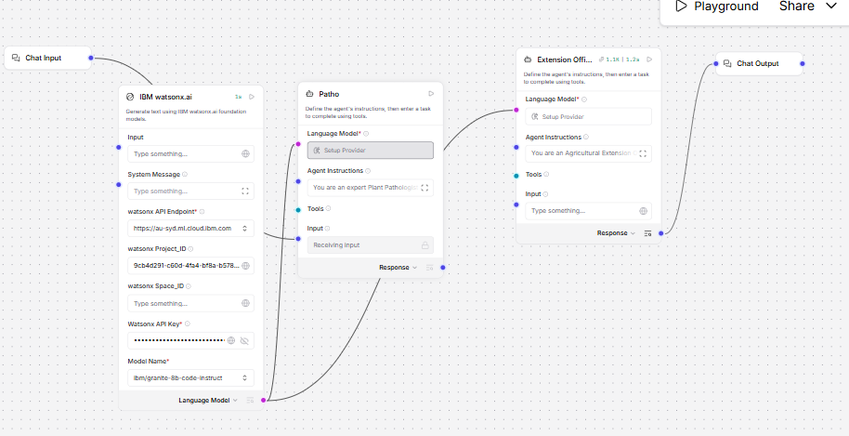
Langflow workflow -

Slide 8
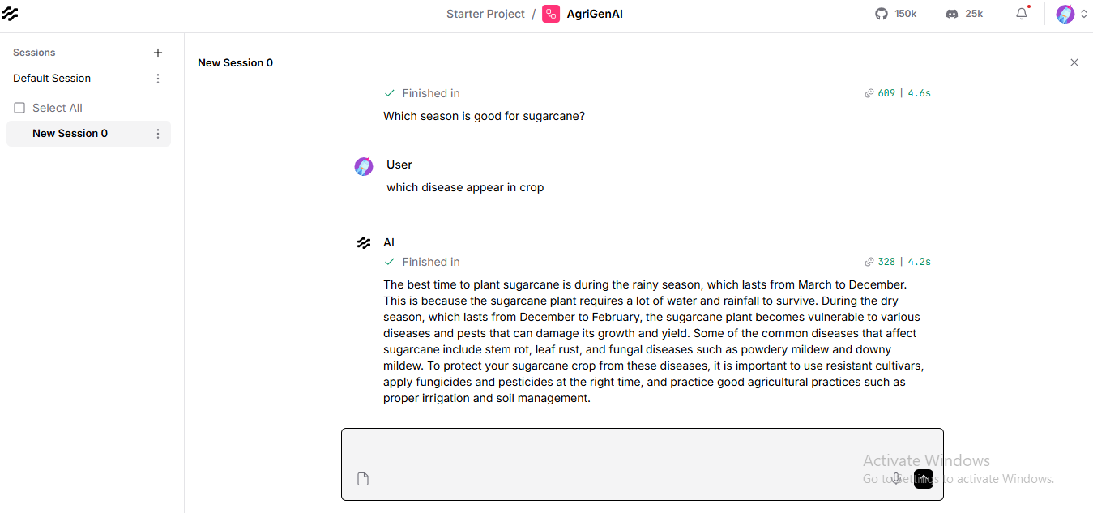

Slide 9
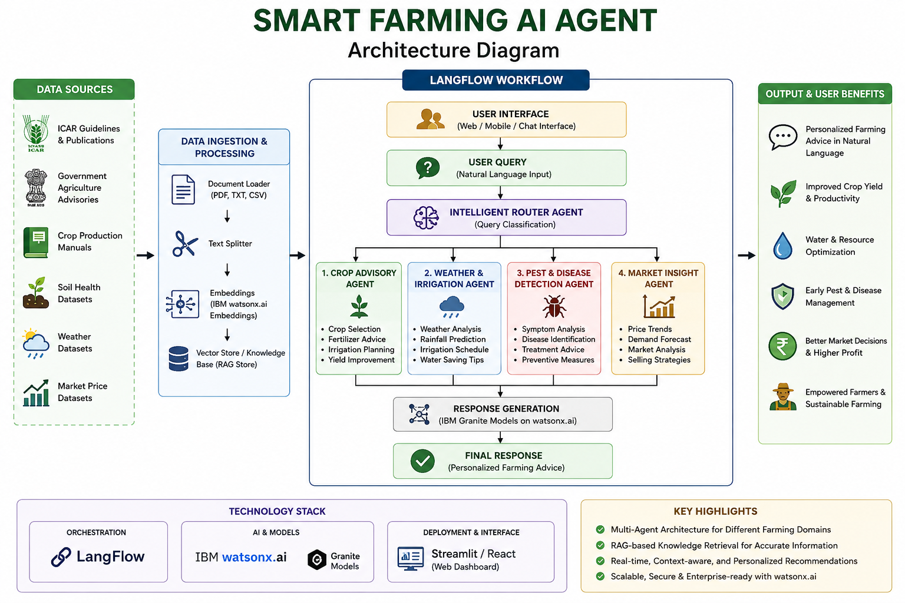
Architecture blueprint

Slide 10

Role of Agentic AI in the solution
🌾 Role of Agentic AI in Smart Farming Agent
Agentic AI enables the Smart Farming Agent to function as an intelligent, autonomous agricultural advisory system rather than a simple Q&A chatbot. Using IBM watsonx.ai and IBM Granite models, it coordinates multiple specialized agents to deliver accurate and data-driven farming recommendations.
Each agent performs a specific role—such as retrieving crop and soil data, analyzing weather conditions, detecting plant diseases, and generating farming advice—while working collaboratively. This multi-agent approach ensures efficient task execution and precise agricultural insights.
Agentic AI also brings context awareness, understanding key farming parameters such as crop type, soil condition, location, and growth stage to generate personalized recommendations for farmers.
It supports real-time adaptation, continuously updating suggestions based on dynamic inputs like weather changes, crop health status, and farmer queries (e.g., irrigation needs or pest issues).
Additionally, agents communicate with each other, enabling better decision-making and integrated farming solutions, such as combining weather forecasts with irrigation planning.
Overall, Agentic AI makes the system proactive, intelligent, and goal-driven, acting like a smart digital agriculture expert that helps farmers improve productivity, reduce risks, and make informed farming decisions.

Slide 11
Technology Used
Langflow Platform For designing and orchestrating multi-agent workflows visually. It helps in building a structured pipeline for farming-related tasks such as crop advice, disease detection, and weather-based recommendations.
IBM Granite Model (IBM watsonx.ai) For example – granite-3-2-8b-instruct – used for natural language understanding, reasoning, and generating personalized farming advice based on user queries and agricultural data.
IBM Cloud It provides the infrastructure to build, deploy, and scale the Smart Farming Agent efficiently. IBM Cloud ensures a reliable, secure, and scalable environment for handling real-time agricultural data and AI services.
RAG (Retrieval-Augmented Generation) Used to first retrieve real agricultural data (such as ICAR guidelines, crop manuals, soil data, and pest information) and then generate accurate and trustworthy farming recommendations.
IBM Watsonx.ai Used for model deployment, embeddings, prompt management, and AI governance. It helps ensure the Smart Farming Agent delivers consistent, high-quality, and controlled AI responses.

Slide 12
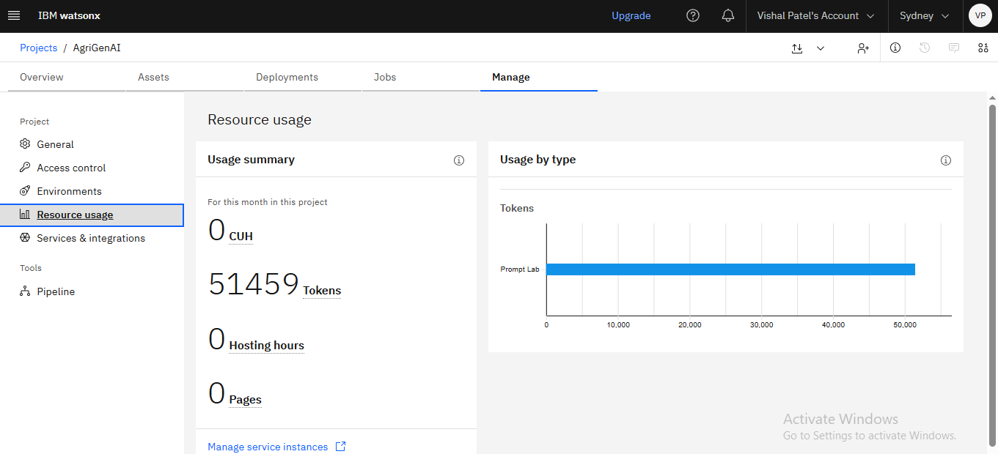
Token Usage
·
·
·

Slide 13
Novelty and Uniqueness
The proposed Smart Farming AI Agent introduces a modern Agentic AI-based approach to agriculture, making it more intelligent and decision-driven compared to traditional advisory systems.
Agentic AI–Driven Farming System
Unlike basic chatbots, the system acts as an autonomous farming assistant that can plan, reason, and take multi-step decisions to provide complete agricultural guidance.
Multi-Agent Collaboration
The system uses a multi-agent architecture where different agents handle specific tasks such as crop advisory, soil analysis, weather interpretation, and pest/disease recommendations. These agents collaborate to generate accurate and reliable outputs.
Context-Aware Personalized Advice
The model understands farmer-specific context such as crop type, soil condition, location, and growth stage to deliver highly personalized farming solutions instead of generic suggestions.
RAG-Based Trusted Knowledge Integration
By integrating Retrieval-Augmented Generation (RAG), the system first fetches verified agricultural data (ICAR guidelines, crop manuals, weather insights) before generating responses, ensuring accuracy and reliability.
Real-Time Adaptive Recommendations
The agent continuously adapts to changing conditions like weather updates, crop health, and user inputs, enabling dynamic and real-time decision support for farmers.
Scalable Cloud & IBM Ecosystem Integration
Built using IBM Watsonx.ai, IBM Granite models, Langflow, and IBM Cloud, the system ensures scalability, security, and enterprise-level AI governance.
Overall Uniqueness
This project stands out by combining Agentic AI + Multi-Agent System + RAG + Real-time agricultural intelligence, creating a smart digital farming assistant that actively supports farmers in decision-making and productivity improvement.

Slide 14
Git Hub Link
https://github.com/Vishal0307/Vishal-/tree/main
Uploaded following three files into github repository 1) AgriGenAI.json
2) AgriGenAI Vishal Patel.pdf
3) FDP_BVM_Vishal_AgriGenAI.pptx
·
·
·

Slide 15
Future Scope
The Smart Farming AI Agent has strong potential for future expansion into a more advanced, real-world agricultural intelligence system.
IoT & Sensor Integration
In the future, the system can be connected with IoT devices and smart sensors to collect real-time data on soil moisture, temperature, humidity, and crop health for more accurate recommendations.
Mobile App for Farmers
A dedicated mobile application (voice-enabled and multilingual) can be developed so that farmers can easily access farming advice in local languages.
Satellite & Drone Data Analysis
Integration with satellite imagery and drone data can help in large-scale crop monitoring, disease detection, and yield prediction.
Voice-Based AI Assistant
A voice-first farming assistant can be introduced to support farmers with low literacy levels, enabling hands-free interaction in regional languages.
Government Scheme Integration
The system can be extended to provide information about government subsidies, crop insurance, and agricultural schemes based on user location and crop type.
Fully Autonomous Farming Advisor
In the long term, the system can evolve into a fully autonomous AI farming advisor that continuously monitors data and provides proactive decision-making support without user prompts.
Overall Vision
To transform the Smart Farming AI Agent into a complete digital agriculture ecosystem that empowers farmers with data-driven, real-time, and intelligent farming decisions.
·
·
·

Slide 16


