Slide 1
MATCH CENTRE UI

Slide 2
Prerequisites:
Html5
Css
Angular6+
Angular plugins only - charts for eg.
Responsive Design

Slide 3
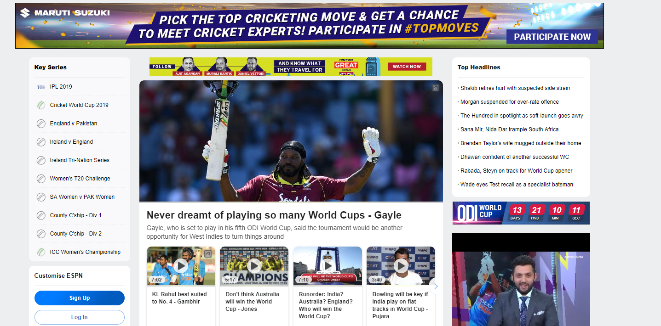
Dashboard
List of tournaments (HomeScreen)
List of series in a tournament (Clicking on a Tournament)

Slide 4
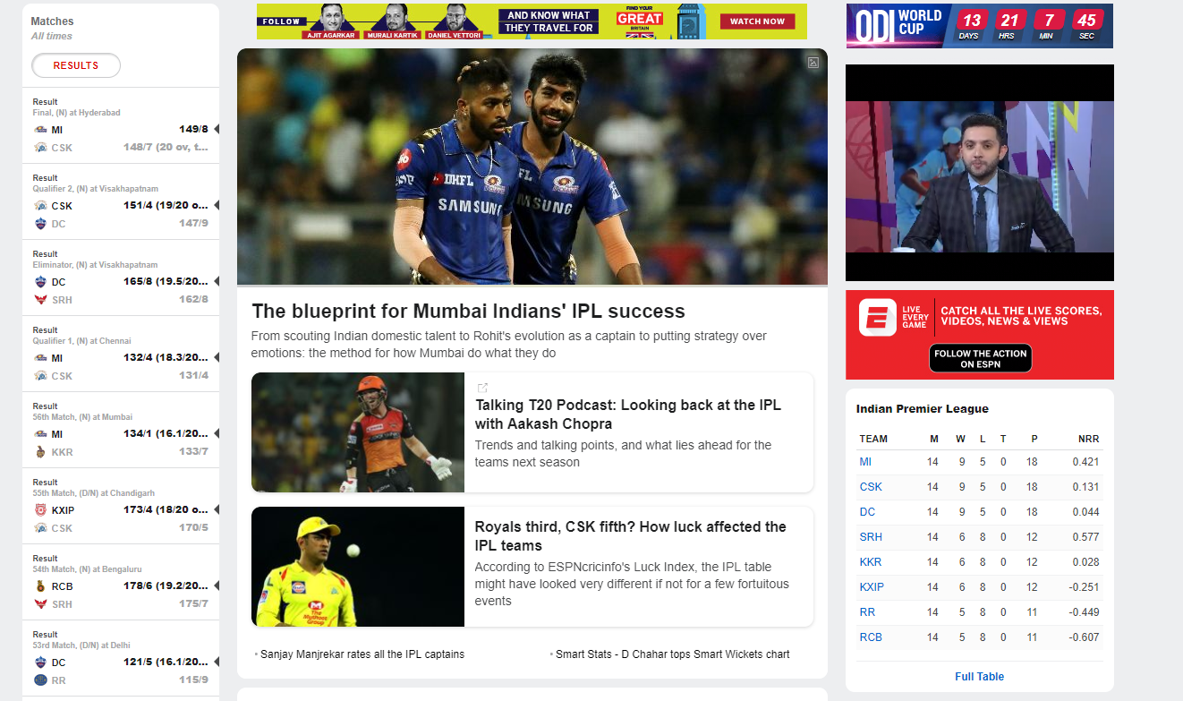
Matches in Series
Side tab view to show all the matches in a series with points table

Slide 5
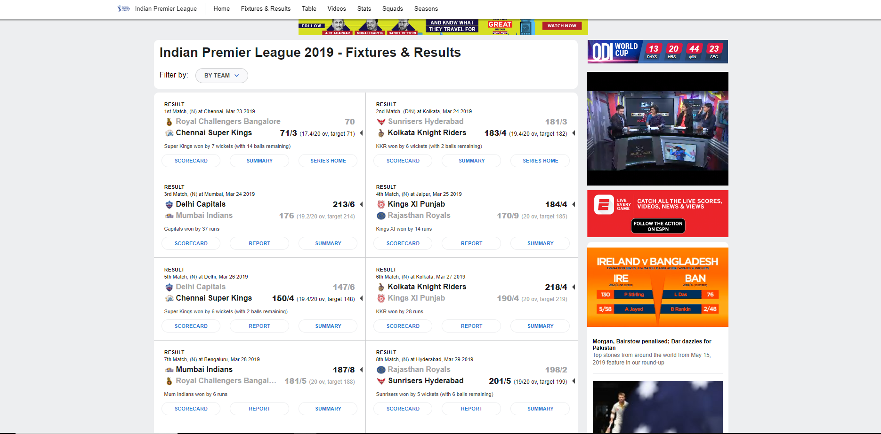
Fixtures in a Series
List of all matches in a series

Slide 6
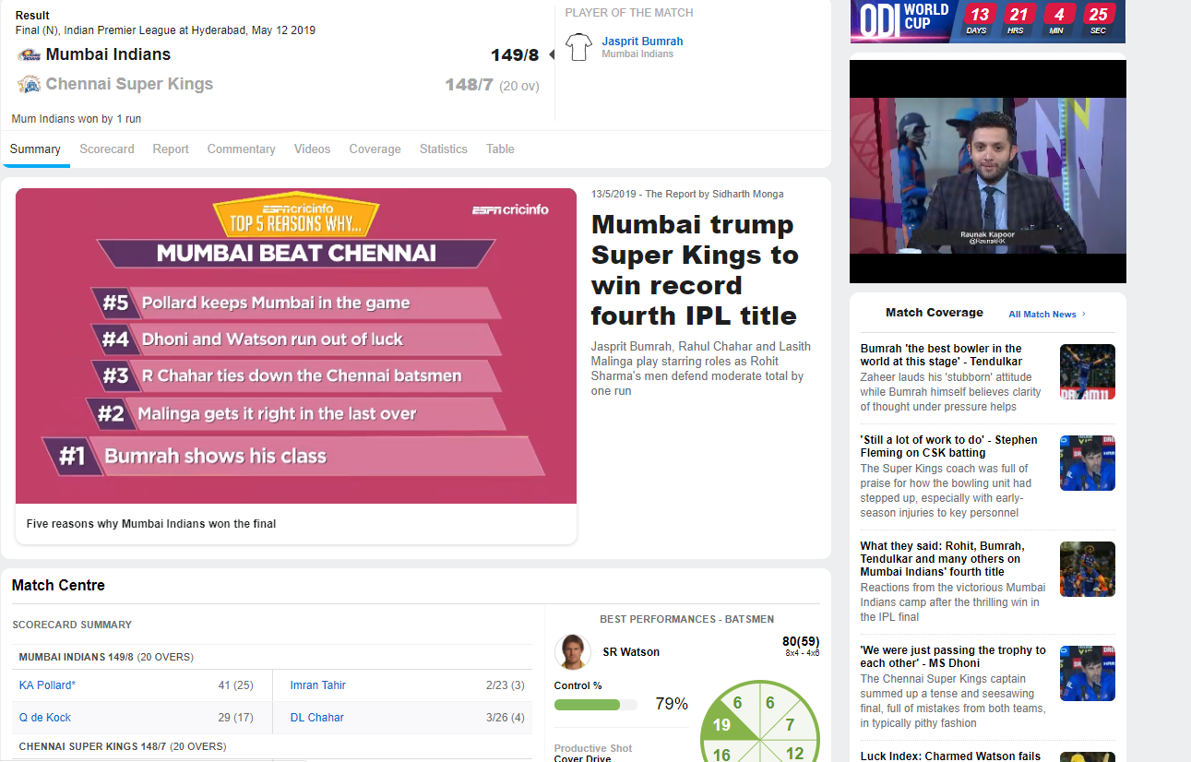
Match Dashboard
This view with tab( Showing multiple options like statistics,Commentary etc)
with ScoreWidget on TOP

Slide 7
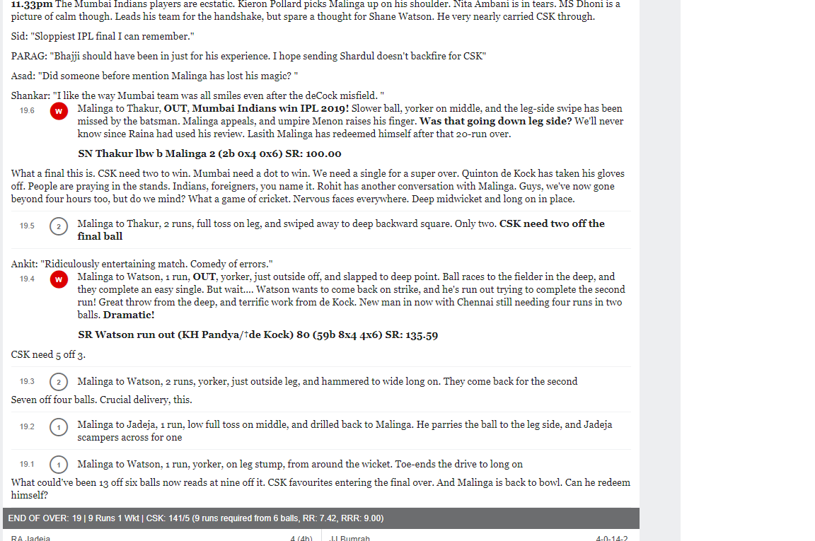
Commentary View
Ball by Ball Commentary view

Slide 8
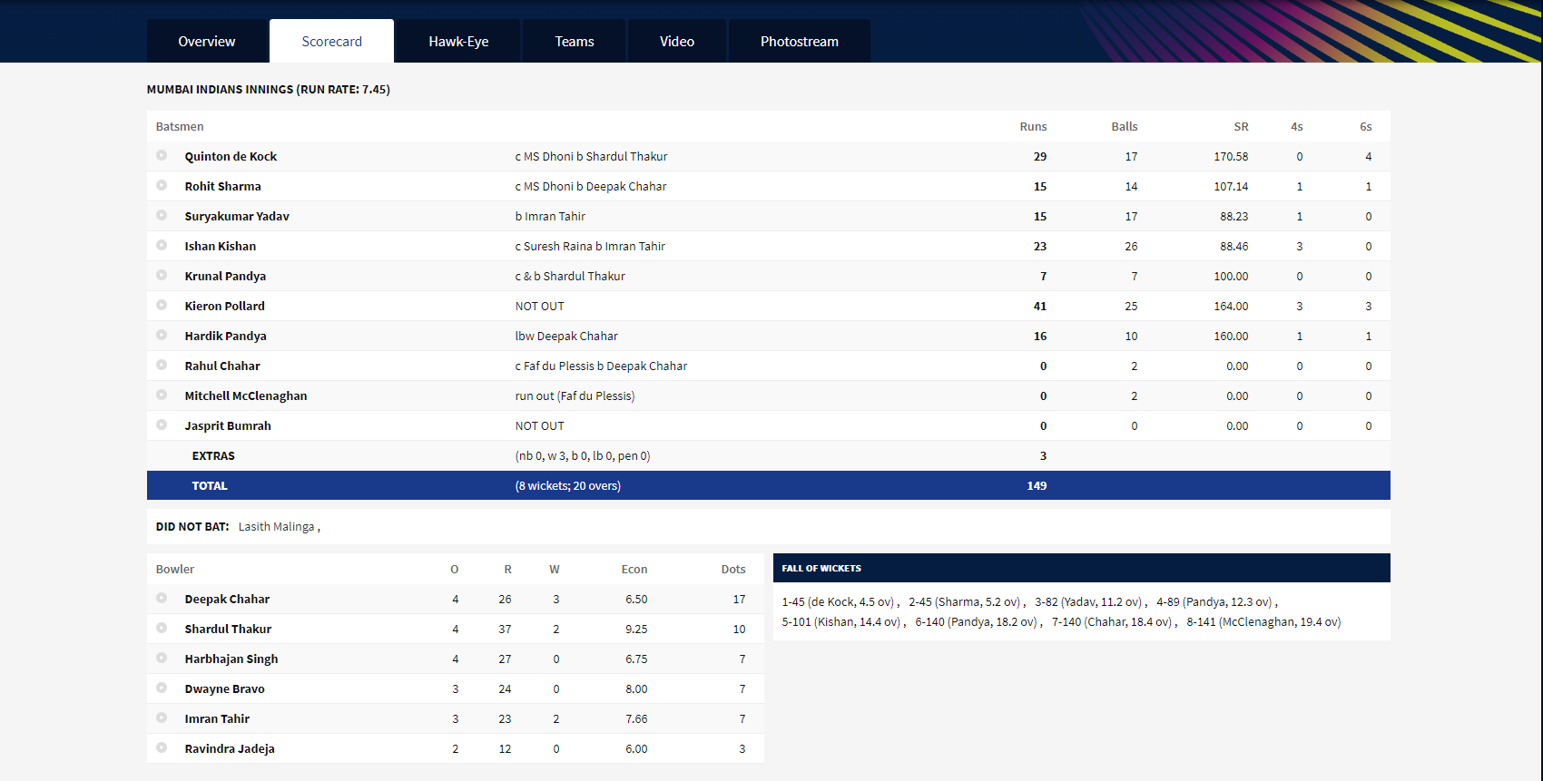
Batting n Bowling Card

Slide 9
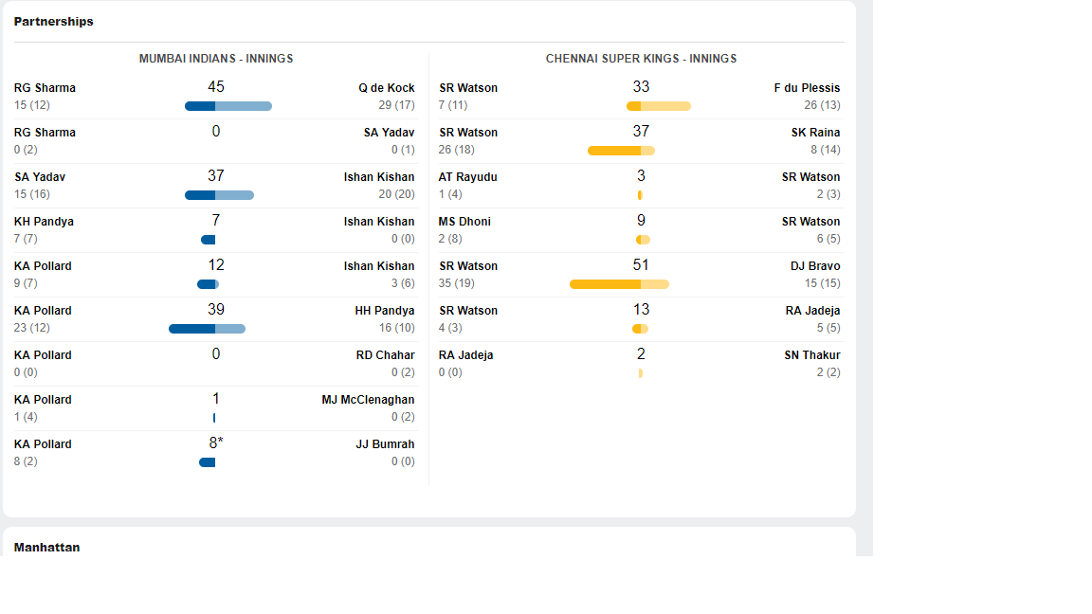
Partnerships for both teams

Slide 10
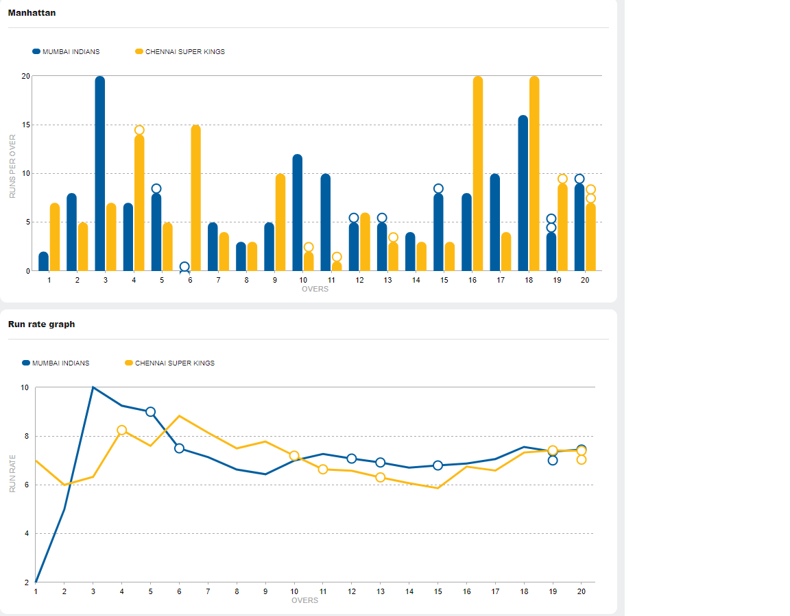
Chart view of Data
Charts should support additional data too, like not only Runs in Bars but Wickets too like in this figure.

Slide 11
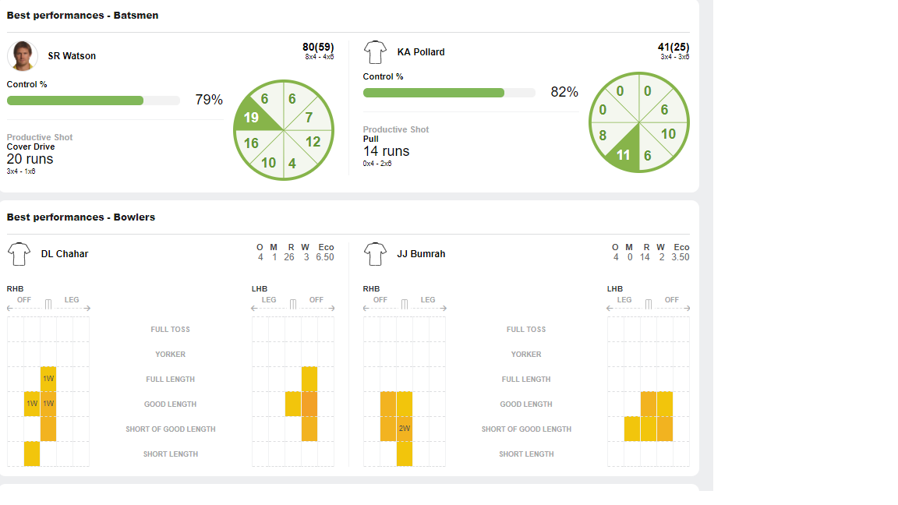
Other Stats - Player Performance

Slide 12
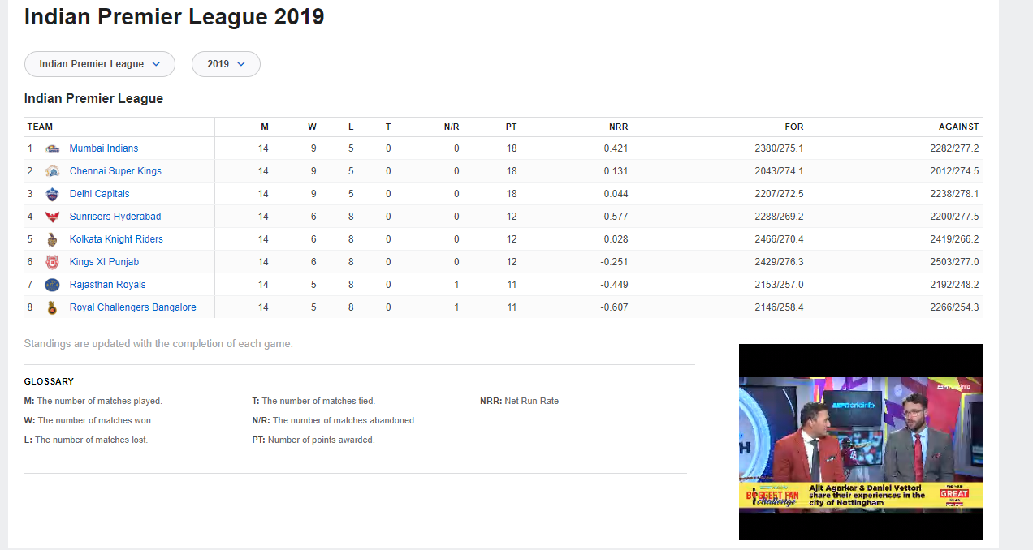
Points Table

Slide 13
References
http://www.espncricinfo.com/
https://www.iplt20.com/

