Slide 1
DATA ANALYTICS PORTFOLIO PROJECT
AI Impact on Jobs:
Layoff Risk Analysis
Python · PostgreSQL · Power BI
Vishal | B.Tech (E&TC), Final Year
Data Analyst / Data Science Candidate

Slide 2
The Problem
Why this analysis matters
As organizations adopt AI and automation at scale, roles built on routine, repeatable tasks face rising displacement risk — while roles demanding creativity and human judgment remain comparatively insulated.
This project analyzes 20,000 employee records to answer a concrete question:
Which combination of role, industry, and individual factors predicts layoff risk in an AI-disrupted workforce — and can that risk be modeled?
1
For HR & Workforce Planning
Identify which teams need reskilling investment first
2
For Job Seekers
Understand which roles carry higher long-term exposure
3
For Analysts (me)
Demonstrate Python, SQL & BI working as one pipeline
20,000 employee records analyzed across 8 industries and 24 job roles

Slide 3

The Dataset
Kaggle: AI Impact on Jobs and Layoff Risk Dataset
20,000
16
0
8 / 24
Employee records
Original columns
Missing values
Industries / Roles
Key feature groups
Personal | Role / Org | AI Exposure | Target
Age, Education, Years of Experience | Industry, Job Role, Company Size, Job Level | AI Adoption Level, # AI Tools, AI Training Hours, Usage Hrs/Week | Layoff_Risk (High / Medium / Low)
Known limitation, stated upfront: Layoff_Risk separates very cleanly along automation-related features, suggesting the dataset was generated with an explicit rule rather than sampled from real outcomes. The modeling work that follows is presented as a demonstration of correct methodology — not a claim of real-world predictive validity.

Slide 4



Tools & Tech Stack
One pipeline, three disciplines
Python
PostgreSQL
Power BI
EDA · Feature Engineering · ML
Business Query Analysis
Interactive Dashboarding
Pandas, NumPy
Matplotlib, Seaborn
Scikit-learn
Window functions
CTEs
Aggregation logic
3-page report
DAX measures
ML output integrated
Demonstrates an end-to-end analytics workflow: raw data → statistical analysis → predictive modeling → business-ready dashboard.

Slide 5


Project Workflow
From raw CSV to a decision-ready dashboard
PostgreSQL
14 business
analysis queries
Raw CSV
Python
Final Output
20,000 rows
Kaggle dataset
Clean · EDA ·
Feature engineering · ML
Risk insights +
predicted risk score
Power BI
3-page interactive
dashboard
Python feeds BOTH downstream tools: a SQL-ready cleaned table, and a Power BI-ready file containing out-of-sample model predictions.

Slide 6
Exploratory Analysis: Key Findings
What the data shows before any modeling
48% vs 20%
Manufacturing carries the highest risk; Education the lowest
45% vs 11%
Entry-level risk is 4x higher than Senior-level risk
81% vs 9%
High AI adoption roles vs Low AI adoption roles
77% vs 0.3%
Risk gap between high-routine and low-routine roles
Pattern: risk concentrates in roles with high routine-task content, low creativity demand, and heavy automation exposure — consistent across every cut of the data.

Slide 7




Feature Engineering
Preparing the data for modeling
Binary target
Ordinal encoding
Collapsed 3-class Layoff_Risk into High_Risk_Flag (High vs Not) for a cleaner business framing.
Education_Level, Job_Level, Company_Size, AI_Adoption_Level encoded with explicit rank order.
One-hot encoding
Engineered feature
Industry and Job_Role encoded as dummy variables — no natural order between categories.
Automation_Exposure_Ratio = Tasks_Automated_% ÷ (Creativity_Requirement + Human_Interaction_Level + 1)
Result: the engineered Automation_Exposure_Ratio became the single most predictive feature in the model — ahead of every raw column.

Slide 8
Machine Learning Models
Two models compared on the same train/test split
Logistic Regression
0.996
Random Forest
0.981
Baseline model
ROC-AUC
Ensemble model
ROC-AUC
StandardScaler applied to all features
class_weight = 'balanced' (handles 66/34 split)
max_iter = 1000
200 trees, max_depth = 10
class_weight = 'balanced'
Used for feature importance + final predictions
Why class_weight = 'balanced'? The binary target has a mild 66% / 34% split. Balancing class weights avoids the model defaulting to the majority class, and keeps recall on the minority (high-risk) class meaningful.

Slide 9
Model Validation:
Avoiding Data Leakage
The single most important methodology decision in this project
✗ The naive (wrong) way
✓ What I did instead
Predict on the same data used for training. Performance looks artificially perfect because the model has already seen those exact rows.
Used 5-fold cross_val_predict: every row's prediction comes from a fold where that row was held out during training — genuine out-of-sample predictions.
Inflated, untrustworthy metric
Honest, defensible metric
92.4%
out-of-sample accuracy — this is the number I'd defend in an interview, not the inflated train-set fit.

Slide 10
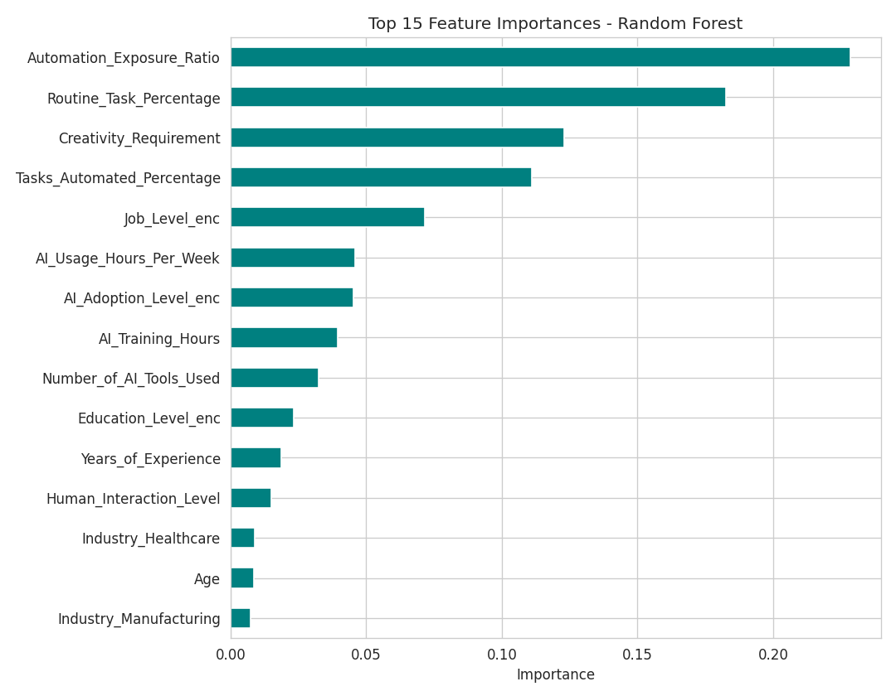
Top Risk Drivers
What the Random Forest model learned mattered most
1
Automation_Exposure_Ratio
Engineered feature — outperformed every raw column
2
Routine_Task_Percentage
Near-perfect risk gate on its own
3
Creativity_Requirement
Inversely related to risk
4
Tasks_Automated_Percentage
Direct automation exposure measure
5
Job_Level (encoded)
Seniority offers real protection

Slide 11
SQL Analysis Highlights
14 PostgreSQL queries — aggregation, CTEs, window functions
GROUP BY + Aggregation
Window Function — RANK()
Window Function — NTILE()
Industry-wise risk ranking
Top 3 riskiest roles per industry
Risk by automation quartile
Total employees, high-risk count and high-risk % per industry, sorted descending.
RANK() partitioned by industry surfaces the highest-risk job roles within each sector.
NTILE(4) splits employees into automation-exposure quartiles to test the risk gradient.
SELECT industry, ROUND(100.0*SUM(high_risk_flag)
/COUNT(*),2) AS high_risk_pct
FROM ai_job_risk GROUP BY industry
ORDER BY high_risk_pct DESC;
RANK() OVER (
PARTITION BY industry
ORDER BY high_risk_pct DESC
) AS risk_rank
NTILE(4) OVER (
ORDER BY tasks_automated_pct
) AS automation_quartile
Full query set also includes CTEs for risk-tier segmentation, HAVING filters, and multi-metric industry summary tables feeding directly into Power BI.

Slide 12

Power BI Dashboard
3 pages — connecting SQL aggregates and ML predictions into one report
01
02
03
Overview
Industry Deep-Dive
AI Adoption Analysis
KPI cards: employees, risk %, model accuracy
Risk split donut chart
Risk by industry bar chart
Matrix: riskiest roles per industry
Bubble chart: routine task % vs risk %
Risk by AI adoption level
Risk vs # of AI tools used
Predicted risk score gauge + tier table
The integration point: Page 3 surfaces each employee's out-of-sample Predicted_Risk_Score, generated by the Python model — not just descriptive BI, but BI fed by validated ML output.

Slide 13



Key Business Insights
What this analysis means in practice
Routine, low-creativity roles face dramatically higher risk
Risk climbs from 0.3% to 77% as Routine_Task_Percentage moves from low to high — the clearest single signal in the dataset.
Entry-level employees are the most exposed group
44.5% high-risk rate at Entry level vs 11.5% at Senior level — reskilling programs should prioritize this group first.
Correlation vs. causation, stated explicitly
Higher individual AI tool usage correlates with higher risk — likely because already-automatable roles adopt more AI tools, not because tool usage itself causes risk.

Slide 14
Limitations & Honest Reflection
What I'd tell an interviewer unprompted
01
02
03
Likely synthetic data
No temporal dimension
No company-level context
The near-perfect separability of risk classes suggests an explicit generation rule, not sampled real-world outcomes. Results show methodology rigor, not real-world predictive validity.
The dataset is a single snapshot — there's no way to show how risk trends change over time, or validate predictions against actual subsequent layoffs.
Missing financial data (revenue, real layoff history, restructuring events) that would be needed to validate findings against real organizational outcomes.
Naming these limitations unprompted is itself part of the deliverable — it signals analytical maturity, not weakness.

Slide 15


Skills Demonstrated
End-to-end pipeline
EDA & feature engineering
Python → SQL → Power BI, one consistent workflow
Domain-driven features that outperformed raw data
Rigorous validation
Business-focused SQL
Cross-validated, leakage-free model evaluation
Window functions, CTEs, real segmentation logic
Thank You
Questions welcome — happy to walk through any part of the code, queries, or dashboard live.
Vishal | github.com/Vishal123-tech

