Slide 1

Industrial Training
Android Oreo App
Development
Project Under:
Udemy
Project By:
Vishal Singh

Slide 2
Contents:
What is Android ?
Different versions in Android
About Android App Development ?
Introduction To Android Studio
Features Of Android Studio
A Simple Currency Converter App
About Advanced Android Features
Creating a Bluetooth App
Different Apps Created
About ARcore
About App Marketing

Slide 3

What is Android ?
Android is a mobile operating system based on a modified version of the Linux kernel and other open source software, designed primarily for touchscreen mobile devices such as smartphones and tablets. Android is developed by a consortium of developers known as the Open Handset Alliance and commercially sponsored by Google. It was unveiled in November 2007, with the first commercial Android device launched in September 2008.
It is free and open source software; its source code is known as Android Open Source Project (AOSP).
However the "Android" name and logo are trademarks of Google which impose standards to restrict "uncertified" devices outside their ecosystem to use Android branding.

Slide 4


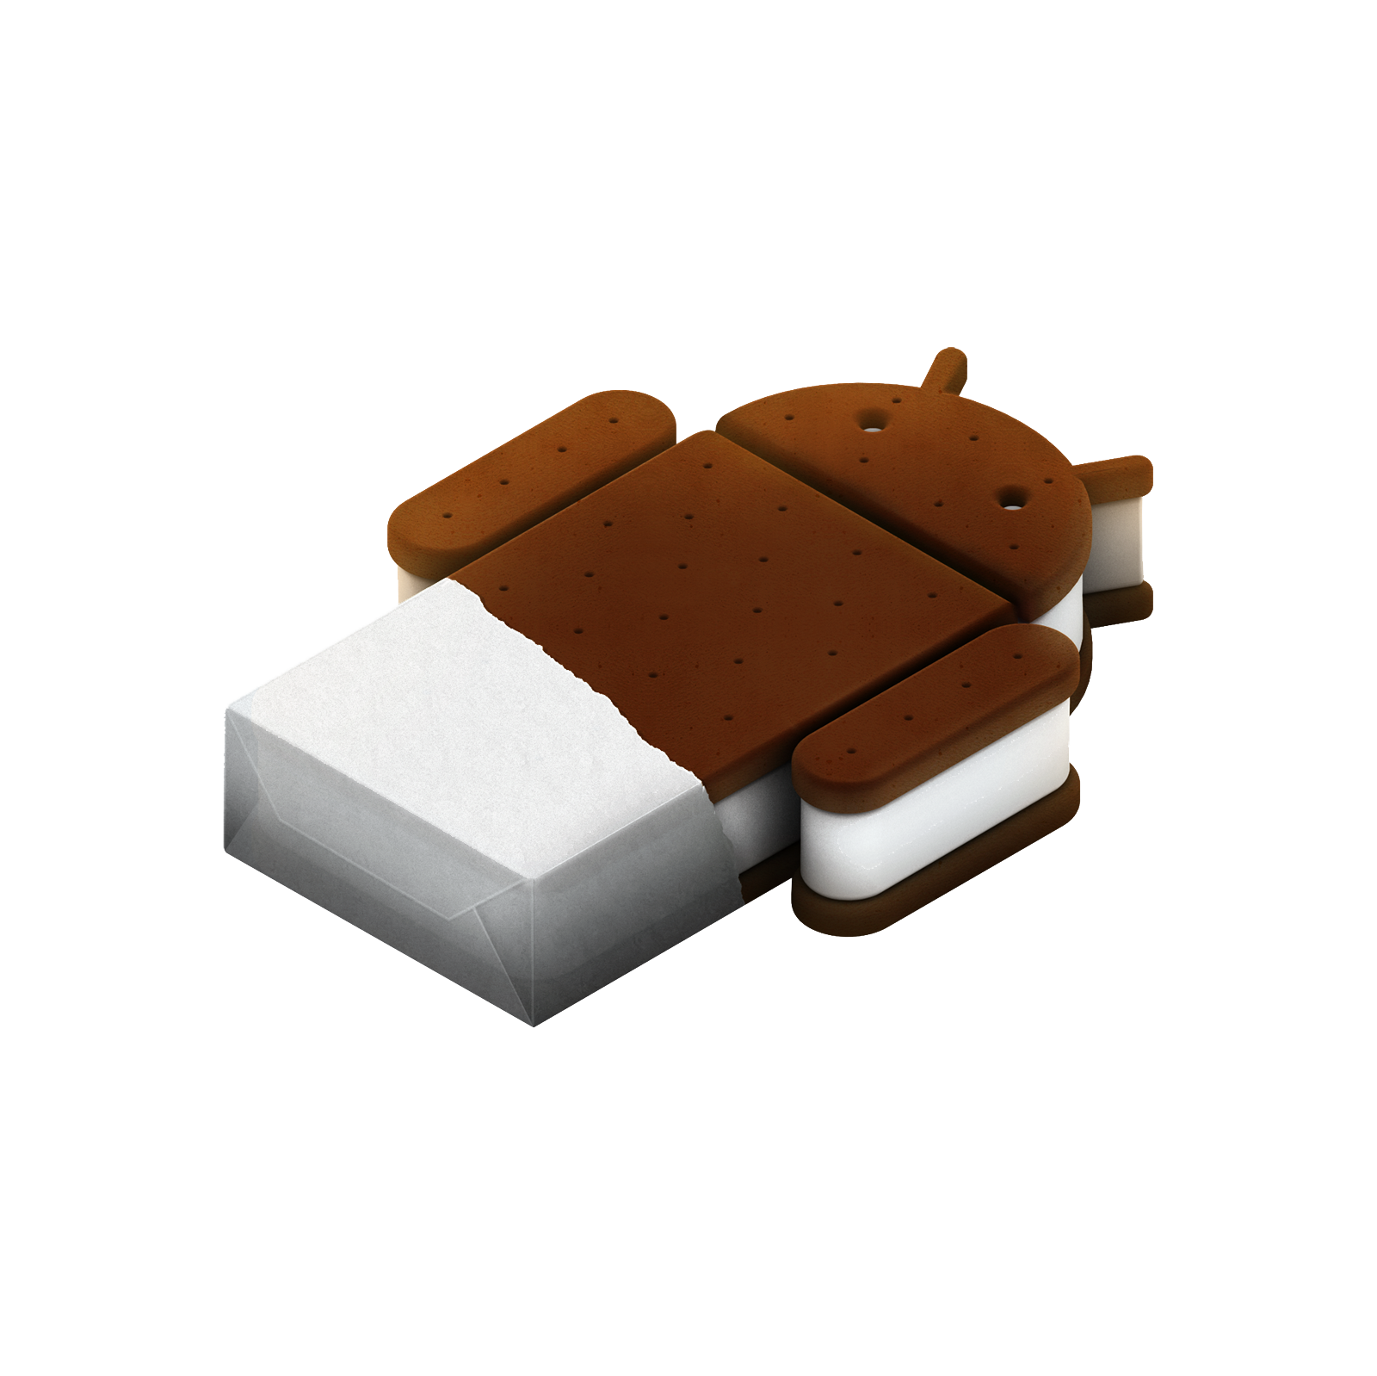
Versions of Android
Code name | Version Number | API Level | Release Date
No codename | 1.1 | 2 | February 9, 2009
Cupcake | 1.5 | 3 | April 27, 2009
Donut | 1.6 | 4 | September 15, 2009
Eclair | 2.0 - 2.1 | 5 - 7 | October 26, 2009
Froyo | 2.2 - 2.2.3 | 8 | May 20, 2010
Gingerbread | 2.3 - 2.3.7 | 9 - 10 | December 6, 2010
Honeycomb | 3.0 - 3.2.6 | 11 - 13 | February 22, 2011
Ice Cream Sandwich | 4.0 - 4.0.4 | 14 - 15 | October 18, 2011
Jelly Bean | 4.1 - 4.3.1 | 16 - 18 | July 9, 2012
KitKat | 4.4 - 4.4.4 | 19 - 20 | October 31, 2013
Lollipop | 5.0 - 5.1.1 | 21- 22 | November 12, 2014
Marshmallow | 6.0 - 6.0.1 | 23 | October 5, 2015
Nougat | 7.0 | 24 | August 22, 2016
Nougat | 7.1.0 - 7.1.2 | 25 | October 4, 2016
Oreo | 8.0 | 26 | August 21, 2017
Oreo | 8.1 | 27 | December 5, 2017
Pie | 9.0 | 28 | August 6, 2018
Android 10 | 10.0 | 29 | September 3, 2019

Slide 5
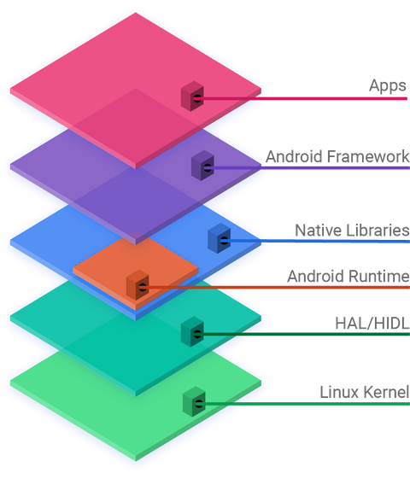
About Android App Development
Android software development is the process by which applications are created for devices running the Android operating system. Google states that "Android apps can be written using Kotlin, Java, and C++ languages" using the Android software development kit (SDK), while using other languages is also possible.
Enhancements to Android's SDK go hand-in-hand with the overall Android platform development. The SDK also supports older versions of the Android platform in case developers wish to target their applications at older devices. Development tools are downloadable components, so after one has downloaded the latest version and platform, older platforms and tools can also be downloaded for compatibility testing.

Slide 6

Introduction to Android Studio
Android Studio is the official^{[7]} integrated development environment (IDE) for Google's Android operating system, built on JetBrains' IntelliJ IDEA software and designed specifically for Android development. It is available for download on Windows, macOS and Linux based operating systems or as a subscription-based service in 2020. It is a replacement for the Eclipse Android Development Tools (E-ADT) as the primary IDE for native Android application development.
Android Studio was announced on May 16, 2013 at the Google I/O conference. It was in early access preview stage starting from version 0.1 in May 2013, then entered beta stage starting from version 0.8 which was released in June 2014. The first stable build was released in December 2014, starting from version 1.0

Slide 7
Features of Android studio
Gradle-based build support.
Android-specific refactoring and quick fixes.
Lint tools to catch performance, usability, version compatibility and other problems.
ProGuard integration and app-signing capabilities.
Template-based wizards to create common Android designs and components.
A rich layout editor that allows users to drag-and-drop UI components, option to preview layouts on multiple screen configurations.
Support for building Android Wear apps.
Built-in support for Google Cloud Platform, enabling integration with Firebase Cloud Messaging (Earlier 'Google Cloud Messaging') and Google App Engine.
Android Virtual Device (Emulator) to run and debug apps in the Android studio.

Slide 8
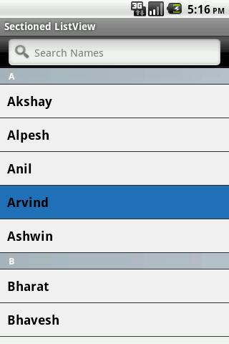
Advanced Android Features
List View:
Android ListView is a view which groups several items and display them in vertical scrollable list.
The list items are automatically inserted to the list using an Adapter that pulls content from a source such as an array or database.

Slide 9
How to construct an app in list view
Following is a small app view developed by me using Android Studio.
I will show u the code for the following program and the emulator view of the output.
Code for the Following App:
package com.example.myapplication1 import androidx.appcompat.app.AppCompatActivity import android.os.Bundle class MainActivity : AppCompatActivity() { @override protected void onCreate(Bundle savedInstanceState) { super.onCreate(savedInstanceState) setContentView(R.layout.activity_main); ListView myListView = findViewById(R.id.myListView); ArrayList<String> myFamily = new ArrayList<String>();
ArrayAdapter<String> arrayAdapter = new ArrayAdapter<String>( context: this, android.R.layout.simple_list_item_1, myFamily); myListView.setAdapter(arrayAdapter); } }
myFamily.add("Vishal"); myFamily.add("Harshit"); myFamily.add(“Ayush"); myFamily.add("Vansh");

Slide 10
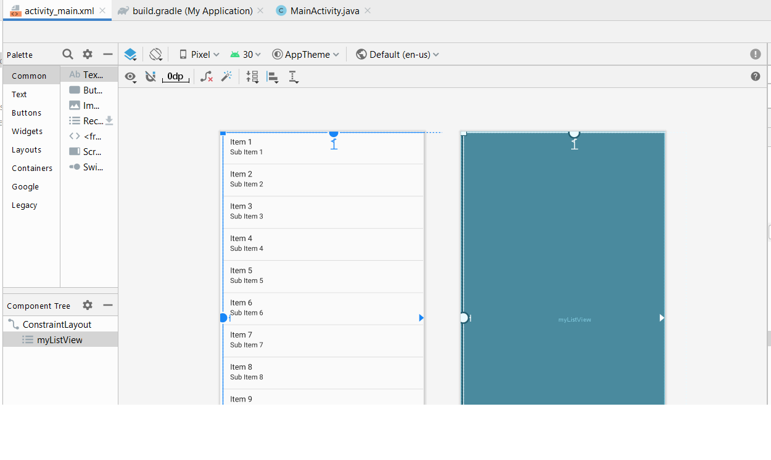
Before writing the code you need to create a ListView in the activity_main.xml which is your design editor of the app. It will help you to give a formalize shape and the place where u want
to set your layouts.
After setting up the ListView you need to set ID for the ListView and then set the constraints for the area.
Now you need to create the following above code in the MainActivity.java where u will add the contents in list. I added my family members name to be shown in the list.
After writing the code u need to run it through the emulator created earlier and then it will show you the Output screen on the emulator with the names of family member in ListView.

Slide 11
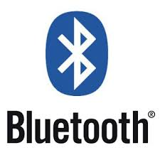
Bluetooth App
Bluetooth is a wireless technology standard used for exchanging data between fixed and mobile devices over short distances using short-wavelength UHF radio waves in the industrial, scientific and medical radio bands, from 2.402 GHz to 2.480 GHz, and building personal area networks (PANs).
Bluetooth technology proves the power of connection. More than 4 billion devices will ship this year using Bluetooth to connect — from phones to tablets to PCs and to each other.
More than just a radio technology, Bluetooth provides full stack, fit-for-purpose solutions to meet the ever-expanding needs for wireless connectivity.

Slide 12
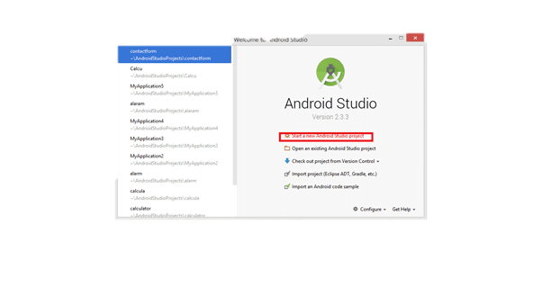
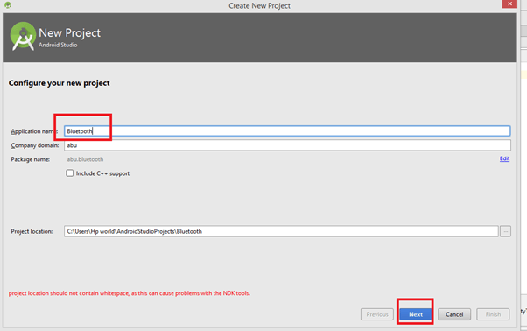
Creating Bluetooth App
Creating A Bluetooth device requires the latest version Of Android Studio. Here I used Android Studio 4.0 .
I started my project with the name Bluetooth Finder (you may give the name to your app as per your interest). So lets get started with this Bluetooth Finder.
You need First of all attach a physical android device so that you can check the functionality of your working Bluetooth device. I personally have my API 22: Android 5.1(Lollipop) where I checked the functionality of my app.

Slide 13
We will be start by setting a button which will be named as search that will help as to search for nearby devices available when pressed.
With this I there would be a TextView that will say the current state of what going on.
And then we will have a ListView.

Slide 14
Moving to our MainActivity.java for the coding purpose -
Following is the code for the :
package com.example.bluetoothfinder1; import androidx.appcompat.app.AppCompatActivity; import android.bluetooth.BluetoothAdapter; import android.bluetooth.BluetoothDevice; import android.content.BroadcastReceiver; import android.content.Context; import android.content.Intent; import android.content.IntentFilter; import android.os.Bundle; import android.util.Log; import android.view.View; import android.widget.Button; import android.widget.ListView; import android.widget.TextView; public class MainActivity extends AppCompatActivity { ListView listView; TextView statusTextView; Button searchButton; BluetoothAdapter bluetoothAdapter; private final BroadcastReceiver broadcastReceiver = new BroadcastReceiver() { @Override public void onReceive(Context context, Intent intent) { String action = intent.getAction(); Log.i( "Action", action); } };

Slide 15
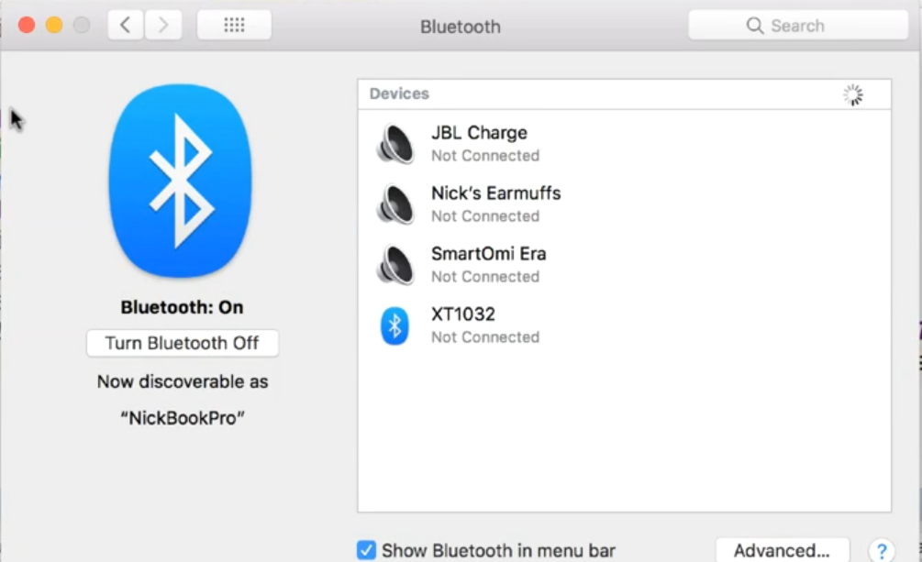
public void searchClicked(View view){ statusTextView.setText("Searching...."); searchButton.setEnabled(false); } @Override protected void onCreate(Bundle savedInstanceState) { super.onCreate(savedInstanceState); setContentView(R.layout.activity_main); listView = findViewById(R.id.listView); statusTextView = findViewById(R.id.statusTextView); searchButton = findViewById(R.id.searchButton); bluetoothAdapter = BluetoothAdapter.getDefaultAdapter(); IntentFilter intentFilter = new IntentFilter(); intentFilter.addAction(BluetoothAdapter.ACTION_STATE_CHANGED); intentFilter.addAction(BluetoothDevice.ACTION_FOUND); intentFilter.addAction(BluetoothAdapter.ACTION_DISCOVERY_STARTED); intentFilter.addAction(BluetoothAdapter.ACTION_DISCOVERY_FINISHED); registerReceiver(broadcastReceiver, intentFilter); bluetoothAdapter.startDiscovery(); } }

Slide 16
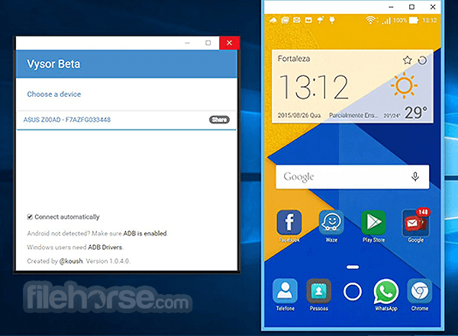
Throughout this whole process of developing the app I have gone through several new software that is Vysor and I used my own physical phone Oppo Af7 to run the app as an emulator.
Vysor :
1.7.3. Vysor is a Chrome App that helps you control your mobile device from your computer. Download the free app, connect your phone via USB, and start working your device from the PC! Simple design, easy to use, and available for everyone.

Slide 17
Different Apps Created
Throughout the whole course I went on to create different apps which include Super mario Clone , I created the clone of Twitter app and many more.
Super mario Clone:
This one is the simple game where I made a clownman who will jump while tapping on the screen and will collect coins and when he will jump on the Bomb “BOOM” Game over.
so under this I used different sprites of coin bomb all well as background sprite .
You need to first of all setup a GDX setup which comes under the libGDX
Which will be the main setup for our game.
Then I have used basic coding for jumping and coin collection and the splash and Game over result when the character get contact with the Bomb.

Slide 18
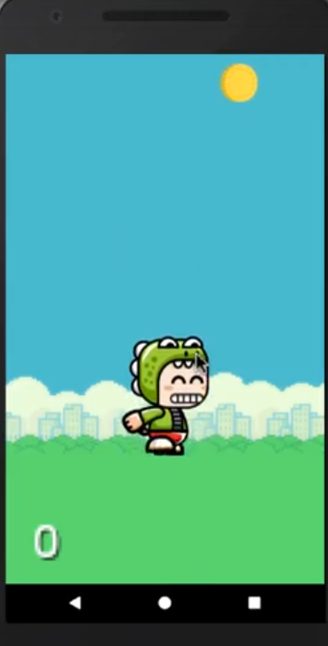
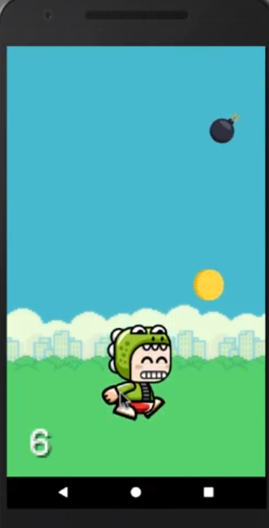
Here is some sort of images of the Game that run onto the Emulator.
Here at the corner I used some sort of points counter that keeps on increasing after the character collects the coin.

Slide 19
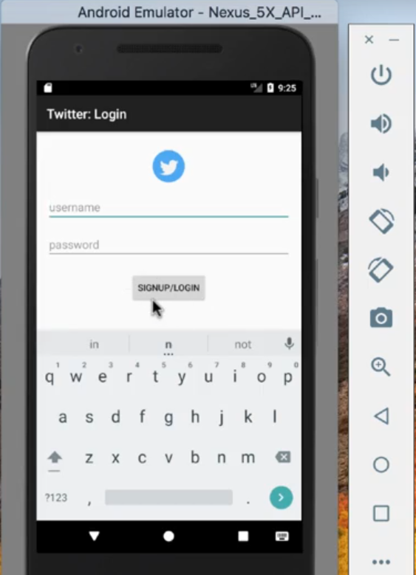
Twitter Clown:
As we All know Twitter is a 'microblogging' system that allows you to send and receive short posts called tweets. Tweets can be up to 140 characters long and can include links to relevant websites and resources.
Here I have tried to make a clown of twitter which will show you the User List with the feed and option to tweet.
Here there is a TextView and password field to
Create the following setup screen. If you type a wrong
Password it will simply show you and error pop and
Will ask to refill the username, password correctly.

Slide 20
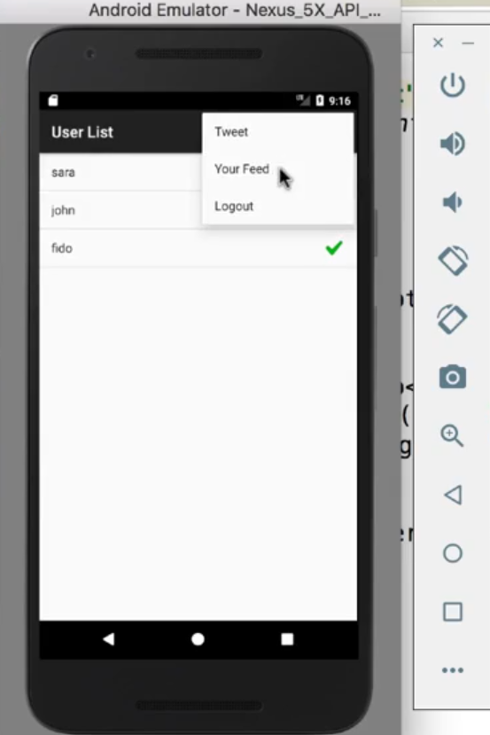
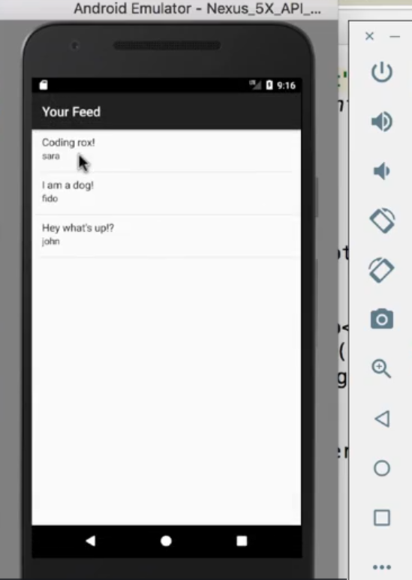
Through these two images I am trying to show you the emulator screen which
where you can observe the user List and the Feed. I put an option over the user list where user can tweet Check feed and can log out. These just a very small dive over the idea of how social networking sides gets idea of creation.

Slide 21
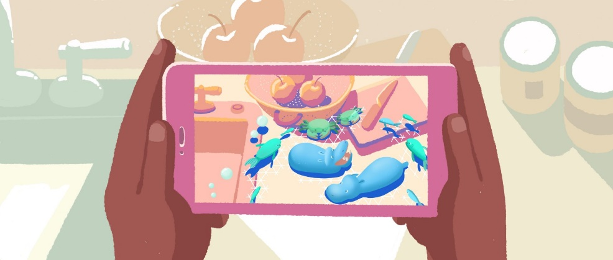
About ARcore
ARCore is Google’s platform for building augmented reality experiences. Using different APIs, ARCore enables your phone to sense its environment, understand the world and interact with information. Some of the APIs are available across Android and iOS to enable shared AR experiences.
ARCore uses three key capabilities to integrate virtual content with the real world as seen through your phone's camera:
Motion tracking allows the phone to understand and track its position relative to the world.
Environmental understanding allows the phone to detect the size and location of all type of surfaces: horizontal, vertical and angled surfaces like the ground, a coffee table or walls.
Light estimation allows the phone to estimate the environment's current lighting conditions.

Slide 22
About App Marketing
Imagine u spend all your time making of any useful App with cool features but no one hardly uses it just because lack of knowledge about the app. So App marketing is equally important as the App building.
Some of the Basics of App Marketing :
> Draw out entire app before ANYTHING.
> Whether you Building or Buying things for the App.
> Monetization for the App.
> Purchase
> Ads
> In-App Purchases
Tell a story with your App
Get Friends to test usability

Slide 23
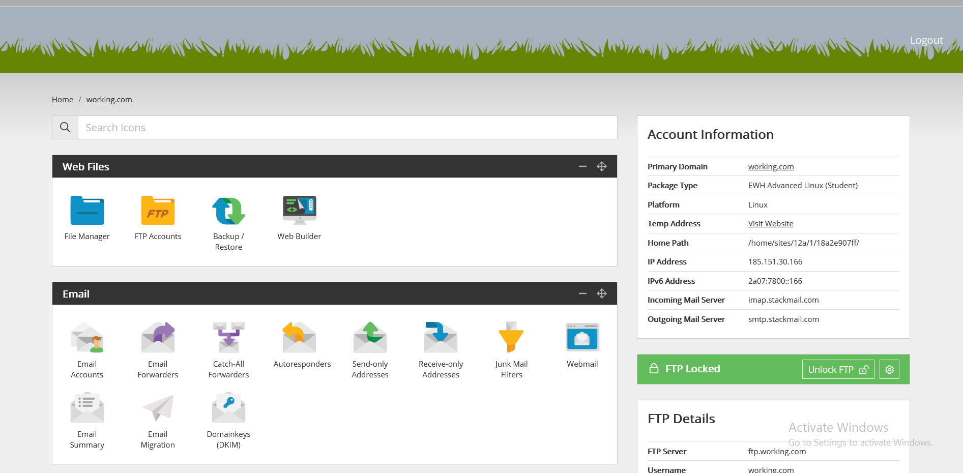
Setting A Website
Here we will set up a marketing website using Eco Web Hosting Account and WordPress.ORG which will help us designing without any knowledge of HTML or JAVA Script or any sort of coding.
First of all I created a account on Eco web Hosting which I got free with the my course.

Slide 24
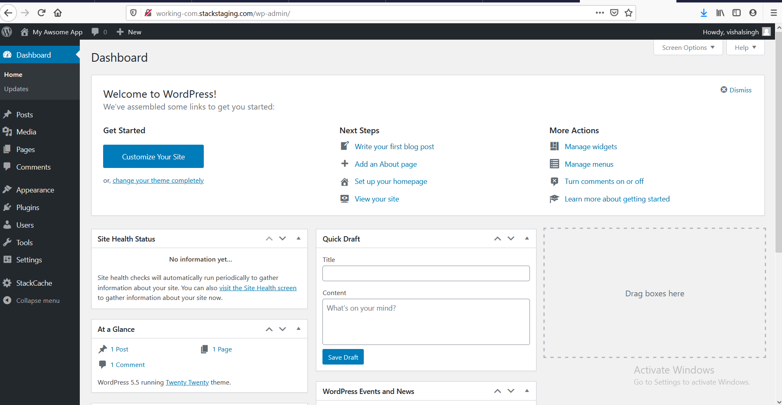
Then I need to create one Domain for it and then I signup for the stackstaging.com where I will be helped to edit my site.
Before going through the stackstaging.com we need to first of all install WordPress using the Eco web Control panel which will directly direct to the signup page for stackstaging.com where you can edit the web site for the main.
So here you can edit your web site as per your requirement.

Slide 25
THANK YOU

