Slide 1
AVL Trees

Slide 2
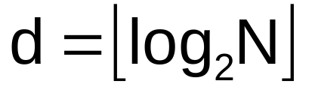
Binary Search Tree - Best Time
All BST operations are O(d), where d is tree depth
minimum d is for a binary tree with N nodes
  What is the best case tree?
  What is the worst case tree?
So, best case running time of BST operations is O(log N)

Slide 3
Binary Search Tree - Worst Time
Worst case running time is O(N)
  What happens when you Insert elements in ascending order?
    Insert: 2, 4, 6, 8, 10, 12 into an empty BST
  Problem: Lack of “balance”:
    compare depths of left and right subtree
  Unbalanced degenerate tree

Slide 4
Balanced and unbalanced BST
1
4
2
2
5
3
1
3
4
4
Is this “balanced”?
5
2
6
6
1
3
5
7
7

Slide 5
Approaches to balancing trees
Don't balance
  May end up with some nodes very deep
Strict balance
  The tree must always be balanced perfectly(might not be possible in many cases.)
Pretty good balance
  Only allow a little out of balance(gives O(log(n) as we’ll prove.)
Adjust on access
  Self-adjusting

Slide 6
Balancing Binary Search Trees
Many algorithms exist for keeping binary search trees balanced
  Adelson-Velskii and Landis (AVL) trees (height-balanced trees)
  Splay trees and other self-adjusting trees
  B-trees and other multiway search trees

Slide 7
Perfect Balance
Want a complete tree after every operation
  tree is full except possibly in the lower right
This is expensive
  For example, insert 2 in the tree on the left and then rebuild as a complete tree
6
5
Insert 2 &
complete tree
4
9
2
8
1
5
8
1
4
6
9

Slide 8
AVL - Good but not Perfect Balance
AVL trees are height-balanced binary search trees
Balance factor of a node
  height(left subtree) - height(right subtree)
An AVL tree has balance factor calculated at every node
  For every node, heights of left and right subtree can differ by no more than 1
  Store current heights in each node

Slide 9
Height of an AVL Tree
N(h) = minimum number of nodes in an AVL tree of height h.
Basis
  N(0) = 1, N(1) = 2
Induction
  N(h) = N(h-1) + N(h-2) + 1
Solution (recall Fibonacci analysis)
  N(h) > φ^{h} (φ ≈ 1.62)
h
h-2
h-1

Slide 10
Height of an AVL Tree
N(h) > φ^{h} (φ ≈ 1.62)
Suppose we have n nodes in an AVL tree of height h.
  n > N(h) (because N(h) was the minimum)
  n > φ^{h} hence log_{φ} n > h (relatively well balanced tree!!)
  h < 1.44 log₂n (i.e., Find takes O(logn))

Slide 11
Node Heights
Tree A (AVL)
Tree B (AVL)
height=2 BF=1-0=1
2
6
6
1
0
1
1
4
9
4
9
0
0
0
0
0
1
5
1
5
8
height of node = h
balance factor = h_{left}-h_{right}
empty height = -1

Slide 12
Node Heights after Insert 7
Tree A (AVL)
Tree B (not AVL)
2
3
balance factor
1-(-1) = 2
6
6
1
1
1
2
4
9
4
9
0
0
0
0
0
1
-1
1
5
7
1
5
8
0
7
height of node = h
balance factor = h_{left}-h_{right}
empty height = -1

Slide 13
Insert and Rotation in AVL Trees
Insert operation may cause balance factor to become 2 or –2 for some node
  only nodes on the path from insertion point to root node have possibly changed in height
  So after the Insert, go back up to the root node by node, updating heights
  If a new balance factor (the difference h_{left}-h_{right}) is 2 or –2, adjust tree by rotation around the node

Slide 14
Single Rotation in an AVL Tree
2
2
6
6
1
2
1
1
4
9
4
8
0
0
1
0
0
0
0
1
5
8
1
5
7
9
0
7

Slide 15
Insertions in AVL Trees
Let the node that needs rebalancing be α.
There are 4 cases:
Outside Cases (require single rotation) :
1. Insertion into left subtree of left child of α.
2. Insertion into right subtree of right child of α.
Inside Cases (require double rotation) :
3. Insertion into right subtree of left child of α.
4. Insertion into left subtree of right child of α.
The rebalancing is performed through four
separate rotation algorithms.

Slide 16
AVL Insertion: Outside Case
j
Consider a valid
AVL subtree
k
h
Z
h
h
X
Y

Slide 17
AVL Insertion: Outside Case
j
Inserting into X
destroys the AVL
property at node j
k
h
Z
h+1
h
Y
X

Slide 18
AVL Insertion: Outside Case
j
Do a “right rotation”
k
h
Z
h+1
h
Y
X

Slide 19
Single right rotation
j
Do a “right rotation”
k
h
Z
h+1
h
Y
X

Slide 20
Outside Case Completed
k
“Right rotation” done!
(“Left rotation” is mirror
symmetric)
j
h+1
h
h
X
Y
Z
AVL property has been restored!

Slide 21
AVL Insertion: Inside Case
j
Consider a valid
AVL subtree
k
h
Z
h
h
X
Y

Slide 22
AVL Insertion: Inside Case
Inserting into Y
destroys the
AVL property
at node j
j
Does “right rotation”
restore balance?
k
h
Z
h
h+1
X
Y

Slide 23
AVL Insertion: Inside Case
k
“Right rotation”
does not restore
balance… now k is
out of balance
j
h
X
h
h+1
Z
Y

Slide 24
AVL Insertion: Inside Case
Consider the structure
of subtree Y…
j
k
h
Z
h
h+1
X
Y

Slide 25
AVL Insertion: Inside Case
j
Y = node i and
subtrees V and W
k
h
Z
i
h
h+1
X
h or h-1
V
W

Slide 26
AVL Insertion: Inside Case
j
We will do a left-right
“double rotation” . . .
k
Z
i
X
V
W

Slide 27
Double rotation : first rotation
j
left rotation complete
i
Z
k
W
V
X

Slide 28
Double rotation : second rotation
j
Now do a right rotation
i
Z
k
W
V
X

Slide 29
Double rotation : second rotation
right rotation complete
Balance has been
restored
i
k
j
h
h
h or h-1
V
X
W
Z

Slide 30
Example of Insertions in an AVL Tree
2
20
Insert 5, 40
0
1
10
30
0
0
25
35

Slide 31
Example of Insertions in an AVL Tree
2
3
20
20
1
1
1
2
10
30
10
30
0
0
0
1
0
0
5
25
35
5
25
35
0
40
Now Insert 45

Slide 32
Single rotation (outside case)
3
3
20
20
1
2
1
2
10
30
10
30
0
0
2
0
0
5
25
35
5
25
40
1
0
0
35
45
1
40
Imbalance
0
45
Now Insert 34

Slide 33
Double rotation (inside case)
3
3
20
20
1
3
1
2
10
30
10
35
0
0
2
0
1
5
Imbalance
25
40
5
30
40
1
0
1
0
25
34
45
35
45
0
Insertion of 34
0
34

Slide 34
Deletion in BST
There are 3 cases.
Node to be deleted is a leaf-simply remove the node.
When node has only one child-attach the child to the parent.
When the node to be deleted has 2 children-

Slide 35
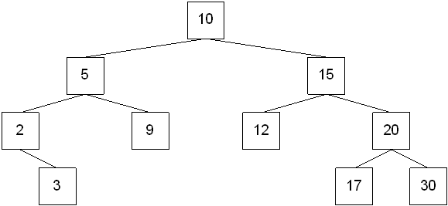
Delete 12

Slide 36
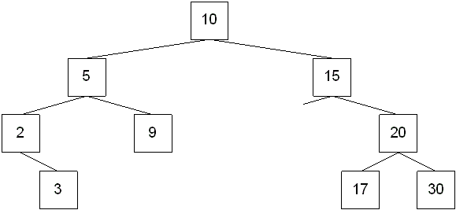
Delete 15

Slide 37
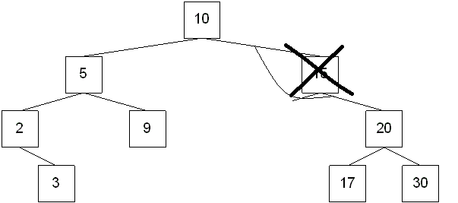

Slide 38

Delete 15

Slide 39
Copy the contents of inorder successor of the node and delete it.

Slide 41
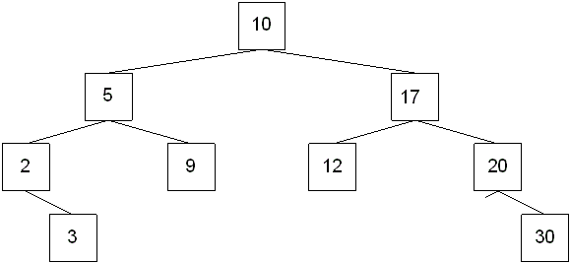

Slide 42
AVL Tree Deletion
Similar but more complex than insertion
  Rotations and double rotations needed to rebalance
  Imbalance may propagate upward so that many rotations may be needed.

Slide 43
Removing a node from an AVL tree may cause more than one AVL imbalance
  Like insert, delete must check after it has been successfully called on a child to see if it caused an imbalance
  Unfortunately, it may cause multiple imbalances that must be corrected
    Insertions will only cause one imbalance that must be fixed

Slide 44
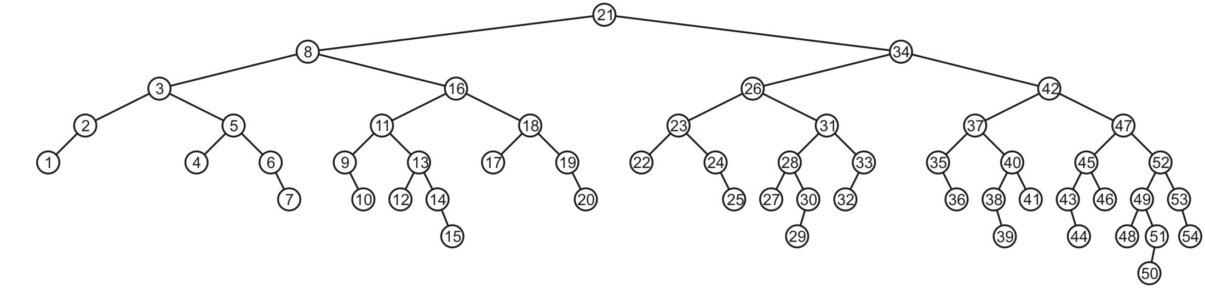
Deletion
Consider the following AVL tree

Slide 45
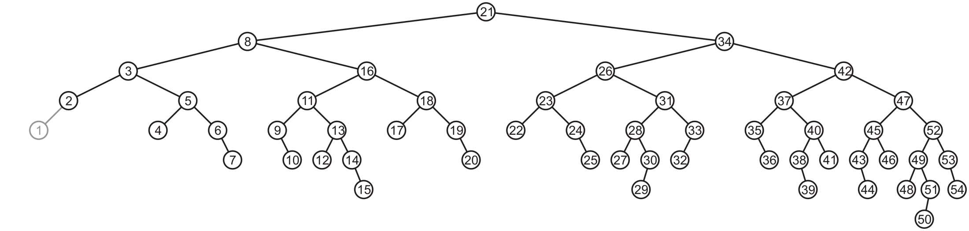
Suppose we delete the front node: 1

Slide 46
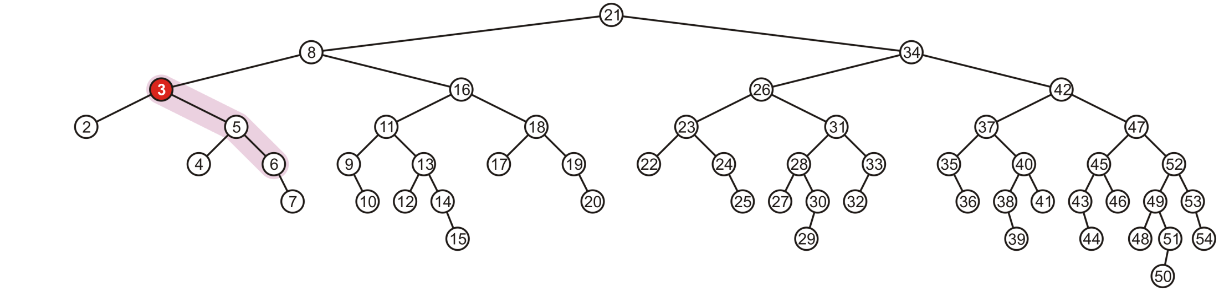
While its previous parent, 2, is not unbalanced, its grandparent 3 is
  The imbalance is in the right-right subtree

Slide 47
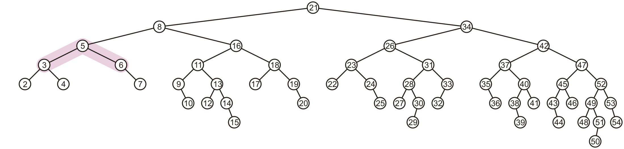
Erase
We can correct this with a simple balance

Slide 48
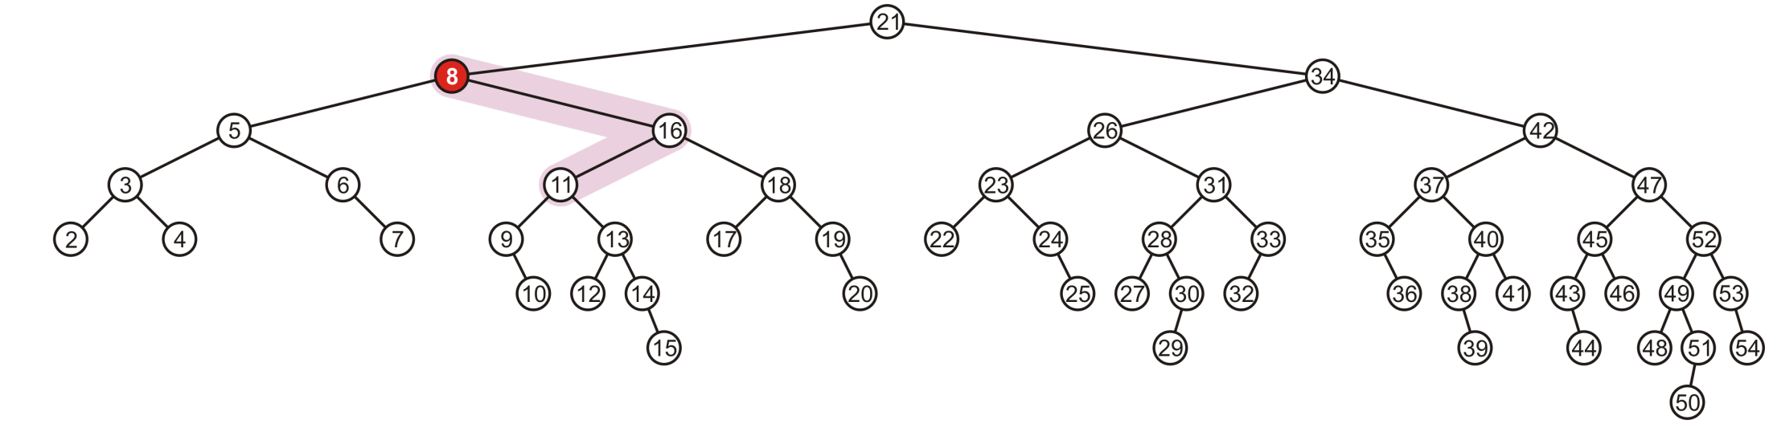
Erase
Recursing to the root, however, 8 is also unbalanced
  This is a right-left imbalance

Slide 49
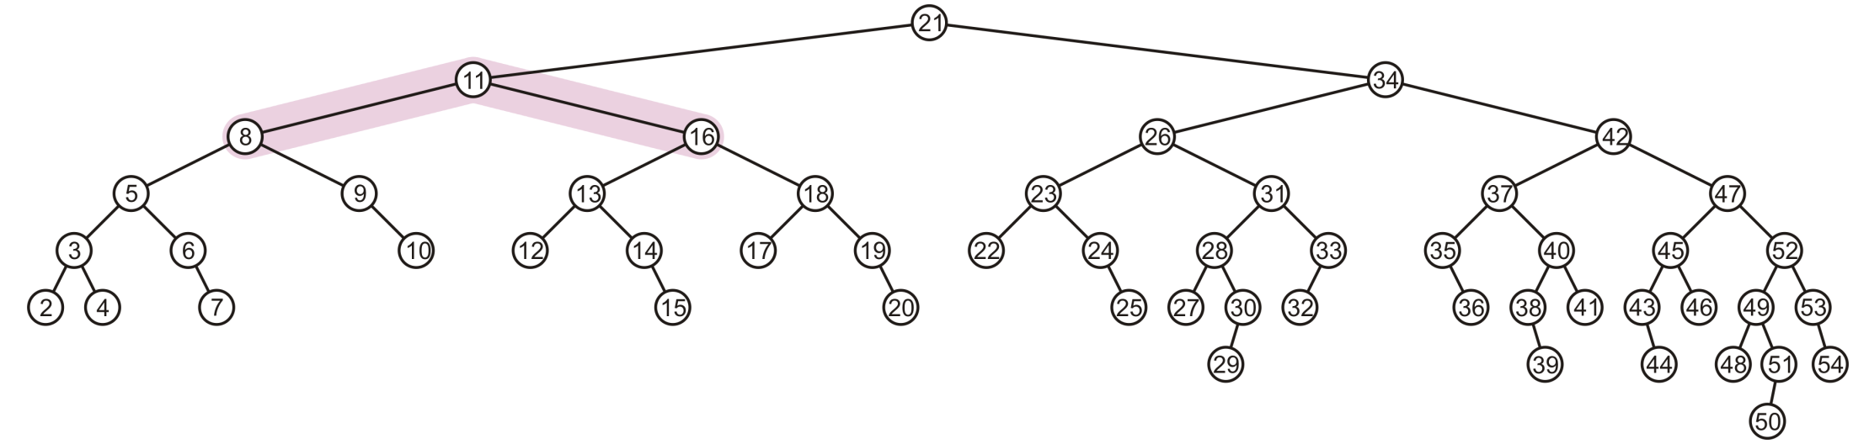
Erase
Promoting 11 to the root corrects the imbalance

Slide 50
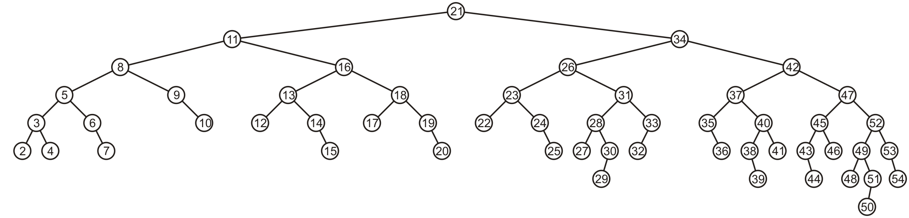
Erase
At this point, the node 11 is balanced

Slide 51
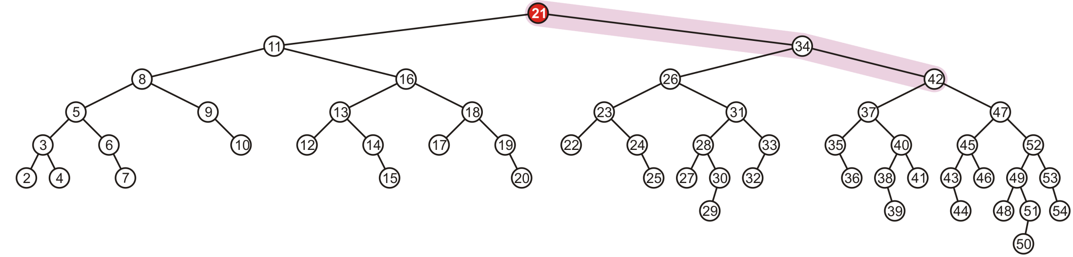
Erase
Still, the root node is unbalanced
  This is a right-right imbalance

Slide 52
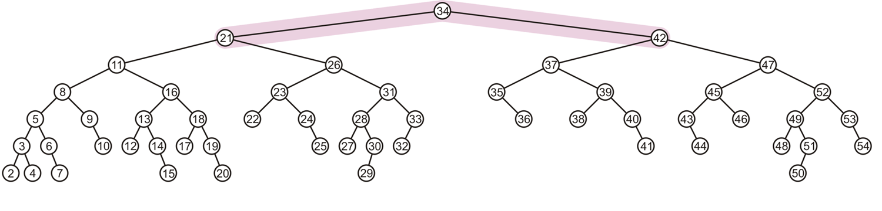
Erase
Again, a simple balance fixes the imbalance

Slide 53
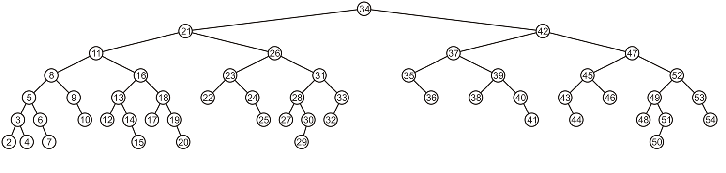
Erase
The resulting tree is now AVL balanced

