Slide 1
CODE-MANIAC
An Online Judge

Slide 2

What is an Online Judge?
System that can compile, execute and check the o/p with pre constructed data.
System will return the result as:
RTE
TLE
AC
WA

Slide 3
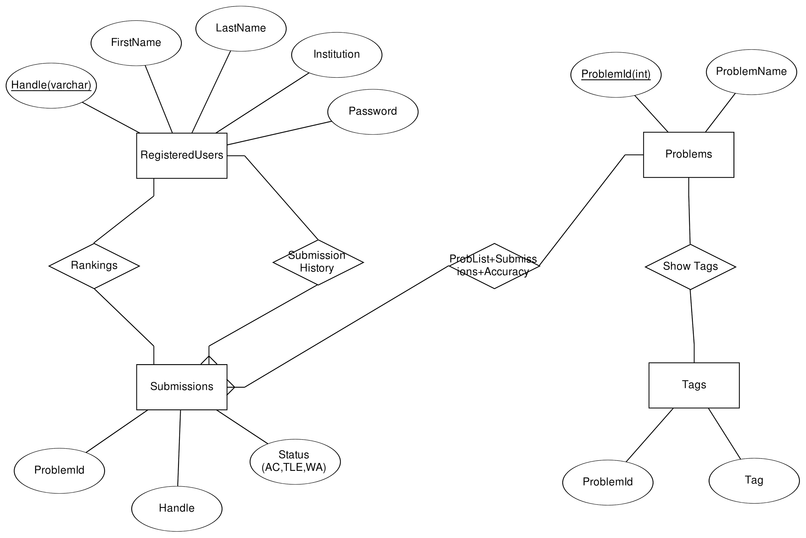
ER DIAGRAM

Slide 4
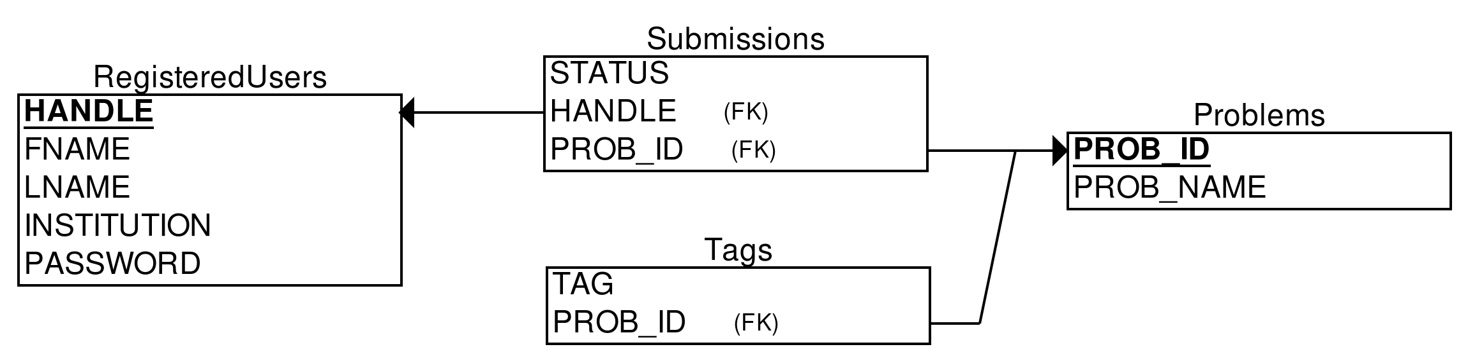
RELATIONAL SCHEMA

Slide 5


Why this platform?
Thousands of problems available
  Submissions
  Accuracy
  Easy, Medium, Hard
Maintains the submission history and statistics of each user:
  Bar Graph
    AC
    WA
    TLE

Slide 6
Why this platform?
Authority to customize the Problem Tags iff the user has already solved that problem.
  Beneficial for beginners as it provides the hint to the problem.
Ranklist
  On the basis of the highest number of successful submissions.

Slide 7
Benefits?
Enhances your computational thinking power.
Grip on Data Structure and Algorithms.
Preparation for IOI, ACM-ICPC.
Provides edge in job interviews.

Slide 8

Group Members
Vishal Anand Aashish Kumar
B16040 B16001
Yash Agrawal Aman Khandelwal
B16120 B16007

