Slide 1
FocusHuddle
Where group minds meet and merge to
focus, study, and grow – with AI guidance
24ECSW302
Minor Project Phase - 1 Review

Slide 2
Team Details
Team No. | C-06
Div: | C
Sl. No. | Name | SRN.
1 | Aditi Nikam | 02FE23BCS416
2 | Shruti Balekundri | 02FE23BCS425
3 | Amna Bijapuri | 02FE23BCS427
4 | Vishal Kadalagi | 02FE23BCS431
Guided by : Prof. Asharani Patil

Slide 3
Agenda
Introduction
Literature Survey
Motivation
Problem Statement
Objectives
Methodology

Slide 4

Introduction
The Virtual Study Room is an innovative digital platform that creates a focused and interactive environment for learners. It helps users minimize distractions by offering features such as personalized timers, task tracking, and virtual group study rooms. Whether studying alone or with friends, users can stay organized, motivated, and productive. The platform aims to replicate the feel of a physical study space—anytime, anywhere—making it easier to build consistent study habits and achieve learning goals.
Notes:
The Virtual Study Room is an innovative digital platform that creates a focused and interactive environment for learners. It helps users minimize distractions by offering features such as personalized timers, task tracking, and virtual group study rooms. Whether studying alone or with friends, users can stay organized, motivated, and productive. The platform aims to replicate the feel of a physical study space—anytime, anywhere—making it easier to build consistent study habits and achieve learning goals.

Slide 5
Literature Survey
Title | Authors | Methods | Advantages | Limitations
Digital Press Archives to Virtual Research Environments (2020) | Michael Hendrik, Valentin Werner | Literature + tech comparison | Boosts collaborative historical research and data access | Inconsistent archive quality, legal and technical access issues
New Possibilities: A Review on Online Study Rooms and Academic Performance (2021) | Zhiliang Yin | Literature review of academic and social factors from classic theories and modern OSR-related studies. | Improves motivation, peer learning, and self-efficacy. | Lacks real-world testing, outcomes vary across users.
A gameful blended-learning experience in nursing (2021) | Ropero-Padilla et al. | Focus groups with nursing students; thematic analysis | Improved engagement, teamwork, and motivation | Single institution, only student feedback
Usability Study of Study Room Reservation System (2022) | Yidan Gao | Surveys, system logs, focus groups, prototyping | User-centered design with validated prototype | Focused on 3 libraries; no homepage analysis
Notes:
the

Slide 6
Literature Survey
Title | Authors | Methods | Advantages | Limitations
Impact of Study With Me and Online Study Communities on Focus (2021) | Lina Jin (Elina) | Interviews with students | Reduces distractions, builds virtual discipline and support | Small-scale, based on subjective views
Paid Study Rooms in the Pandemic Economy – A Case in Nanjing (2021) | Dai Yining, Zhai Yufang, Shao Hongquan | Survey + case analysis | Enables focused space, encourages discipline during remote learning | High cost, unsustainable after pandemic
The Virtual Reading Room: Thinking Globally, Acting Locally (2023) | Donna McRostie, Lisa McIntosh | Pilot study + institutional collaboration | Remote access to rare collections, improved accessibility and engagement | Requires funding, copyright and privacy limitations
Notes:
the

Slide 7
Literature Survey
Title | Authors | Methods | Advantages | Limitations
How Users Use Group Study Rooms at UNC (2011) | Margaret Edwards | Surveys and observations | Highlights user behavior and tech integration | Small sample, observer influence, localized
New Group Study Room at JSU Library (2012) | Kayla Eassey | Informal feedback and staff interviews | Promotes collaboration with isolated, equipped space | Anecdotal and early-stage feedback, no formal study
Virtual Classroom as an Alternate Platform – A Case Study (2015) | Minimol Anil Job | Survey of 70 graduate students. | Easy access to learning, improved performance, time-saving. | Small sample, limited features, reliant on stable internet.
StudySphere – Web-Based Study Focus Application (2020) | Bhavana A. Khivsara et al. | System design with multiple modules | Combines focus timer, chat, and materials access in one platform | No user testing or performance analysis
Notes:
the

Slide 8

Motivation
Many students struggle to stay focused and consistent while studying at home. Distractions, isolation, and lack of accountability often lead to procrastination and reduced productivity.
We were inspired to build a virtual space where learners could feel motivated, supported, and productive—just like in a real study room. By combining focus tools, group study, and networking features, our platform aims to create a structured, social, and distraction-free learning environment—anytime, anywhere.

Slide 9

Problem Statement
Remote learning often leads to distractions, lack of motivation, and a sense of isolation for students. Despite various study tools available, none offer an integrated solution for maintaining focus, collaborating with peers, and tracking progress in a structured, engaging way. This results in decreased productivity and a fragmented study experience. There is a need for a platform that combines focused study sessions, real-time collaboration, and accountability to help students stay motivated and connected while studying remotely.

Slide 10
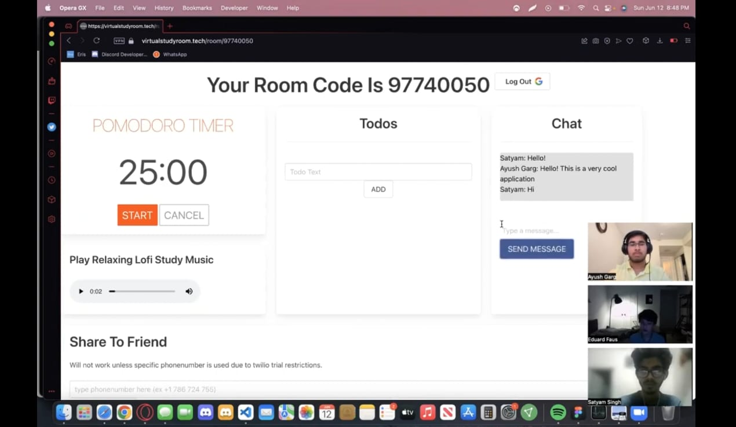
Problem Statement
Unlike existing platforms, our virtual study room features built-in AI chatbot integration for real-time academic support and collaboration.

Slide 11
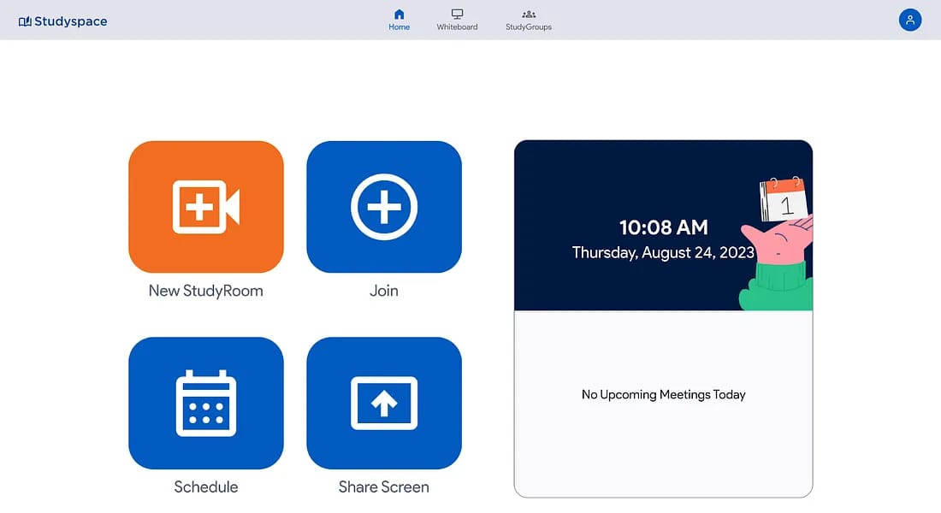
Problem Statement
Our system features a real-time code editor where students can collaboratively write and edit code together.

Slide 12
Objectives
To develop a virtual study environment that enables structured study sessions and minimizes distractions through time-based controls.
To integrate an AI-powered chatbot that provides real-time academic support, including answering queries, summarizing content.
To implement an intelligent focus control system that automatically redirects users back to their designated study websites after breaks.
Notes:
To develop a virtual study environment that enables structured study sessions and minimizes distractions through time-based controls.
To integrate an AI-powered chatbot that provides real-time academic support, including answering queries, summarizing content, and generating quizzes.
To design a personalized study assistant module that manages reminders, tracks progress, and provides tailored feedback based on user activity.
To implement an intelligent focus control mechanism that monitors user activity and redirects them to designated study platforms after scheduled breaks.

Slide 13
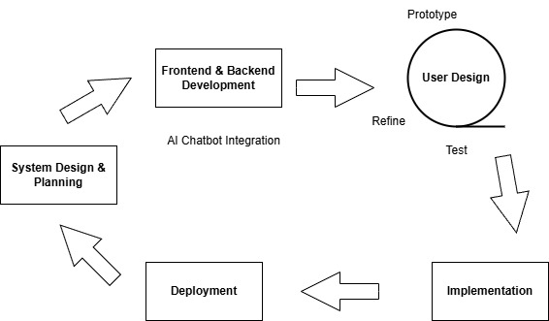
Methodology

Slide 14
Methodology
1. System Design & Planning:
Modules: Study session manager, AI chatbot, user dashboard,
progress tracker.
Tech used: Figma for UI/UX mockups Trello for planning and
task management.
Frontend Development: Build a responsive UI for the virtual
study room with features like timers, task lists, and chat
interface.
Tech used: React.js, Tailwind CSS for sleek styling. Socket.IO
for live interaction between users is planned.

Slide 15
Methodology
3. Backend Development:
Set up APIs for authentication, study data storage, chatbot
communication, and usage analytics.
Tech used: Node.js + Express.js for backend server. Firebase
Firestore for cloud database, JWT for secure authentication.
4. AI Chatbot Integration:
Incorporate an AI chatbot to assist users with subject
questions, reminders, and motivation.
Tech used: OpenAI GPT-4 API for natural language
understanding and response.

Slide 16
Methodology
5. Real-Time Features:
Enable real-time notifications, live progress updates, or user
interaction.
Tech used: Firebase Realtime Database or Socket.IO for real-
time updates.
6. User Personalization and Analytics:
Track user study habits, session lengths, and chatbot queries.
Tech used: Google Analytics for usage tracking. Chart.js for
data visualization in the dashboard AI/ML model (basic) to
adapt chatbot tone or suggest study plans.

Slide 17
Methodology
7. Testing & Deployment: Perform unit, integration, and user
testing before deploying the application.
Tech used: Selenium for testing. Firebase Hosting for
deployment.

Slide 18
References
Page, S. F. (2012). New group-study room has students excited.
Job, M. A. (2014). Virtual class Room as an alternate platform–a case study of the use of Web-Ex Live teach and learn in the synchronous online environment.
CHANDWAD, S. K. C. StudySphere-Web Based Study Focus Application.
Sharma, M. (2021). Virtual reality world and education: virtual classes and research rooms in respect to academic performance and social development. Ilkogretim Online, 20(3).
Usability Study of Study Room Reservation System (2021)
Ropero-Padilla, C., Rodriguez-Arrastia, M., Martinez-Ortigosa, A., Salas-Medina, P., Ayora, A. F., & Roman, P. (2021). A gameful blended-learning experience in nursing: A qualitative focus group study. Nurse education today, 106, 105109.

Slide 19
Thank You!

