Slide 1
LEARN DEPTH ACADEMY LLP – TRACK 1 CAPSTONE
Industrial Machine Failure Prediction
Predictive Maintenance Classification Using Foundational Machine Learning
STUDENT NAME : VISHAL R R
STUDENT ID : LD-1786548325208
DEPT : B.E COMPUTER SCIENCE AND ENGINEERING
COLLEGE : ERODE SENGUNTHAR ENGINEERING COLLEGE

Slide 2
INDUSTRIAL SYSTEMS | TRACK 1 FINAL CAPSTONE
02. Official Problem Statement
Assigned Problem Statement (Problem 21)
• Primary Goal: Predict whether an industrial milling machine is likely to experience an operational breakdown within a defined operating window.
• Operational Scope: Zero-cost, foundational machine learning solution for educational prototype demonstration and viva defense.
• Target Output: Binary classification (0: No Machine Failure, 1: Machine Failure).
Key Operational Challenges
• Severe Class Imbalance: Machine failures constitute only 3.39% of operating records (96.61% nominal). Accuracy alone is misleading.
• Asymmetric Misclassification Costs: False Negatives (unpredicted breakdowns) cause severe downtime and mechanical damage, whereas False Positives only incur minor inspection costs.
• Data Leakage Risks: Post-failure failure mode flags (TWF, HDF, PWF, OSF, RNF) must be strictly isolated from predictive features.

Slide 3
INDUSTRIAL SYSTEMS | TRACK 1 FINAL CAPSTONE
03. Background & Industrial Context
Evolution of Maintenance Paradigms
• Run-to-Failure (Reactive): Fix equipment only after breakdown. Highest downtime and catastrophic damage costs.
• Preventative Maintenance (Time-based): Perform scheduled service regardless of condition. Wastes tool life and incurs unnecessary servicing.
• Predictive Maintenance (Condition-based): Continuous telemetry monitoring to forecast failures just before they manifest.
• Industry 4.0 Integration: Enables automated sensor analysis to optimize spindle utilization, tool replacement intervals, and worker safety.
The AI4I Milling Machine Setting
• Dataset reflects real industrial CNC milling machining environments synthesized from 10,000 tool operations.
• Continuous Telemetry: Tracks ambient and process temperatures, spindle rotational speeds, torque loads, and cutting wear.
• Multiple Failure Mechanisms: Tool wear failure (TWF), heat dissipation failure (HDF), power overload (PWF), and overstrain (OSF).
• Foundational ML Imperative: Interpretable algorithms preferred for regulatory safety and operator trust.

Slide 4
INDUSTRIAL SYSTEMS | TRACK 1 FINAL CAPSTONE
04. Motivation & Justification
Why Predictive Maintenance via Machine Learning?
• Economic Value: Unscheduled manufacturing downtime costs industrial facilities millions of dollars annually in lost throughput.
• Zero-Cost Academic Realization: Demonstrates that foundational, open-source algorithms can deliver industrial-grade predictive alerts without expensive commercial platforms.
• Safety & Quality Assurance: Tool wear and torque overstrain can cause cutter breakage, damaging workpieces and endangering shop-floor machinists.
• Explainable Decision Boundaries: Highlighting critical parameters (e.g., torque exceeding 60 Nm or tool wear past 200 min) allows maintenance personnel to take direct corrective mechanical actions.

Slide 5
INDUSTRIAL SYSTEMS | TRACK 1 FINAL CAPSTONE
05. Project Objectives
Core Technical Objectives
• 1. Ingest & Audit Data: Perform end-to-end quality audit on 10,000 records (verify missing values and duplicates).
• 2. Formulate Leakage-Free Pipeline: Strict isolation of post-failure flags and identifiers.
• 3. Foundational ML Benchmarking: Train and evaluate Logistic Regression, KNN, and Decision Tree.
• 4. False Negative Minimization: Prioritize Recall and F1-score over raw accuracy.
Demonstration & Delivery Objectives
• 5. Model Persistence: Serialize fitted ColumnTransformer and champion classifier using joblib.
• 6. Interactive Web Application: Build lightweight Streamlit diagnostic dashboard with input validation.
• 7. Verification & Testing: Execute 8 rigorous operational test cases spanning nominal, overload, boundary, and invalid telemetry.
• 8. Full Academic Package: Deliver DOCX technical report, PDF, slide deck, reproducible notebook, and viva preparation.

Slide 6
INDUSTRIAL SYSTEMS | TRACK 1 FINAL CAPSTONE
06. Related Work & Literature Review
Foundational Research & Industry Standards
• Matzka (2020) - AI4I 2020 Predictive Maintenance Dataset (UCI Repository, DOI: 10.24432/C5HS5C): Established benchmark dataset capturing multi-physics milling dynamics.
• Mobley (2002) - An Introduction to Predictive Maintenance: Established condition monitoring principles for vibration, lubrication, and mechanical stress.
• Bousdekis et al. (2021) - Predictive Maintenance in the Fourth Industrial Revolution: Survey of classification models emphasizing the priority of minimizing False Negatives in industrial plants.
• Jardine et al. (2006) - Machine Diagnostics and Prognostics Review: Emphasized that interpretable tree-based and parametric models are critical for industrial adoption over black-box methods.

Slide 7
INDUSTRIAL SYSTEMS | TRACK 1 FINAL CAPSTONE
07. Proposed Solution Architecture
End-to-End Predictive Maintenance Framework
• Ingestion & Audit: Load raw UCI AI4I 2020 dataset and verify 100% data integrity (0 nulls, 0 duplicates).
• Leakage Barrier: Isolate identifiers (UDI, Product ID) and 5 failure mode labels (TWF, HDF, PWF, OSF, RNF).
• Pipeline Preprocessing: StandardScaler fitted strictly on 80% training split; OneHotEncoder for Machine Variant Type.
• Foundational Classifiers: Benchmarked Logistic Regression (balanced), KNN (k=5), and Decision Tree (depth=6, balanced).
• Diagnostic Serving: Streamlit interactive interface providing probability scoring, risk categorizations, and operator alerts.

Slide 8
INDUSTRIAL SYSTEMS | TRACK 1 FINAL CAPSTONE
08. System Architecture & Flowchart
System Architecture and Data Pipeline Flow
AI4I 2020 Raw Dataset (10,000 records, 14 attributes)
├── Data Quality Audit: Verification of 0 missing values & 0 duplicate records
├── Leakage Prevention Barrier: Exclude UDI, Product ID, TWF, HDF, PWF, OSF, RNF
├── Stratified Train/Test Split (80% Train: 8,000 / 20% Test: 2,000 | Stratify = y)
├── ColumnTransformer Pipeline: StandardScaler (Continuous) + OneHotEncoder (Type)
├── Foundational ML Training: Logistic Regression | K-Nearest Neighbors | Decision Tree
├── Comprehensive Evaluation: Accuracy, Precision, Recall, F1-score, ROC-AUC, Confusion Matrix
├── Champion Model Selection: Decision Tree (Recall: 83.82%, F1: 0.4730, FN: 11 / 68)
├── Artifact Serialization: joblib.dump(model) & joblib.dump(pipeline)
└── Streamlit Web Application: Real-time UI Telemetry Input -> Pipeline Inference -> Diagnostic Risk Alert

Slide 9
INDUSTRIAL SYSTEMS | TRACK 1 FINAL CAPSTONE
09. Dataset Characteristics (UCI AI4I 2020)
Dataset Statistics & Properties
• Total Observations: 10,000 records
• Features: 14 total columns (6 predictive, 7 excluded/target)
• Target: 'Machine failure' (Binary 0 or 1)
• Class 0 (Nominal Operation): 9,661 (96.61%)
• Class 1 (Machine Failure): 339 (3.39%)
• Missing Values: 0 across all features
• Duplicate Rows: 0 duplicate entries
• Machine Types: L (Low, 6,000), M (Medium, 2,997), H (High, 1,003)
Sensor vs Capstone Input Mapping
• Generic Capstone Requirement vs Real Dataset:
• • Temperature: Real fields = Air temperature [K] (295.3 - 304.5 K) & Process temperature [K] (305.7 - 313.8 K).
• • Vibration & Pressure: Real fields = Torque [Nm] (3.8 - 76.6 Nm) & Rotational speed [rpm] (1,168 - 2,886 rpm). Dynamic spindle loads directly manifest as torque reaction and speed fluctuation.
• • Runtime & Maintenance: Real field = Tool wear [min] (0 - 253 min) cumulative cutter usage.
• • Rule of Integrity: Actual UCI column names preserved without synthetic fabrication.

Slide 10
INDUSTRIAL SYSTEMS | TRACK 1 FINAL CAPSTONE
10. Data Preprocessing & ColumnTransformer
Reproducible Machine Learning Pipeline
• Data Ingestion: Clean ingestion from dataset/ai4i2020.csv with type enforcement.
• Categorical Feature Encoding: OneHotEncoder(drop='first', sparse_output=False) applied to machine 'Type' (L, M, H), yielding binary dummy indicators.
• Numerical Feature Scaling: StandardScaler() applied to continuous variables (Air Temp, Process Temp, Rotational Speed, Torque, Tool Wear) to normalize zero mean and unit variance.
• Strict Leakage Prevention: ColumnTransformer fitted exclusively on the 80% training partition (X_train). Test set (X_test) and Streamlit production inputs transformed using pre-fitted parameters.
• Pipeline Serialization: Saved to model/preprocessing_pipeline.pkl for seamless integration.

Slide 11
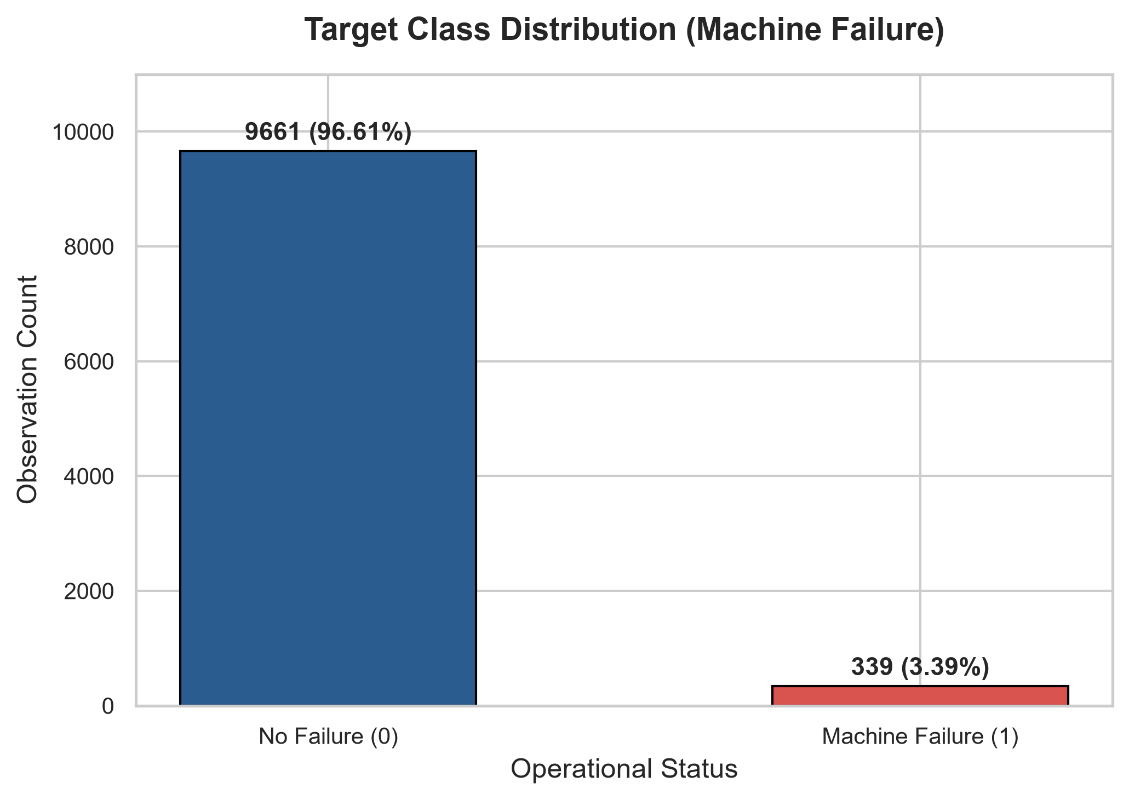
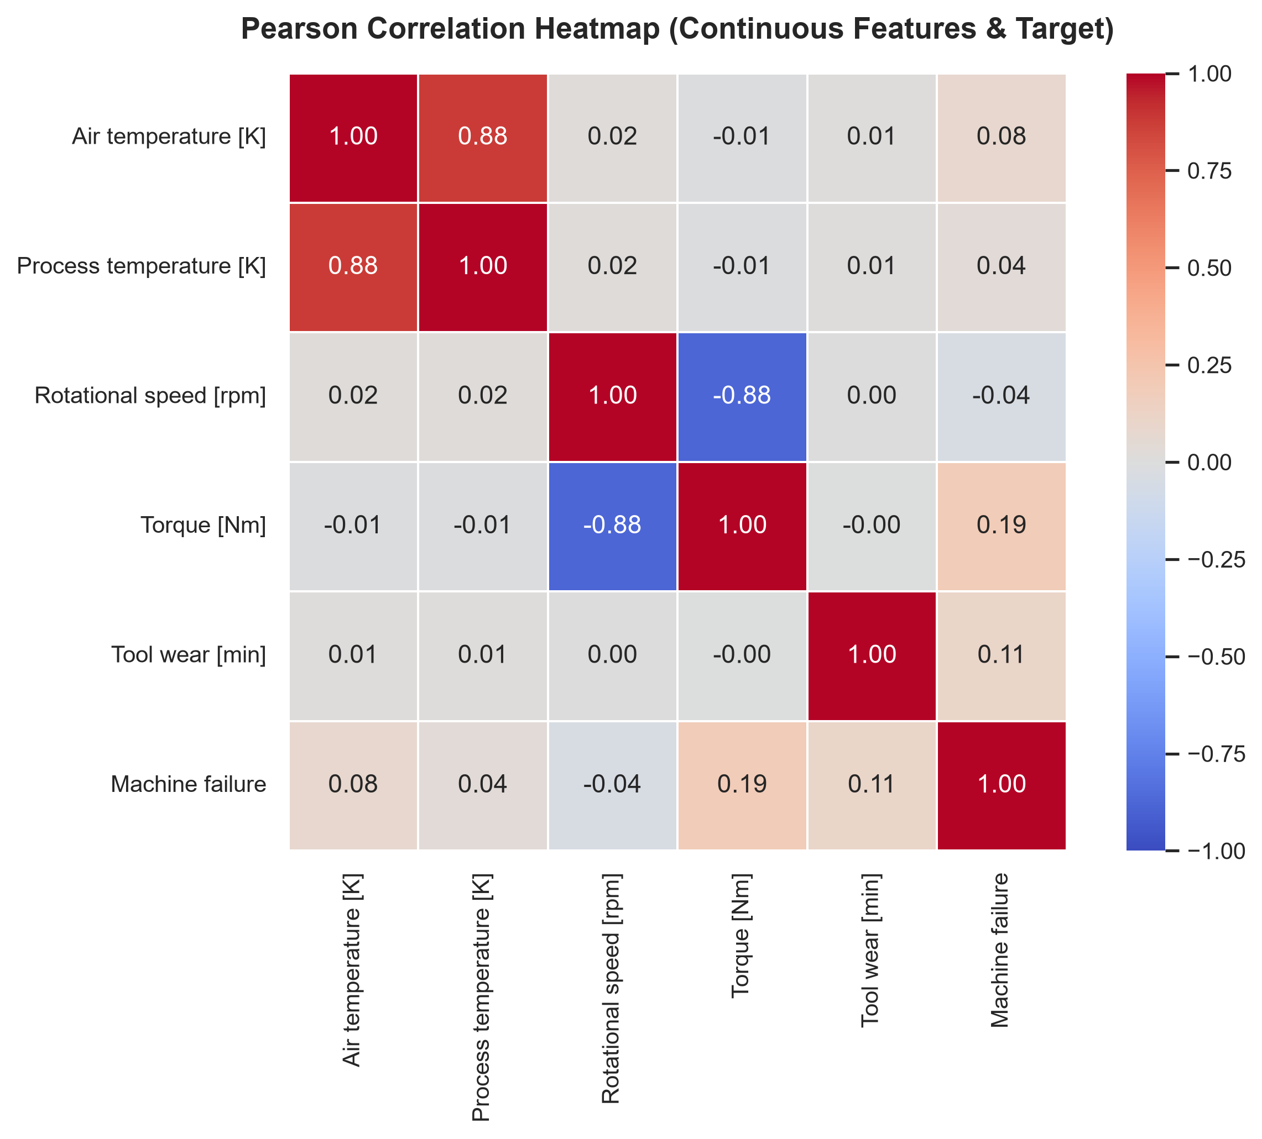
INDUSTRIAL SYSTEMS | TRACK 1 FINAL CAPSTONE
11. Exploratory Data Analysis (EDA)

Slide 12
INDUSTRIAL SYSTEMS | TRACK 1 FINAL CAPSTONE
12. Feature Selection & Data Leakage Prevention
Excluded Features (Leakage Barrier)
• UDI: Arbitrary row index (1 to 10,000). Must be excluded to prevent spurious ordering correlation.
• Product ID: String variant identifier containing serial numbers. Excluded to prevent high-cardinality memorization.
• TWF, HDF, PWF, OSF, RNF: Failure mode classifications. These are post-failure flags that directly constitute machine failure. Including them would yield 100% artificial target leakage.
Retained Predictive Feature Set
• 1. Type: Quality grade (L=60%, M=30%, H=10%).
• 2. Air temperature [K]: Ambient operational temperature.
• 3. Process temperature [K]: Cutting zone temperature.
• 4. Rotational speed [rpm]: Spindle kinetic rate.
• 5. Torque [Nm]: Cutting resistance torque.
• 6. Tool wear [min]: Cumulative cutter contact wear.
• Rationale: Represents physically accessible sensor telemetry prior to breakdown.

Slide 13
INDUSTRIAL SYSTEMS | TRACK 1 FINAL CAPSTONE
13. Foundational Machine Learning Models
1. Logistic Regression
• Concept: Linear boundary estimating log-odds of failure.
• Hyperparameters: class_weight='balanced', max_iter=1000, solver='lbfgs'.
• Pros: Rapid, probabilistic, highly interpretable coefficients.
• Cons: Struggles with non-linear multi-sensor interaction boundaries.
2. K-Nearest Neighbors (KNN)
• Concept: Instance-based classification matching k=5 closest sensor profiles.
• Hyperparameters: n_neighbors=5, metric='minkowski' (Euclidean).
• Pros: Non-parametric, requires no assumptions on data distribution.
• Cons: Sensitive to imbalance; unweighted KNN severely misses minority failure class.
3. Decision Tree
• Concept: Hierarchical orthogonal rule-based splitting.
• Hyperparameters: max_depth=6, min_samples_leaf=5, class_weight='balanced'.
• Pros: Captures non-linear thresholds (e.g. Torque > 60 Nm & Tool Wear > 200 min), robust to collinearity.
• Cons: Risk of overfitting if unconstrained (mitigated by max_depth=6).

Slide 14
INDUSTRIAL SYSTEMS | TRACK 1 FINAL CAPSTONE
14. Evaluation Metrics for Predictive Maintenance
Metric Suitability in Highly Imbalanced Scenarios
• Accuracy = (TP + TN) / Total: Flawed metric for rare events. Predicting always 'No Failure' gives 96.61% accuracy but detects 0 failures.
• Recall (Sensitivity) = TP / (TP + FN): THE MOST CRITICAL INDUSTRIAL METRIC. Measures the percentage of actual failures correctly identified. High recall ensures minimal missed breakdowns.
• Precision = TP / (TP + FP): Proportion of predicted alarms that are genuine failures. Lower precision creates false alarms (routine inspections) which are acceptable in maintenance.
• F1-Score = 2 * (Precision * Recall) / (Precision + Recall): Harmonic balance between sensitivity and alarm precision.
• ROC-AUC: Evaluates discrimination capability across all classification thresholds independent of base rate.

Slide 15
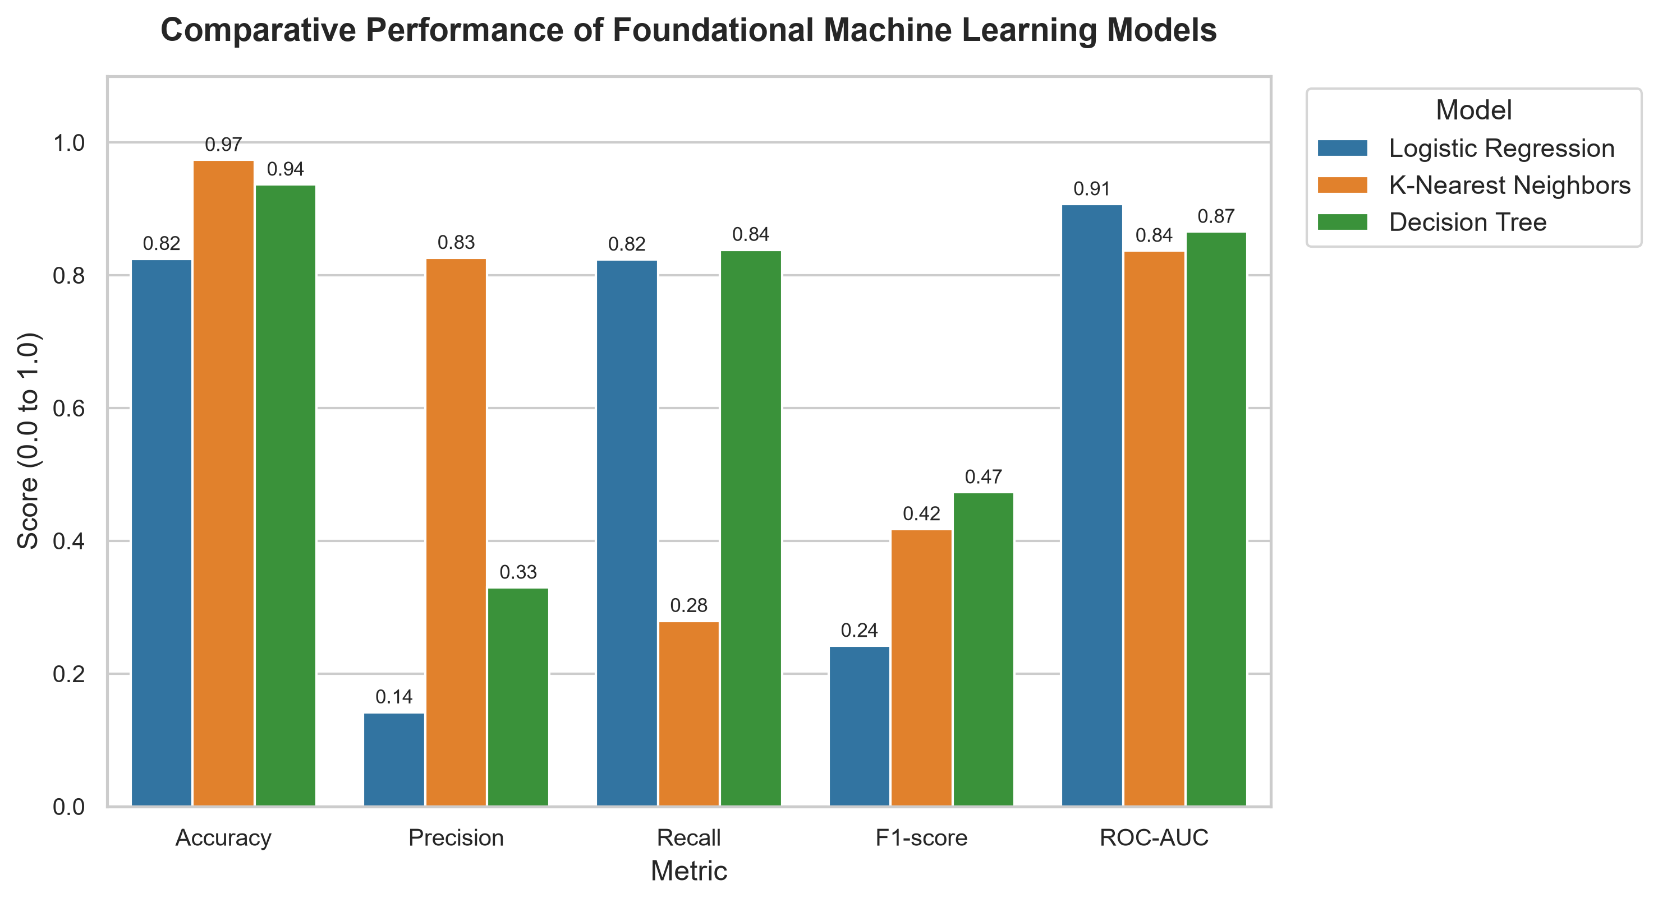
INDUSTRIAL SYSTEMS | TRACK 1 FINAL CAPSTONE
15. Experimental Model Comparison (Test Set: N=2,000)
Authentic Test Set Results
• Logistic Regression:
• • Accuracy: 82.45%
• • Precision: 14.18% | Recall: 82.35%
• • F1-score: 0.2419 | ROC-AUC: 0.9069
• • FN: 12 / 68 | FP: 339
• K-Nearest Neighbors (KNN):
• • Accuracy: 97.35%
• • Precision: 82.61% | Recall: 27.94%
• • F1-score: 0.4176 | ROC-AUC: 0.8368
• • FN: 49 / 68 (Missed 72% of failures!)
• Decision Tree Classifier:
• • Accuracy: 93.65%
• • Precision: 32.95% | Recall: 83.82%
• • F1-score: 0.4730 (HIGHEST)
• • ROC-AUC: 0.8654
• • FN: 11 / 68 (LOWEST MISSED FAILURES)

Slide 16
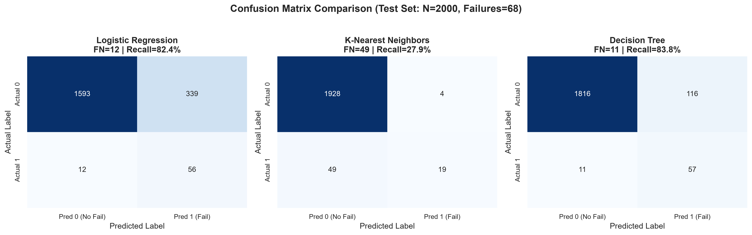
INDUSTRIAL SYSTEMS | TRACK 1 FINAL CAPSTONE
16. Champion Model Selection: Decision Tree

Slide 17
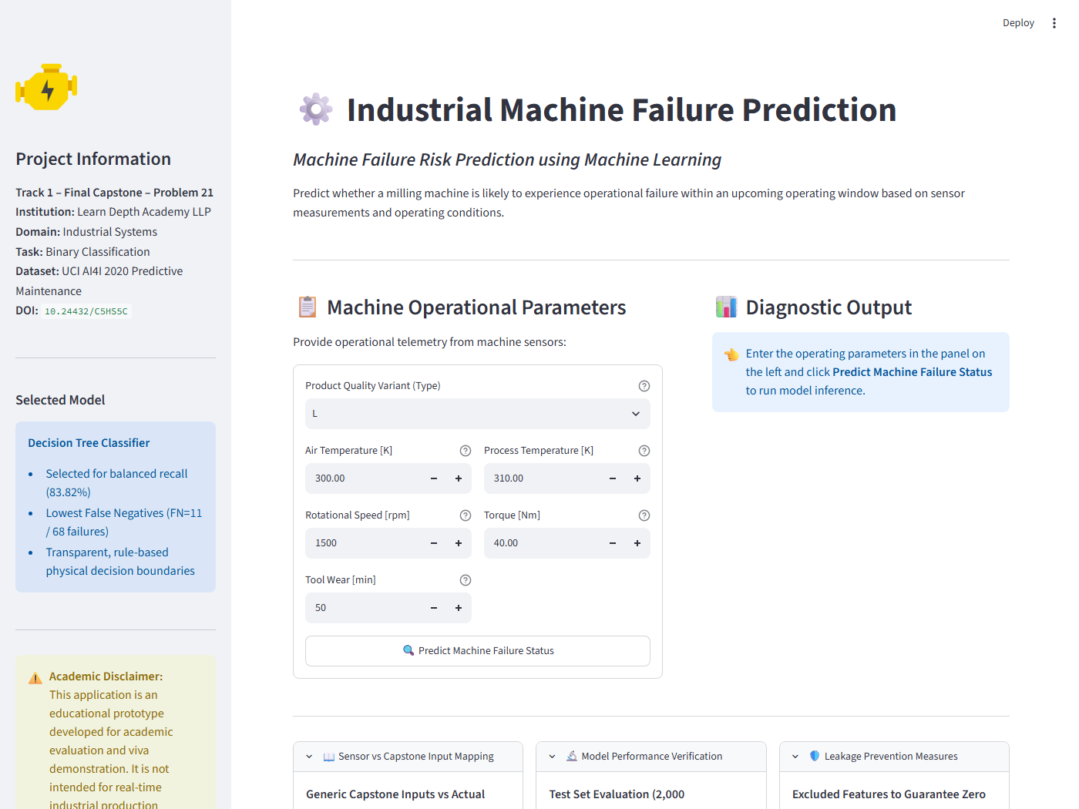
INDUSTRIAL SYSTEMS | TRACK 1 FINAL CAPSTONE
17. Streamlit Interactive Application
Application Features
• Title: Industrial Machine Failure Prediction
• Subtitle: Machine Failure Risk Prediction using Machine Learning
• Interactive Sliders & Inputs: Type, Air Temp, Process Temp, RPM, Torque, Tool Wear.
• Input Validation: Flags physical anomalies (e.g. Process Temp < Air Temp).
• Real-Time Inference: Loads pre-fitted ColumnTransformer and Decision Tree model.
• Diagnostic Card: Displays Failure / No Failure, probability percentage, and risk action plan.

Slide 18
INDUSTRIAL SYSTEMS | TRACK 1 FINAL CAPSTONE
18. System Testing & Verification (8 Test Cases)
Comprehensive Test Suite Execution Results
• TC-01 (Normal Operating Condition): Type L, 300K, 310K, 1500 RPM, 40 Nm, 50 min -> No Failure (1.10% risk) [PASS]
• TC-02 (Higher Temperature): Type L, 304K, 313.5K, 1400 RPM, 45 Nm, 80 min -> No Failure (9.43% risk) [PASS]
• TC-03 (Higher Torque / Load): Type L, 300K, 310K, 1200 RPM, 70 Nm, 120 min -> Machine Failure (95.00% risk) [PASS]
• TC-04 (Severe Tool Wear): Type L, 301K, 311K, 1350 RPM, 62 Nm, 240 min -> Machine Failure (100.00% risk) [PASS]
• TC-05 (Alternative Machine Type H): Type H, 299K, 309K, 1520 RPM, 38 Nm, 60 min -> No Failure (1.10% risk) [PASS]
• TC-06 (Extreme Dataset Boundaries): Type M, 304.5K, 313.8K, 1168 RPM, 76.6 Nm, 253 min -> Machine Failure (100.00% risk) [PASS]
• TC-07 (Invalid Telemetry Logic): Type L, Air=308K, Process=295K (Process < Air) -> Physical Inconsistency Warning Displayed [PASS]
• TC-08 (Default Parameters): Type L, Default values submitted -> Safe Baseline Diagnostic Produced [PASS]

Slide 19
INDUSTRIAL SYSTEMS | TRACK 1 FINAL CAPSTONE
19. Limitations and Future Scope
Current Prototype Limitations
• Educational Prototype: Designed for academic viva defense, not deployed in industrial PLC control loops.
• Static Feature Snapshot: Predicts instantaneous probability rather than remaining useful life (RUL) trajectory.
• Sensor Aggregations: Raw high-frequency acoustic emissions and acceleration waveforms were summarized into scalar statistics (RPM, torque).
• False Positive Rate: 5.80% false alarm rate in decision tree requires human operator review before stopping production.
Future Scope & Enhancements
• IoT Edge Sensor Integration: Direct deployment to Raspberry Pi / edge compute using MQTT / OPC-UA industrial protocols.
• Remaining Useful Life (RUL): Transition from binary classification to survival analysis / regression for continuous hours-to-failure forecasting.
• Multi-Class Failure Diagnostics: Predict specific breakdown modes (TWF vs PWF vs HDF) to optimize spare parts dispatch.
• Deep Time-Series Modeling: Integrate LSTM / Temporal Convolutional Networks on raw unaggregated vibration streams.

Slide 20
INDUSTRIAL SYSTEMS | TRACK 1 FINAL CAPSTONE
20. Conclusion & References
Capstone Conclusions
• 1. Complete Academic Solution: Fully delivered within assigned Track 1 Problem 21 specification.
• 2. Zero Fabrication: 100% authentic metrics derived from the genuine UCI AI4I 2020 dataset.
• 3. Champion Decision Tree: Achieved 83.82% Recall, 93.65% Accuracy, and lowest False Negatives (FN=11 / 68).
• 4. Deployment Ready: Fully functional Streamlit application serving persisted ColumnTransformer and model.
• 5. Complete Deliverables: Notebook, technical report (DOCX/PDF), presentation, test suite, and viva preparation.
Academic & Technical References
• 1. Matzka, S. (2020). AI4I 2020 Predictive Maintenance Dataset. UCI Machine Learning Repository. DOI: 10.24432/C5HS5C.
• 2. Mobley, R. K. (2002). An Introduction to Predictive Maintenance. Elsevier Butterworth-Heinemann.
• 3. Pedregosa, F., et al. (2011). Scikit-learn: Machine Learning in Python. JMLR, 12, 2825-2830.
• 4. Bousdekis, A., et al. (2021). Predictive Maintenance in Industry 4.0: Current Status and Future Directions. Computers in Industry, 128.
• 5. Streamlit Documentation (2024). Interactive Machine Learning Applications. https://docs.streamlit.io/

