Slide 1
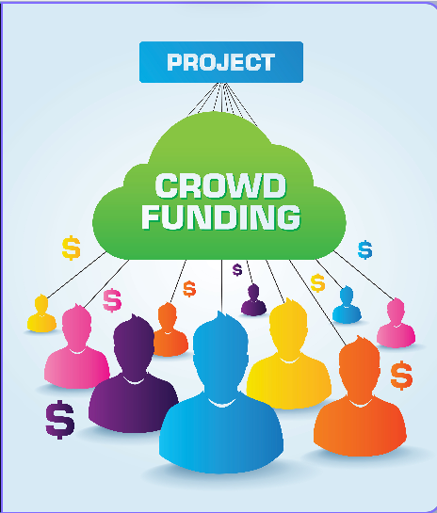
Crowdfunding Dapp
Innovative platform that is transforming the way we fundraise for projects and ideas.

Slide 2
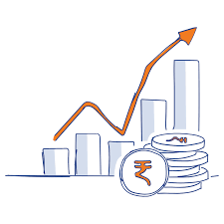

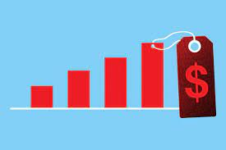
Problems with Traditional Crowdfunding
Limited reach
Lack of Transparency
High Fees

Slide 3
SOLUTION
Blockchain Technology
Our decentralized platform is built to ensure transparency, low fees, and secure transactions.
Smart Contracts
Smart contracts ensure that funds are automatically transferred to creators when conditions are met, and refunds are provided if conditions are not met.
Crowd verification
Our system relies on crowd verification to ensure that projects are legitimate and viable before being listed on the platform. This increases the credibility of the platform.
Unlimited reach
Our platform has unlimited reach as anyone, anywhere can access it and invest in projects that they are passionate about.

Slide 4
Market Opportunity
Market Analysis
The current crowdfunding market is worth around $1.25 billion
Global Audience
users from all around the world, providing access to a much larger pool of investors
Increased Innovation
Our platform's innovative use of blockchain technology will differentiate us from traditional crowdfunding platforms, leading to increased user adoption

Slide 5
USE CASES
Social causes
startups
creators
educational
Equity

Slide 6
DEMO

Slide 7
THANK YOU
Do you have any questions?
NISCHAY CHIB
nischaychib@gmail.com
+14379833463
https://www.linkedin.com/in/nischay-chib-017172132/
VISHAL PAWAR
Vp2264613@gmail.com
+16476093069
https://www.linkedin.com/in/vishal-pawar-67b476256/

